Slide 1
Population Dynamics of Developmental Time in Drosophila melanogaster
Workshop on
FLAGS SIGNALLING AND LANDSCAPES (WFLS)
Institute of Mathematical Sciences (IMSc)
Chennai, India
Ishitva Gupta
Nithin K A
Sarthak Saini

Slide 2
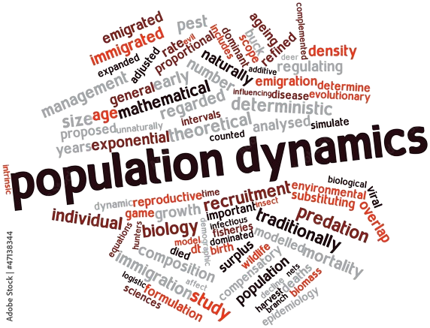
Outline
Introduction
Trade-off: Development rate v/s Stress Responses
Motivation for the model
Model description
Results
Implications
Adobe Stock Photos

Slide 3
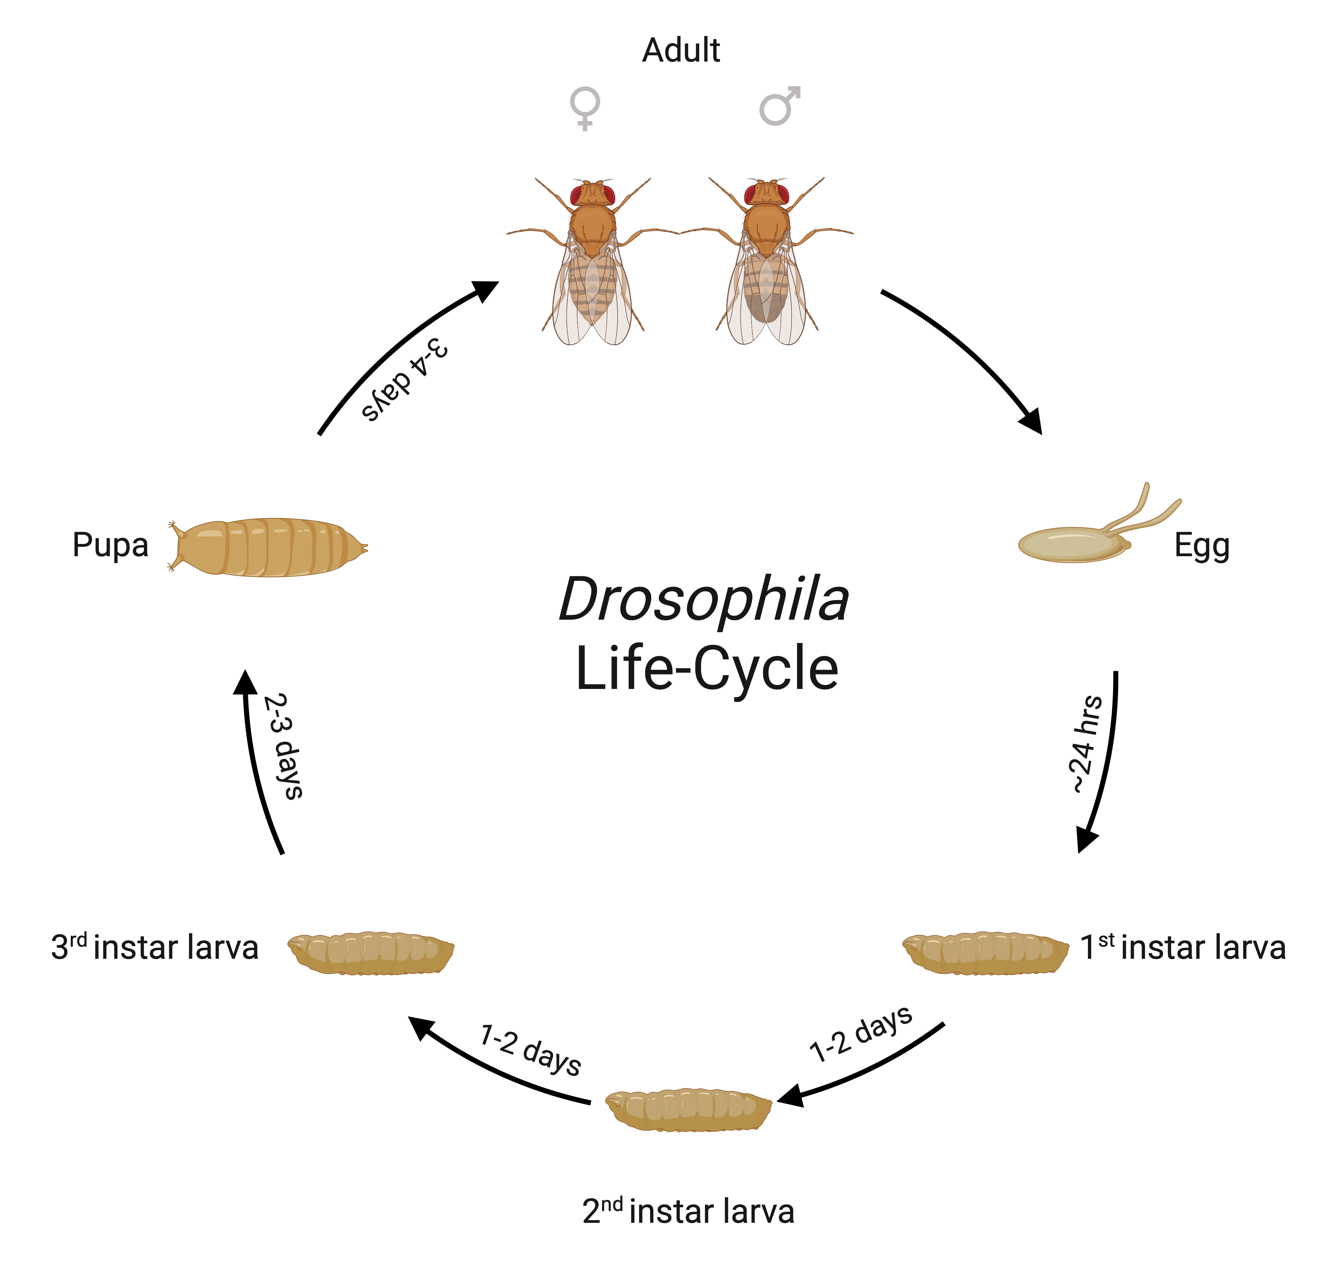
Introduction
Egg to Adult Developmental Time:
Developmental time can vary in wide ranges based on environmental and genetic factors
Important life history traits which guide a lot of phenotypic characteristics
Body weight
Reproductive potential (Fecundity)
Pre-adult Survivorship
Created with BioRender.com

Slide 4
Trade-off: Development Rate v/s Stress responses
Faster-developing flies have the advantage of starting laying eggs early in life
However, they have reduced body weight, pre-adult survivorship and response to stress
Late-developing flies face consequences as they can only start to lay eggs long after the fast-developing flies
However, they get the advantage of having higher early-life fecundity and better response to stress

Slide 5
Motivation for the Model
There is a fitness trade-off that individuals face in choosing a particular development regime
Interesting dynamics of maturation time over the course of generations can be expected
These dynamics will depend upon the parameters of mortality and fecundity associated with the developmental time ranges
These dynamics are difficult to study in an experimental setup owing to the cost and labor

Slide 6
Model Description
Simplistic Approach: Depicting the trade-off
Assuming mortality rate $(m)$, fecundity $(f)$, maturation time $(tm)$ and generation time $(td)$ to be constant and$N$ to be the number of individuals in a particular generation.
Mortality Rate$\left(m\right)=$ proportion of individuals dying per unit time
Fecundity$(f) =$number of eggs produced per individual per unit time
Number of Eggs produced in the generation $(E):$
$$E = N∗f + \left(N−m∗N\right)f +\{\left(N −m∗N\right)−m(N−mN)\}f+…$$
There are two kinds of individuals in a population:
Developing faster $(N1, m1, f1, tm1)$
Developing slower$(N2, m2, f2, tm2)$

Slide 7
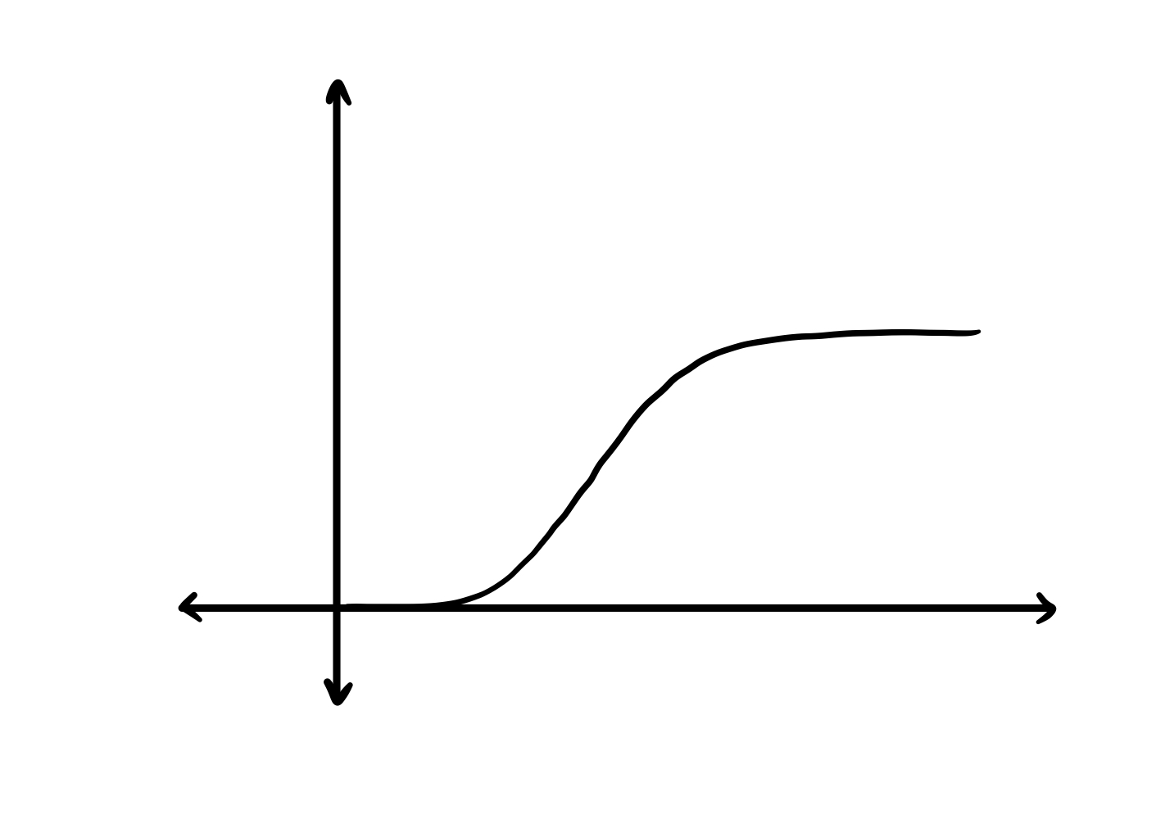
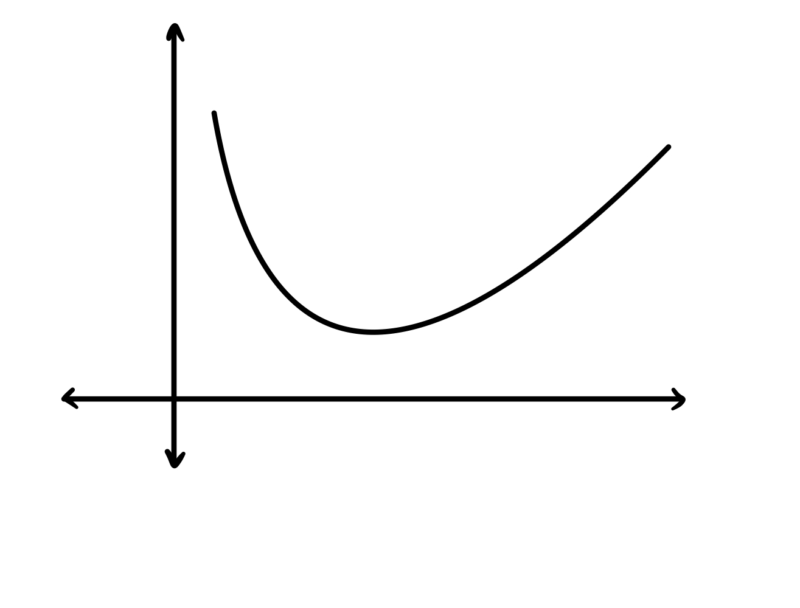
Model Description
Different Approach:
$$dad$$
Fecundity:
Mortality:
$$μ= μ0\left(\frac{b^{4}}{b^{4}+t_{m}`^{4}}\right)∗\left(\frac{t_{m}}{t_{m}+t_{m}`}\right)$$
Fecundity
Age (in days)
$$λ=\frac{e^{\frac{t_{m}}{t_{m}^{0}}}}{t_{m}}$$
Mortality Rate
Maturation (in days)

Slide 8
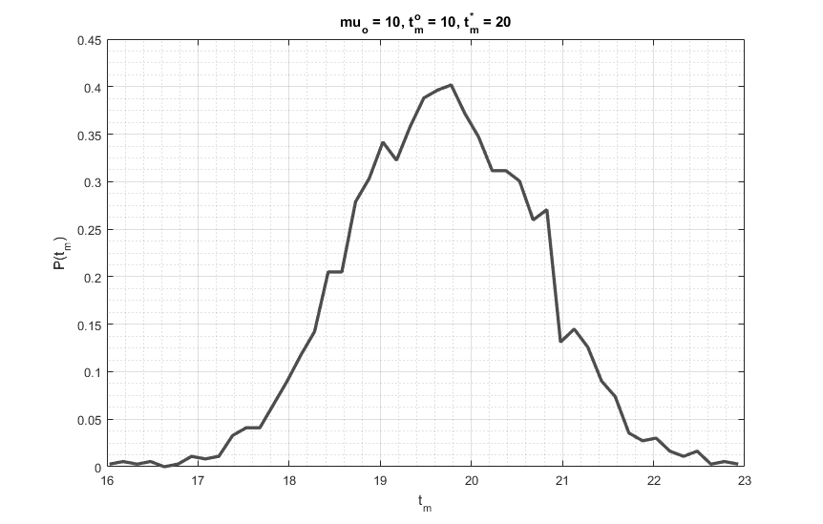
Results
Figure 1: In the absence of significant trade-offs we get a normal distribution

Slide 9
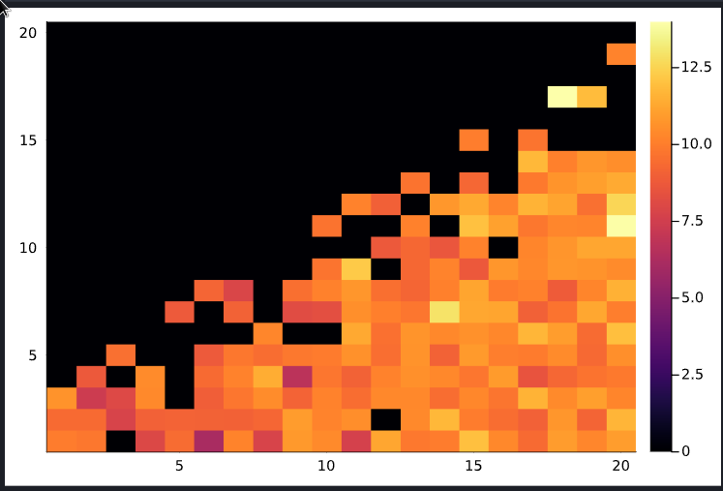
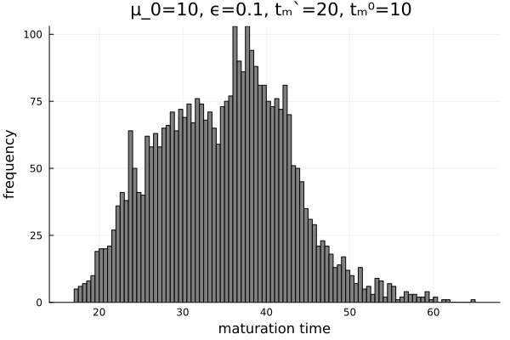
Results
Bistablity:
The introduction of trade-offs in the system leads to bistablity
Time thresholds can lead to bistablity

Slide 10
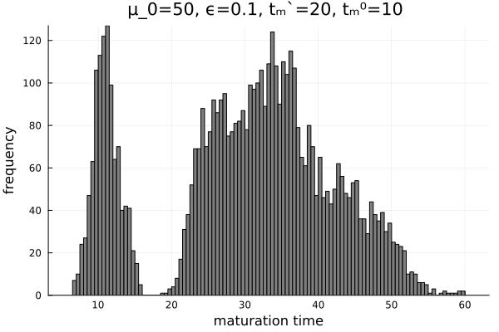
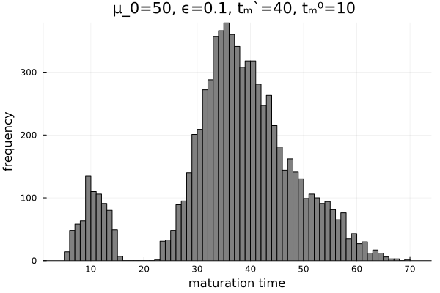
Results

Slide 11
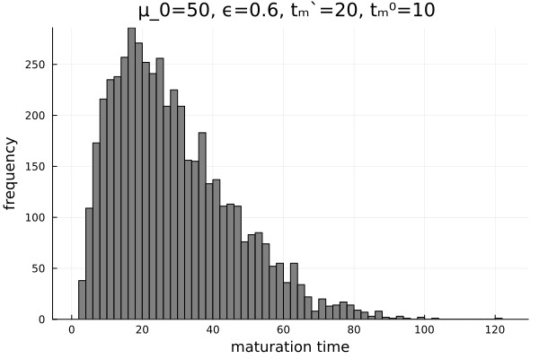
Results
Introduction of noise in the heritability of trait

Slide 12
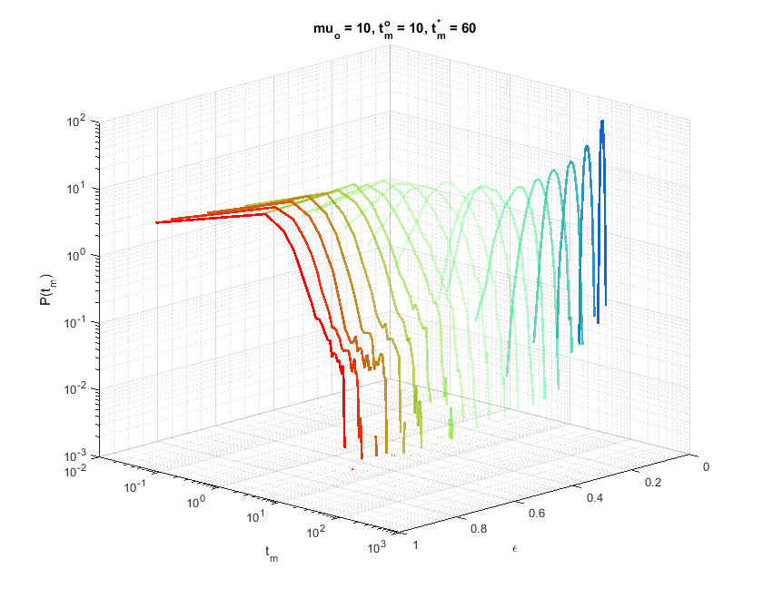
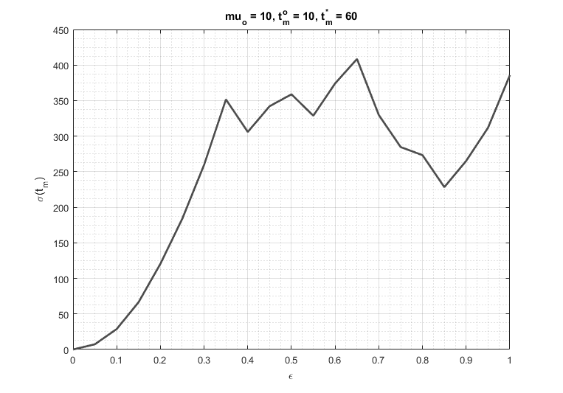
Results
Maturation time variation
Frequency
Maturation time
Noise
Noise

Slide 13
Implications
Based on the characteristics of the initial population, different kinds of population dynamics can arise over the course of time. Therefore, not just the parameters of fitness but also the distribution of the existing population is essential.
Co-existence is possible because of the contrasting trade-offs and the temporal differences
Environment plays a vital role in maintaining the variations in the population, and even though selection will guide the population towards homogeneity, the noise in the heritability of the developmental-time trait will maintain the heterogeneity in the population.

Slide 14
Future Directions

Slide 15
References
Gillooly, J., Charnov, E., West, G. et al. Effects of size and temperature on developmental time. Nature417, 70–73 (2002). https://doi.org/10.1038/417070a
Zwaan, Bas, R. Bijlsma, and R. F. Hoekstra. "Artificial selection for developmental time in Drosophila melanogaster in relation to the evolution of aging: direct and correlated responses." Evolution 49.4 (1995): 635-648.
Ghosh, Shampa M., et al. "Does long-term selection for development time result in canalization: a test using Drosophila melanogaster." Frontiers in Ecology and Evolution7 (2019): 228

Slide 16
Acknowledgement
Mentors and Co-mentors
Fellow workshop attendees and the new people we met here
Speakers
Cats
AND OF COURSE FLIES!!

Slide 17
Thank You

