Slide 1
Classification with deep neural networks
Workshop on Spins, Games and Networks
at
The Institute of Mathematical Sciences, Chennai
Anuran Pal
17.12.24

Slide 2
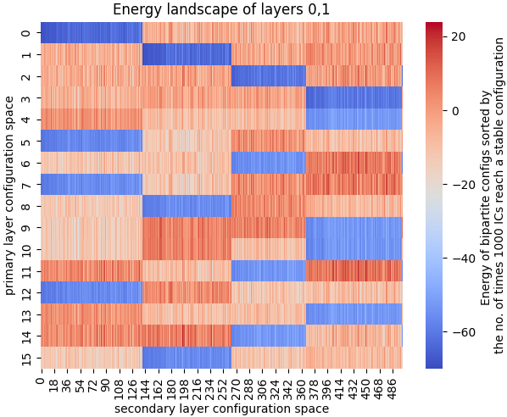
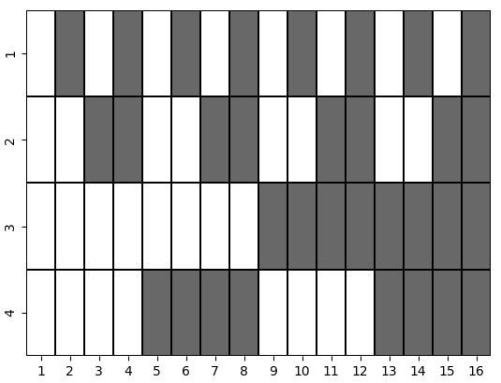
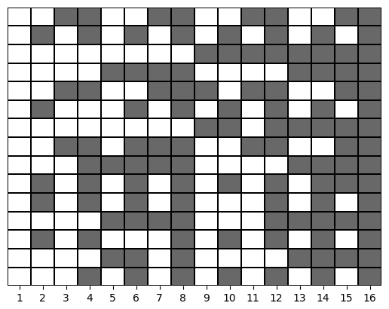
Energy minimas of RBM
Architecture : [16,512]

Slide 3
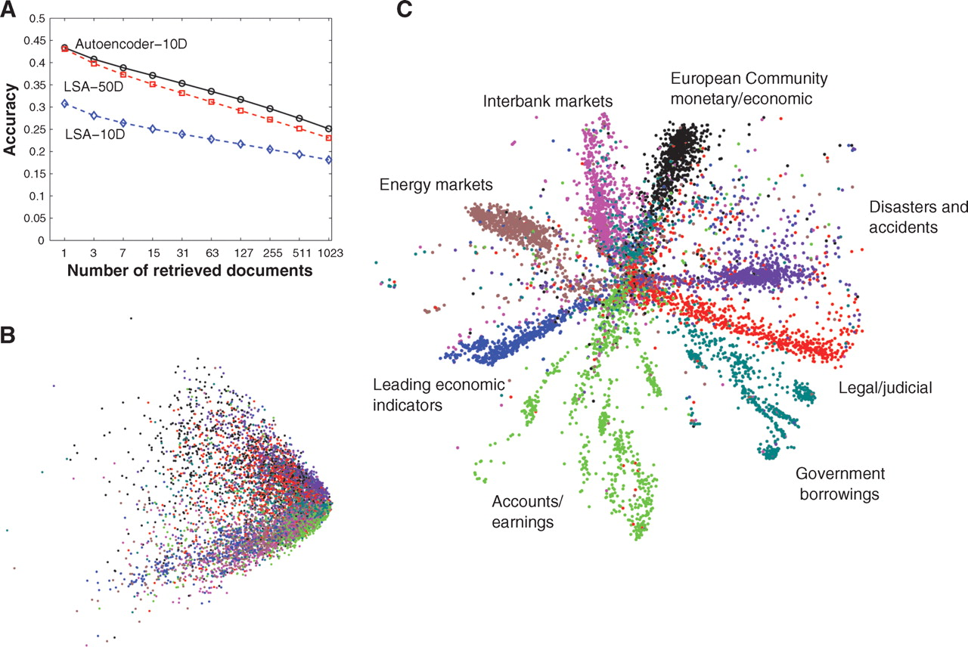
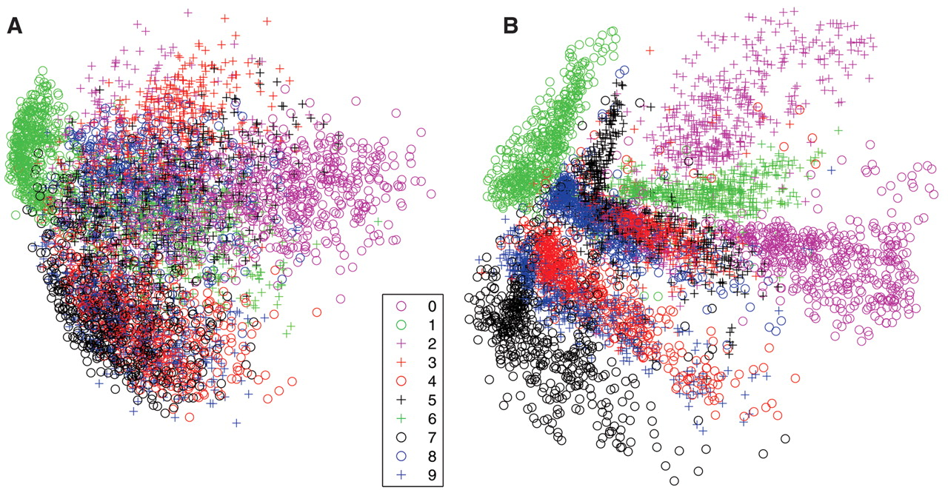
Autoencoder
Hinton, Salakhutdinov; 2006, Science 313(5786)
(A) The fraction of retrieved documents in the same class as the query when a query document from the test set is used to retrieve other test set documents, averaged over all 402,207 possible queries. (B) The codes produced by two-dimensional LSA. (C) The codes produced by a 2000-500-250-125-2 autoencoder.
(A) The two-dimensional codes for 500 digits of each class produced by taking the first two principal components of all 60,000 training images. (B) The two-dimensional codes found by a 784-1000-500-250-2 autoencoder
LSA - Latent Semantic Analysis

Slide 4
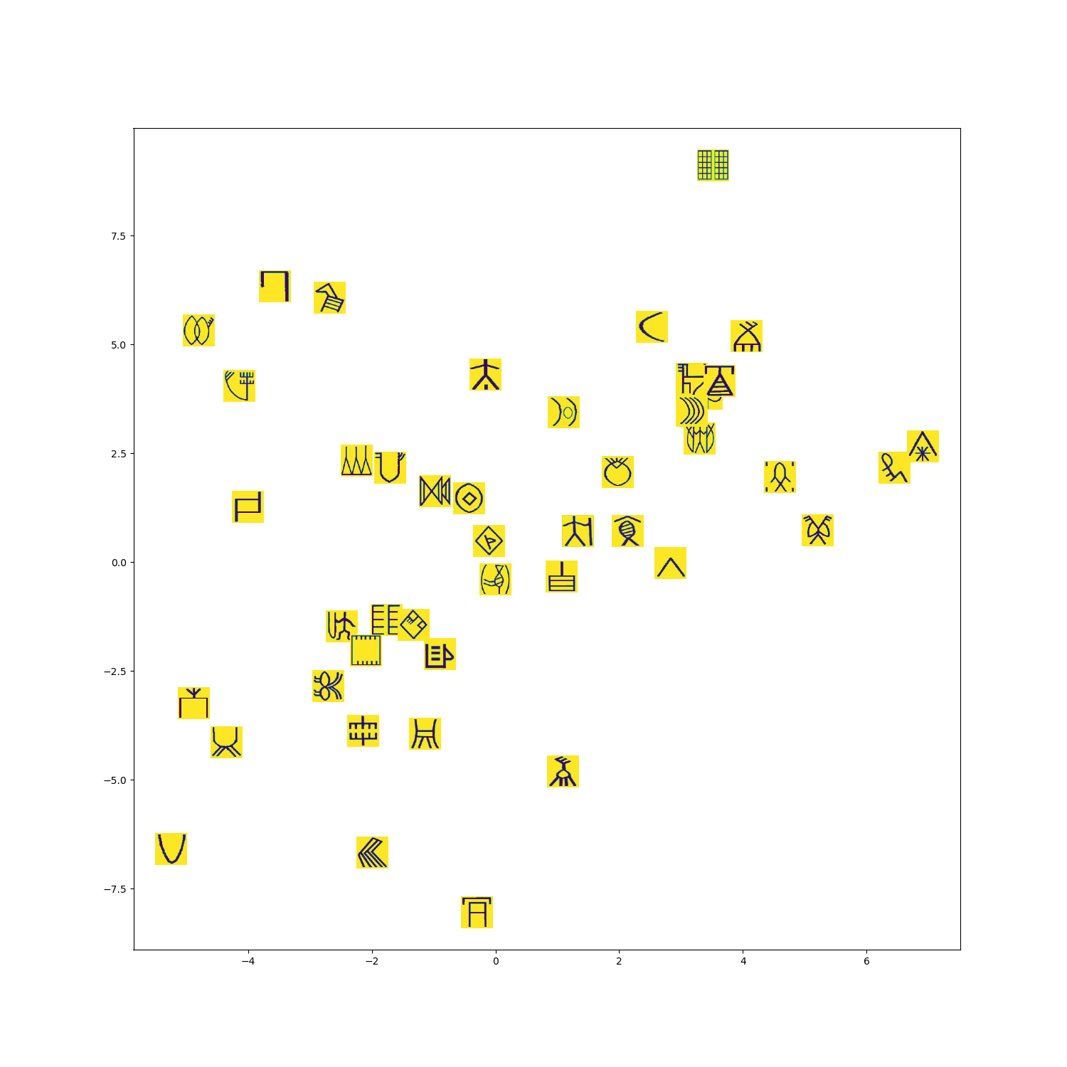
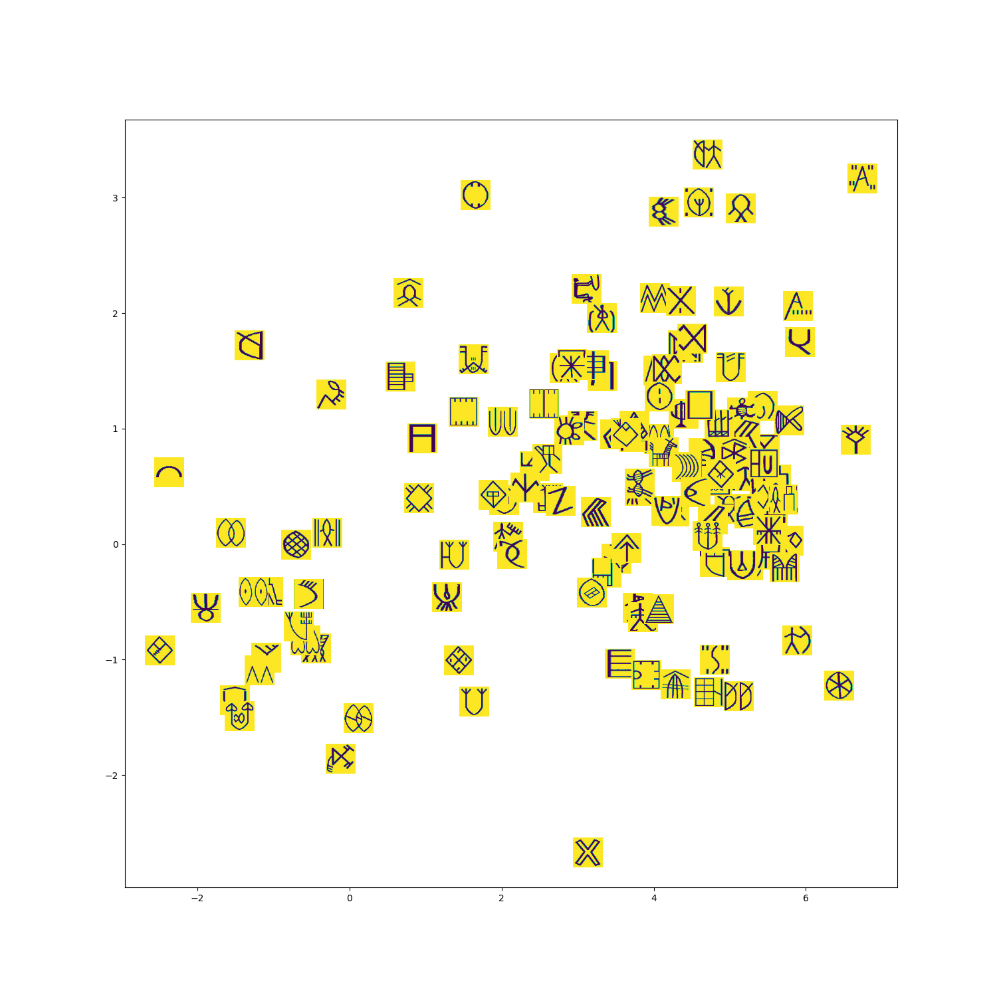
Autoencoder on Indus symbols

Slide 5
Varying the temperature
T=2.5
T=1.9
T=0.76
T=0.0
Temperature
State Space

Slide 6
Thank you
Questions?

