Slide 1

SGN Workshop
Start
(GAME)STOCK SHORT SQUEEZE
An analysis of the hysteria that took over Wall Street during January, 2021
HIRANMAYI RAMAMURTHY - HUNNERVIR SINGH - JAI BAKSHI
MENTORED BY - PROF. ANINDYA - HAREESH J

Slide 2
OF COURSE
THIS HAPPENS ON
REDDIT

Slide 3
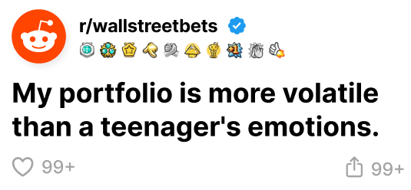

Slide 4
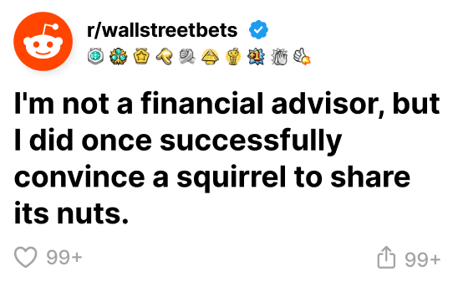

Slide 5
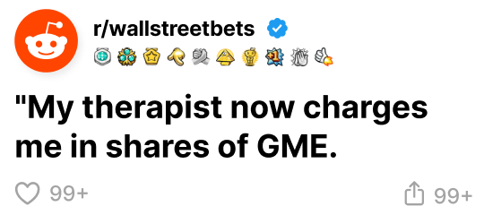

Slide 6
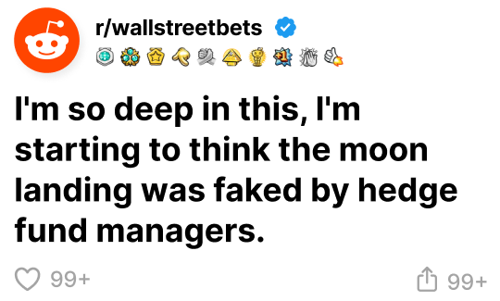

Slide 7
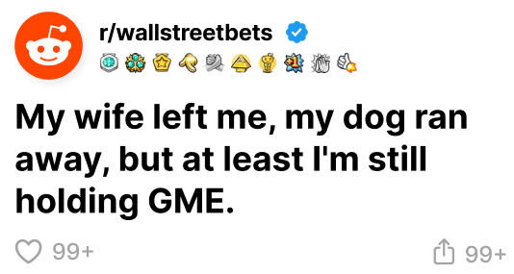

Slide 8
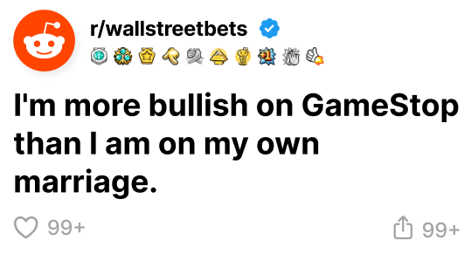

Slide 9
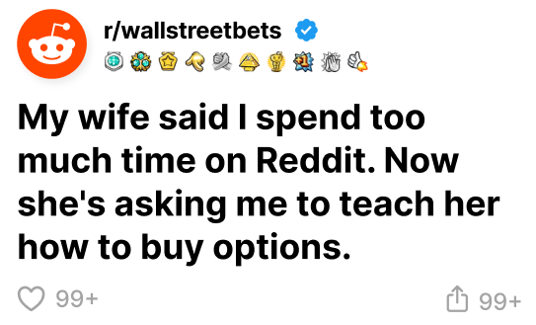

Slide 11
WHAT HAPPENED?

Slide 12
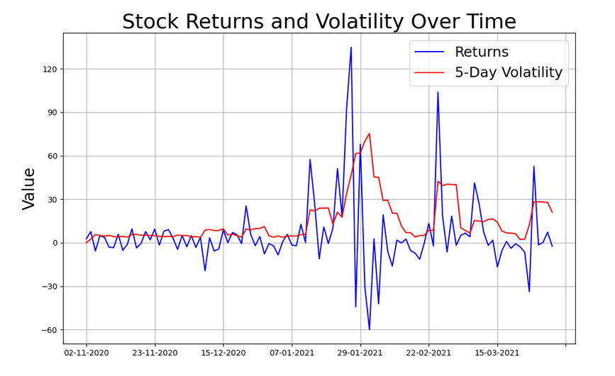
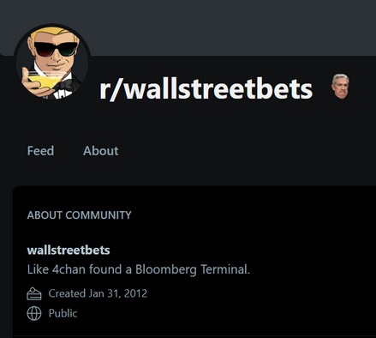
SGN Workshop
ABOUT THE FIASCO
The GameStop saga highlighted the power of online communities to mobilize collective action and disrupt traditional financial markets. It became a cultural phenomenon, capturing global attention and sparking debates about market fairness, the role of social media, and the future of investing.
The first signs of the GameStop stock mania appeared after Citron’s Andrew Left said that GameStop is ”pretty much in terminal decline”, pushing the retail investors from the subreddit r/wallstreetbets towards a coordinated move against Citron and hedge funds (Bocconi Students Investment Club, 20).

Slide 13
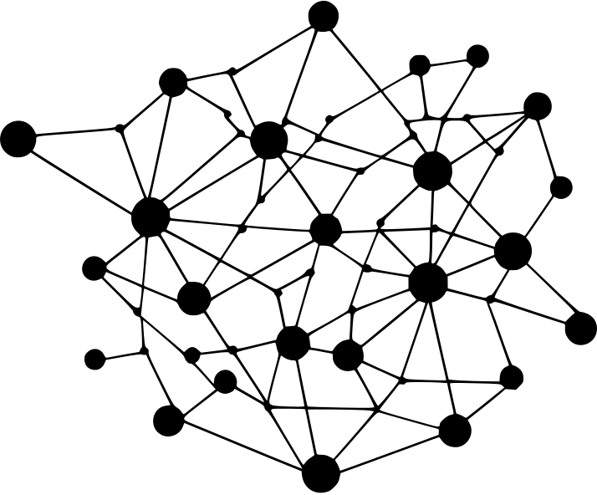
SGN Workshop
UNPACKING THE EVENT
OUR APPROACH:
We employ a network analysis approach to investigate the user interactions within r/WallStreetBets during the crucial period surrounding the short squeeze.
SOURCES OF DATA
Our post and user data comes directly from the epicentre of the GameStop phenomenon: Reddit's r/WallStreetBets forum. Our historical financial data for GameStop stock price comes from Investing.com

Slide 14
SGN Workshop
ABOUT OUR DATA:
We collected financial and user data spanning from January 12th, 2021, to February 15th, 2021, This period is divided in four phases: Incubation, Development, Climax and the Fade.
We acknowledge that our data only represents a snapshot of the activity on r/WallStreetBets. The data for the 23rd and 24th of January are missing based on the reddit archive we utilised for this project.
Our dataset consists of posts, comments, and user interactions alongside the daily stock value of Gamestop Stock reported at the End of the Day.

Slide 15
SGN Workshop
SENTIMENT ANALYSIS
  The chat data for Reddit threads was taken from a publicly available archive.
  We used Python’s NLTK toolkit to clean the data and then used Huggingface’s FinBERT to look for keywords `Buying’, `Selling’ or `Holding’ in the chat log.
  Many of the comments/posts were neither of them(`Neutral’) and were discarded as noise. A sentiment value was attached to each comment/post as:
+1 for `Buying’
-1 for `Selling’
0 for `Holding’
  Each user was assigned a sentiment value based on the total sentiment of all his posts/comments.

Slide 16
SGN Workshop
NETWORK CONSTRUCTION
One is a Bipartite Network, consisting of nodes representing Posts and Comments. The other is a network between users with comments to a post being in-edges.
Only the author network is directed, which is important to capture the flow of information. The sizing of each node represents its degree of interaction.
We used two kinds of Graphical Networks in this project to represent the state of the subreddit during the period of the squeeze.

Slide 17
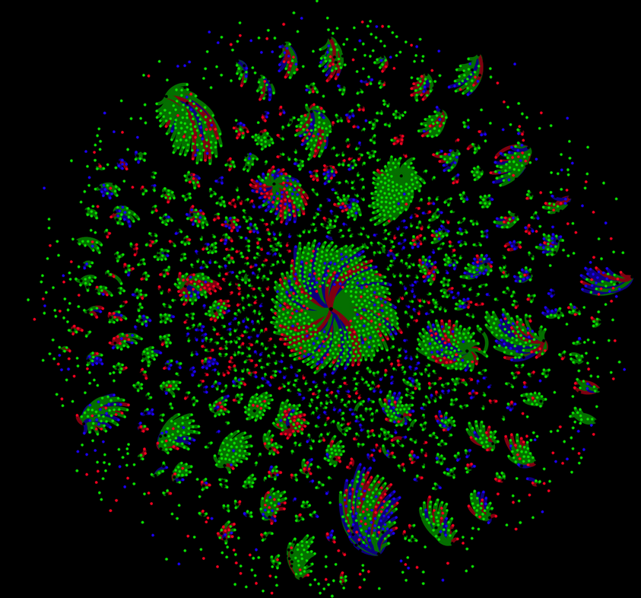
SGN Workshop
THE POST/COMMENT NETWORK
The nodes in the graph represent the various posts and comments that exist in the subreddit during the specified time period.
The nodes in green, red, and blue represent the post/comment's overall sentiment in terms of buying, selling, or holding the stock. The edges are green, red, or blue, representing the same.

Slide 18
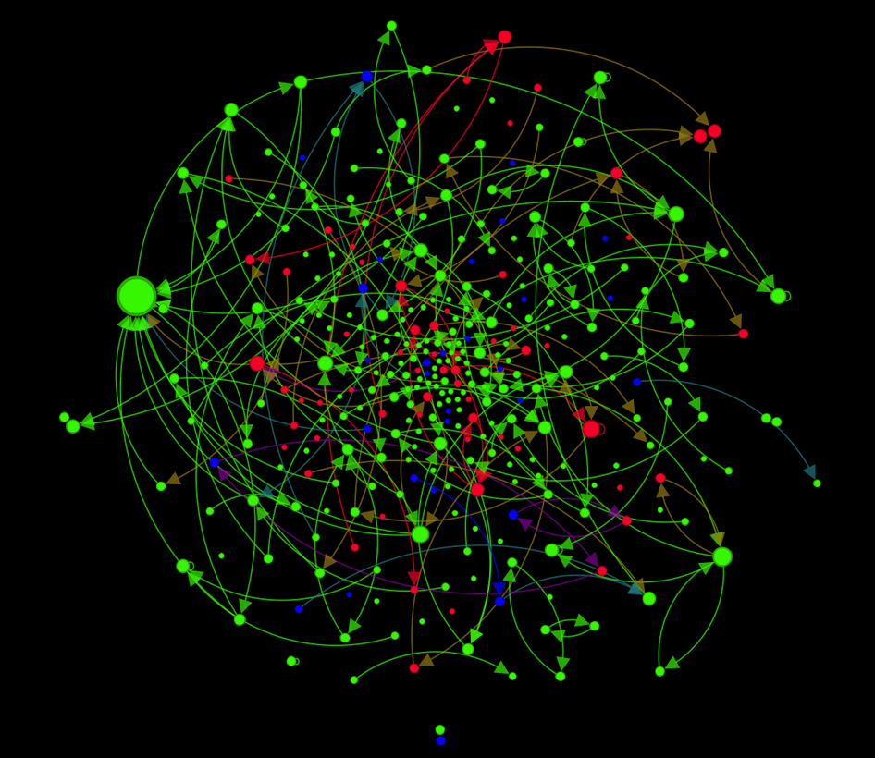
SGN Workshop
THE AUTHOR NETWORK
The nodes in the graph represent the various authors who have made contributions to the subreddit with their posts and comments.
The nodes in green, red, and blue represent the author's overall sentiment in terms of buying, selling, or holding the stock. The edges are additive combinations of the colors of the in and out nodes, resulting in either green, red, or blue for the same sentiments, or purple, brown, or light blue for different sentiments.

Slide 19

SGN Workshop
METHOD
OUR APPROACH:
To understand the network structure, we employ several key measures:
  Degree Centrality: Identifies the most connected nodes (users or posts).
  Betweenness Centrality: Highlights nodes that bridge different parts of the network.
  Closeness Centrality: Reveals nodes that are close to all other nodes.
  Clustering Coefficient: Indicates the tendency of nodes to form tightly knit groups (communities).
  Modularity: A measure of the structure of networks or graphs which measures the strength of the division of a network into modules

Slide 20
SGN Workshop
CENTRALITY MEASURES
For the Author Network:
  Degree centrality helps us identify those redditors that individually had the most impact in influencing others to join/buy the stock. Here, u/marcusmongeau has the most influence as it is the most connected node.
  These users are likely to be the instigators/major participants in this event.
  There are two types of instigators:
    In-degree centrality: Those whose posts reach the people, i.e. the comment section is very active, and people get influenced by interacting with the post.
Highest- u/marcusmongeau: 0.0691
    Out-degree Centrality: Those who reach out to posts, i.e. the person goes from post to post spreading information and encouraging others to follow suit.
Highest- u/krzystone1989, u/jkaplan0, u/marcusmongeau: 0.0213

Slide 21
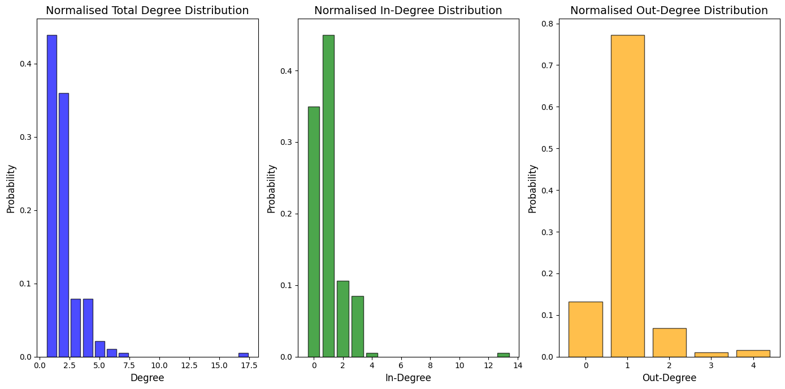
SGN Workshop

Slide 22
SGN Workshop
CENTRALITY MEASURES
  Betweenness Centrality: Helps us identify which users have facilitated the spread of information throughout various subreddits, i.e. wide spread of information. They are likely to have bridged several users to the main instigator nodes. (the connection between clusters)
Highest- u/marcusmongeau: 0.0079
  Closeness Centrality: Identifies the users that are the closest to the most number of other users, i.e. they facilitate the fast spread of information.
Highest- u/marcusmongeau: 0.0851
  Modularity: The author network has a modularity coefficient of 0.904. This is indicative of the spread-apart nature of posts and comments through the authors.

Slide 23
SGN Workshop
COMMUNITY STRUCTURE
Low Clustering Cofficient- The subreddit exhibited a low clustering coefficient (0.005), indicating that users were not tightly connected. This was largely due to the high volume of posts with which relatively few users interacted.
Our Observations:
  Fragmented Information Spread: The low clustering coefficient suggests that information within r/WallStreetBets was dispersed across loosely connected users rather than concentrated within tightly-knit groups. This allowed information to spread broadly rather than being contained in specific cliques.
  Amplified Visibility: Posts gained traction through upvotes or comments and reached a wide audience due to the lack of dense user clusters. This amplified the visibility of strategies of a few influential users, creating a perception of widespread consensus and `Herd Mentality’.

Slide 24
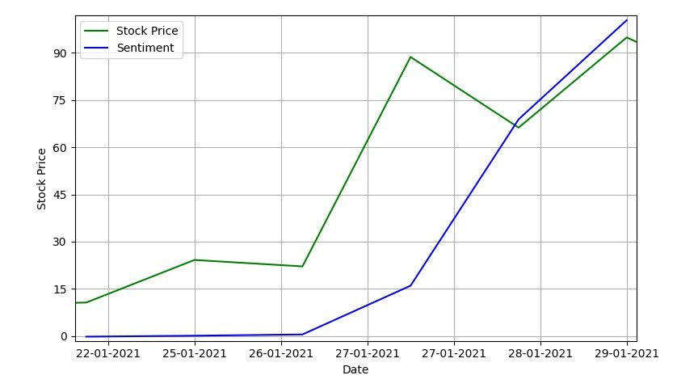
SGN Workshop
STOCK PRICE AND SENTIMENT

Slide 25
SGN Workshop
ALTERNATIVE STUDIES
A similar study was conducted and the results were almost identical to our own findings
External study:
  The interaction networks on r/WSB, have a topological structure partial to boost the diffusion of the investment information.
  The topic distribution produces a significant change, both, at the individual level and the community. With the rise of the GameStop event becoming more centralized, the degree of topic dispersion of influential users is larger than that of common users.
  As the short squeeze event developed and progressed, more users were noted to have a positive sentiment polarity i.e. buying GameStop stocks.
Our study:
  In our study, we have observed that the clustering coefficient is low which means the topology of the network leans more toward spread of information rather than having tightly knit groups.
  The user u/marcusmongeau: 0.0213 seems to have played a very important role in this event and this user was present in several other subreddits and was the most influential.
  We also observed that buying sentiment increased as the stock prices increased.

Slide 26
SGN Workshop
IMPLICATIONS AND FUTURE RESEARCH
The Power of Online Collective Action: Our findings underscore the remarkable ability of online communities, like r/WallStreetBets, to mobilize collective action and exert significant influence on financial markets.
The Role of Network Representation: The topological structure of r/WallStreetBets, particularly the presence of central users and the formation of communities, played a crucial role in the rapid dissemination of information, the coordination of trading activities, and the amplification of sentiment during the GameStop short squeeze.
In the future, by using more comprehensive means of sentiment analysis, we can gain a deeper understanding of the emotional dynamics of such events; expanding the analysis to include other social media platforms would be able to provide a more comprehensive overview and finally, by comparing the network structure and dynamics of r/WallStreetBets to other online financial communities would help us understand the unique characteristics of this community and the factors that contributed to its success in mobilizing collective action.

Slide 27
SGN Workshop
CONCLUSION
  We found that the Stock Prices increased with the increase in `Buying’ sentiment on r/WallStreetBets.
  From the network topology, we can identify a few key players (such as u/marcusmongeau) who played a significant role in this event.
  Low Network Clustering implies that there were a few key players whose presence lead to the increase in
  Some of our findings from our study are different from the ones found by Zheong et. al in 2021, such as key players which may be attributed to the different AI Algorithms used and different measures to calculate the sentiment.

Slide 28
SGN Workshop
REFERENCES
Bocconi Students Investment Club, (2020).The Game Theory of Gamestop.
https://bsic.it/wp-content/uploads/2021/02/The-Game-Theory-of-GameStop.pdf
in.investing.com/equities/gamestop-corp
https:reddit.com/r/wallstreetbets
Xiaolong, Zheng & Tian, Hu & Wan, Zhe & Wang, Xiao & Zeng, Daniel Dajun & Wang, Fei-Yue. (2021). Game Starts at GameStop: Characterizing the Collective Behaviors and Social Dynamics in the Short Squeeze Episode. IEEE Transactions on Computational Social Systems. PP. 1-14. 10.1109/TCSS.2021.3122260.

Slide 29
SGN Workshop
THANK YOU!

