Slide 1
Noisy Games
Shuban Ramesh Gupta
Abhishek Singh
Hadhin Anjum
SGN 2024, IMSc
Image: Kitazawa Sohta

Slide 2
Background
Environmental heterogeneity (both spatial and temporal) exists in nature.
Natural selection is locally optimizing.
Fitness is dependent on both genetic and environmental factors.
Heterogeneity can affect evolution.
We think of this as noise in the fitness (payoffs).

Slide 3
Nowak and May, 1992
Evolutionary game with individuals on lattice.
The strategies are hard-wired into individuals.
Individual takes over neighbouring sites with lower payoff.
Changes we made:
Agents are on (toroidal) square lattice.
We add noise to the payoff matrix.

Slide 4
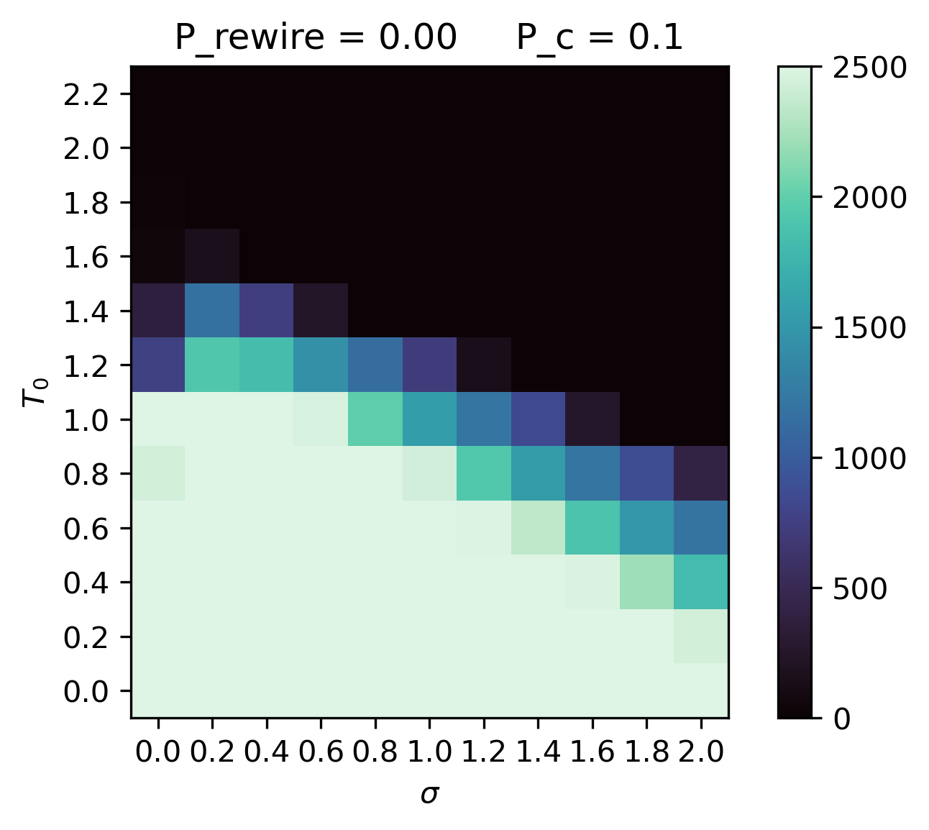
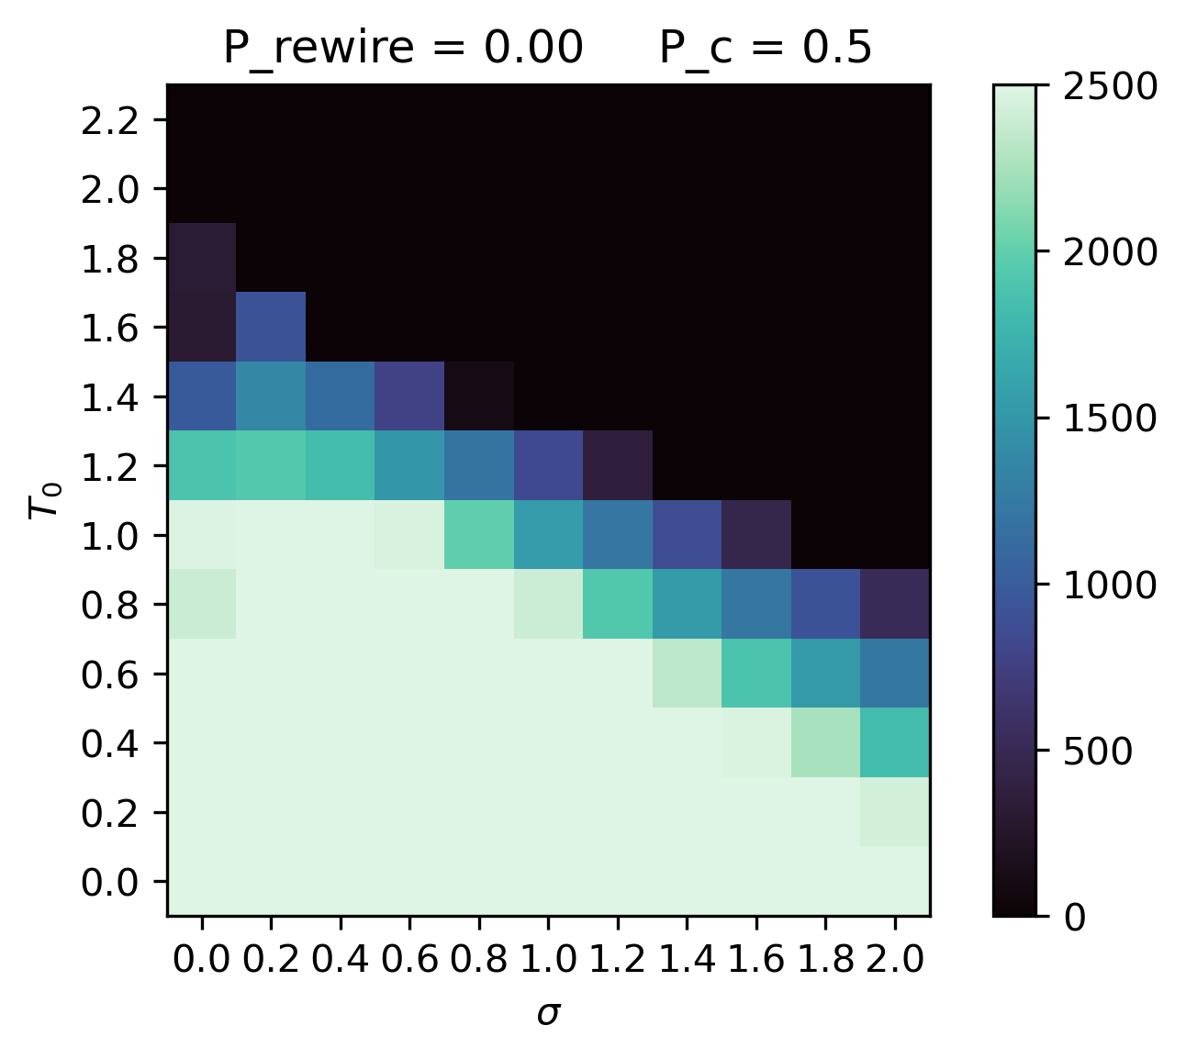
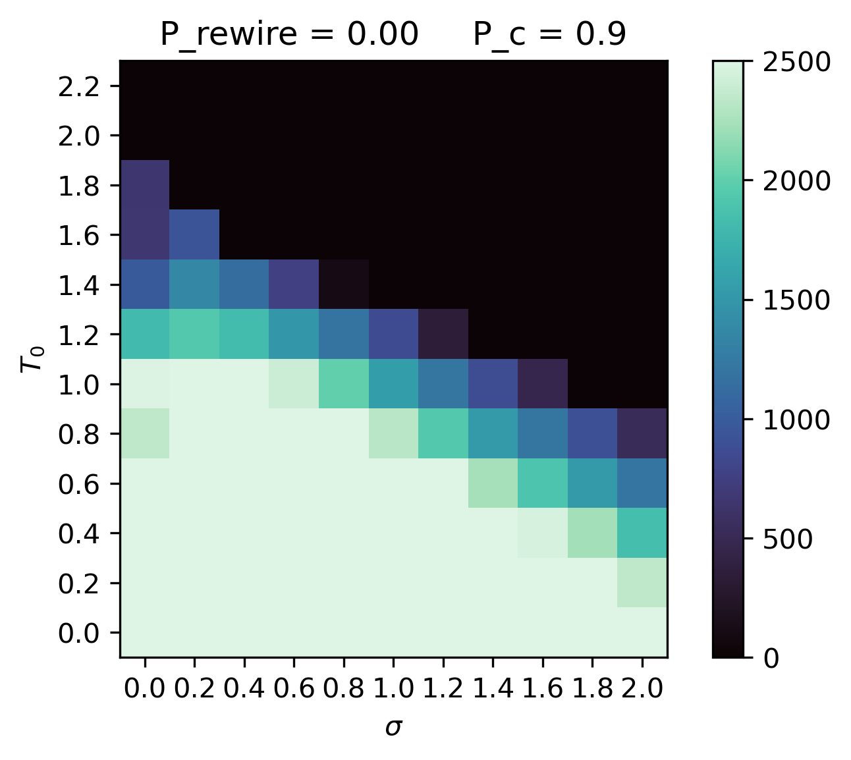
Findings
Results for a 50x50 lattice averaged over 50 replicates
Initial conditions are irrelevant (qualitatively)

Slide 5
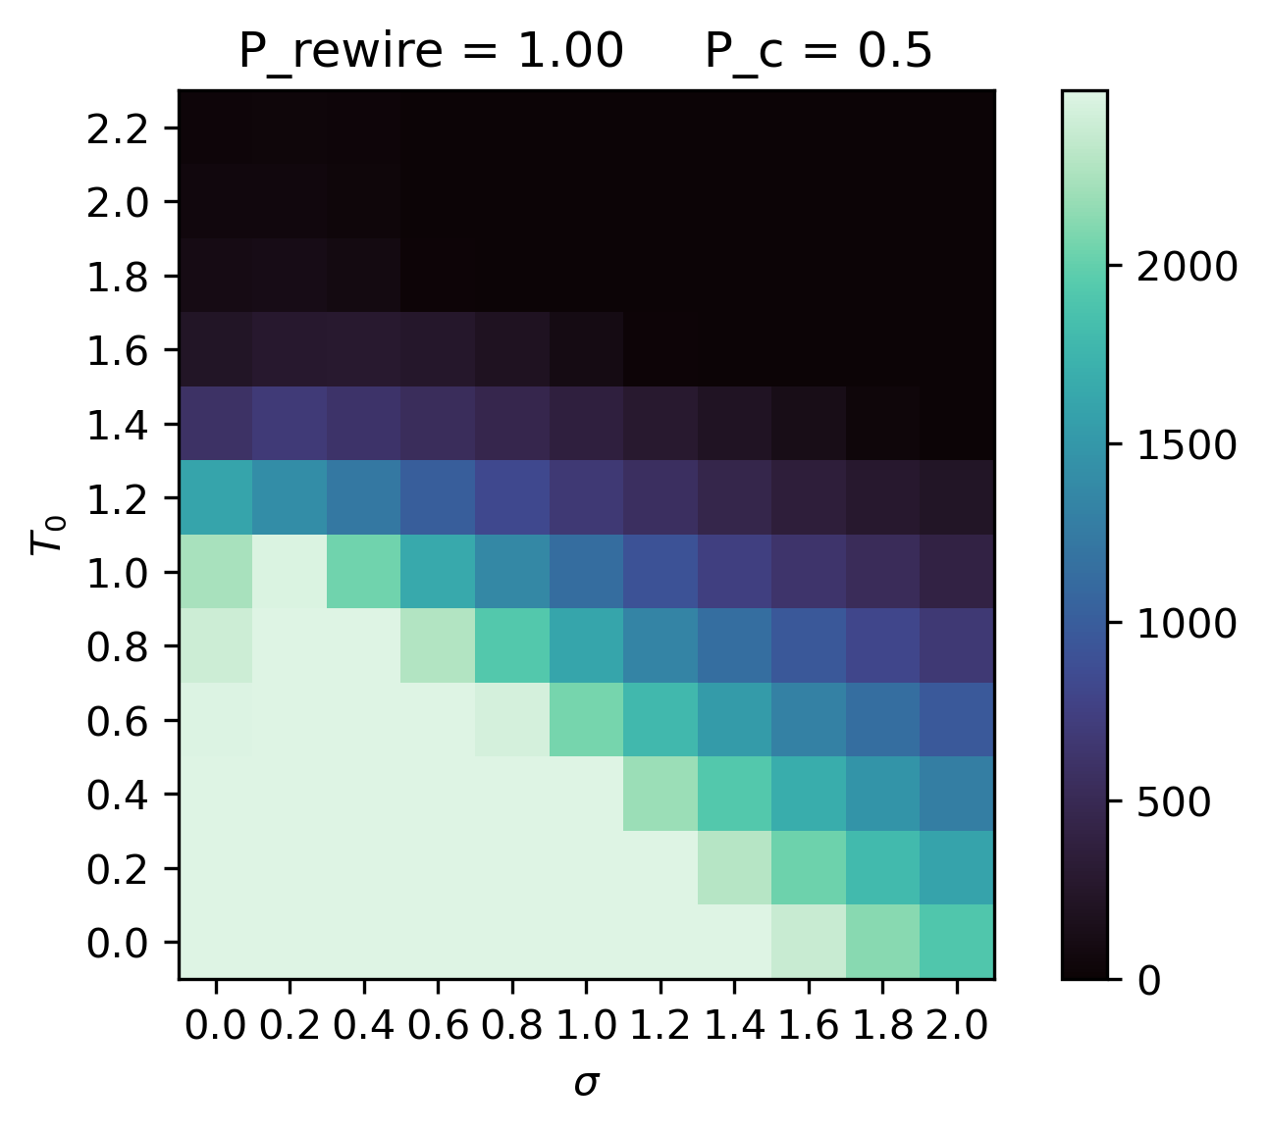
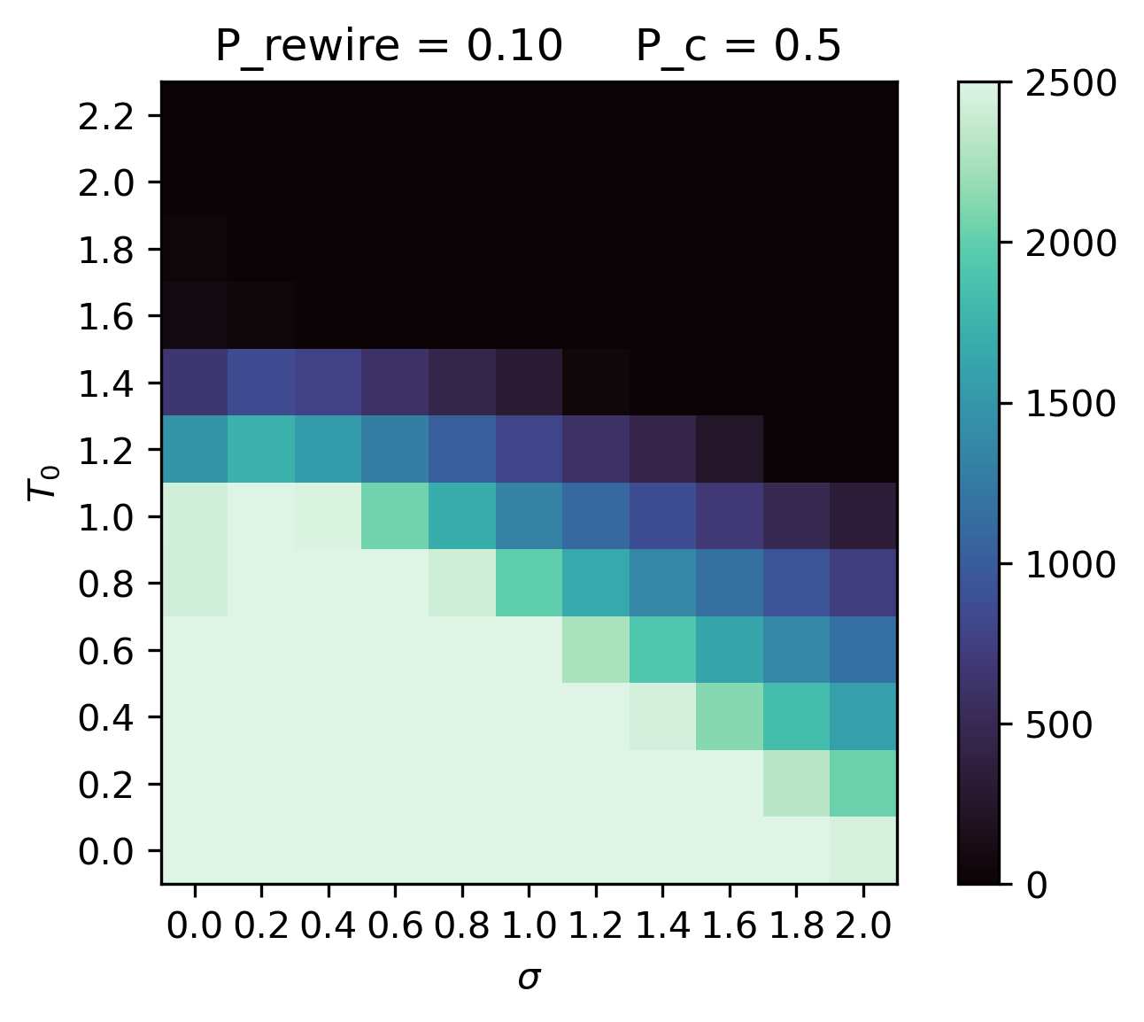
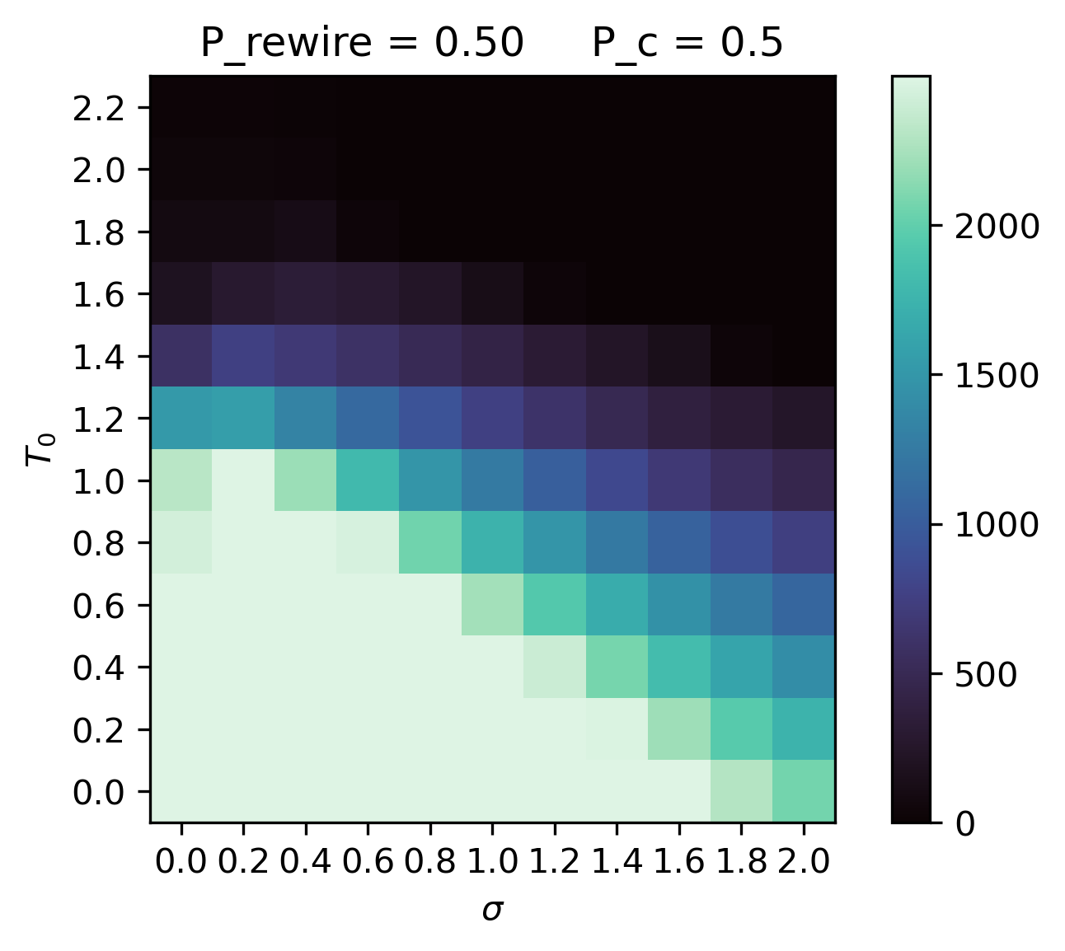
Effect of Rewiring

Slide 6
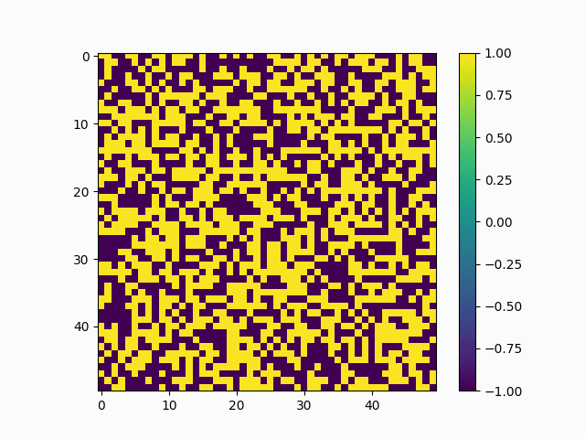
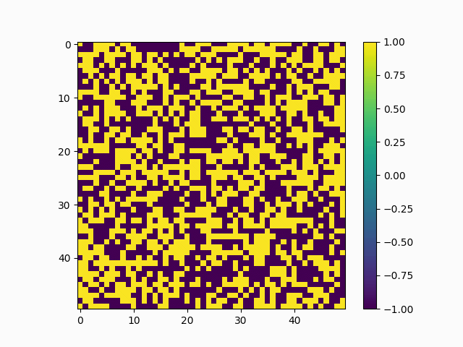
Coexistence
Domination
Legend:
Cooperator
Defector
T₀ = 1.5, 𝜎 = 0.5, P_{c} = 0.5, P_{rewire} = 0
T₀ = 1.5, 𝜎 = 2.0, P_{c} = 0.5, P_{rewire} = 0

Slide 7
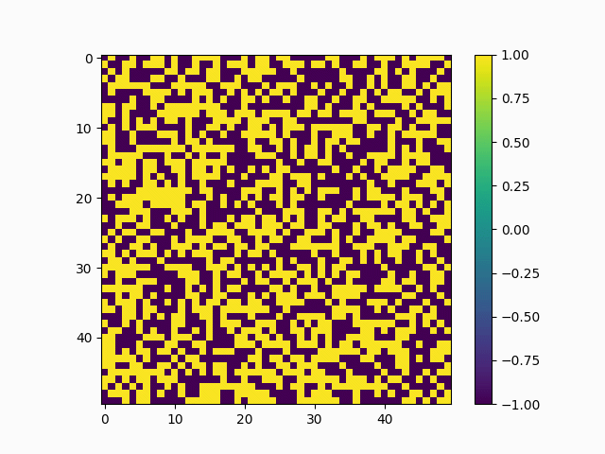
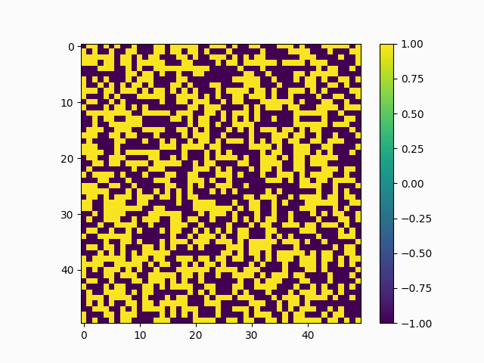
Let ’em roll
Legend:
Cooperator
Defector
T₀ = 1, 𝜎 = 0, P_{c} = 0.5, P_{rewire} = 0
T₀ = 2, 𝜎 = 0, P_{c} = 0.5, P_{rewire} = 0

Slide 8
Plausible Conclusions
Cooperation could reduce in times of drastic environmental (spatial and temporal) variation
When long-range interaction increases, co-existence (of defectors and cooperators) seems to be more widespread in parameter space.

Slide 9
Noise doesn’t favor the nice.
(especially Gaussian noise on a square lattice with periodic boundary conditions)

