Slide 1
NETWORKS
Behaviour, Ecology and Emergence 2026
11 Jun 2026 | The Institute of Mathematical Sciences | Hareesh J

Slide 2





$$ϕ$$
Sequence
Conformation
Gene Regulation
Cell Fate
$$x$$
Neuronal
Connectome
Locomotion
Behaviour
$$t$$
Ecological Interactions
Fitness
$$\$$$
$$t$$
Supply Chain
Network
Shock Propagation
Social Networks
Polarization

Slide 3
Why Study Networks?
[ Structure ]
[ Complicated Dynamics ]
[ Function, Behaviour ]
High Dimensional, Causal Forces
Complex Dynamics
Low Dimensional, Contextual

Slide 4
OUTLINE
LECTURE - I
Connectivity and Structure
LECTURE - II
Stability and Complexity
LECTURE - III
Adaptation and Evolution

Slide 5
LECTURE - I

Slide 6



A powerful conceptual framework :
“Relations between Entities”
NODE - VERTEX
LINK - EDGE
GRAPH - NETWORK
ADJACENCY MATRIX
8
0 | 1 | 0 | 1 | 1 | 1 | 0 | 0
1 | 0 | 1 | 0 | 0 | 0 | 0 | 1
0 | 1 | 0 | 1 | 0 | 0 | 0 | 0
1 | 0 | 1 | 0 | 0 | 0 | 1 | 0
1 | 0 | 0 | 0 | 0 | 0 | 0 | 0
1 | 0 | 0 | 0 | 0 | 0 | 0 | 0
0 | 0 | 0 | 1 | 0 | 0 | 0 | 0
0 | 1 | 0 | 0 | 0 | 0 | 0 | 0
2
3
6
1
5
4
7
$$A_{ij}= \begin{matrix}1 \\ 0\end{matrix}$$
Edge from Node $j$ to $i$
Generalizing the notion of
“neighbourhood” in physical space
Else
$$A_{ii}=0$$
No Self-Loop [ Why? ]

Slide 7



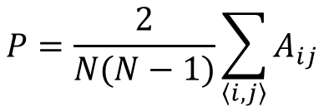





$$P=\frac{2}{N(N−1)}\sum_{\left\langle i,j\right\rangle }{A_{ij}}$$
$$P∈[0,1]$$
[ Erdos-Reyni Graph ]
PMD 6 (3–4): 290–297 (1959)
[ Density – Connection Probability ]
$$P_{∗}$$
[ Connected Components ]
Increasing Density
$$P_{∗}=\left(\ln{N}\right)/N$$
$$P\left(s\right)∼s^{−3/2}$$
[ Fragmentation Threshold ]
[ Cluster Size Distribution ]
$$\frac{d\overline{x}}{dt}=\overline{\overline{A}}\overline{x}$$
$$A_{ii}<0$$
Nature 238 413–414 (1972)
$$σ^{2}NP<1$$
$$A_{ij}∈N\left(μ=0,σ\right)$$
[ Diversity-Stability Relation ]

Slide 8






$$A_{ji}=A_{ij}$$
$$r=\frac{\sum_{ij}{A_{ij}A_{ji}}}{\sum_{ij}{A_{ij}}}$$
[ Reciprocity ]
[ Undirected ]
$$r∈[0,1]$$
$$A_{ji}≠A_{ij}$$
How does Reciprocity depends on
the Density for an Erdos-Reyni Graph?
[ Directed ]
[ Weakly Connected Component ]
[ Strongly Connected Component ]
$$P_{∗}=\left(\ln{N}\right)/N$$
$$P_{∗}=2\left(\ln{N}\right)/N$$

Slide 9




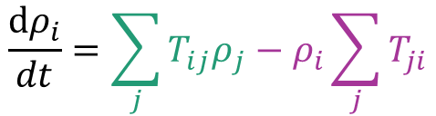



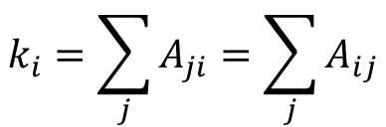

Random Walkers on Undirected Networks
$$i$$
$$\frac{dρ_{i}}{dt}=\sum_{j}{T_{ij}ρ_{j}}−ρ_{i}\sum_{j}{T_{ji}}$$
$$T_{ji}=\frac{A_{ji}}{k_{i}}$$
$$j$$
$$k_{i}=\sum_{j}{A_{ji}}=\sum_{j}{A_{ij}}$$
$$K_{ij}=0, K_{ii}=k_{i}$$
[ Degree ]
$$T=K^{−1}A$$
Network property (degree) predict
steady state behaviour (density)
$$\dot{ρ}=0 ⇒ ρ_{i}∼k_{i}$$
What is the Degree Distribution of an Erdos-Reyni graph?
$$k_{i}^{out}=\sum_{j}{A_{ji}}$$
$$k_{i}^{in}=\sum_{j}{A_{ij}}$$
[ Out - Degree ]
[ In - Degree ]
What about Random Walkers on Directed Networks?

Slide 10






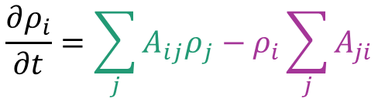




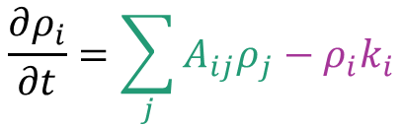




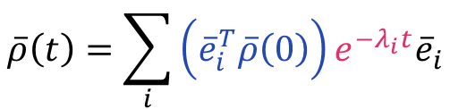
$$\frac{∂ρ_{i}}{∂t}=\sum_{j}{A_{ij}ρ_{j}}−ρ_{i}\sum_{j}{A_{ji}}$$
$$L_{ij}=−A_{ij}$$
$$i$$
$$L_{ii}=k_{i}$$
$$j$$
[ Laplacian ]
$$\frac{∂ρ_{i}}{∂t}=\sum_{j}{A_{ij}ρ_{j}}−ρ_{i}k_{i}$$
$$\frac{d\overline{ρ}}{dt}=−\overline{\overline{L}}\overline{ρ}$$
Combination of Rescaled
Eigenvectors
$$A$$
$$v$$
=
$$w$$
$$\overline{\overline{A}}\overline{e}=λ\overline{e}$$
Eigenvectors
Eigenvalues
Rotation and Scaling
$$\overline{ρ}\left(t\right)=\sum_{i}{\left({\overline{e}}_{i}^{T}\overline{ρ}\left(0\right)\right)e^{−λ_{i}t}{\overline{e}}_{i}}$$
Inverse Eigenvalues of Laplacian
as Persistence Timescale
$$τ∼\frac{1}{λ}$$
$$λ_{i}>0$$
$$λ_{1}=0, \overline{e_{1}}=\overline{1} ⇒ τ_{1}→∞$$
$$τ_{2}∼1/λ_{2}$$
Transient States
Steady State
Relaxation Timescale

Slide 11
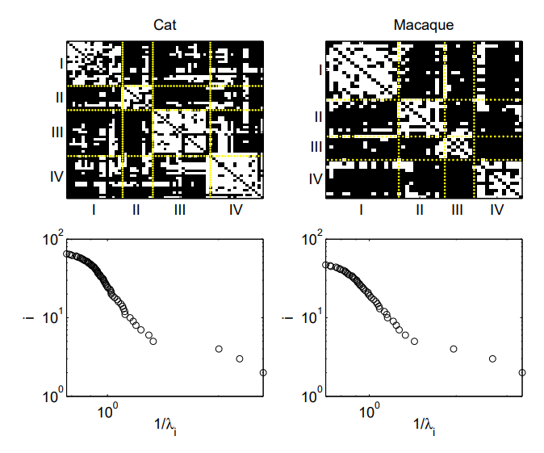
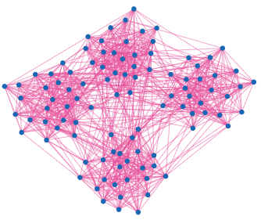
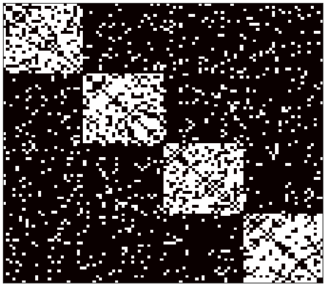
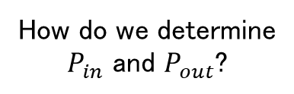




$$t≪τ_{2}$$
$$t \sim τ_{2}∼1/λ_{2}$$
$$t≫τ_{2}$$
EPL 85, 68006 (2009)
What are the implications
of timescale separation?
High (Low) Connection Density
within (across) modules
$$r=P_{out}/P_{in}$$
[ Modularity ]
How do we determine
$P_{in}$ and $P_{out}$?

Slide 12






1/0
0
1
0
0
1/0
1
0
0
1/0
0
1
Laplacian
$$\overline{\overline{L}}\overline{e}=\overline{0}$$
$$n\left(λ=0\right)=n_{c}$$
Zero Eigenvalue corresponding to each Connected Component
$$\overline{\overline{L}}={\overline{\overline{K}}}^{out}−\overline{\overline{A}}$$
$$λ_{1}=0$$
$$\overline{\overline{L}}\overline{r_{1}}=0$$
$$\overline{\overline{L}}\overline{l_{1}}=0 ⇒ \overline{l_{1}}={\left({\overline{\overline{K}}}^{out}\right)}^{−1}\overline{\overline{A}}\overline{l_{1}}$$
Right Eigenvector marks
Weakly Connected Components
Left Eigenvector is the
random walk steady state distribution

Slide 13
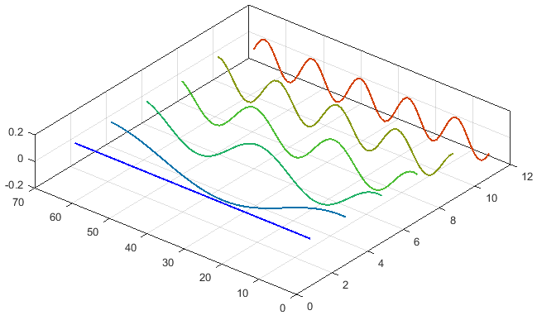
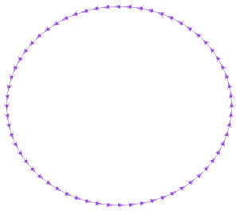
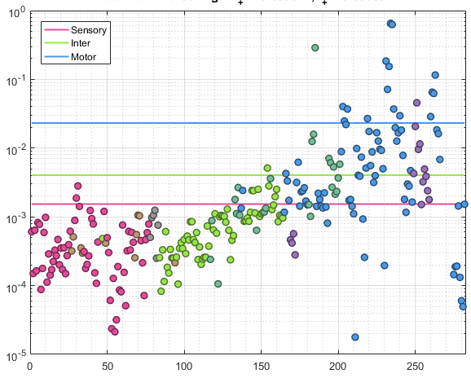


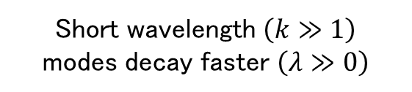
Eigenvectors of the Laplacian of a Cycle
$$\frac{dρ}{dt}=D\frac{∂^{2}ρ}{∂x^{2}}$$
$$\frac{dφ}{dt}=−Dk^{2}φ$$
Node
Vector Index
Short wavelength $\left(k≫1\right)$
modes decay faster $\left(λ≫0\right)$
Chemical Synaptic Network
Caenorhabditis elegans
Eigenvector Component
Philos Trans R Soc Lond B Biol Sci
314(1165):1-340 (1986)
Sensory (Motor) Neurons are
more “source (target)-like”
Neuron Index

Slide 14
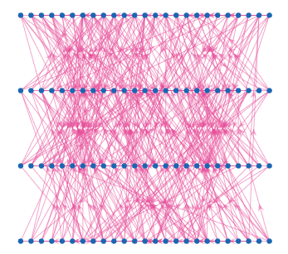
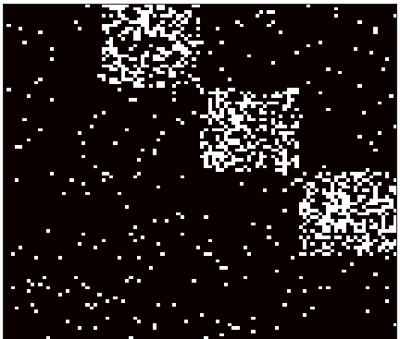
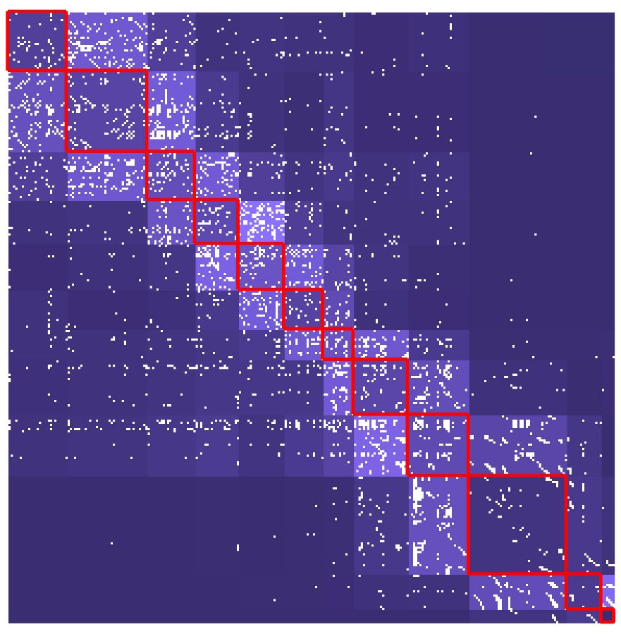
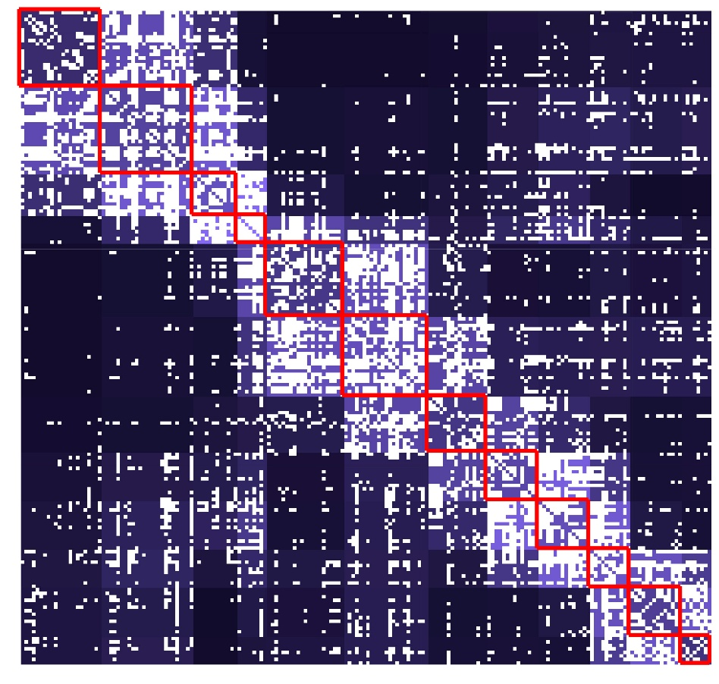
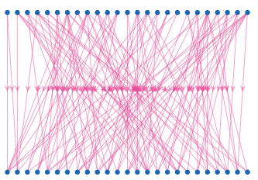
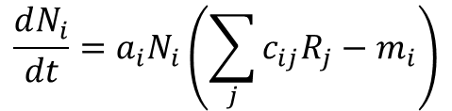

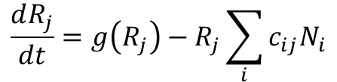
[ Hierarchical Structures ]
High Connection Density
across consecutive layers
Hierarchical Organization in
Neuronal Connectome of Nematodes
and Brain Regions of Primates
PNAS 121 (27) e2314291121 (2024)
$$\frac{dN_{i}}{dt}=a_{i}N_{i}\left(\sum_{j}{c_{ij}R_{j}}−m_{i}\right)$$
MacArthur and Levins’
Resource-Consumer Model
$$\frac{dR_{j}}{dt}=g\left(R_{j}\right)−R_{j}\sum_{i}{c_{ij}N_{i}}$$
arXiv:2403.05497v1 (2024)
[ Bipartite Networks ]
$$N_{c}≤N_{r}$$
[ Competition Exclusion Principle ]

Slide 15
LECTURE - II

Slide 16




Unbound
Bound
$$P\left(g\right)$$
Off
On
$$g$$
Gene Expression
Protein-Ligand Interactions
Pro
Against
Jagged
Homogenous
Opinion Dynamics
Tissue Patterns
$$V$$
Off
Off
On
On
Susceptible
Infected
$$t$$
Neuronal Activity
Contagion Spread

Slide 17










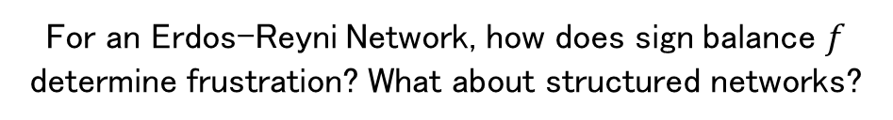














$$s_{i}=±1, 0/1$$
Binary States for Nodes
[ Ising Model ]
[ Boolean Networks ]
$$\begin{matrix}f \\ 1−f\end{matrix}$$
$$+$$
$$A_{ij}=\begin{matrix}+1 \\ −1\end{matrix}$$
$$A_{ij}=\begin{matrix}±1 \\ 0\end{matrix}$$
$$\begin{matrix}P \\ 1−P\end{matrix}$$
$$−$$
[ Sign – Balance ]
$$f∈[0, 1]$$
[ Structural Balance / Frustration]
$$U=−\prod_{⟨i,j⟩}{A_{ij}}$$
$$+$$
$$+$$
$$+$$
$$−$$
$$+$$
$$−$$
$$+$$
$$−$$
$$+$$
$$−$$
$$−$$
$$−$$
$$U∈[−1,1]$$
$$U=−1$$
$$U=+1$$
For an Erdos-Reyni Network, how does sign balance $f$ determine frustration? What about structured networks?

Slide 18
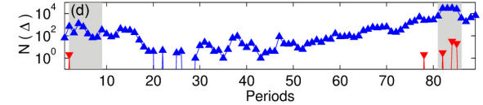







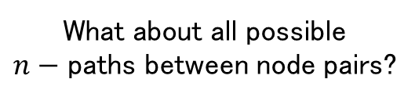
$$L_{ii}=\sum_{j}{\left|A_{ij}\right|}$$
$$L_{ij}=−A_{ij}$$
[ Signed Laplacian ]
[ Cycle ]
[ Semi-Cycle ]
$$0<λ_{1}<4l/n$$
Smallest Eigenvalue as a
measure of Frustration Index
Number of paths of length 2
$${\left[A^{2}\right]}_{ik}=\sum_{j}{A_{kj}A_{ji}}$$
$$i$$
What about all possible
$n−$ paths between node pairs?
$$j$$
$$k$$
Frustration as a marker
of Systemic Market Crisis
PRE 99, 052306 (2019)

Slide 19
LECTURE - III

Slide 20
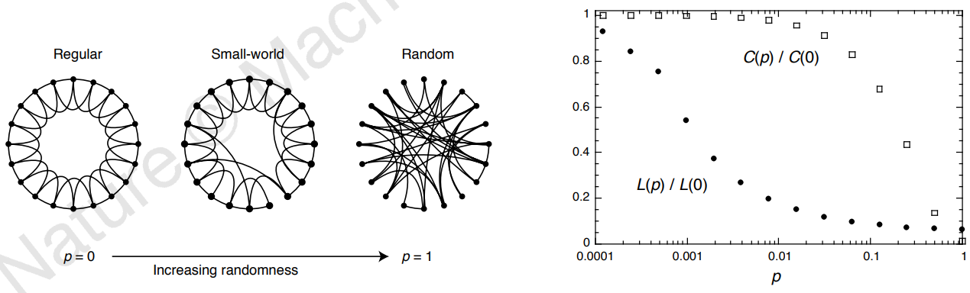




[ Regular ]
[ Clustering Co-efficient ]
$$C∈ [0, 1]$$
High Clustering
Large Path Length
$$n_{Λ}=k\left(k−1\right)/2$$
P = 0
$$C_{i}=n_{Δ}/n_{Λ}$$
$$C=\left\langle c_{i}\right\rangle$$
Average fraction of connected neighbours
[ Small- World ]
Nature 393 (6684): 440–442 (1998)
High Clustering
Low Path Length
0 < P < 1
[ Random ]
Low Clustering
Low Path Length
P = 1
What is the Clustering Co-efficient of a 2-D hexagonal lattice?
What about Erdos-Reyni graphs?

Slide 21
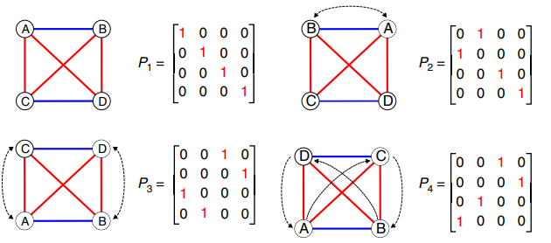
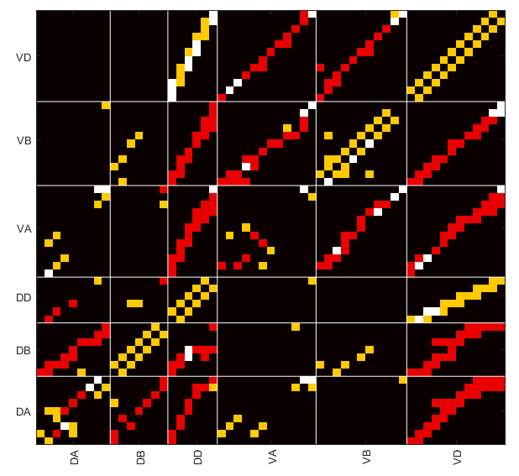



Nat Commun 10, 4961 (2019)
Conditions for Symmetry
$$P^{−1}AP=A$$
$$\left[A,P\right]=AP−PA=0$$
Gap Jn
Chem Syn
Both
$$\left|\left[A,P_{ε}\right]\right|<εM$$
[ Pseudosymmetry ]
Are structures shaped by evolution interpretable?

Slide 22


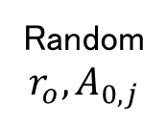





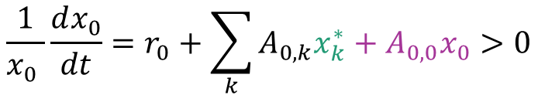

New node connects to m pre existing nodes
$$P\left(i→j\right)=\frac{k_{j}}{\sum_{j}{k_{j}}}$$
$$\frac{dk_{i}}{dt}=m\frac{k_{i}}{2mt}=\frac{k_{i}}{2t}$$
$$P\left(k_{i}<k\right)=1−{\left(m/k\right)}^{2}$$
$$P\left(k\right)∼k^{−3}$$
[ Power Law Degree Distribution ]
Preferential Attachment gives rise to Scale-Free Networks
[ Assimilating Ecological Networks]
Introduce a new species in low abundance at a low rate
$$\frac{1}{x_{0} }\frac{dx_{0}}{dt}=r_{0}+\sum_{k}{A_{0,k}x_{k}^{∗}}+A_{0,0}x_{0}>0$$
$$r_{0}>−\sum_{k=1:N}{A_{0,k}x_{k}^{∗}}$$
[ Invasion Criteria ]
Random
$$r_{o}, A_{0,j}$$
$$r_{0}≈r_{i}$$
$$A_{0,j}≈A_{i,j}$$
$$λ∼0$$
[ Migration ]
[ Mutation ]

Slide 23
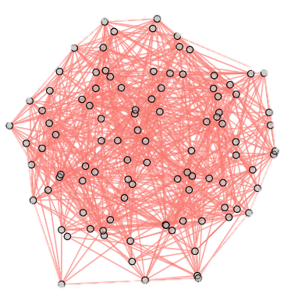
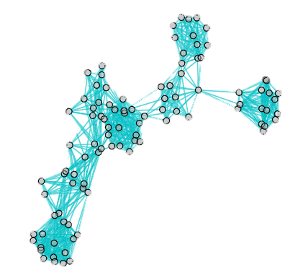

Spandrels in Ecological Networks
Partial overlap for
Structural & Functional Networks
$$V$$
Observable
$$t$$
[ Migration ]
[ Mutation ]
Network Structures reflect the
growth process, not dynamical stability
[ Functional Network ]
Correlation / Causality
Ecol Lett. 21(3):324-334 (2018)
PNAS 106(6):2035-2040 (2009)
Does selection act on network structures?

Slide 24












$$A_{ij}=σ_{i}σ_{j}$$
[ Hopfield Networks ]
$$U=\left\langle U_{ijk}\right\rangle ={−A}_{ij}A_{jk}A_{ki}=−1$$
$$A_{ii}=0$$
PNAS 81(10) 3088-92
Structurally Balanced by Construction
$$\frac{d\overline{s}}{dt}=\left(\tanh\left(β\overline{z}\right)−\overline{s}\right)$$
[ Free Energy / Lyapunov Function ]
$$z_{i}=\sum_{j}{A_{ji}s_{j}}$$
$$\frac{d\overline{σ}}{dt}=−∇_{σ}φ\left(\overline{σ}\right)$$
Input
$$\overline{σ}$$
[ Dynamics ]
How is it related to the Ising Model?
$$A_{ij}=\frac{1}{N}\sum_{μ=1:p}{σ_{i}^{μ}σ_{j}^{μ}}$$
$$A_{ii}=0$$
$${\overline{σ}}^{2}$$
Robust Line Attractor
Embedded in Yeast
Gene Regulatory Network
$${\overline{σ}}^{1}$$
$${\overline{σ}}^{3}$$
Storing multiple patterns
leads to higher frustration
PNAS 101 (14) 4781-4786 (2004)

Slide 25
Increased Frustration
Frustration is related to ruggedness of the underlying Landscape
[ Fixed Point ]
[ Limit Cycle ]
[ Chaos ]
Frustration is related to Attractor Complexity

Slide 26
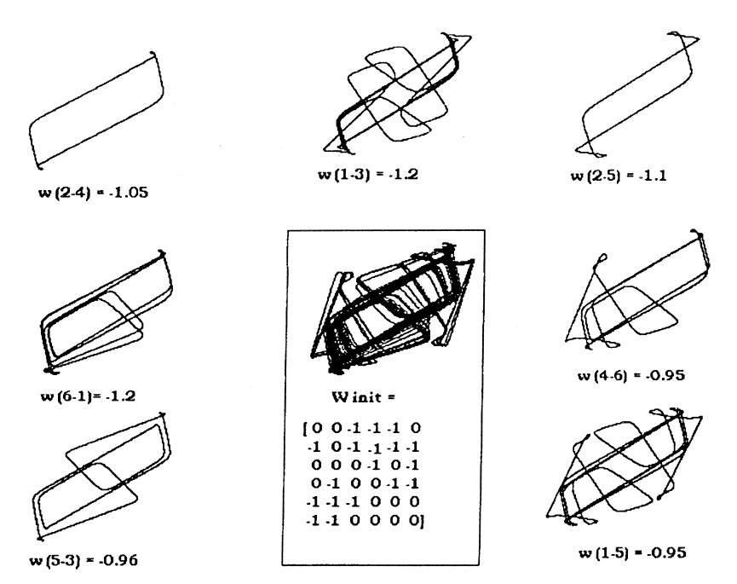
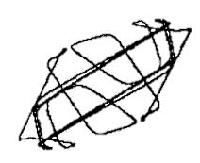
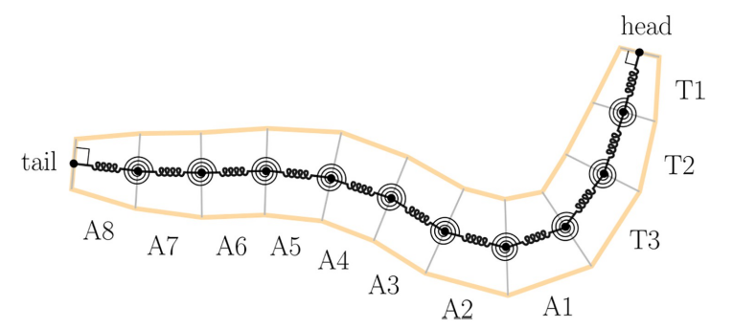
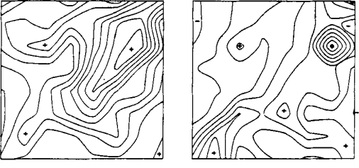
Pruning
Pruning frustrated edges collapses a chaotic attractor into distinct limit cycles
J Theor Biol 188(2):187-200 (1997)
PLOS Comp Bio 15(7) e1006635 (2019)
Learning and Retrieval using Chaotic Dynamics in Rabbit Olfactory Systems
Chaotic Dynamics in
Locomotion Behavioural Switching
Int. J. Intell Syst. 10 71-88 (1995)

Slide 27
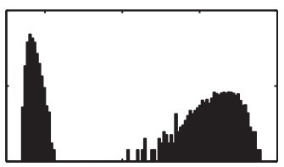
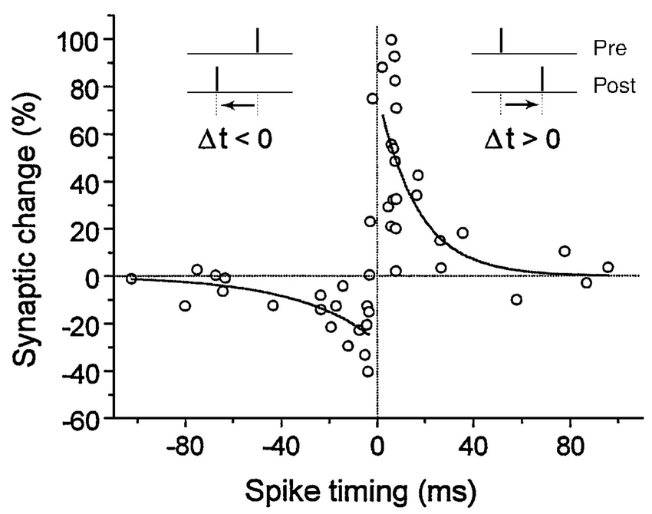












[ Hebbian Learning ]
$$ε≪1$$
$${ΔA}_{ij}^{t}=ε\left(σ_{i}^{μ}{σ }_{j}^{μ}−A_{ij}^{t}\right)$$
$$ε=1$$
$ε :$Learning Rate
Relaxation Time
[ Energy ]
$${10}^{2}$$
EPL 105 10003 (2014)
$$E=−\sum_{⟨i,j⟩}{A_{ij}σ_{i}σ_{j}}$$
$$f$$
$$ΔA_{ij}=ε\left(σ_{i}^{t}σ_{j}^{t}−A_{ij}\right)$$
$${10}^{0}$$
$${10}^{2}$$
$$τ$$
$${10}^{8}$$
[ Genetic Assimilation ]
STDP as an example
of Hebbian Learning
Journal of Neuroscience
18 (24) 10464-10472 (1998)
Nature 150 (3811): 563-365 (1942)

Slide 28




$$λ<0$$
[ Phase Transition ]
$$λ>0$$
$$λ∼0$$
Natural Selection of Gene Regulatory Network optimized for perception
select for near-critical systems
PNAS 111 (28) 10095-10100 (2014)

Slide 29

Structure
Low Dimensional Representation
Emergent Property
Molecular Interactions
Gene Regulatory Networks
Neuronal Connectomes
Ecological Interactions
Socio-Economic Relations
Configurational Free Energy
Epigenetic Landscapes
Attractor Spaces
Fitness Landscapes
Utility Functions
Protein Conformation
Cell Fate Identity
Behavioral States
Population Dynamics
Cooperation
$$?$$
How do networks relate to relevant low dimensional representation?
Is it sufficient? Is it necessarily tractable?

Slide 30

More is Different
P W Anderson, 1972
Science 177 4047 (1972)

Slide 31
THANKS

