Slide 1
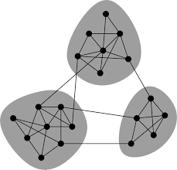
Chain of Thoughts
BDC, 2025
Swathi, Aditya, Insha
Mentored by
Dr. Sumithra Surendralal Dr. Soling
Anuran Pal
Brain, Dynamics, and Computation, 2025
Institute of Mathematical Sciences

Slide 2
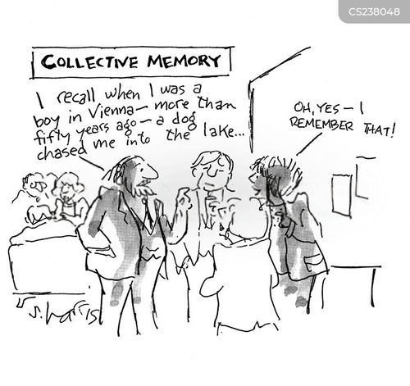
How do we recall memories through associations ?

Slide 3
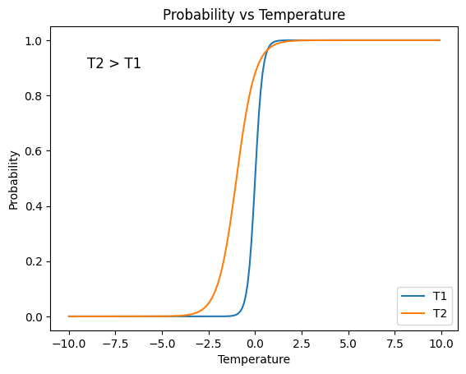
LENZ MODEL
Lenz Ising Model — the minimalist's dream of physics!
It’s like giving the universe a checkerboard and asking:
"Hey, what happens if each square has an opinion — up or down — and they gossip with their neighbors?"
By writing its energy, we decode how tiny states evolve, interact, and suddenly flip into a whole new phase!
Throughout our study, we have taken spin values to be:
As we gradually increase the temperature of the system, it slowly spread
Wij represents the strength between the ith and jth spin.
https://stanford.edu/~jeffjar/statmech/intro4.html

Slide 4
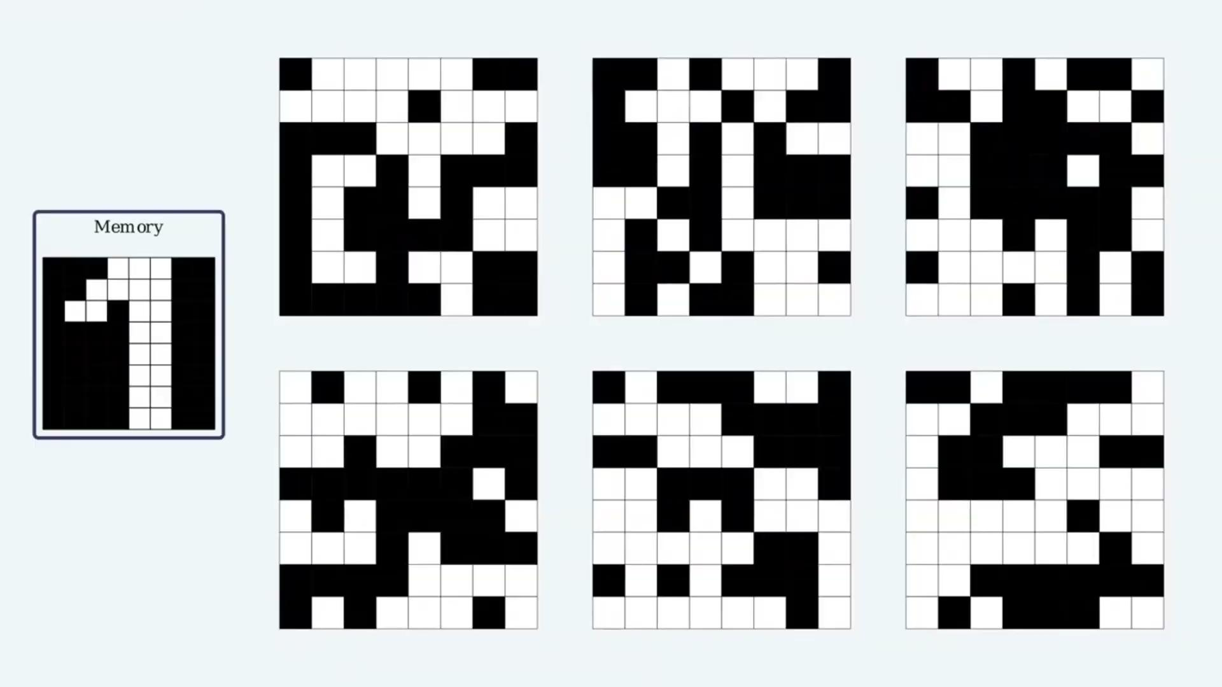
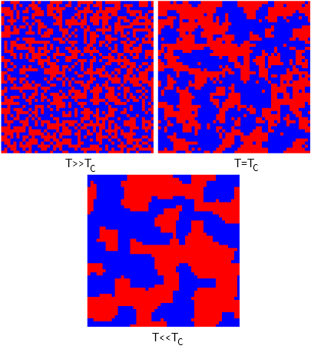
pattern formation
How the random patterns align towards the right pattern or the “memory” and, in some cases, the “complementary-memory”
https://rf.mokslasplius.lt/ising-model/
https://felixonline.co.uk/science/

Slide 5
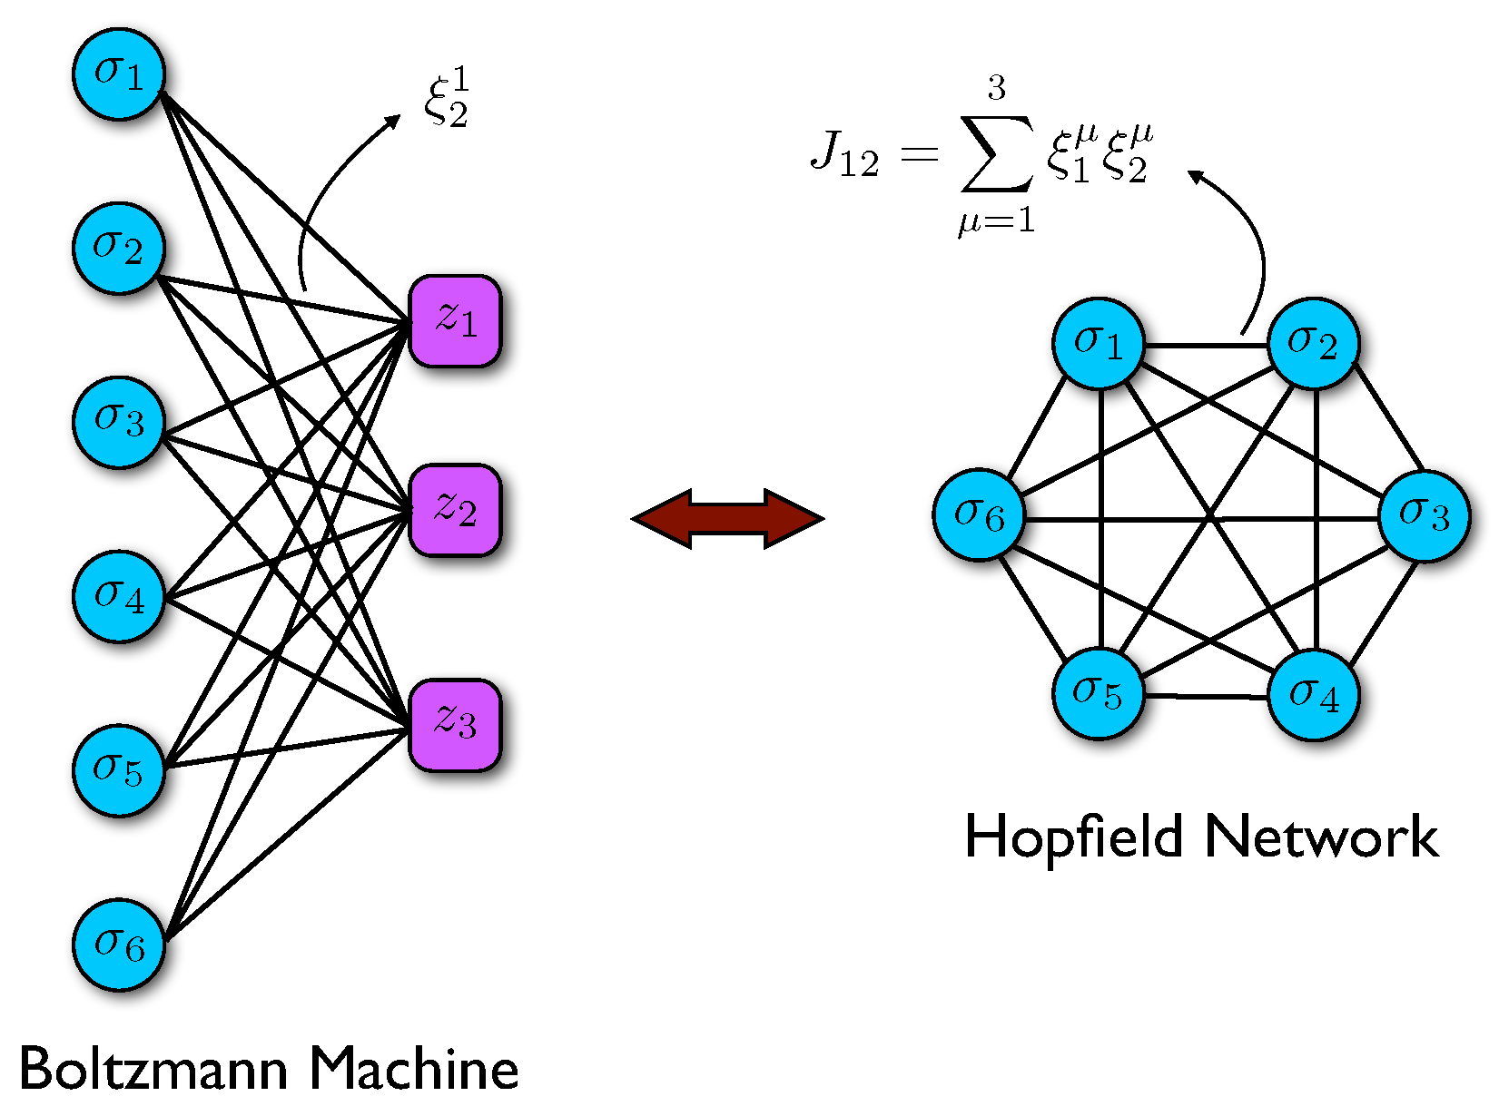
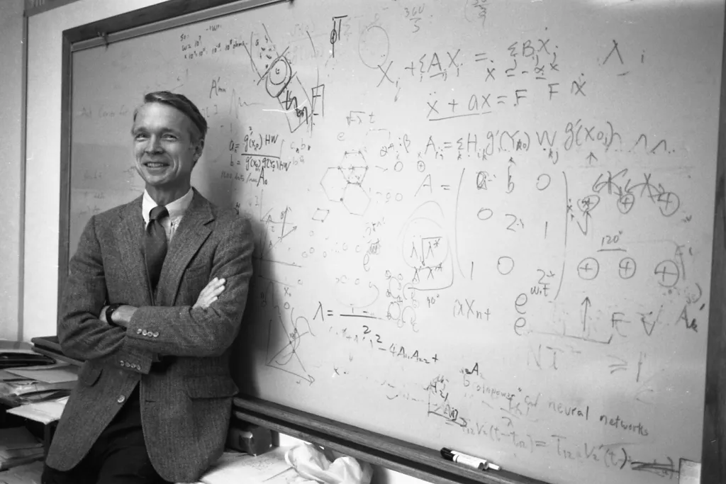
Hopfield Network
Our brains can recall the correct memory from just a few clues like a face from a blurry photo or a song from a single note.
These clues act as initial parameters, guiding the brain to converge on the full memory.
This is exactly how models like the Hopfield Network work ; they start from partial input and evolve toward the closest stored pattern, just like how our mind fills in the gaps.
https://doi.org/10.3390/e23010034
b is the external field used as initial condition.
Hopfield introduced the problem by taking i neurons and assigning a value for each neuron based on their firing ability.
The strength of connection between neuron i and j was captured using a weight matrix which quantifies how strongly the two neurons influence each other. These weights are symmetric and learned based on the patterns the network is meant to store.

Slide 6
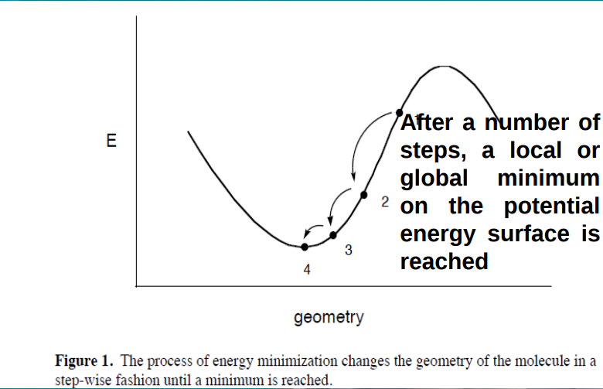
Memory is recalled when initial configuration evolves into corresponding attractors!
Protein folding entropy funnel
An interesting parallel can be drawn between protein folding and this memory recall process. There is only 1 right arrangement, which has the lowest energy.

Slide 7
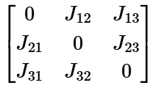
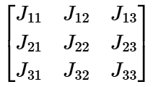
Constructing MODULAR NETWORK
A B
is taken for symmetric/undirected network
Sparsity/Modularity ratio, it gives an idea of how "full" or "connected" a module is relative to how connected it could possibly be.
N is the number of nodes in a module and L is the number of actual links present
Adjacency matrix represents the intramodular links (connections within the module A or B) and intermodular links (connections across modules A and B)
For the connections within a module:
For the connections across modules:
The diagonal terms indicate the absence of self-loops in the module, as each node receives input only from its neighboring nodes, not from itself.

Slide 8
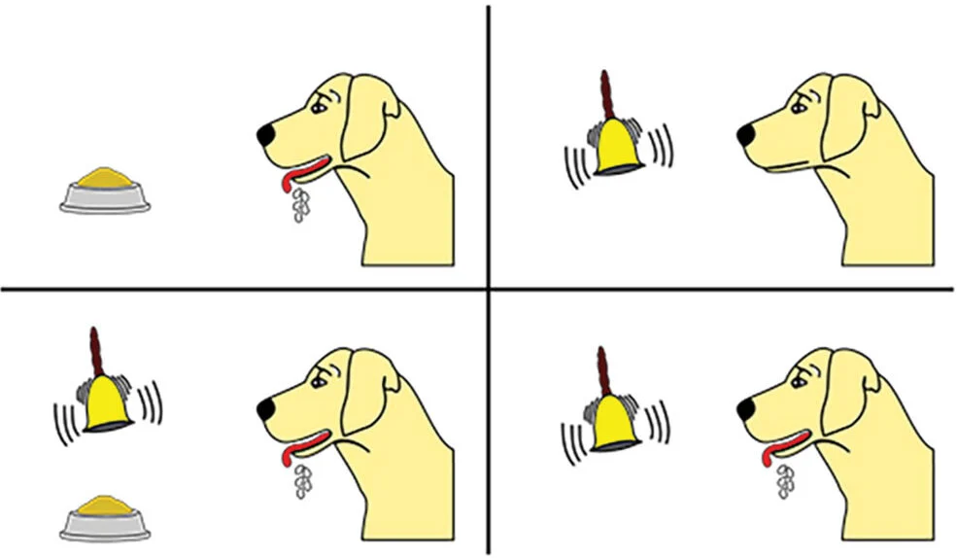
Associative memory
When certain inputs repeatedly activate a specific group of neurons, the synaptic connections between those neurons get strengthened.
Over time, this leads to pattern formation where the network can recognize or recall similar input patterns with greater ease.
This is how associative memory works — linking a smell to a memory, or recognizing faces.
Associating Shapes with Colors
Let’s say a neural system is exposed to visual inputs where certain shapes are consistently paired with certain colors:
Each time the system sees a circle, it also sees the color red. Over repeated exposures:
Circle neurons and Red neurons fire together → their synaptic connection strengthens.
This happens similarly for square–blue and triangle–green.
Pavlov’s dog
Triangle | Green
Blue | Square
Circle | Yellow

Slide 9
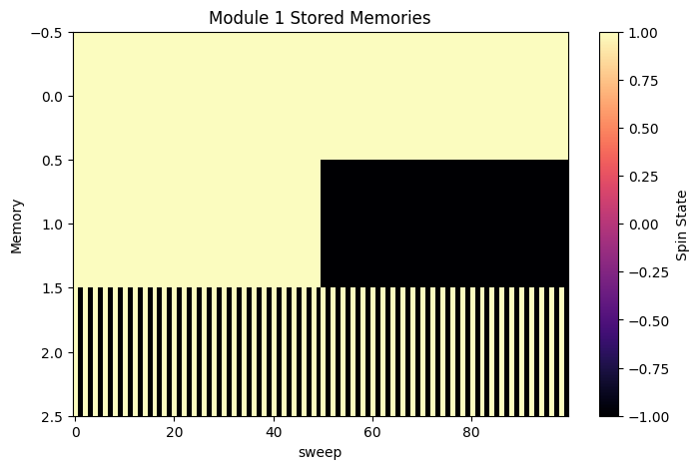
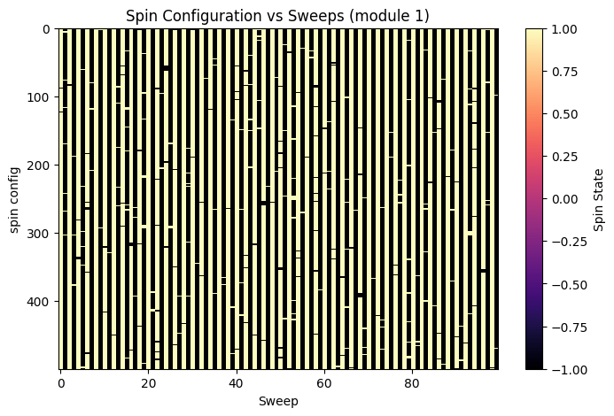
State Evolution for Undirected networks
The memory patterns stored in module A are
[+1, +1, +1, +1, +1, +1, +1, +1, +1, +1, +1, +1, +1, +1, +1, +1, +1, +1, +1…..N]
[+1, +1, +1, +1, +1, +1, +1, +1, +1, …N/2, -1, -1, -1, -1, -1, -1, -1, -1, -1, -1,...N]
[+1, -1, +1, -1, +1, -1, +1, -1, +1, -1, +1, -1, +1, -1, +1, -1, +1, -1, +1, +1, -1…..N]
The system has fallen into the third attractor in module 1

Slide 10
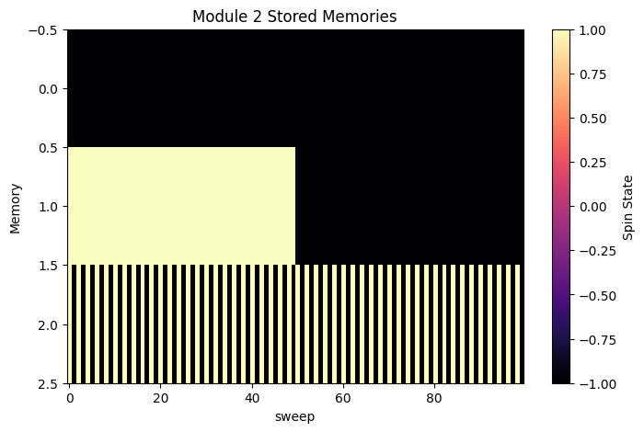
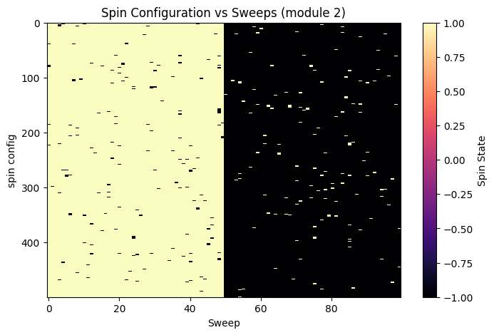
The memory patterns stored in module B are
[-1, -1, -1, -1, -1, -1, -1, -1, -1, -1, -1, -1, -1, -1, -1, -1, -1, -1, -1…..N]
[-1, -1, -1, -1, -1, -1, -1, -1, -1, -1,…N/2,+1, +1, +1, +1, +1, +1, +1, +1, +1,...N]
[+1, -1, +1, -1, +1, -1, +1, -1, +1, -1, +1, -1, +1, -1, +1, -1, +1, -1, +1, +1, -1…..N]
The system has fallen into the second attractor in module 2
The controlling parameters for our system are:
Modularity, ⍴
External field, b
Temperature, T

Slide 11
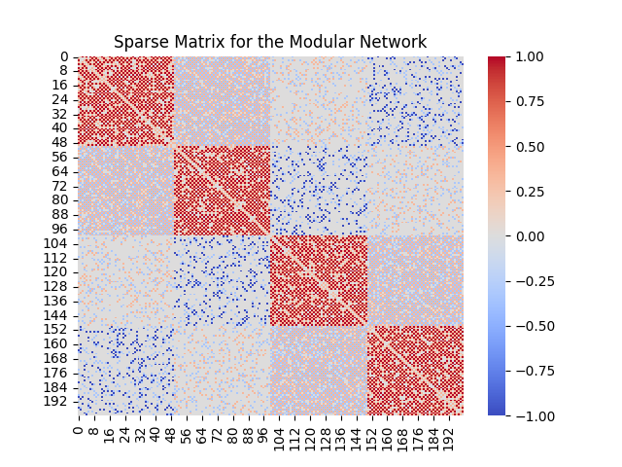
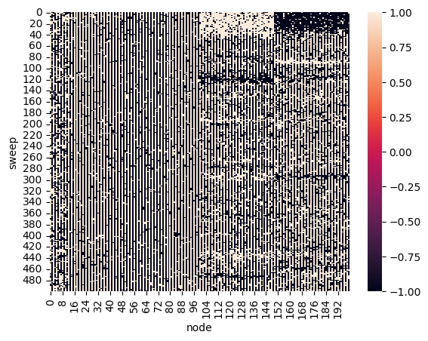
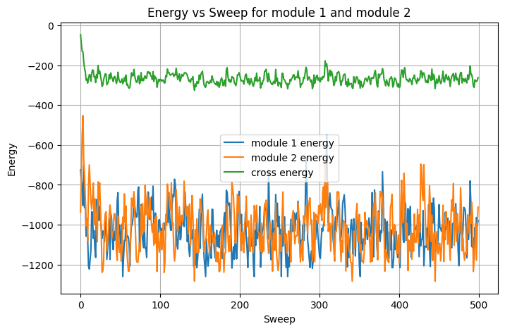
Remember the adjacency
matrix we formed earlier?
This plot shows the sparsity of the modular network
Memory recalled!!!
The third attractor and the second attractor from module A and B respectively has come together to recall the memory

Slide 12
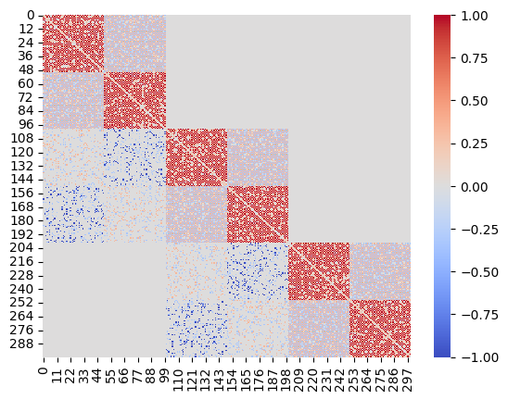
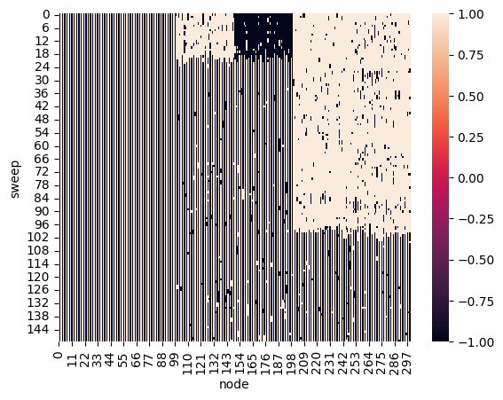
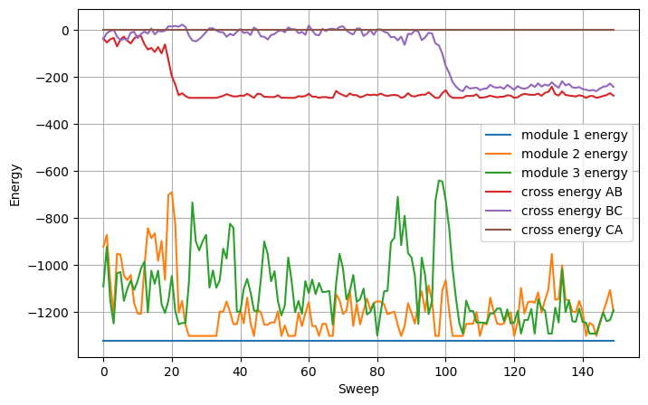
State Evolution for directed networks
A similar procedure was followed to construct a three-module network, but this time using directed links.
Meaning, we can only go from
A→ B→ C
A ⇄ B ⇄ C isn’t allowed in directed network!

Slide 13
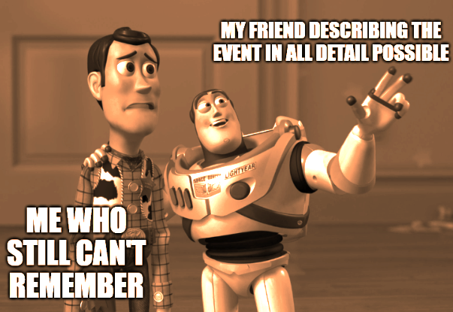
Future directions ➔
Cognitive Modeling & Neuroscience
Simulating how the human brain might store and retrieve memories.
Useful in modeling synesthesia (e.g., linking colors to shapes or sounds), by reinforcing cross-modal associations.
Modern Hopfield networks
The storage capacity has been significantly increased, surpassing the classical limit of 0.14N, describing how we can increase the amount of patterns stored more than the number of neurons.
The authors show a simple connection between this memory model and common deep learning networks, where different types of pattern recognition match different activation functions in neural nets. This duality helps apply insights from associative memory to better understand and design neural networks

Slide 14
THANK YOU!
Still wondering why the title says “Chain of Thought”?
You all saw how providing an initial condition to the first module, A, triggered the next module, B, to automatically fall into its associated attractor. In turn, module C followed B’s instructions and did the same. This cascading process continues if our system consists of more such modules—ultimately allowing the system to recall the desired memory or thought!
How cool is that?

Slide 15
References
Tao, P., Du, C., Xiao, Y. et al. Data-driven detection of critical points of phase transitions in complex systems. Commun Phys 6, 311 (2023). https://doi.org/10.1038/s42005-023-01429-0
https://stanford.edu/~jeffjar/statmech/intro4.html
Energy Landscape of a Hopfield Network. Mrazvan22 (CC BY-SA 3.0), via Wikimedia Commons; Science Issue 1854 https://felixonline.co.uk/science/
https://www.youtube.com/watch?v=piF6D6CQxUw&t=550s
https://en.wikipedia.org/wiki/Hopfield_network
Marullo, C., & Agliari, E. (2021). Boltzmann Machines as Generalized Hopfield Networks: A Review of Recent Results and Outlooks. Entropy, 23(1), 34. https://doi.org/10.3390/e23010034

