Slide 1
HOW DO WE COUNT?
Anagha, Avni, and Rwitacheta
Group Project Presentation BDC2025

Slide 2
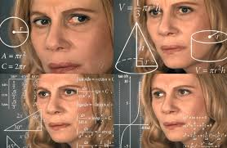
HOW DO WE COUNT?
(Sort of…………)

Slide 3
GAME TIME!
Can you count the number of faces?

Slide 5
GAME TIME!
How about now?

Slide 7
GAME TIME!
Final Round. Ready?

Slide 9
MOTIVATION
Animals possess an approximate number system (ANS) that encodes numerosity as an internal magnitude
Discrimination between two numerosities follows Weber’s law: the just-noticeable difference (JND) increases proportionally with the magnitude, so larger numbers require greater differences to be distinguished
This encoding is logarithmic, consistent with Fechner’s law
Neurophysiological and behavioural studies confirm these psychophysical laws in numerosity judgments, showing similar performance patterns and neural tuning in both humans and non-human animals
Notes:
meaning the subjective sense of number grows with the logarithm of the actual quantity, a pattern validated across humans, primates, and birds5.

Slide 10
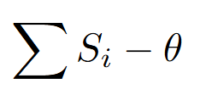
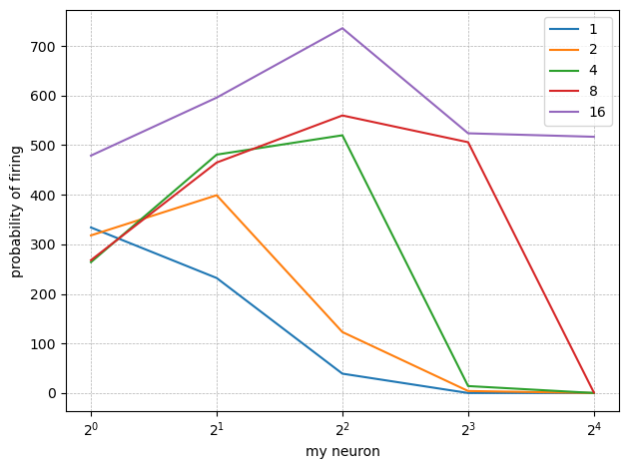
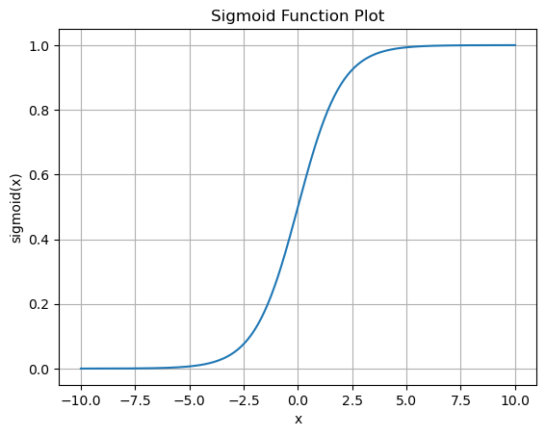
MODEL 1
2
4
8
16

Slide 11
Limitations of our first attempt:
The activation of neurons was hard-coded and assumed to be probabilistic which is not consistent with how neurons behave
Including mechanisms like lateral inhibition to make the model more physiologically accurate failed
Model could not recreate the probabilistic firing pattern that is typically observed in humans and other primates
MODEL 2

Slide 12
Layer 1
d
2d
3d
4d
Layer 2

Slide 13
Layer 1
d
2d
3d
4d
Layer 2

Slide 14
Layer 1
d
2d
3d
4d
Layer 2

Slide 15
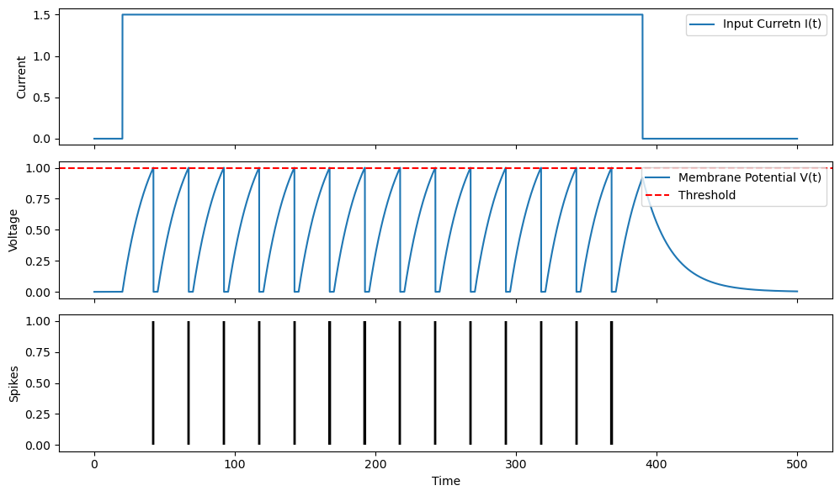
LIF Neurons
V = Membrane Potential
τ = Characteristic time-scale
R = Resistance
w_{j} = Synaptic current
d_{j} = delay
V_{th} = Threshold Potential

Slide 16
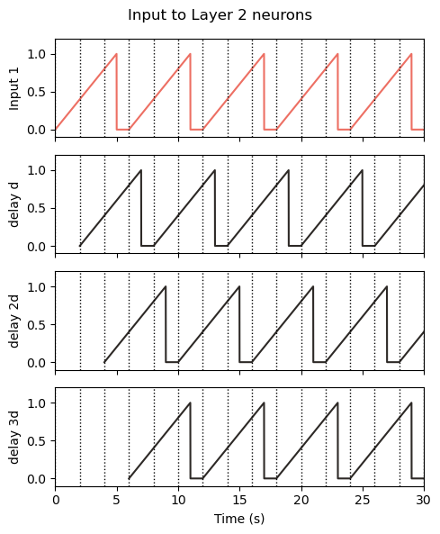
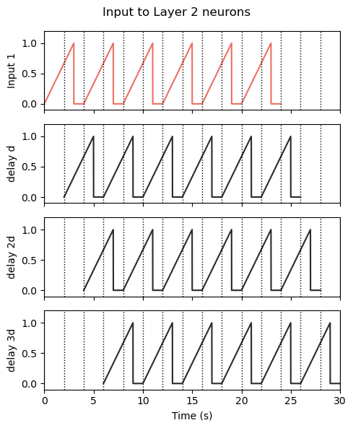
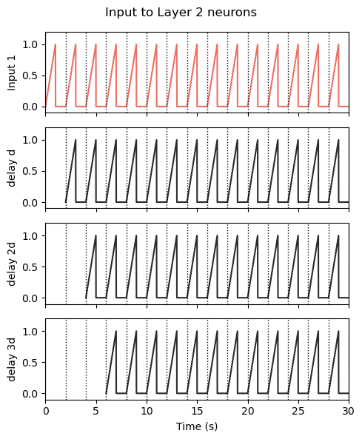
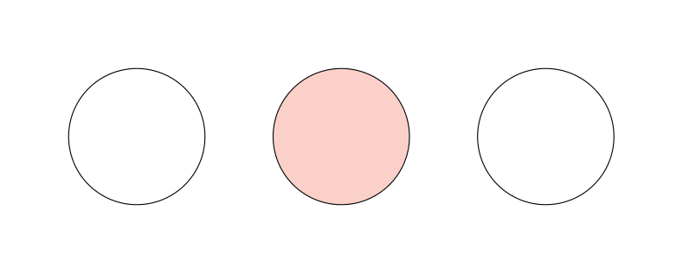
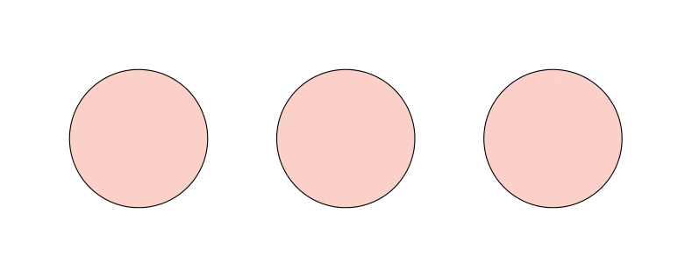
Delay and frequency (τ and amplitude)

Slide 17
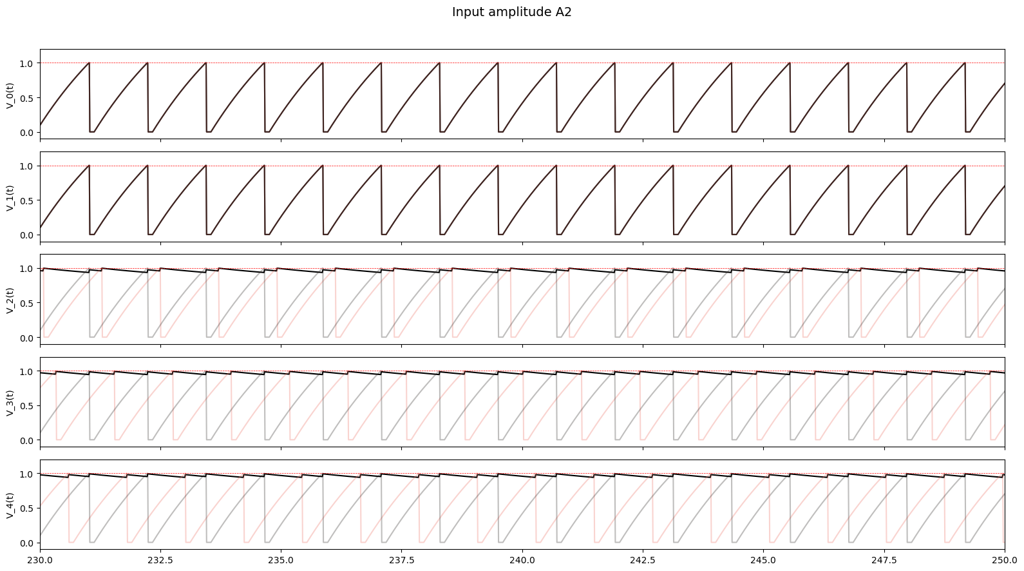

Slide 18
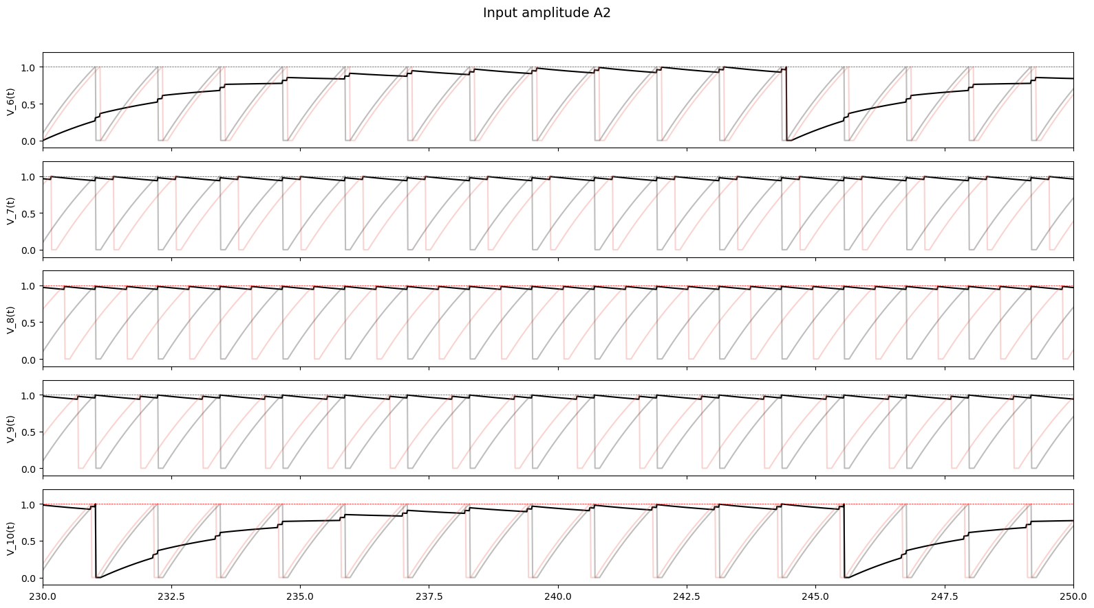

Slide 19
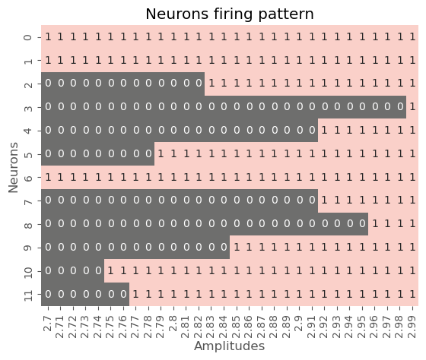
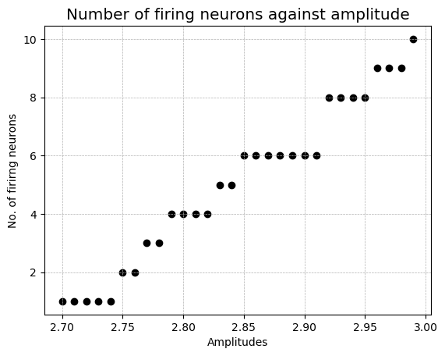
RESULTS
τ = 2.5

Slide 20
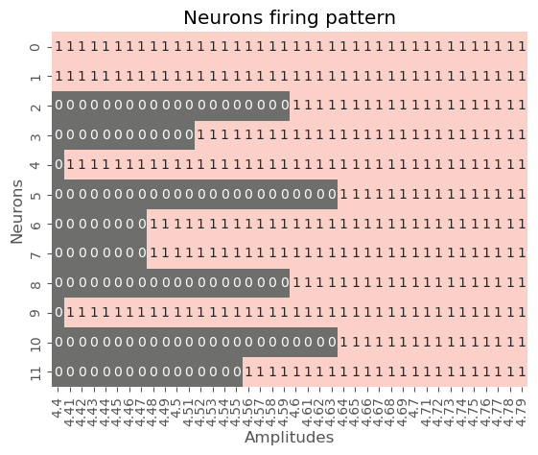
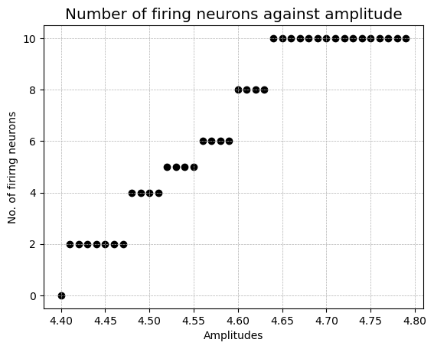
RESULTS
τ = 4

Slide 21
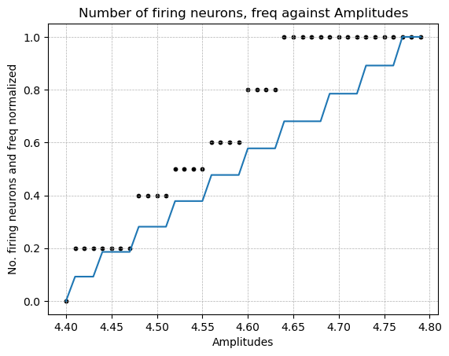
RESULTS
τ = 4

Slide 22
Potential Applications of our Model
Responses in animals when faced with aggression and enemies
Estimating how humans perceive brightness changes
How to make changes in
audio system levels
Quorum sensing in unicellular animals

Slide 23
THANK YOU!
Nieder, A., & Dehaene, S. (2009). Representation of number in the brain. Annual Review of Neuroscience, 32, 185–208. https://doi.org/10.1146/annurev.neuro.051508.135550
Lorenzi, E., Perrino, M., & Vallortigara, G. (2021). Numerosities and other magnitudes in the brains: A comparative view. Frontiers in Psychology, 12, 641994. https://doi.org/10.3389/fpsyg.2021.641994
Mehta, P., Goyal, S., Long, T., Bassler, B. L., & Wingreen, N. S. (2009). Information processing and signal integration in bacterial quorum sensing. Molecular Systems Biology, 5, 325. https://doi.org/10.1038/msb.2009.79

Slide 24
Amplitude modulation is a general sensory coding principle: In sensory systems, amplitude modulation (AM) is widely used to encode stimulus intensity or magnitude. For example, in the auditory system, sound intensity is encoded by the amplitude of neural firing, and in vision, contrast or brightness can be reflected in response amplitude. This general principle supports the plausibility of encoding numerosity or magnitude in amplitude for neural processing.
Amplitude vs. frequency encoding in biological systems: Recent research demonstrates that both amplitude and frequency of neural signals can encode information about stimulus magnitude, but with different properties. Amplitude encoding is optimal for a limited range of stimulus strengths and provides intensity-dependent discrimination, while frequency encoding offers scale-invariant discrimination. Some biological systems (e.g., yeast, neurons) use both strategies to broaden their dynamic range for stimulus discrimination. Stevens’ Power Law: Perceived magnitude PPP relates to stimulus intensity III via P=kIaP = kI^aP=kIa, indicating that subjective magnitude grows as a power function of physical amplitude (intensity).
Applications in artificial and quantum systems: Amplitude encoding is also used in quantum machine learning and neural networks, where the magnitude of a value is directly represented by the amplitude of a quantum state or neural activation. This mirrors biological strategies and demonstrates the utility of amplitude-based encoding for representing numerical information.
??Neural amplitude reflects numerical magnitude: Electrophysiological studies in humans show that the amplitude of neural responses (measured via EEG or ERP) increases with numerical distance between stimuli and with the absolute magnitude of small numerosities. For example, larger differences between numbers (e.g., 2 vs. 8) elicit greater amplitude responses than smaller differences (e.g., 2 vs. 3), reflecting the encoding of magnitude in amplitude. This "distance effect" is a robust neural signature of magnitude processing.

