Slide 1
Hierarchy and Population Invariance: Further dive into structural complexity in brain networks
Anand Pathak
Dept. of Psychological and Brain Sciences
Dartmouth College, NH, USA
Brains, Dynamics & Computation: A Workshop on Network Neuroscience

Slide 2
Complexity in brain networks
Brain is a complex system

Slide 3
Complexity in brain networks
Brain is a complex system
Brain functions via dynamical interaction patterns between large number of components

Slide 4
Complexity in brain networks
Brain is a complex system
Brain functions via dynamical interaction patterns between large number of components
Not every component interacts with every components all at once, their interactions are highly structured

Slide 5
Complexity in brain networks
Brain is a complex system
Brain functions via dynamical interaction patterns between large number of components
Not every component interacts with every components all at once, their interactions are highly structured
These interactions are driven as well as constrained by the anatomical connectivity, or ‘structural connectivity’

Slide 6
Complexity in brain networks
Brain is a complex system
Brain functions via dynamical interaction patterns between large number of components
Not every component interacts with every components all at once, their interactions are highly structured
These interactions are driven as well as constrained by the anatomical connectivity, or ‘structural connectivity’
Organizing principles of structural connectivity can be understood through network neuroscience tools

Slide 7
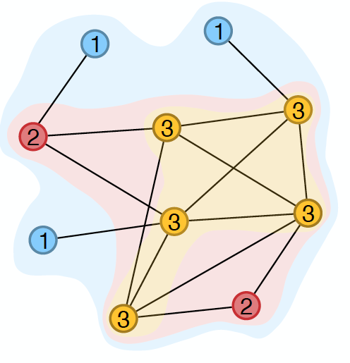
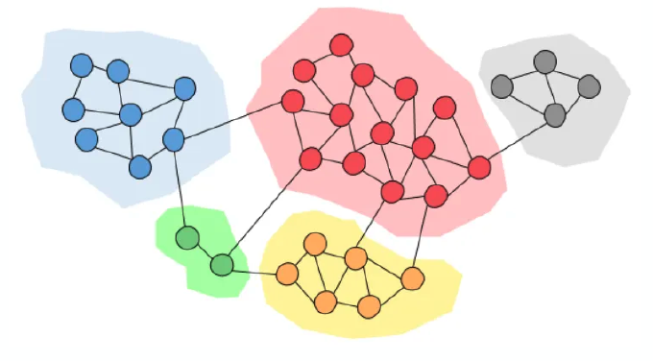
Complexity in brain networks
Brain is a complex system
Brain functions via dynamical interaction patterns between large number of components
Not every component interacts with every components all at once, their interactions are highly structured
These interactions are driven as well as constrained by the anatomical connectivity, or ‘structural connectivity’
Organizing principles of structural connectivity can be understood through network neuroscience tools
Examples of commonly studied organizing principles in brain networks:
Core-periphery
Modularity

Slide 8
Our contribution
We addressed the lack of network neuroscience tool to study a very specific type of organizational principle which is very commonly found in brain at various scales: Hierarchy

Slide 9
Our contribution
We addressed the lack of network neuroscience tool to study a very specific type of organizational principle which is very commonly found in brain at various scales: Hierarchy
‘Hierarchy’ suffers from terminology confusion : one word means so many things over a vast literature

Slide 10
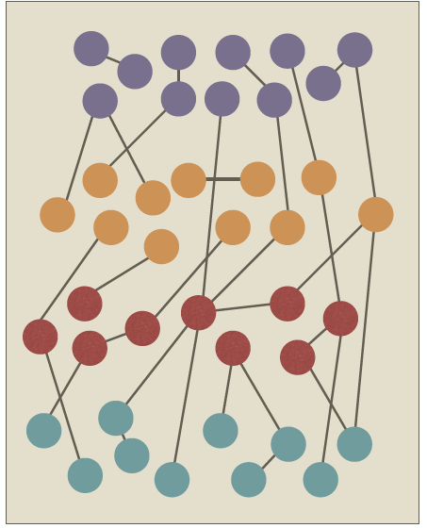
Our contribution
We addressed the lack of network neuroscience tool to study a very specific type of organizational principle which is very commonly found in brain at various scales: Hierarchy
‘Hierarchy’ suffers from terminology confusion : one word means so many things over a vast literature
We define hierarchy as organization of a network into groups or ‘layers’ that are sequentially arranged, such that there are dense forward and backward connections between any two consecutive layers while sparse connections between non-consecutive pairs of layers.

Slide 11
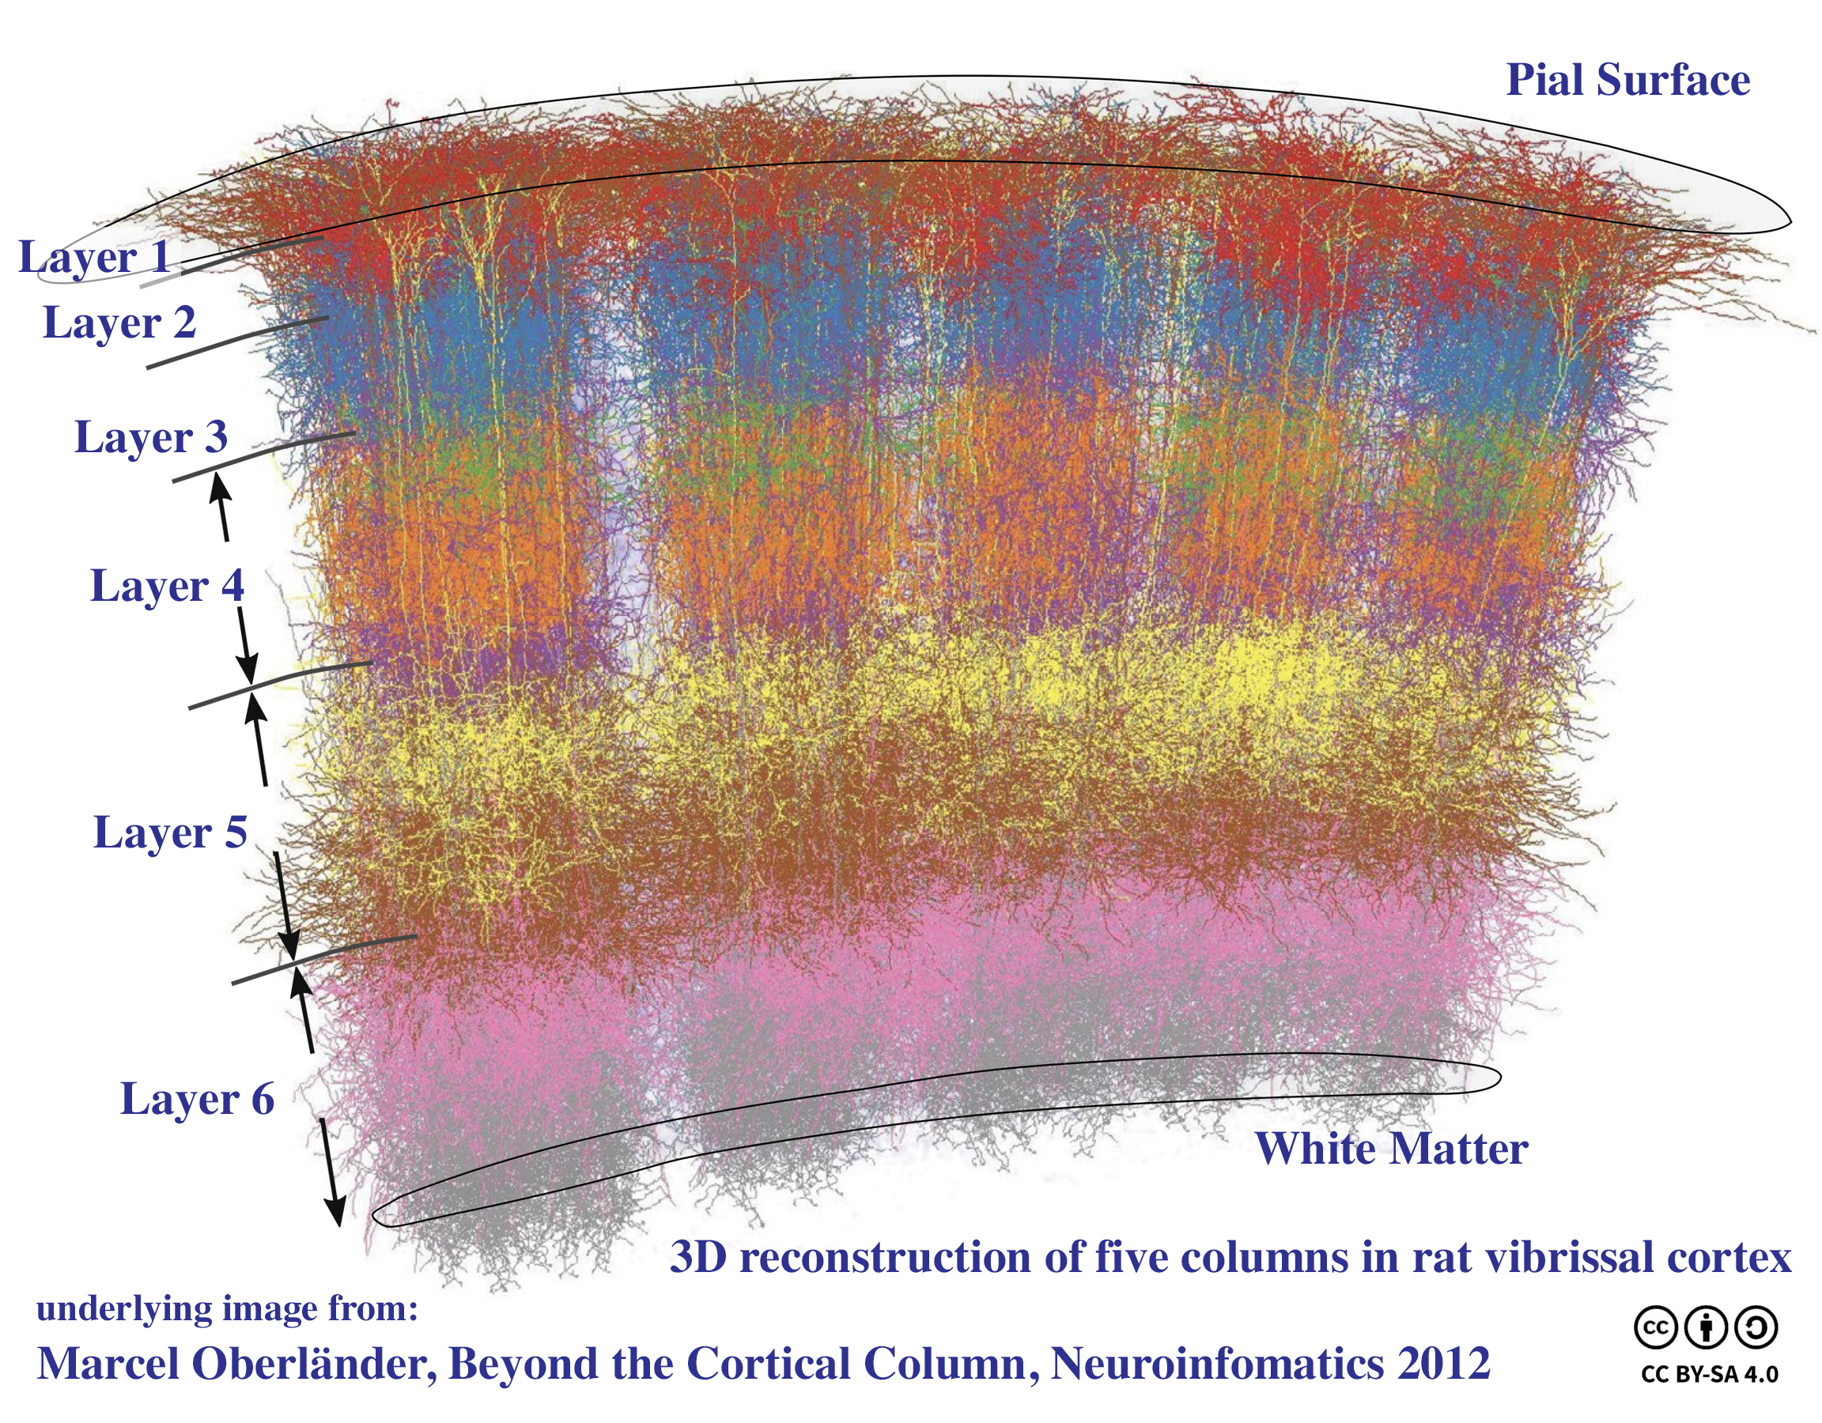
Hierarchy as an organizing principle in the brain
Visual stream
Cortical columns
Hilgetag & Goulas, 2020, Phil. Trans. R. Soc. B, Van Essen & Maunsell, 1983, Trends Neurosci

Slide 12
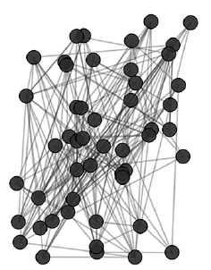
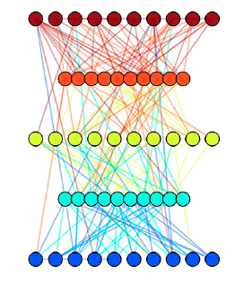
Hierarchy as an organizing principle in the brain
What if such a hierarchical organization is more ubiquitous in the brain, across species and across scales?
If it is, how do we find it in any given brain network?
How do we measure the degree of “hierarchicalness”?
Given this
Can we obtain this ?

Slide 13
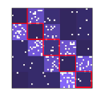
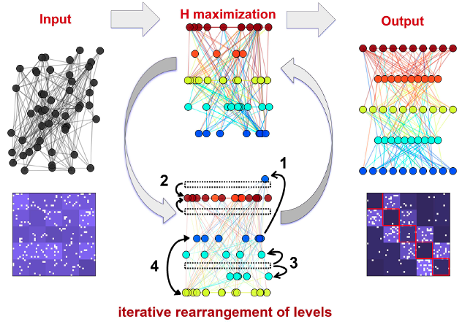
Hierarchy Index
We define a new measure of ‘Hierarchy index’ :
We then device a simulated annealing routine that sorts the nodes into
sequential layers which maximizes H
Pathak, A., Menon, S. N. and Sinha, S., PNAS 121, e2314291121 (2024).

Slide 14
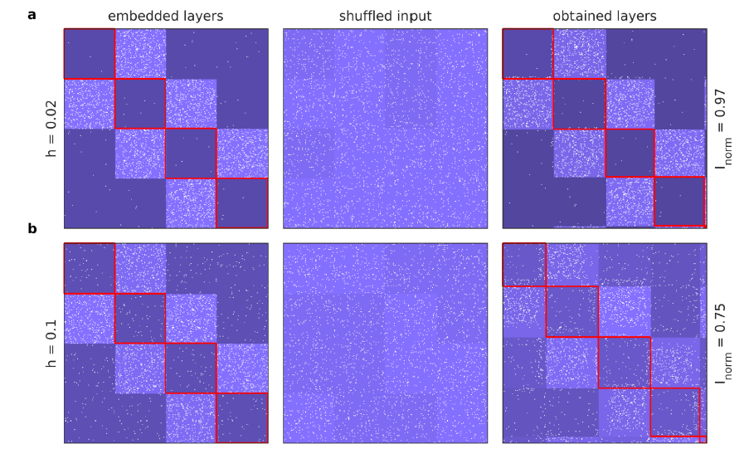
Benchmarking on synthetic networks

Slide 15
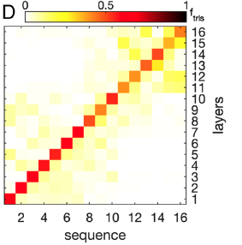
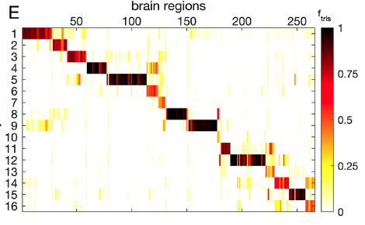
Hierarchy in Macaque brain
Pathak, A., Menon, S. N. and Sinha, S., PNAS 121, e2314291121 (2024).

Slide 16
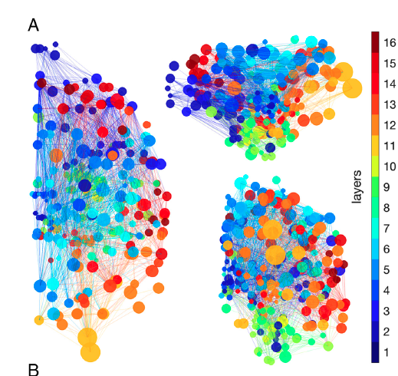
But macaque brain was modular too!
A Pathak, SN Menon, and S Sinha, Phys. Rev. E 106, 054304 (2022).
Pathak, A., Menon, S. N. and Sinha, S., PNAS 121, e2314291121 (2024).

Slide 17
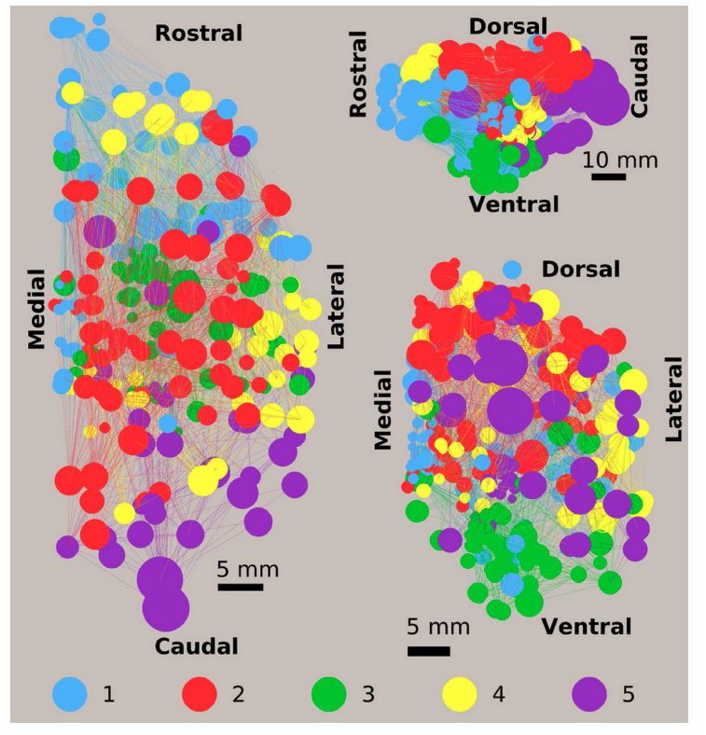
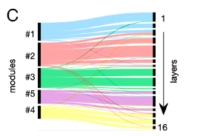
Modularity and Hierarchy are intertwined

Slide 18
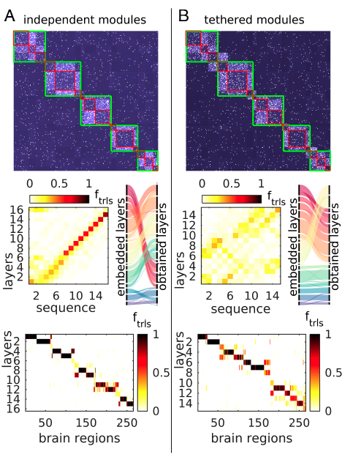
Modular-Hierarchy is what it is
Intriguing interpretations of such network structure
Distributed processing vs systematic integration
Deep vs shallow architecture
And more…
Pathak, A., Menon, S. N. and Sinha, S., PNAS 121, e2314291121 (2024).

Slide 19
Modular Hierarchy in human brain
Pathak, A., Menon, S. N. and Sinha, S., PNAS 121, e2314291121 (2024).

Slide 20
Modular Hierarchy in C. elegans
Pathak, A., Menon, S. N. and Sinha, S., PNAS 121, e2314291121 (2024).

Slide 21
Conclusions
Hierarchy is a fundamental form of organization known to occur in certain brain areas over several scales.
We developed a quantitative definition and measure of hierarchy in the network that does not assume any extra information other than anatomical connectivity
We found that hierarchy might be ubiquitous across species
The brain network are highly modular as well, thus giving rise to a complex entangled structure we call ‘modular hierarchy’
We analyze three distinct networks: macaque brain, human brain and C. elegans, and find intriguing structure function correspondence.
Such an organization provides us a bridge to seek correspondence between artificial deep neural networks and the Brain
For those interested: Pathak, A., Menon, S. N. and Sinha, S., PNAS 121, e2314291121 (2024).

Slide 22
Invariant Structural Organization of Human Brain : Is there a ‘typical’ human brain?

Slide 23
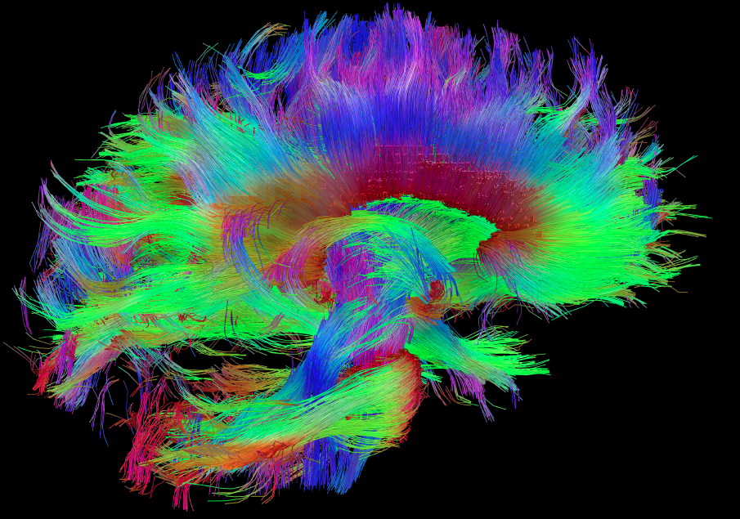
Human brain wiring dataset
Nathan Kline Institute (NKI) / Rockland Sample
196 healthy human subjects
Diffusion Tensor Imaging (DTI) : structural connectivity
Specific brain atlas (Craddock et. al., 2012, Human Brain Mapping) with 188 brain regions
Undirected weighted network
Weights represent observed thickness of axonal tracts

Slide 24
More commonly occurring connections have thicker axonal tracts
Pathak, A., Menon, S. N. and Sinha, S., arXive (2020).

Slide 25
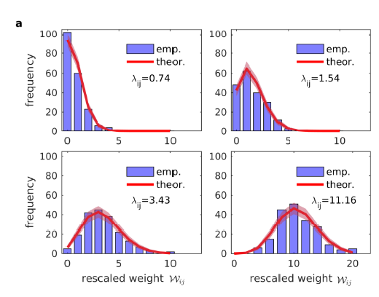
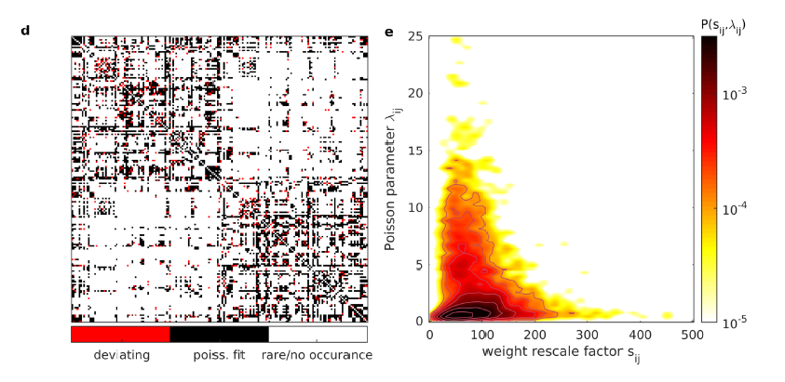
Connection weights follow nontrivial Poisson statistics
measured weights
There is a Poisson statistics underlying the connection weights
scaling factor
Rescaled Poisson variable
Pathak, A., Menon, S. N. and Sinha, S., arXive (2020).

Slide 26
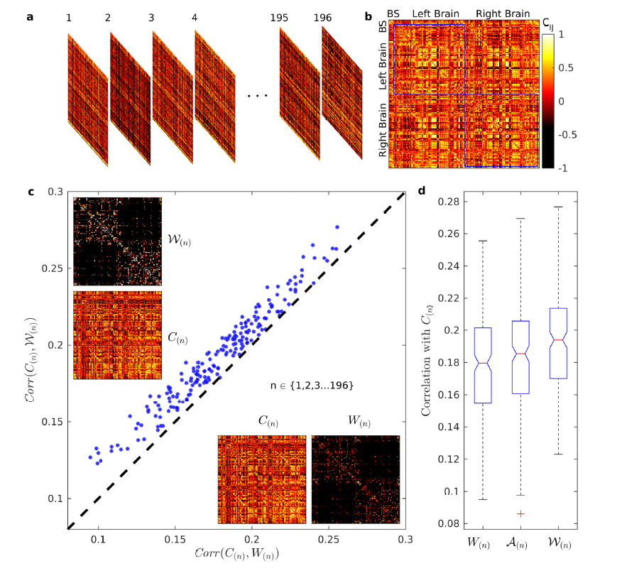
Poisson variable may have real biological interpretability
Pathak, A., Menon, S. N. and Sinha, S., arXive (2020).

Slide 27
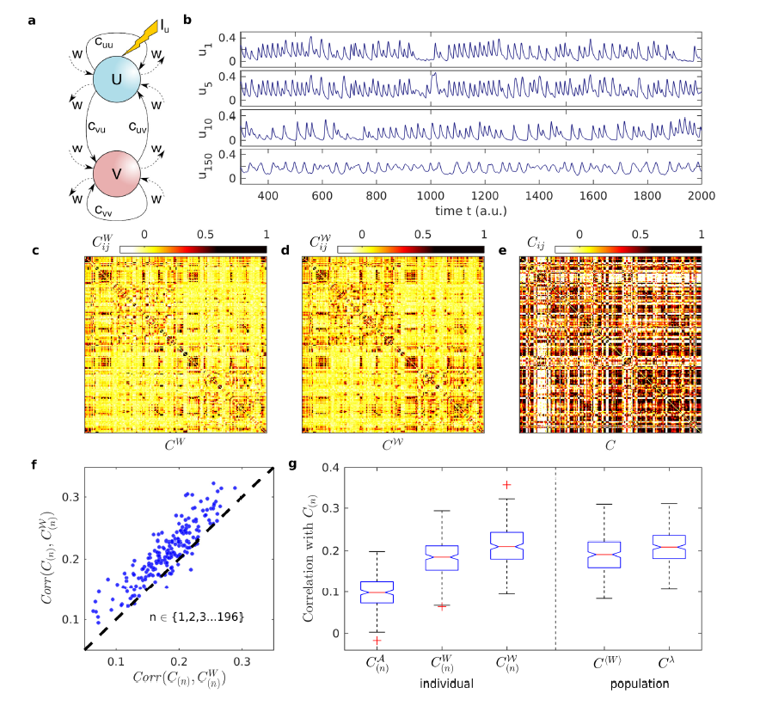
Poisson variable may have real biological interpretability
Pathak, A., Menon, S. N. and Sinha, S., arXive (2020).

Slide 28
Human brain has an invariant ‘basal’ network
Pathak, A., Menon, S. N. and Sinha, S., arXive (2020).

Slide 29
Conclusions
Poisson statistics underlying connection weights allows single parameter to explain frequency of occurrence of a connection as well as its weight distribution.
Implies a common generative mechanism for wiring and weighting during development.
Using the statistics, we can rescale the the weights which appear to have more biological interpretability : rescaled weight may represent number of connections while rescale factor may represent individual axon thickness.
We also observe strong bimodality in the variability in connection weights: dividing the structural brain network into two subnetworks : an invariant ‘basal’ network and a highly varying ‘super-structure’ network.

Slide 30
Thank You for your attention
Questions?

