Slide 1
Emergence modularity or circuits in the network

Slide 2
Emergence modularity or circuits
Witvilet et. al., Nature, 2021
~55% of new synapses are added to stable connections that did not increase modularity.
~14% of new synapses are developmentally dynamic and contributes to the increase in modularity

Slide 3
How phylogenetically conserved circuits or modules emerge?
Neurons that form circuits in the mature nervous system do not share obvious relationship

Slide 4
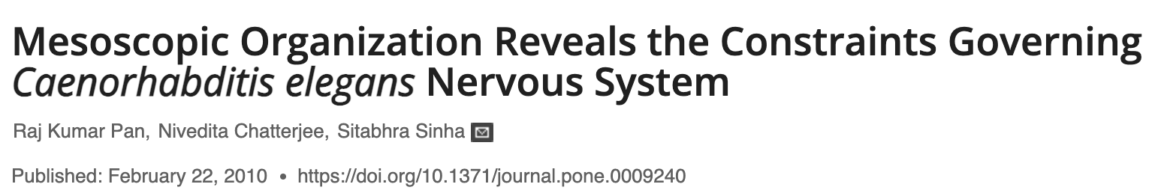
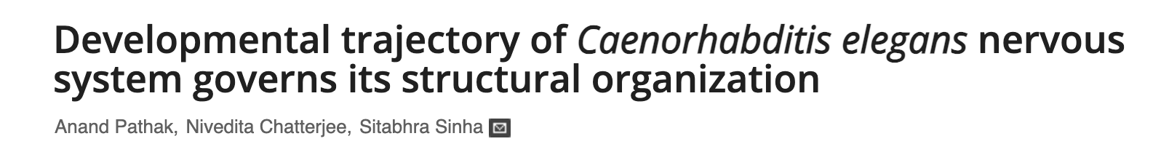

Slide 5
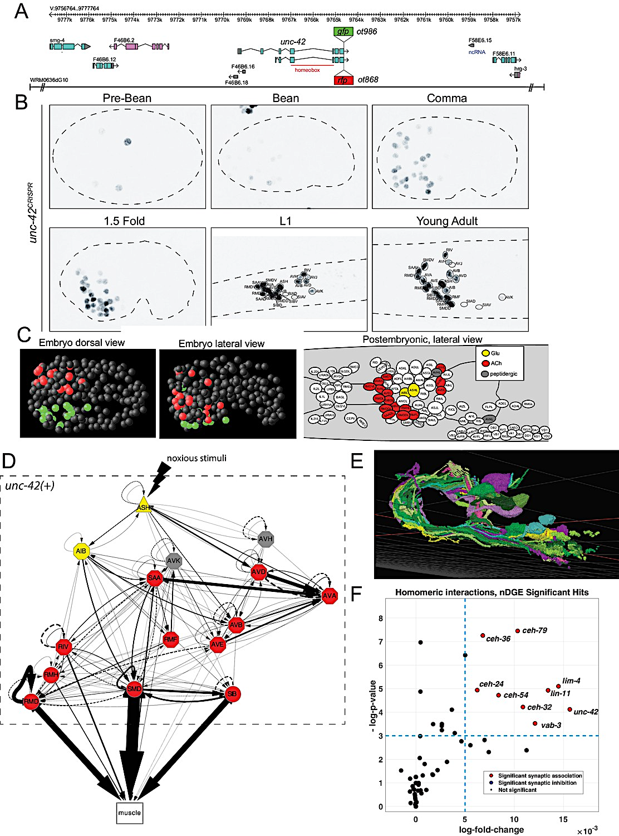
Broader ‘meta-themes’ of organizational properties: Concept of circuit organizer transcription factors
(network differential gene expression)
Connectome is randomly rewired while maintaining its topological properties such as the membrane adjacency, and looked for network differential gene expression.
Expression of eight homeodomain-transcription factors showed significant enrichment in synaptically connected neurons.
Berghoff, Glenwinkel, Bhattacharya et. al., Elife, 2021

Slide 6
Broader ‘meta-themes’ of organizational properties: Concept of circuit organizer transcription factors
(network differential gene expression)
The set of neurons that expressing certain transcription factors although do not share obvious commonalities, but tend to be heavily interconnected.
Berghoff, Glenwinkel, Bhattacharya et. al., Elife, 2021

Slide 7
Example of a Circuit organizer transcription factor: UNC-42
All these neurons project to the same neuropil, where synaptic connections are made
All UNC-42-postive neurons (40 neurons that fall into 15 classes) are heavily connected
Berghoff, Glenwinkel, Bhattacharya et. al., Elife, 2021

Slide 8
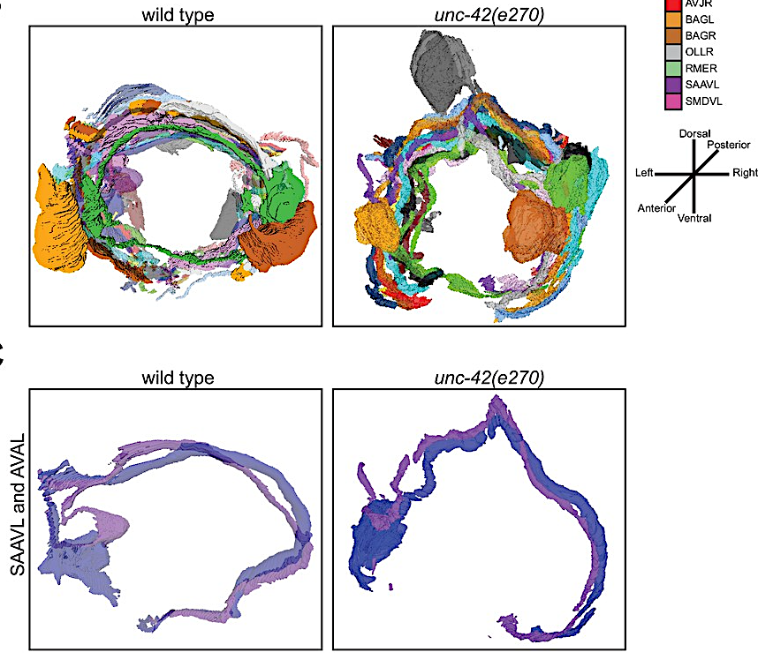
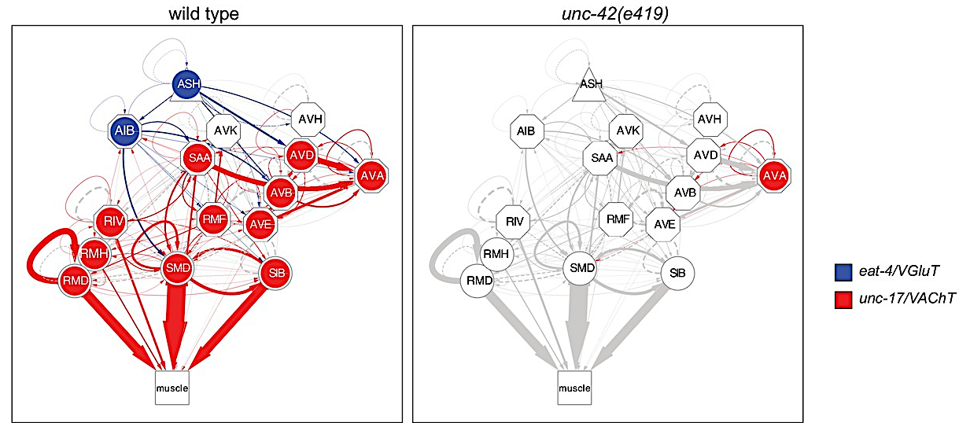
Circuit organizer transcription factors regulate multiple aspects of circuit organization
Neurotransmitter identity of the entire circuit is affected
And many more aspects……
Axon pathfinding, synaptic organizations are affected in unc-42 mutant
Defines the routes of communication between interconnected neurons
Berghoff, Glenwinkel, Bhattacharya et. al., Elife, 2021

Slide 9
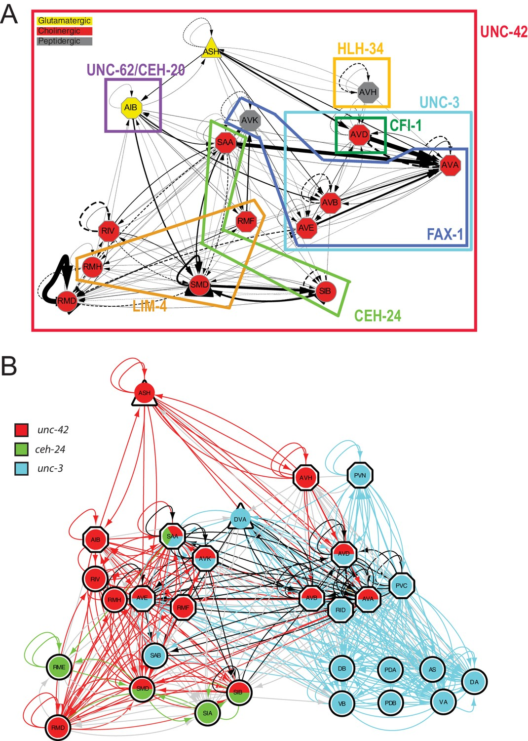
Overlapping circuit organizers may assemble individual circuits into larger-scale connectomes
Subcircuit specification
Berghoff, Glenwinkel, Bhattacharya et. al., Elife, 2021

Slide 10
Structural vs Functional Connectome

Slide 11
Hard-wired neuronal connectome provided a road map that tells how information can flow to generate a behavior.
However, it does not tell you when or where information is actually flowing – again connectomics of C. elegans has given us wonderful testable hypotheses in terms of how neural circuits work.
Time delay information is also missing

Slide 12
Towards functional connectome:
How to monitor circuit activity real-time in behaving animals
Powerful microscopes: that can track a behaving animal and
simultaneously image individual neurons
Activity sensor: To monitor neuronal activity real-time
Neuronal identity marker: To identify specific neurons distinctly in behaving, live animals

Slide 13
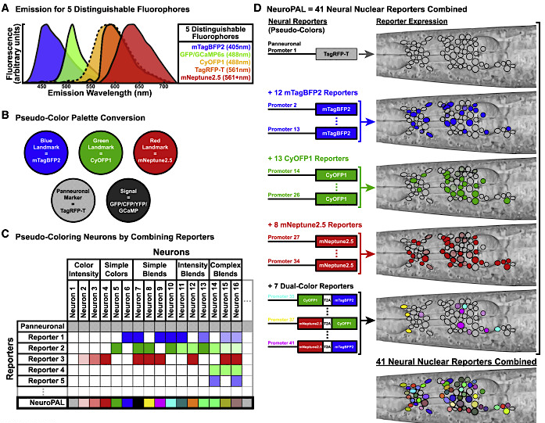
Neuronal identity marker: To identify specific neurons distinctly in behaving, live animals
Yemini et. al., 2021

Slide 14
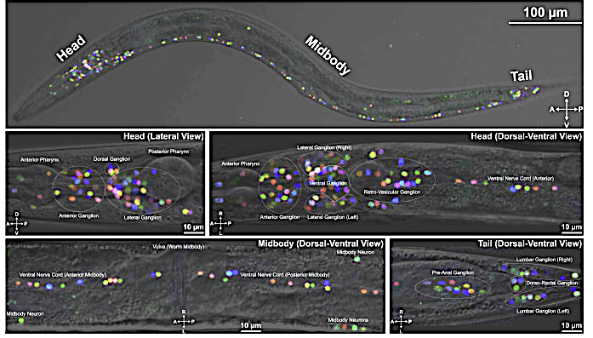
Each neuron can be distinctly identified based on
specific color code and positional information
Yemini et. al., 2021

Slide 15
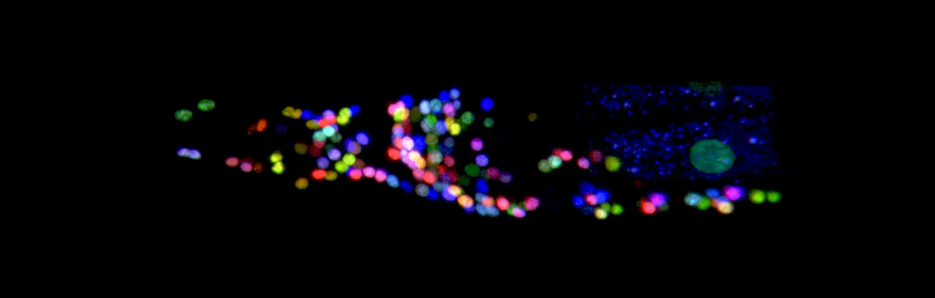
NeuroPAL: A Multicolor Atlas for Whole-Brain Neuronal Identification in C. elegans
Yemini et. al., 2021

Slide 16
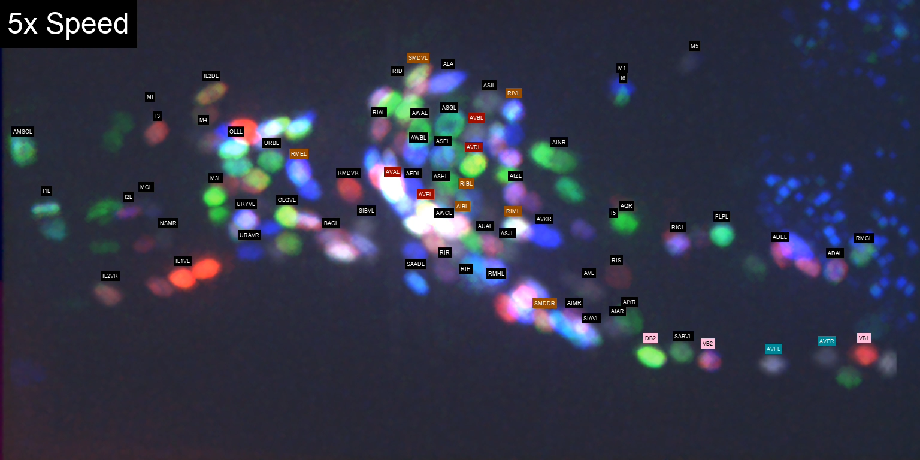
Whole brain neuronal activity monitoring under specific environmental cue - using GCaMP (activity sensor) and NeuroPAL (neuronal identity atlas)
Yemini et. al., 2021

Slide 17
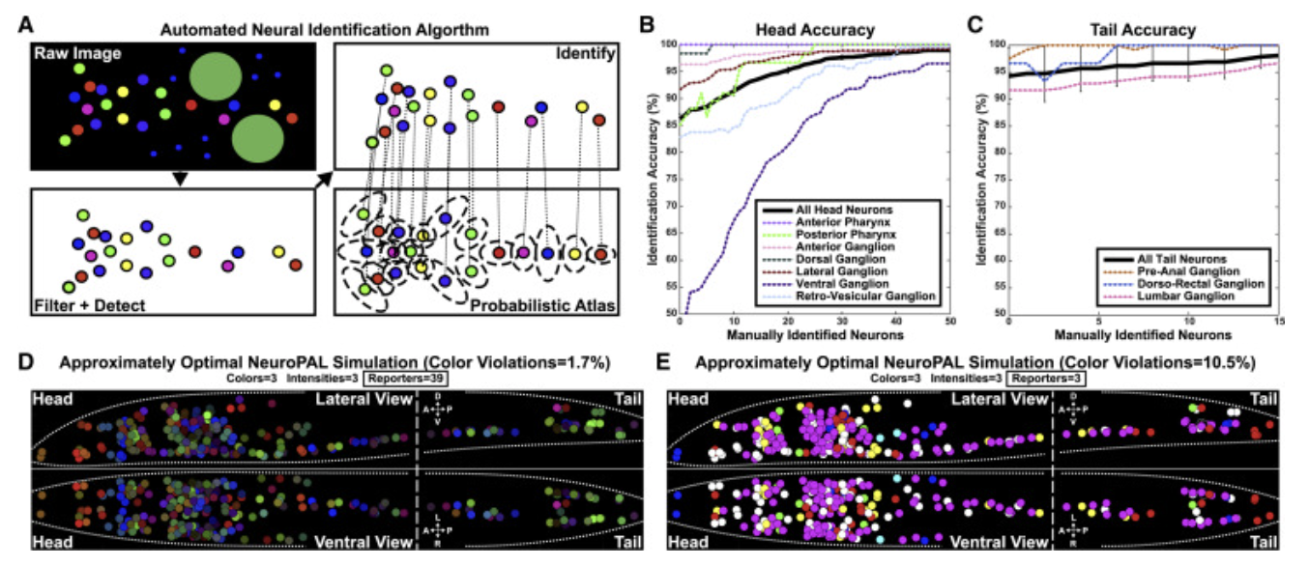
An Algorithm for Semi-automated Neuronal Identification
Yemini et. al., 2021

Slide 18
Whole brain neuronal activity monitoring under specific environmental cue - using GCaMP (activity sensor) and NeuroPAL (neuronal identity atlas)
Yemini et. al., 2021

Slide 19
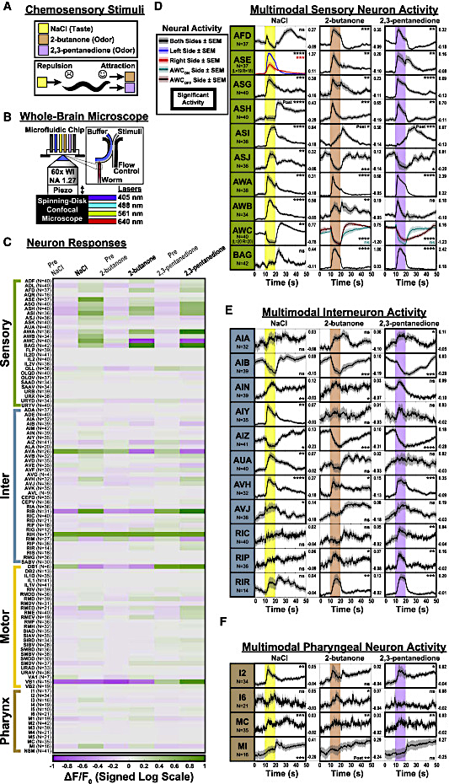
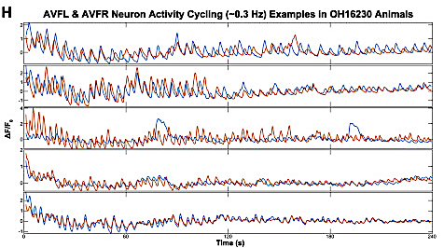
Functional mapping of the connectome
AVF left and right (blue and red)
The AVF interneurons, exhibit cyclical activity of ~0.3 Hz.
This cycle is similar to the freely-moving crawling frequency
Yemini et. al., 2021

Slide 20
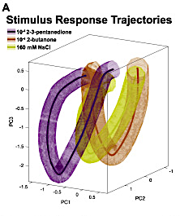
Brain dynamics are stimulus-specific
Stereotypic stimulus-specific neuronal correlations across individuals,
but each stimulus generated its own brain-wide correlation pattern.
Yemini et. al., 2021

Slide 21
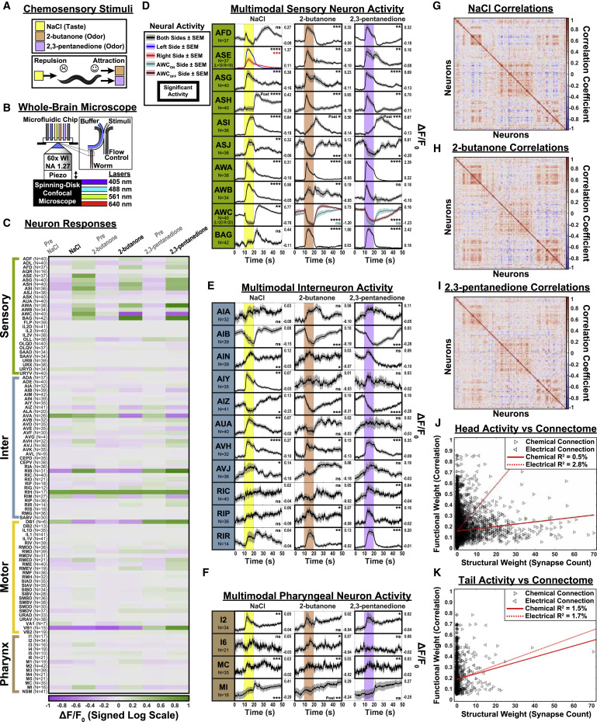
Comparison of functional activity to the connectome
Yemini et. al., 2021

Slide 22
Non-hardwired Connectome

Slide 23
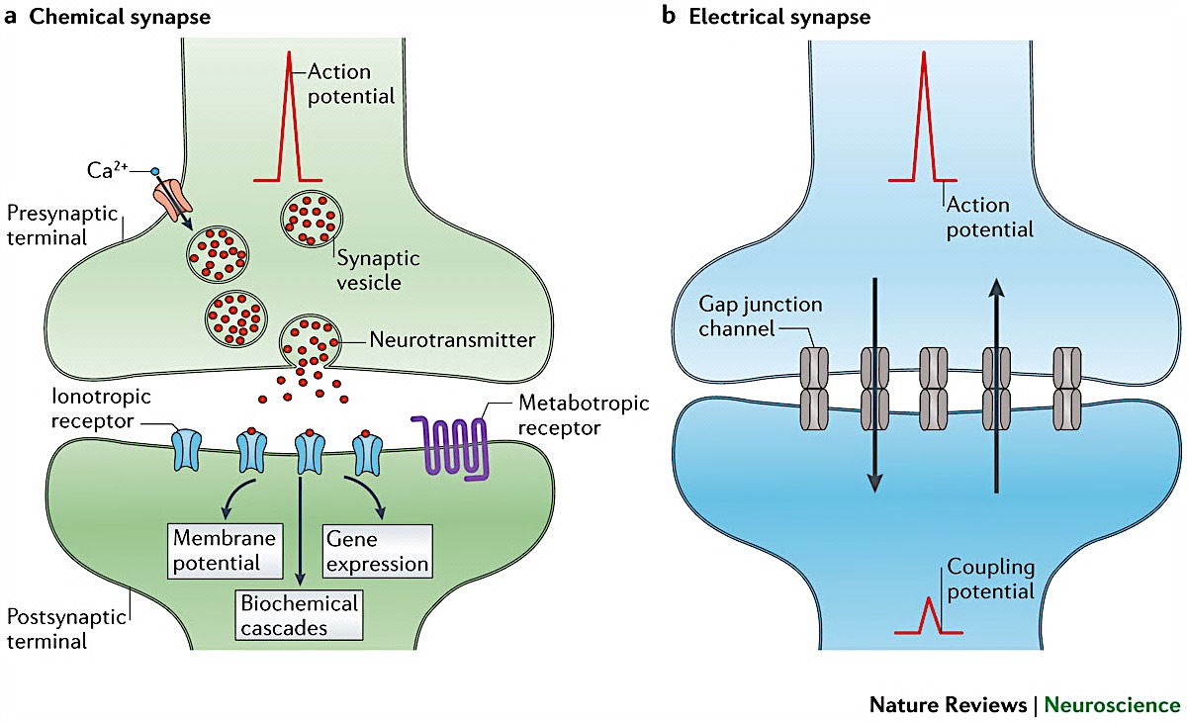
Different modes of connection
Chemical synapse Electrical synapse
Monoaminergic/ Neuropeptidergic synapse
.
.
.
.
.
.
.
.
.
.
.
.
.
.
.
.
.
.
.
.
.
.
.
.
.
.
.
.
.
.
.
.
.
.
.
.
.
.
.
.
.
.
.
.
Local or long-range diffusion
.
.
.
.
Pereda A. E.; 2014;

Slide 24
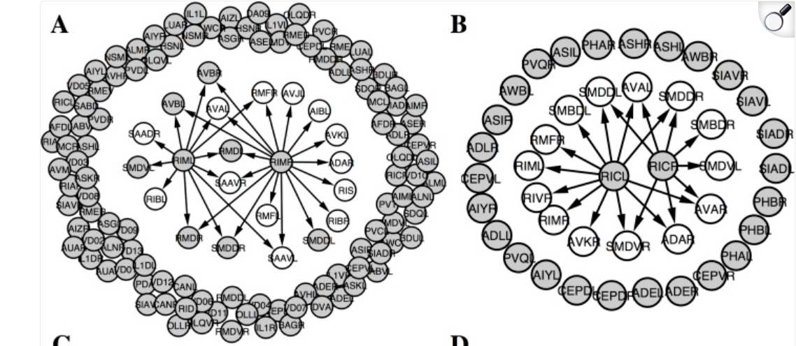
Receptor expression patterns suggested high fraction of
monoamine signaling to be extra-synaptic
Tyramine
Octopamine
Arrows = Outgoing hardwired synaptic edges
Monoamine receptor expressing neurons (Grey)
Bentley et. al., 2016

Slide 25
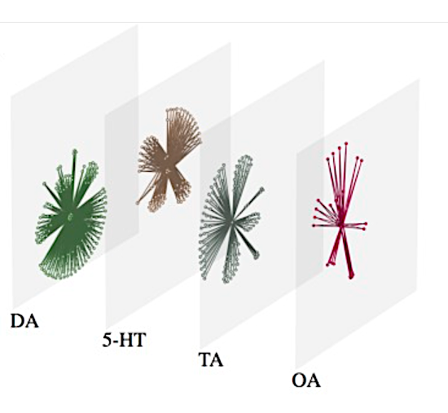
Topology of Monoamine networks
18 of the 302 neurons release monoamines, while 251 neurons (83%) express one or more monoamine receptors
Bentley et. al., 2016

Slide 26
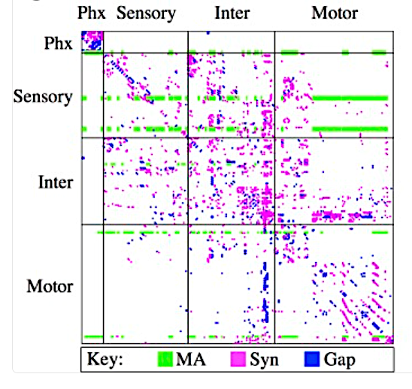
Hardwired and mono-amine signaling do not completely overlap
Serotonin
Dopamine
Tyramine
Octopamine
Bentley et. al., 2016

Slide 27
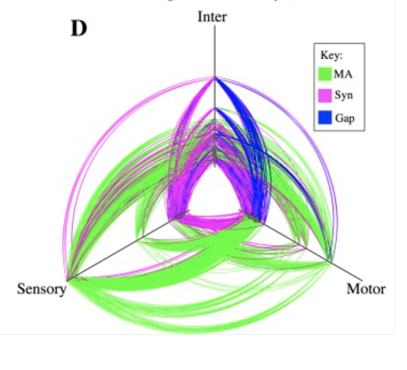
Monoamine networks: few hubs with high interconnectedness
Hubs are located further out along the axes
Provides direct connection between sensory to motor neurons
Bentley et. al., 2016

Slide 28
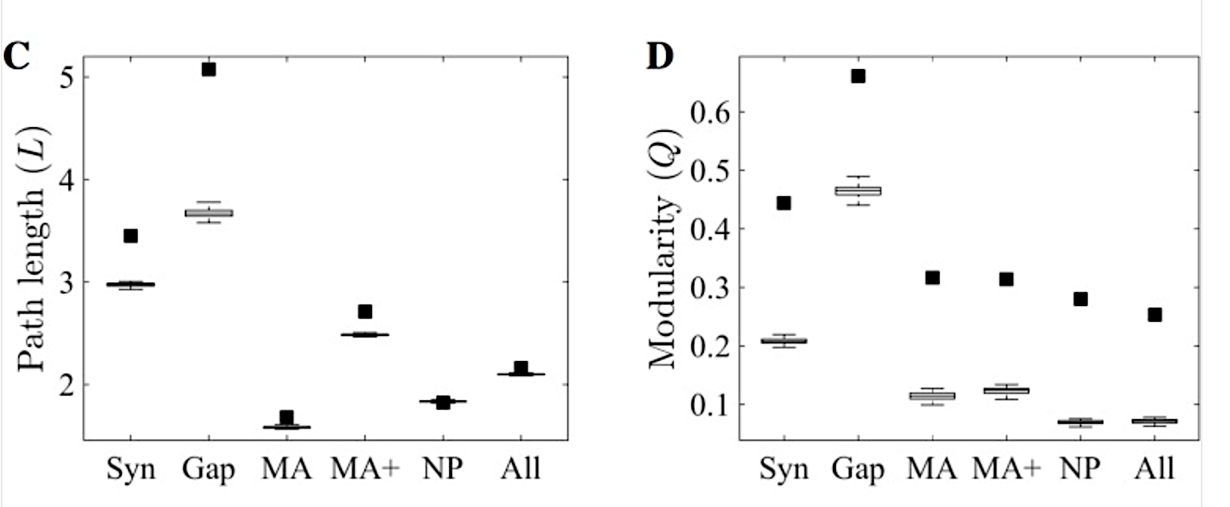
Monoamines provide efficient global connections linking disparate parts of the network
Bentley et. al., 2016

Slide 29
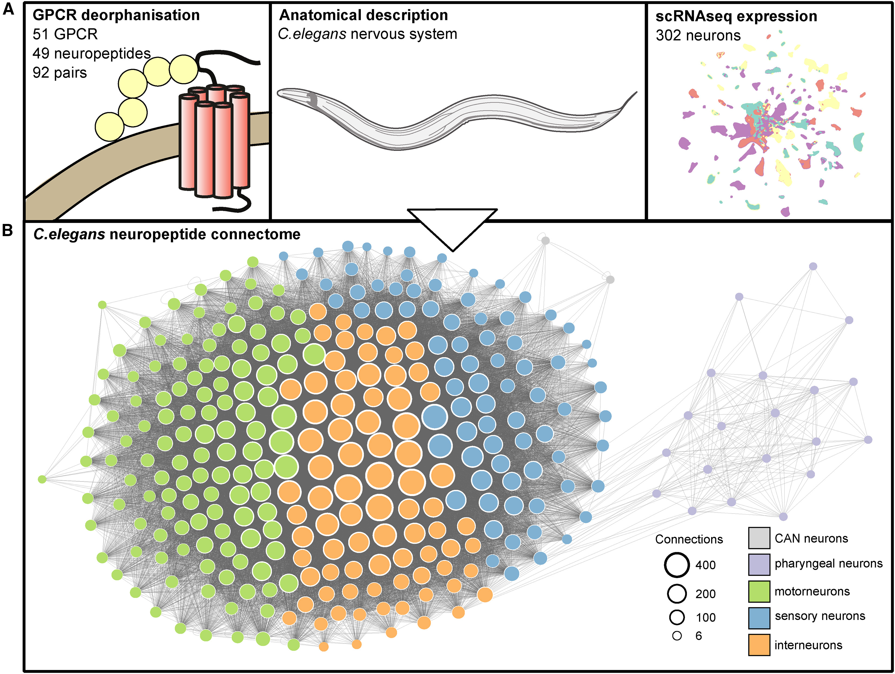
Neuropeptide signaling forms a dense and decentralized wireless network, connecting disconnected neural circuits
55,384 potential neuropeptide-receptor interactions
461 neuropeptide-receptor pairs showed meaningful activation
Beets et. al., 2023
All neurons form a single connected network
Ripoll-Sanchez et. al., 2023

Slide 30
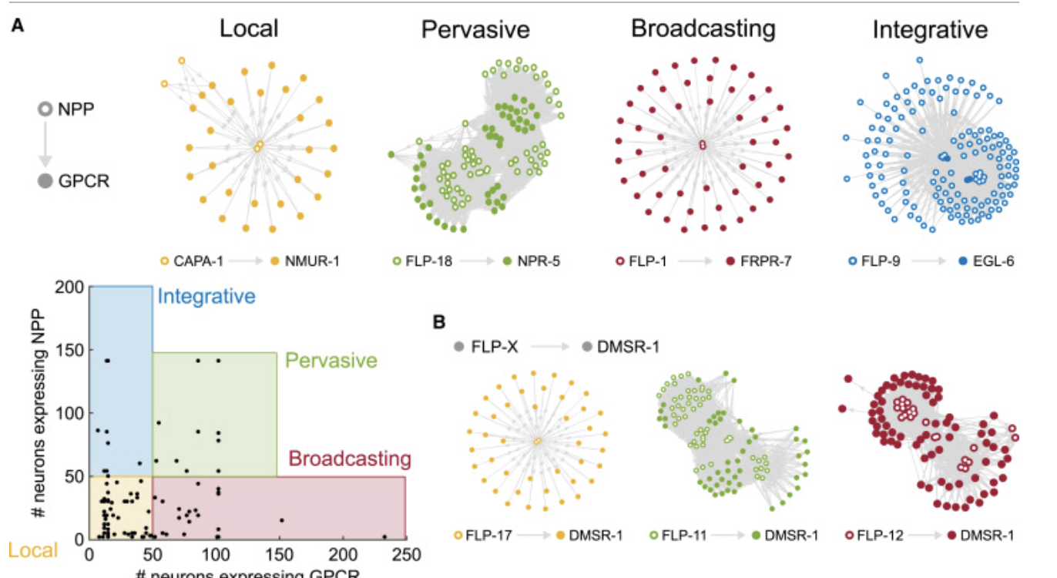
Diverse topologies of neuropeptide networks
Versatile peptides: Peptides activating more than one receptor
Promiscuous receptors: Receptors activated by multiple peptides
Ripoll-Sanchez et. al., 2023

Slide 31
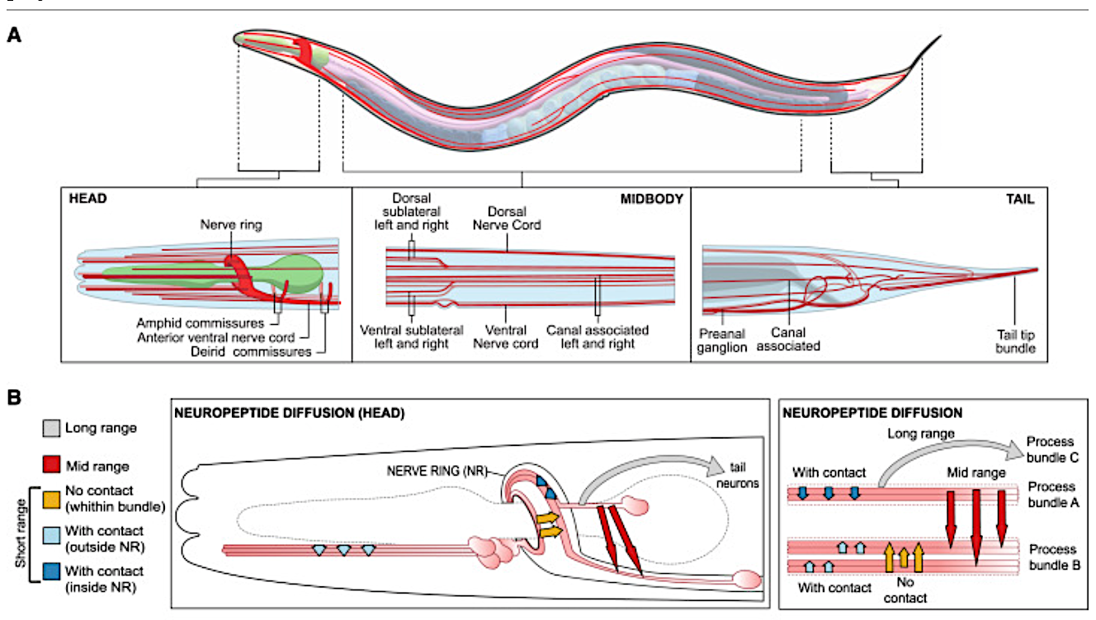
How far is too far: Long-range vs mid-range vs short-range

Slide 32
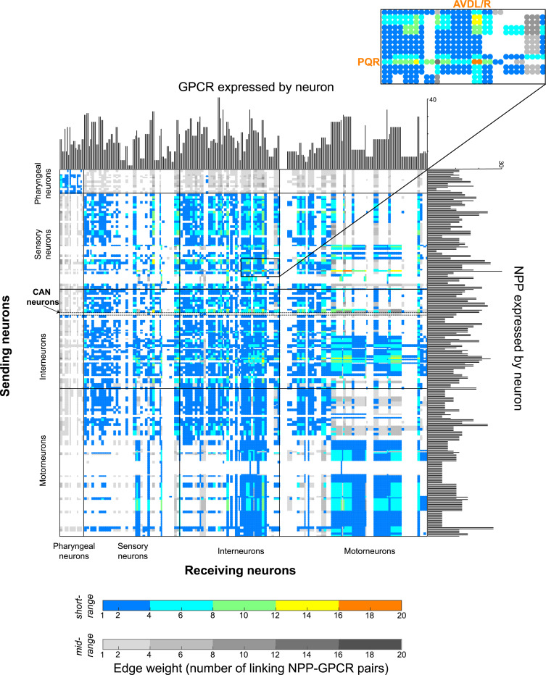
The aggregate neuropeptide connectome connects all neurons in a dense network
Ripoll-Sanchez et. al., 2023

