Slide 1
Oscillations in the Brain:
The role of Excitation and Inhibition
Brain Dynamics and Computation
at
The Institute of Mathematical Sciences, Chennai
Anuran Pal
24.05.25

Slide 2
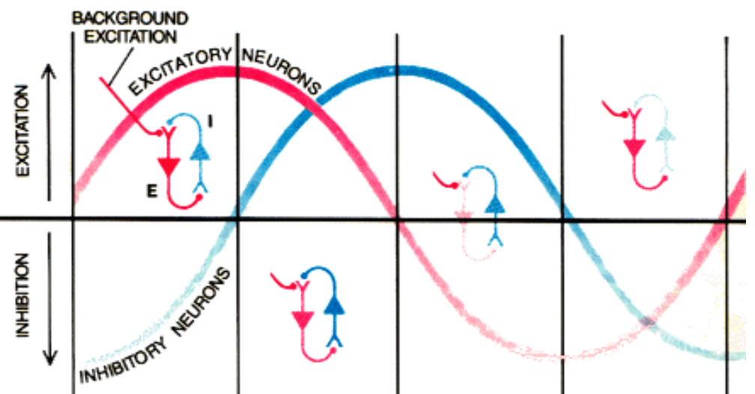
Contents
Neuron as a RC switch
Coupling an excitatory and inhibitory neuron
Pool of excitatory and inhibitory neurons
Relaxing the constraints
Freeman, Walter (1991) Sci Am
Tools
Phase plane technique
Linear stability analysis
Mean field approach

Slide 3
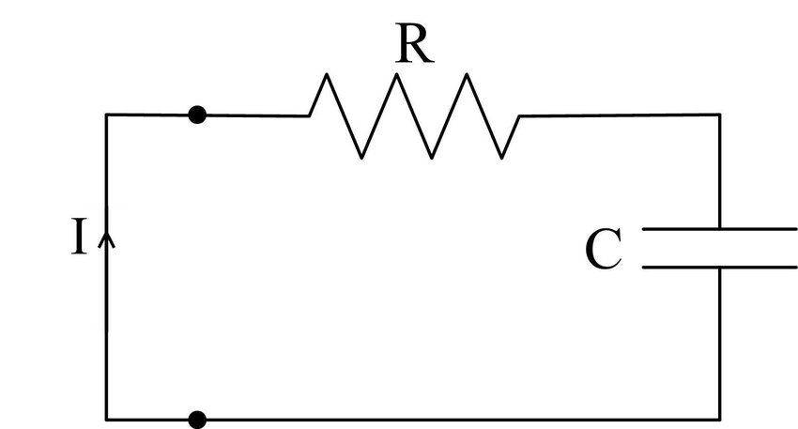
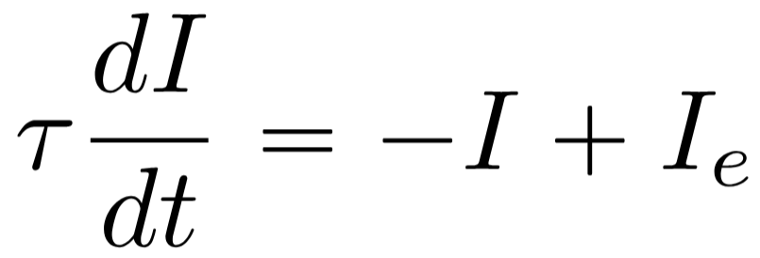
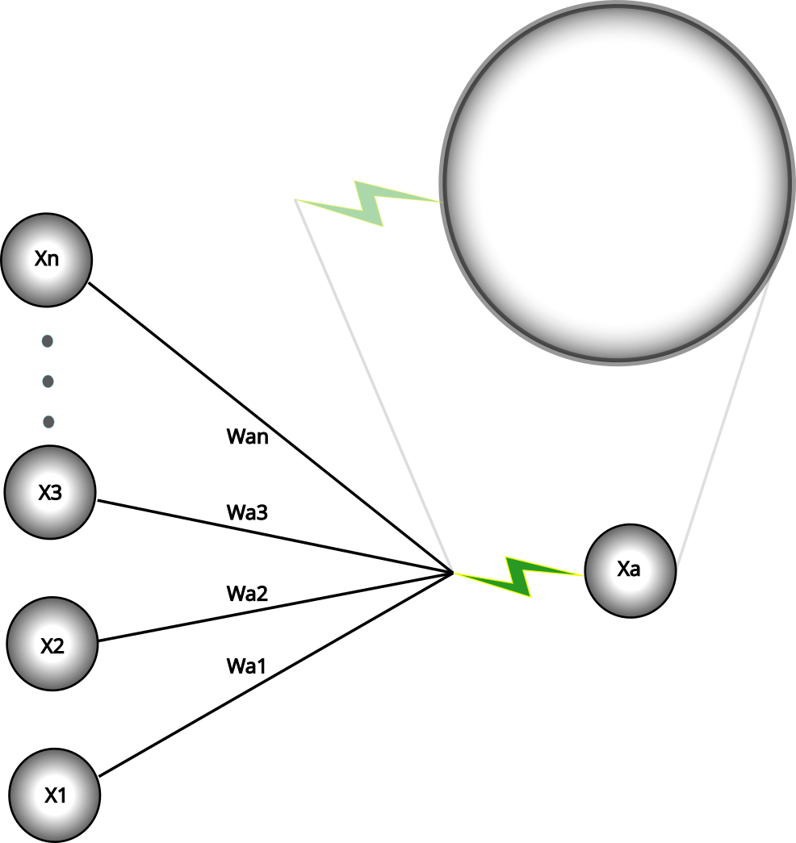
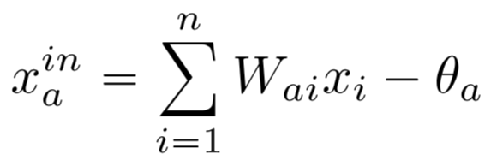
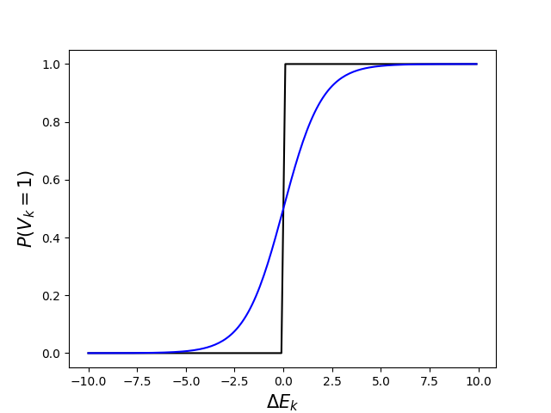
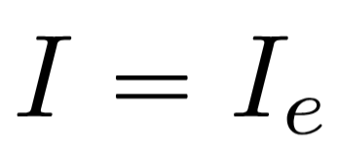
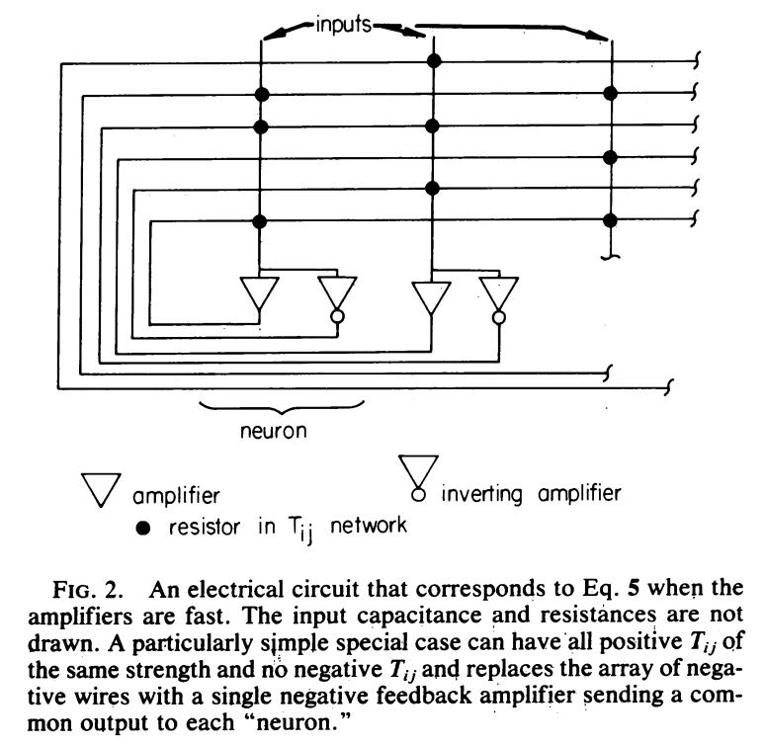
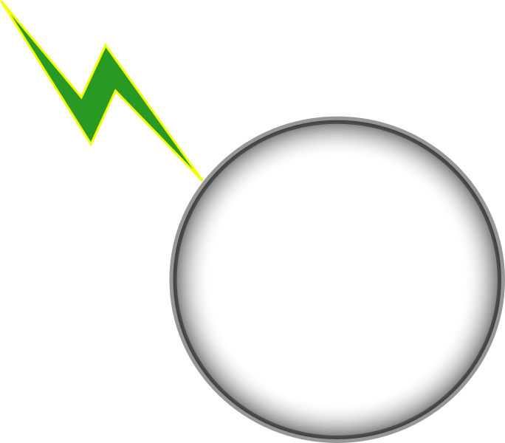
Neuron as an RC circuit
With an external current
steady state
Neuron receiving an input
steady state
At low temperature the probability of activation is either 0 or 1
Hopfield (PNAS) 1984

Slide 4
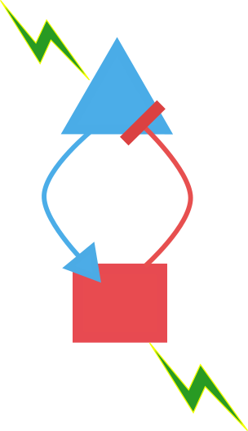
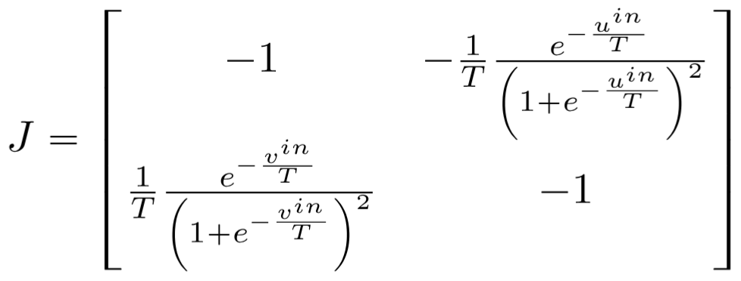
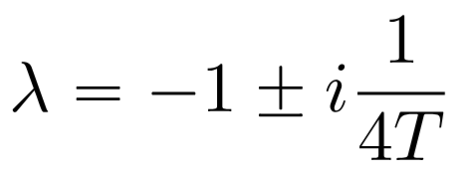
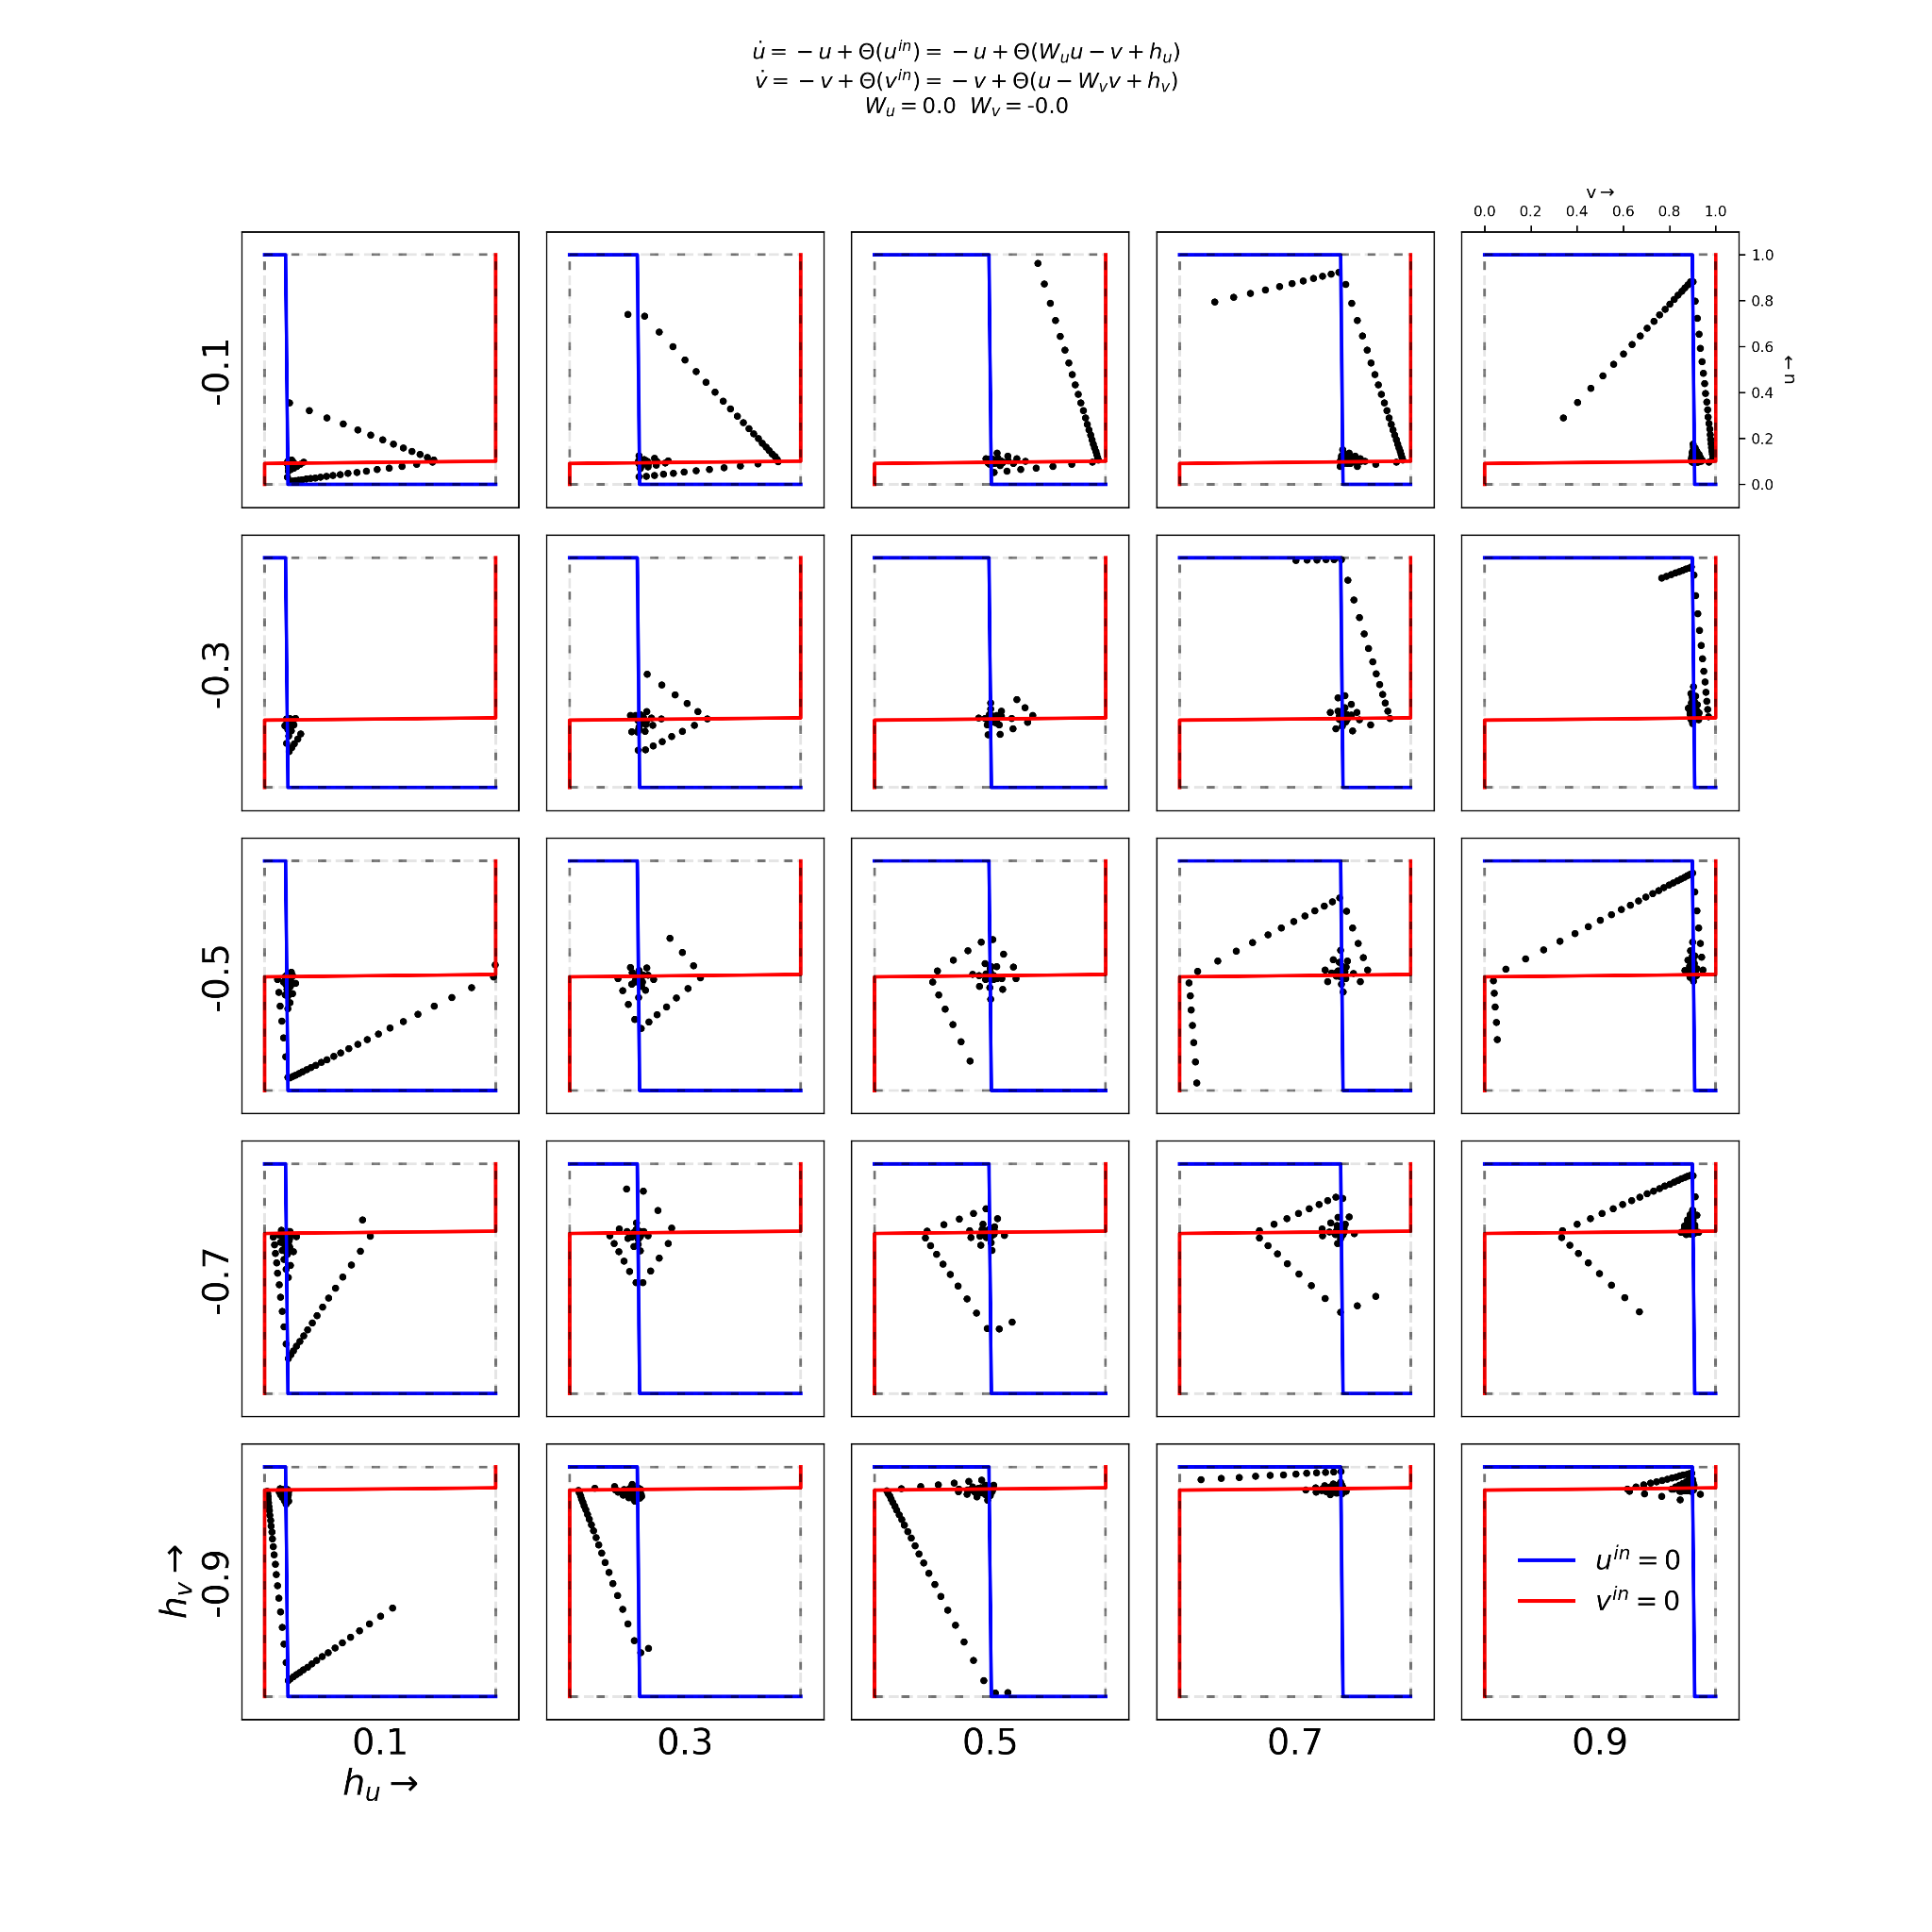
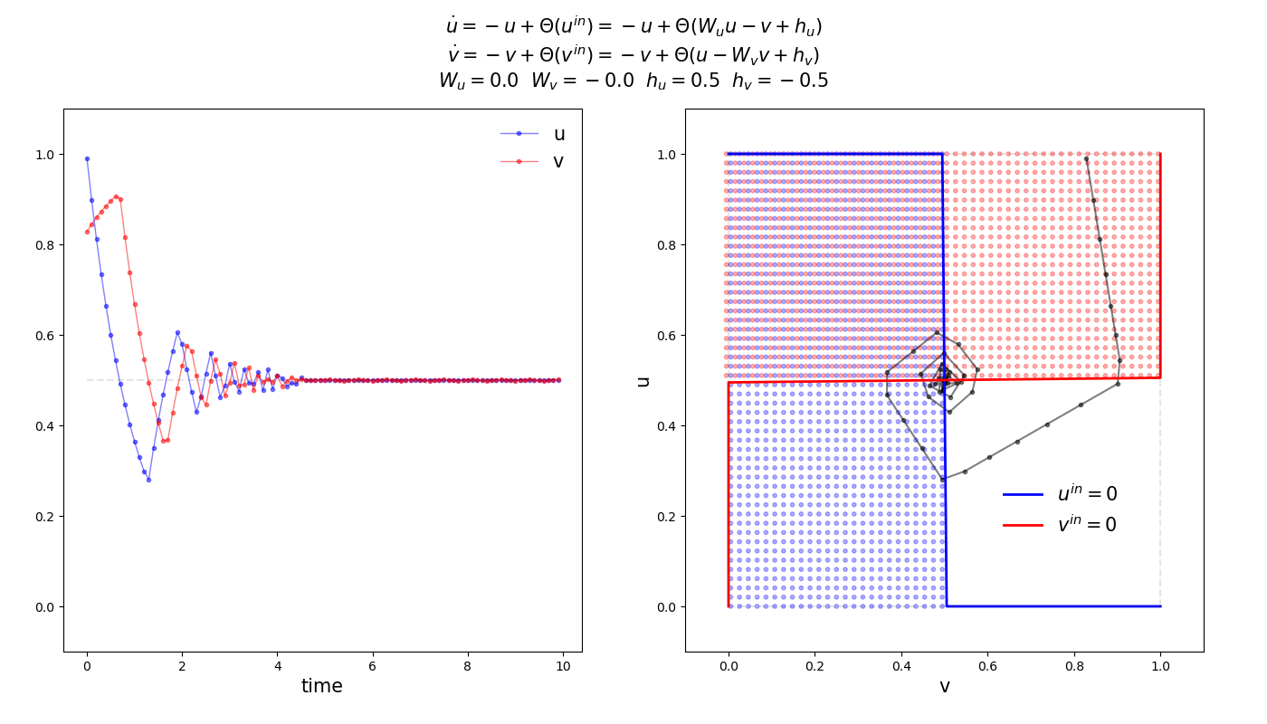
Minimal excitatory-inhibitory single neuron coupling
Linear stability analysis
steady state

Slide 5
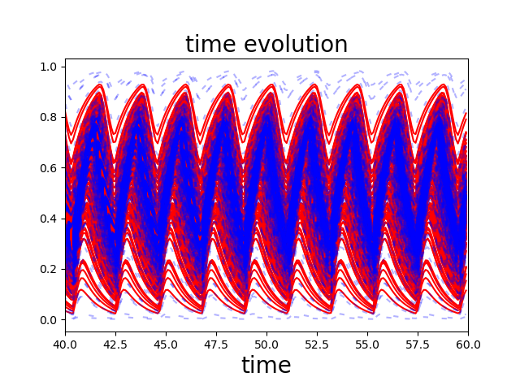
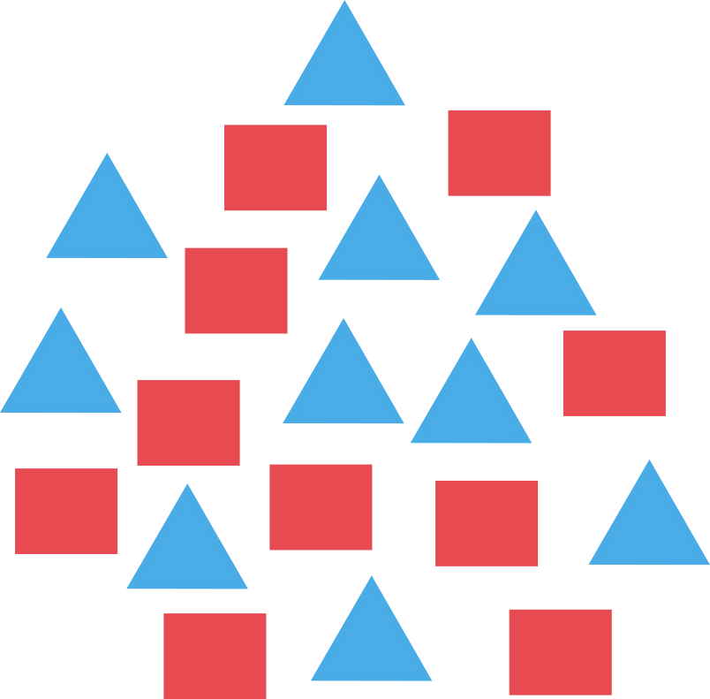
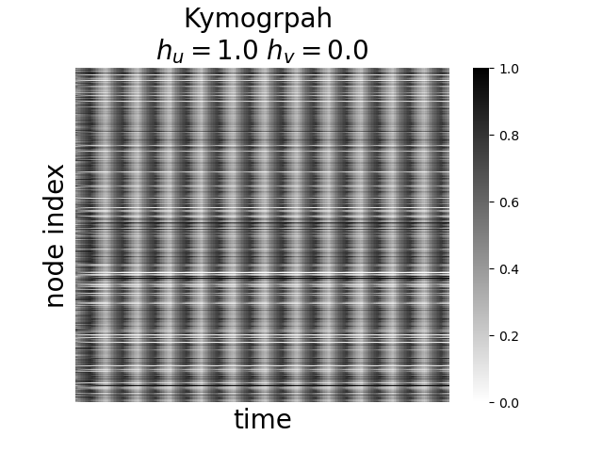
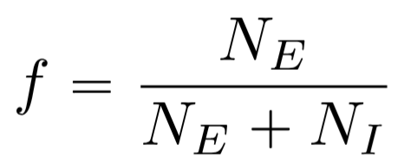
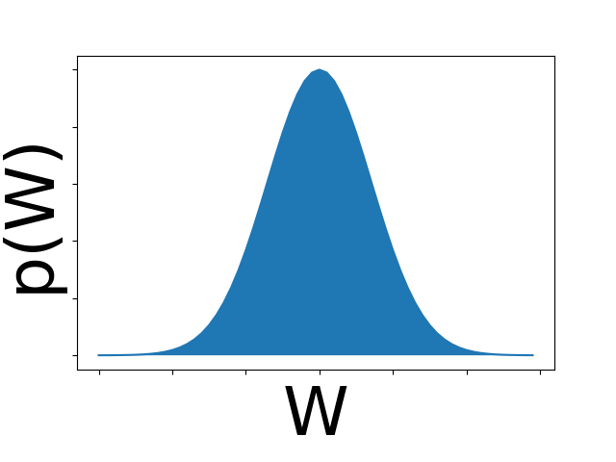
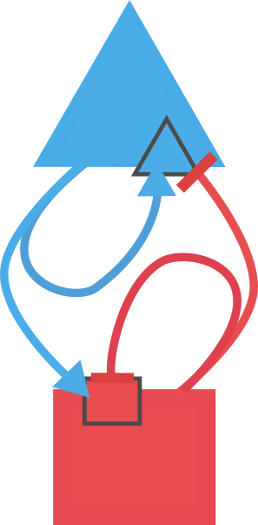
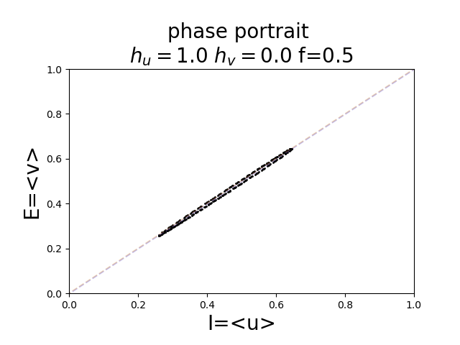
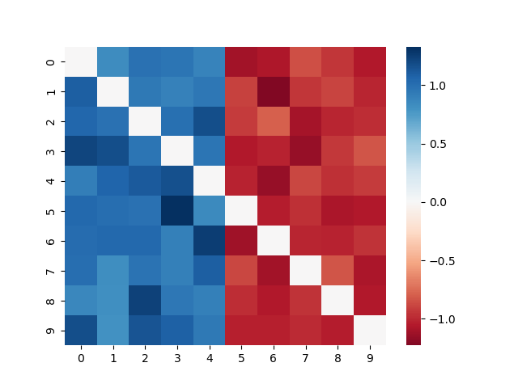
Pool of excitatory and inhibitory neurons
u is the average activity of the excitatory units
similarly,
In the mean field limit the input is the same for both excitatory and inhibitory node

Slide 6
Recap - mean field analysis of the Lenz model
Lenz spin system
Single spin Boltzmann distribution
Replacing the pair interaction by interaction with the mean activity
Average magnetization of a single spin should be same as the system’s magnetization
m is the system magnetization
Energy corresponding to a single spin
which leads to the consistency equation
Spins interact with the system’s mean magnetization

Slide 7
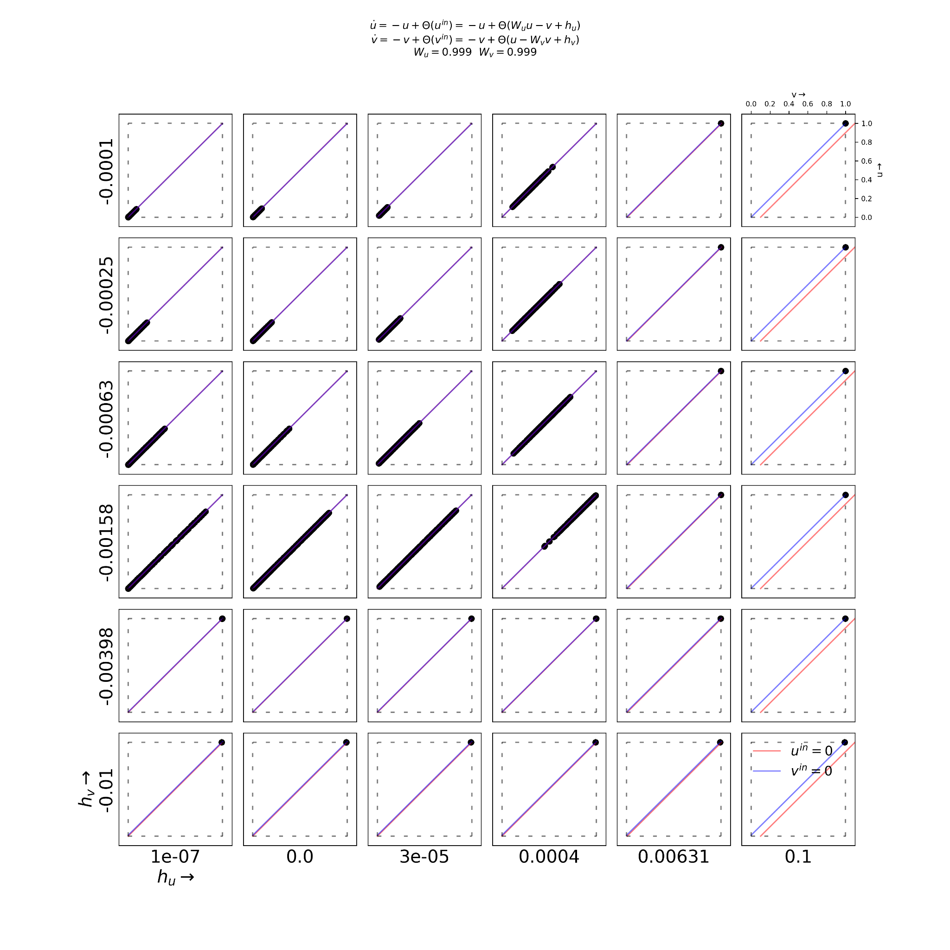
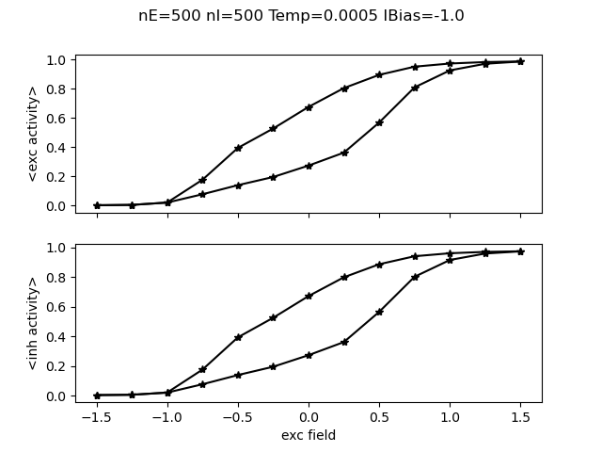
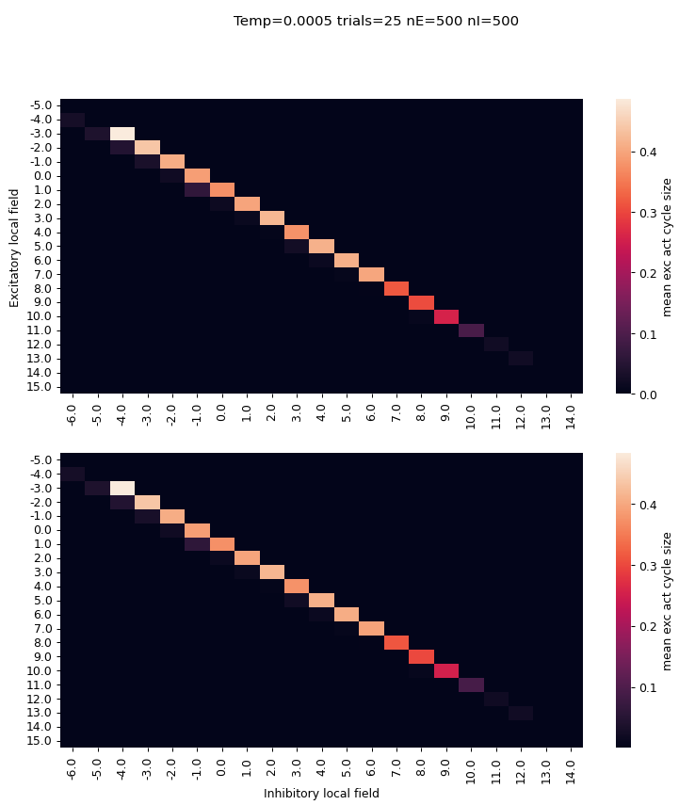
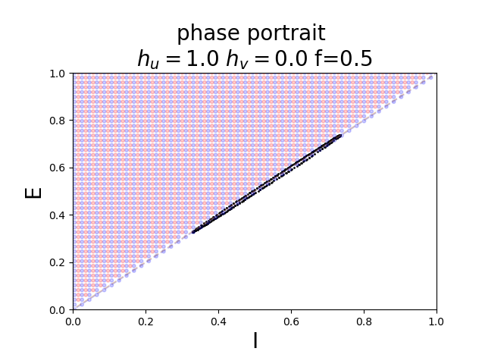
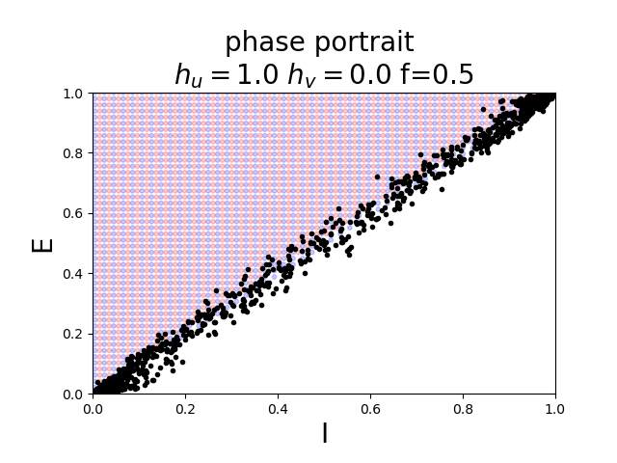
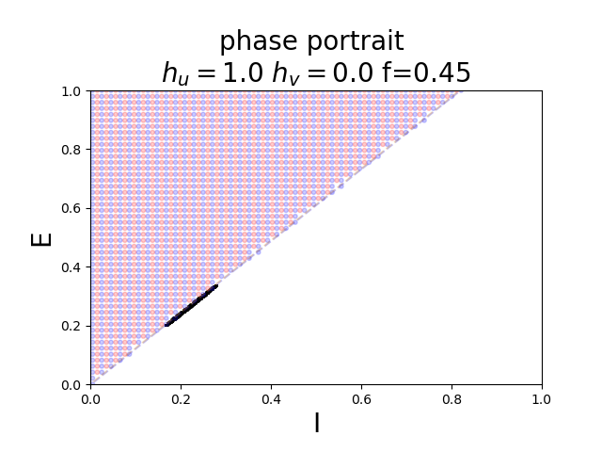
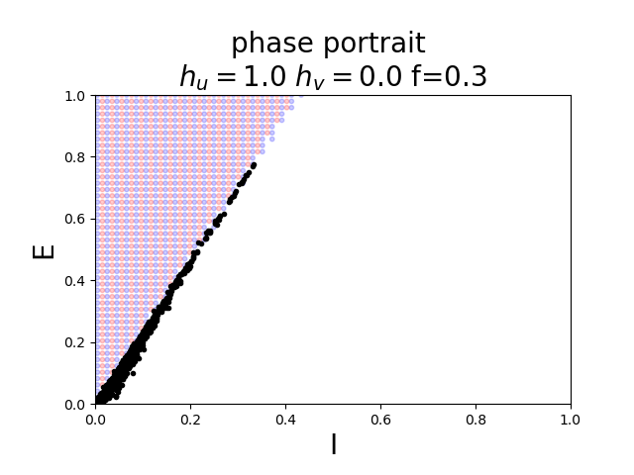
Consistency equation of our model
consistency equation
Continuous dynamics
Stochastic dynamics
An energy function cannot be written for a system with asymmetric connections
A difference in bias of the O(1/N) allows for oscillatory behavior

Slide 8
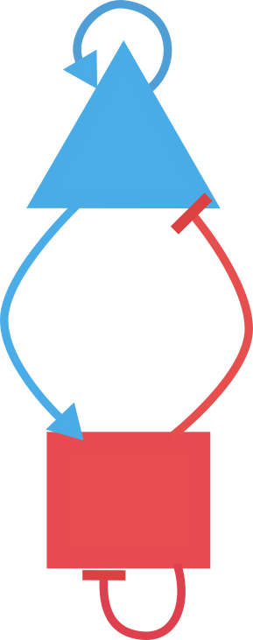
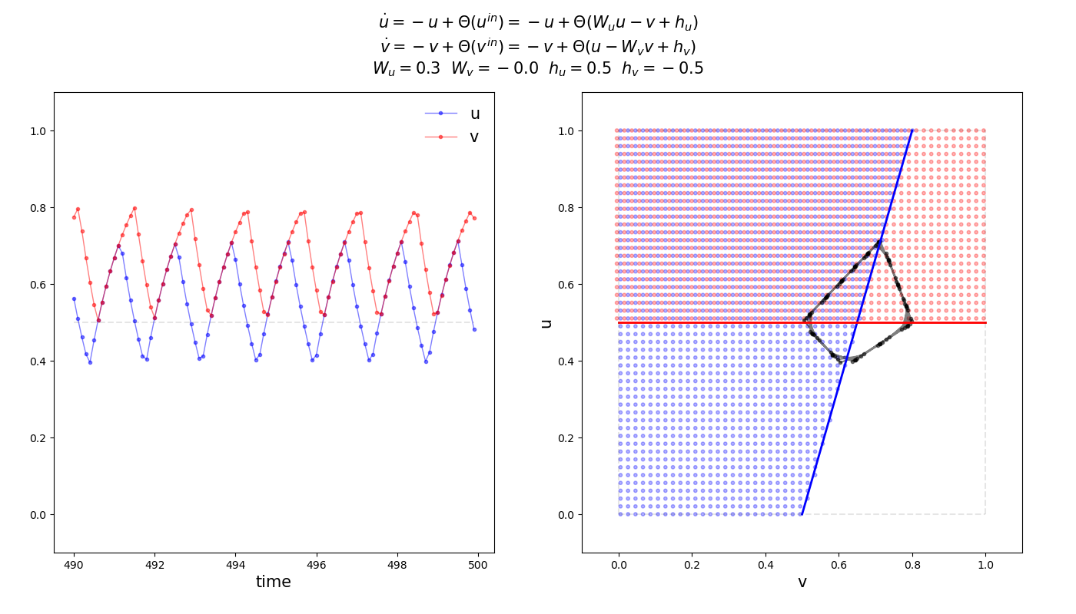
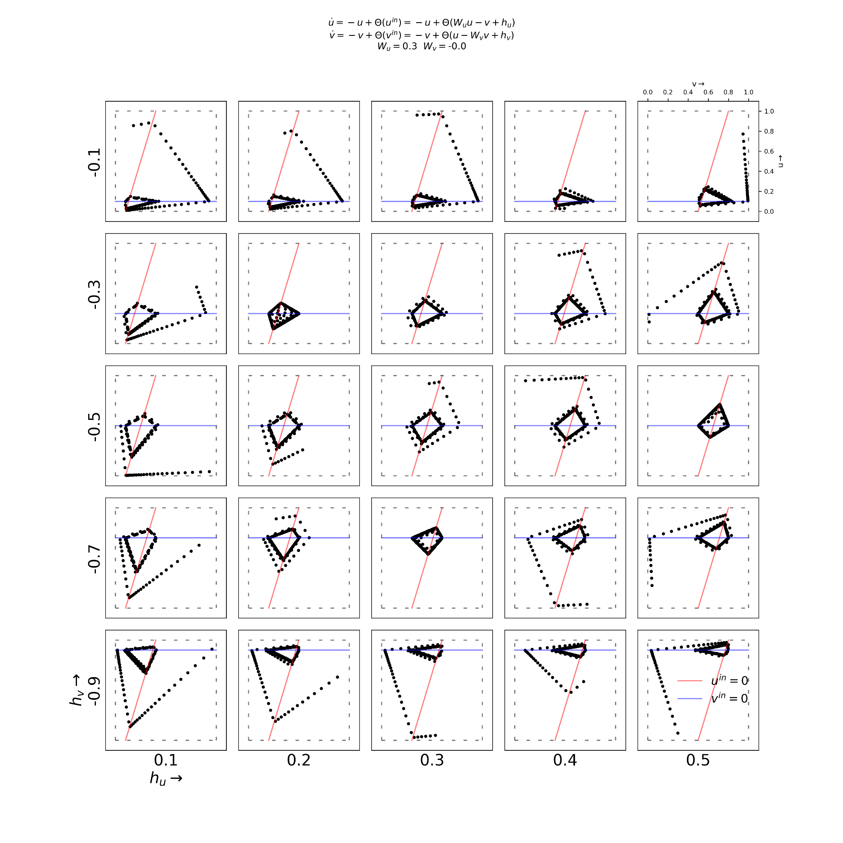
Excitatory-inhibitory neural mass
steady state

Slide 9
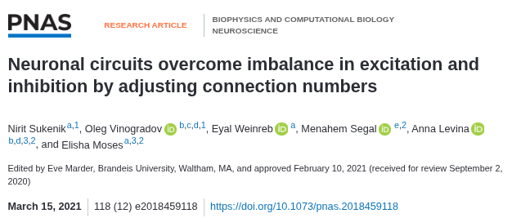
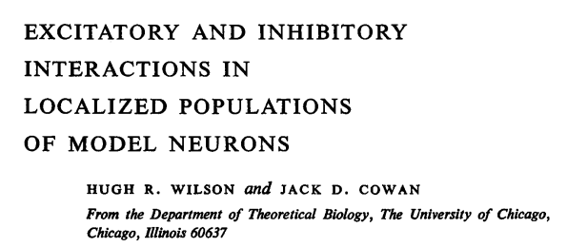
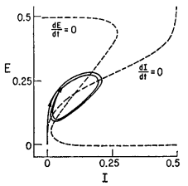
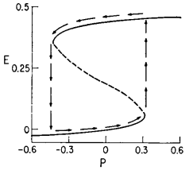
Excitation and Inhibition in the literature
Balance of excitation and inhibition in cultured hippocampal networks - experiment and model
Information theoretic approach to understand excitation inhibition balance
Cortical column of pyramidal neurons receiving inhibitory and excitatory feedback from local interneurons
THANK YOU

