Slide 1
How Natural are Artificial Neural Networks?
(Part 1)
Brain Dynamics and Computation
at
The Institute of Mathematical Sciences, Chennai
Anuran Pal
22.05.25

Slide 2
Contents
Switch as the Unit of Brain
Linear Perceptrons and the XOR Problem
Multilayer Perceptrons and Backpropagation
Convolution Neural Networks - a success story
Or is it?

Slide 3
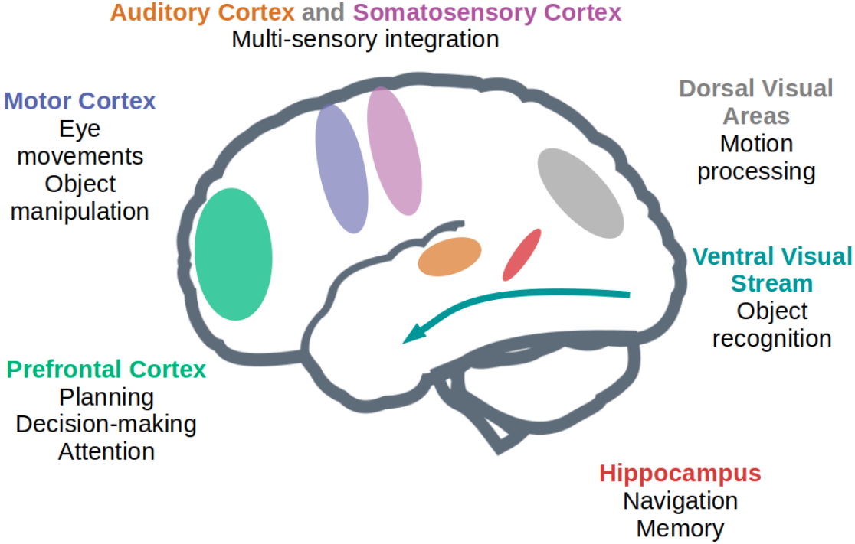
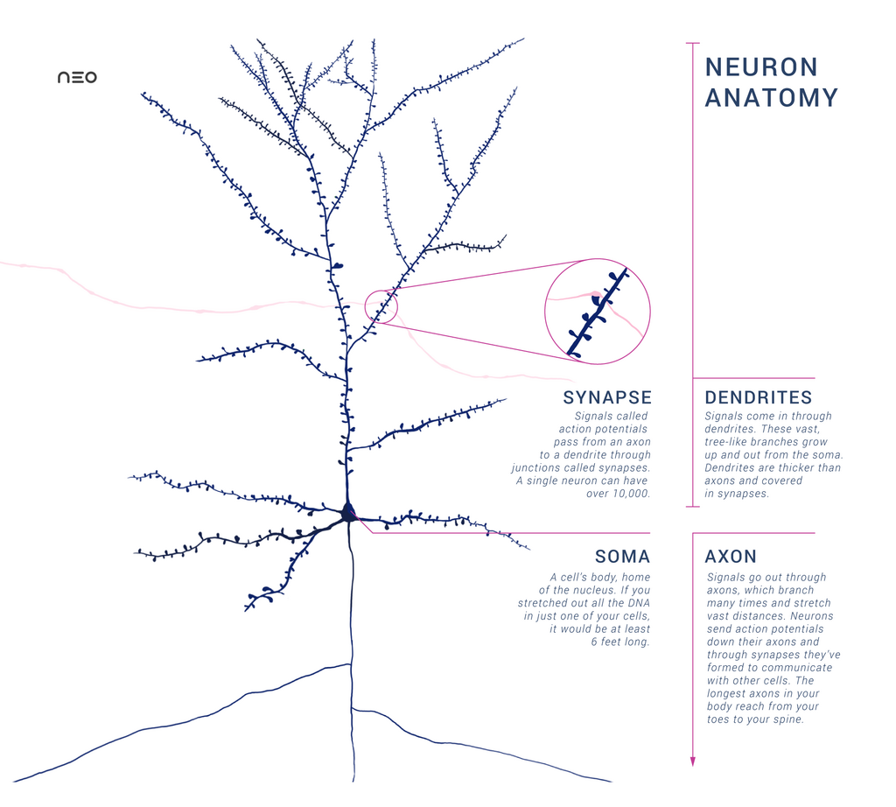
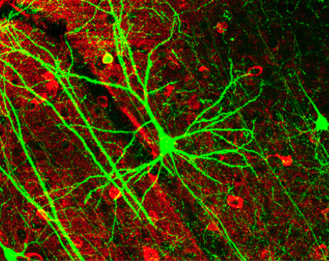
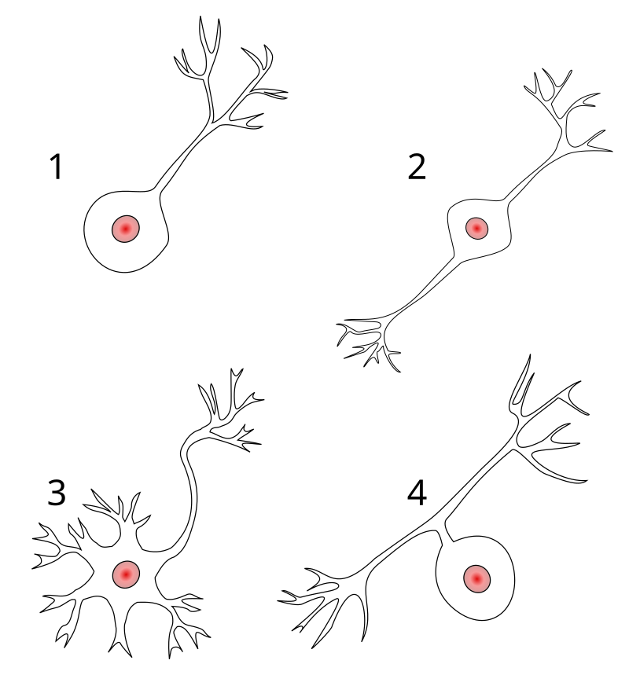
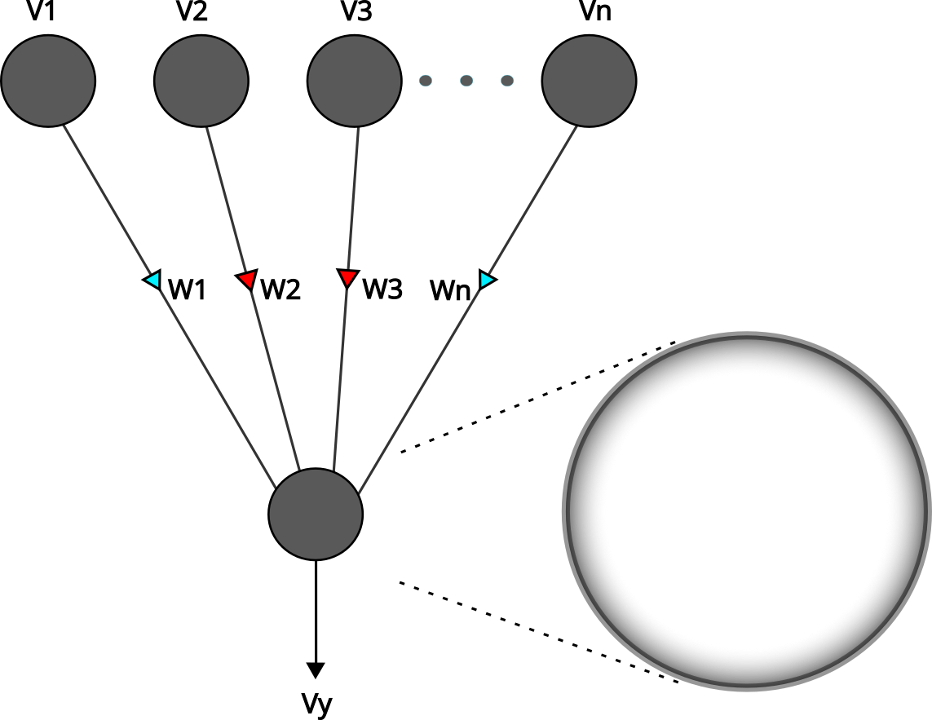
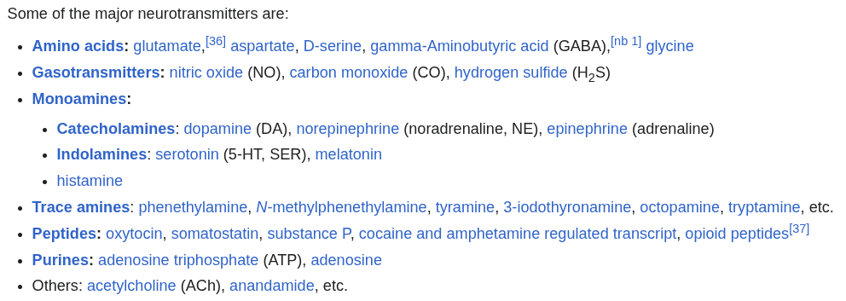
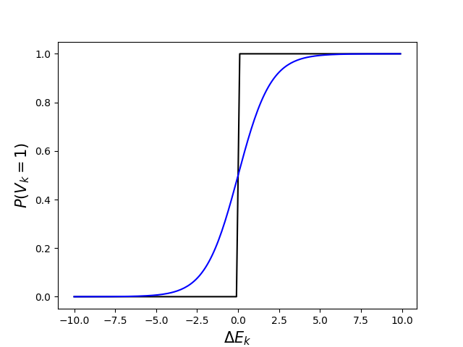
The Complexity of the Brain
https://arxiv.org/pdf/2001.07092
Many uses of visual information by the brain
Wikipedia
Approximating neuron as a switch
GABAergic neurotransmitter: GABA, Glycine
Glutamatergic neurotransmitter: Glutamate, Epinephrine, Norepinephrine
Neuromodulators: Acetylcholine, Dopamine

Slide 4
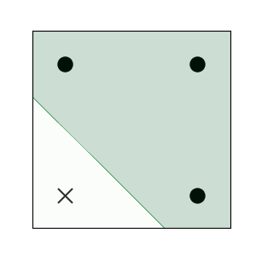
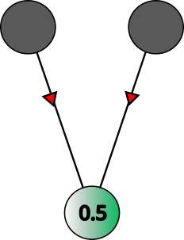
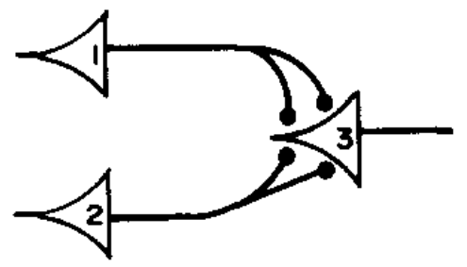
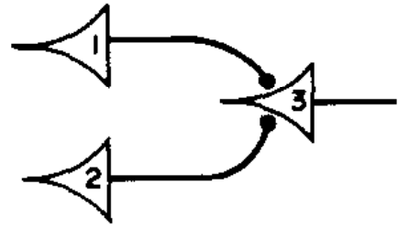
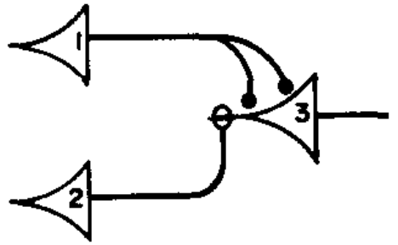
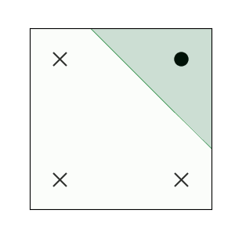
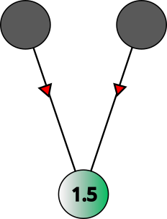
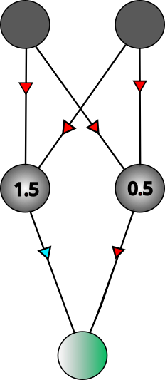
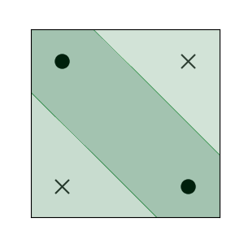
Linear Perceptrons
x | y | x∨y
0 | 0 | 0
0 | 1 | 1
1 | 0 | 1
1 | 1 | 1
(0,1)
(1,1)
Logical calculus for nervous activity
AND
McCulloch & Pitts (1943) Bull. Math. Biol.
(0,0)
(1,0)
x | y | x∧y
0 | 0 | 0
0 | 1 | 0
1 | 0 | 0
1 | 1 | 1
(0,1)
(1,1)
The XOR problem
hidden units provide multiple decision boundaries
OR
x | y | x⊕y
0 | 0 | 0
0 | 1 | 1
1 | 0 | 1
1 | 1 | 0
(0,1)
(1,1)
(0,0)
(1,0)
AND
OR
Multilayer feedforward networks with as few as one hidden layer are universal approximators
(0,0)
(1,0)
Hornik, Kurt (Neural Networks) 1989

Slide 5
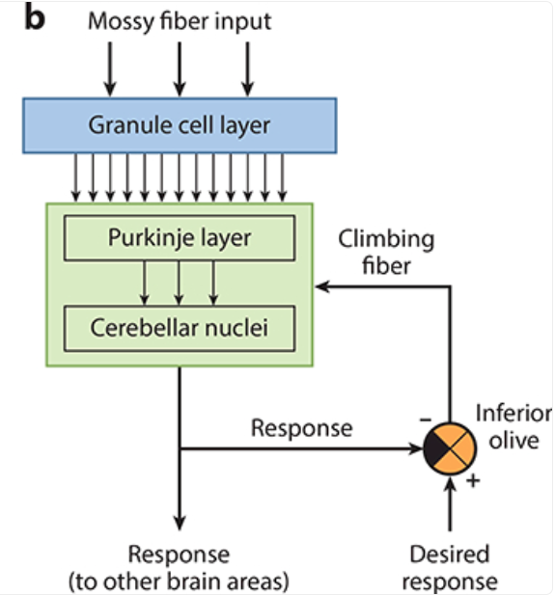
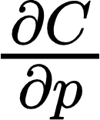
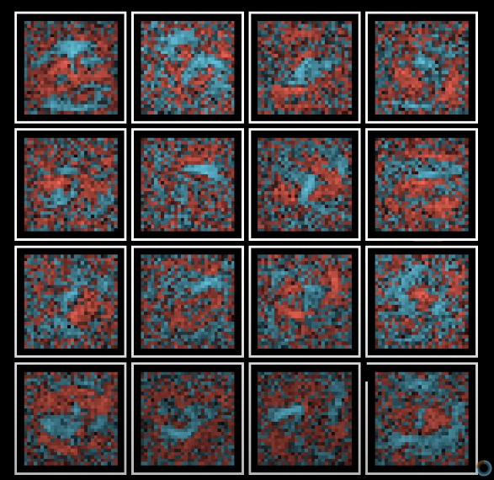
Multilayer Perceptrons
and Learning by Backpropagation
Gradient Descent
………
.
.
………
.
.
.
.
Cost(C)
Raymond and Medina (2018) Ann Rev Neurosci
.
.
C
…
…
C - learning signal which captures the discrepancy between predicted and true output
Parameter(p)
Image: Youtube 3Blue1Brown
Forward propagation - Predicting
Backpropagation - Supervised Learning
GD using chain rule
Assumption of a normally distributed data gives the MSE cost function
Entropy maximization gives the cross-entropy loss function
Receptive field using backpropagation
GD of layer L weights
Rumelhart et. al. (Nature) 1986
GD of layer L-1 weights
Backpropagation requires upstream flow of downstream connection information

Slide 6
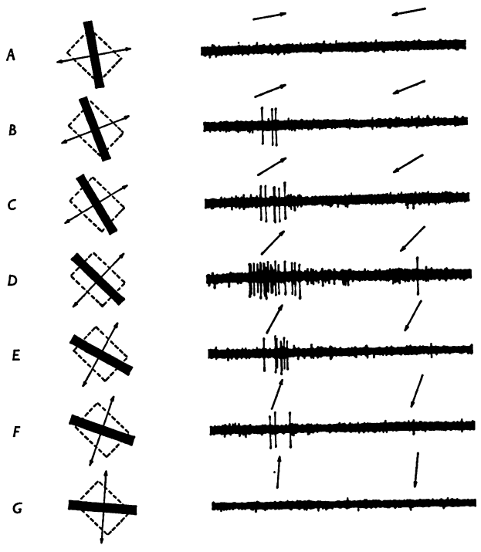
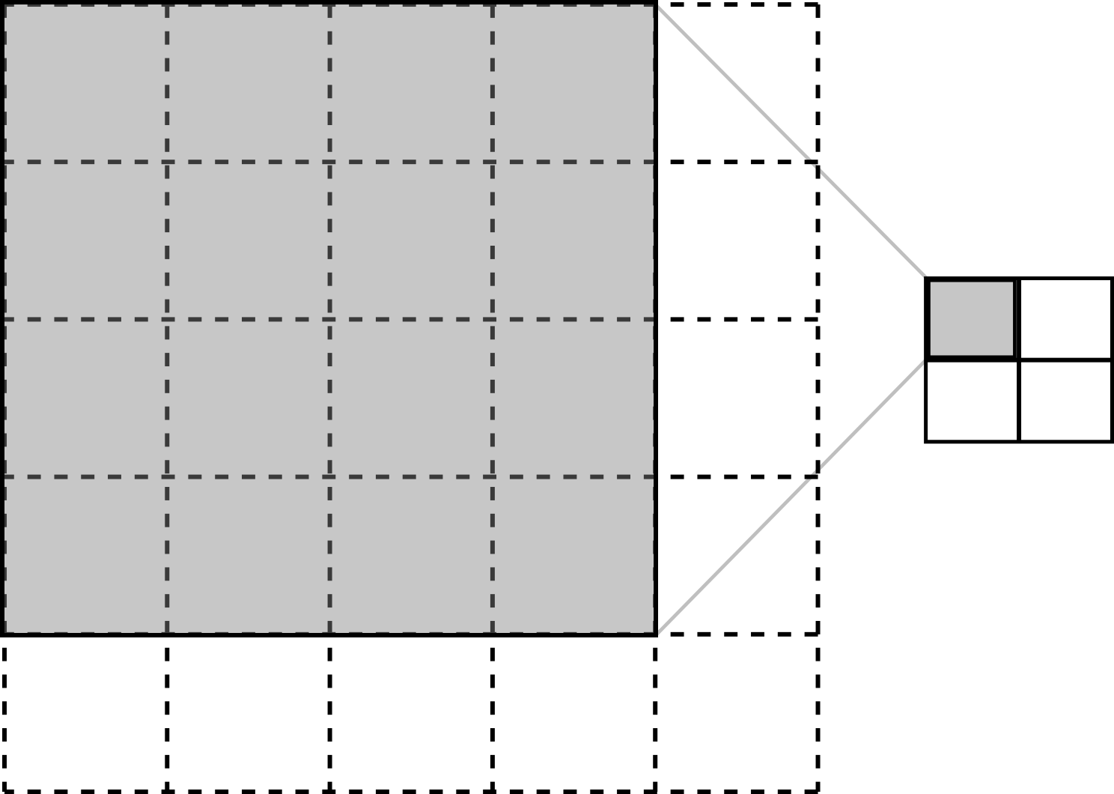
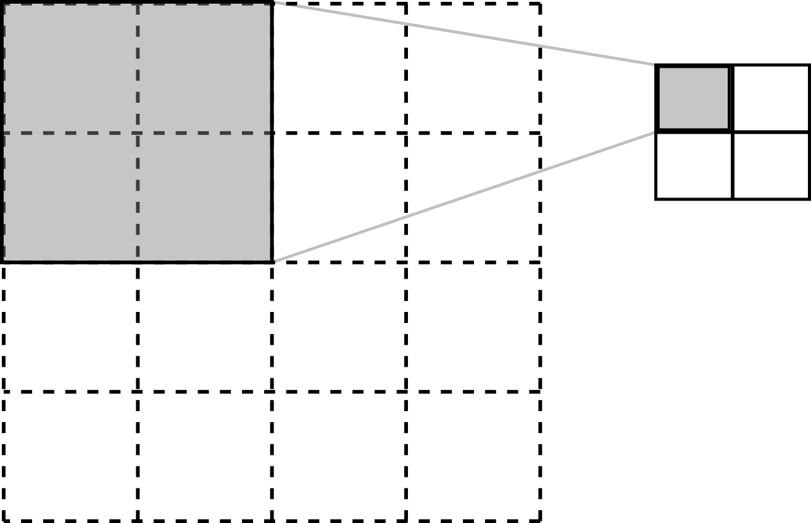
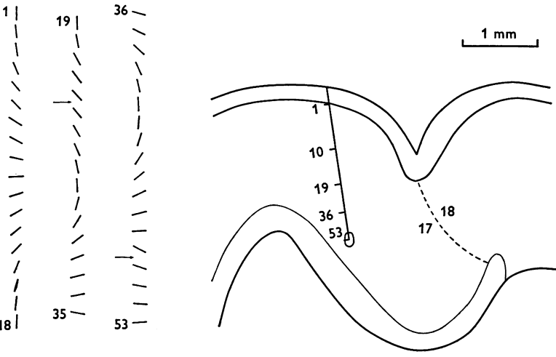
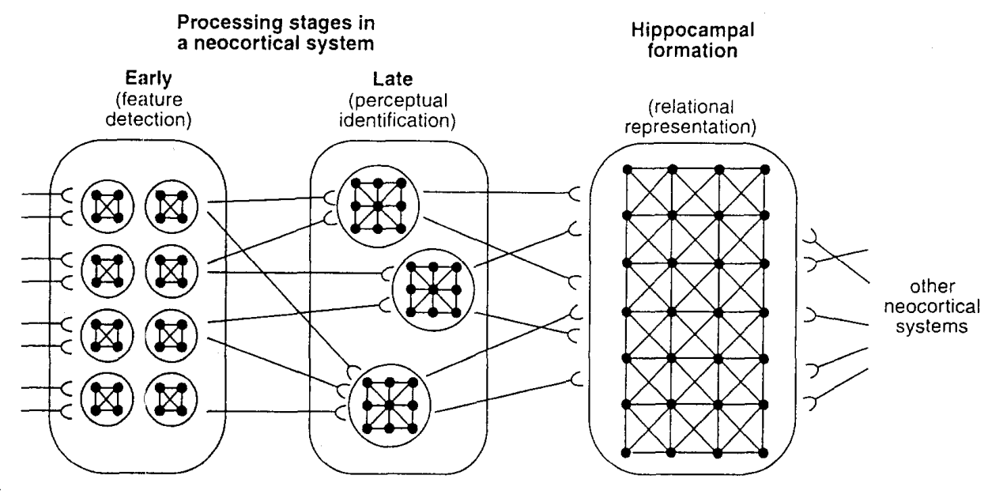
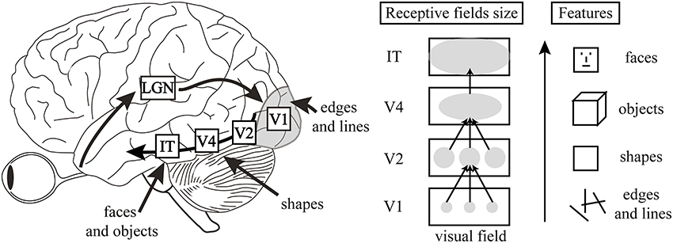
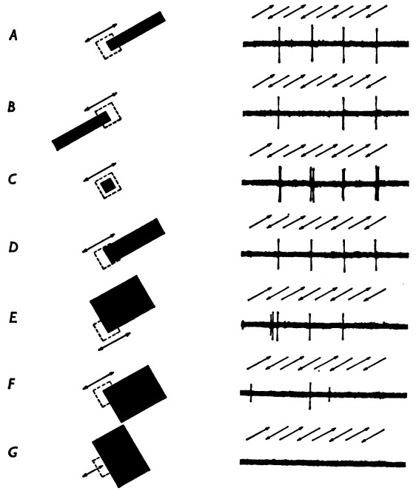
Convolutional Neural Networks
Cost
LeCun et. al. (Proc. IEEE) 1998
Number of feature maps is increased as the spatial resolution is decreased
resulting in shift invariance
Hubel and Wiesel (J. Physiol) 1968
Neocognitron : Kunihiko Fukushima
Biol. Cybernetics 36, 193 202 (1980)
Sx
Units in a layer are organized in planes within which all the units share the same set of weights
Cx
Assumption of a normally distributed data gives rise to MSE cost function
Entropy maximization gives the cross-entropy loss function
https://distill.pub/2017/feature-visualization/
https://gracewlindsay.com/2018/05/17/deep-convolutional-neural-networks-as-models-of-the-visual-system-qa/

Slide 7
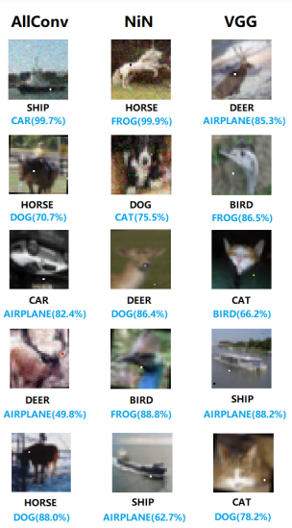
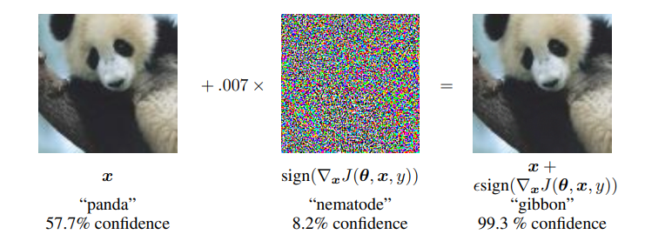
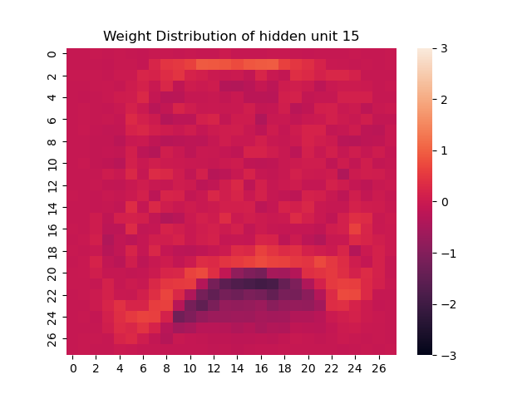
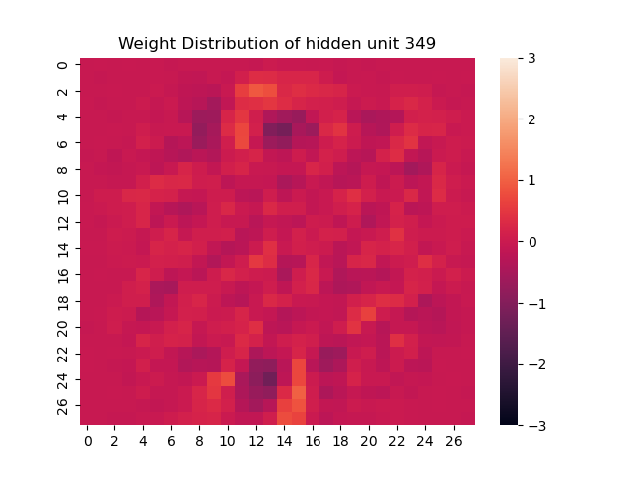
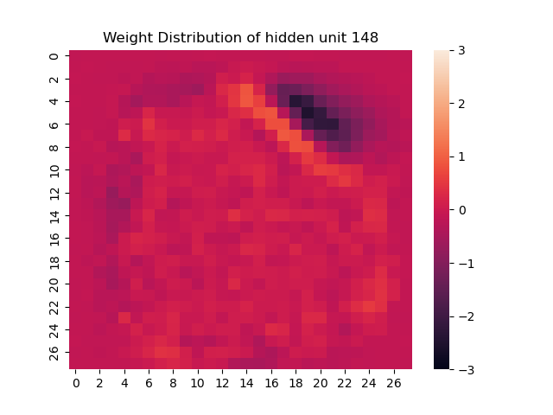
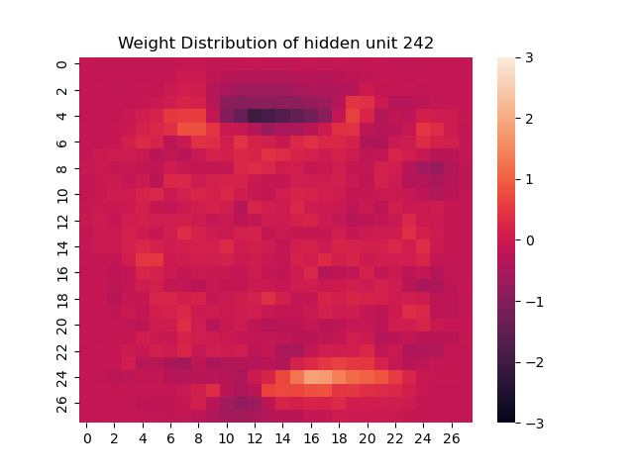
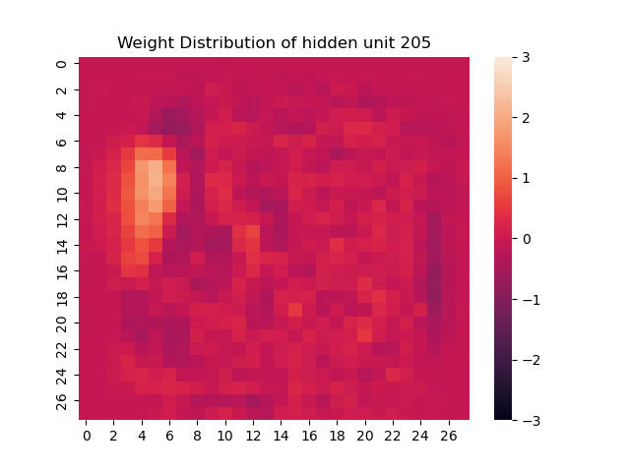
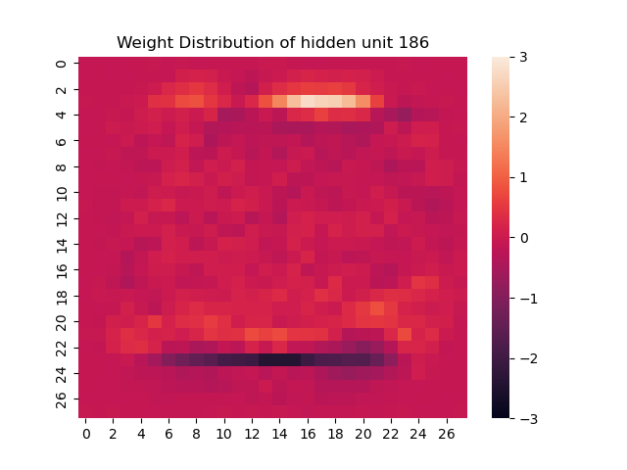
Adversarial attacks on CNN
Adding sign of the gradient of the cost function with respect to the input
One pixel attack
Goodfellow et. al., (2015) arxiv
Su et. al., (2019) arxiv
Limitations:
Deep networks trained with backpropagation get stuck in local minimas
Brain does not always require supervision or a global error signal
Backpropagation might be biologically unrealistic
THANK YOU

