Slide 1
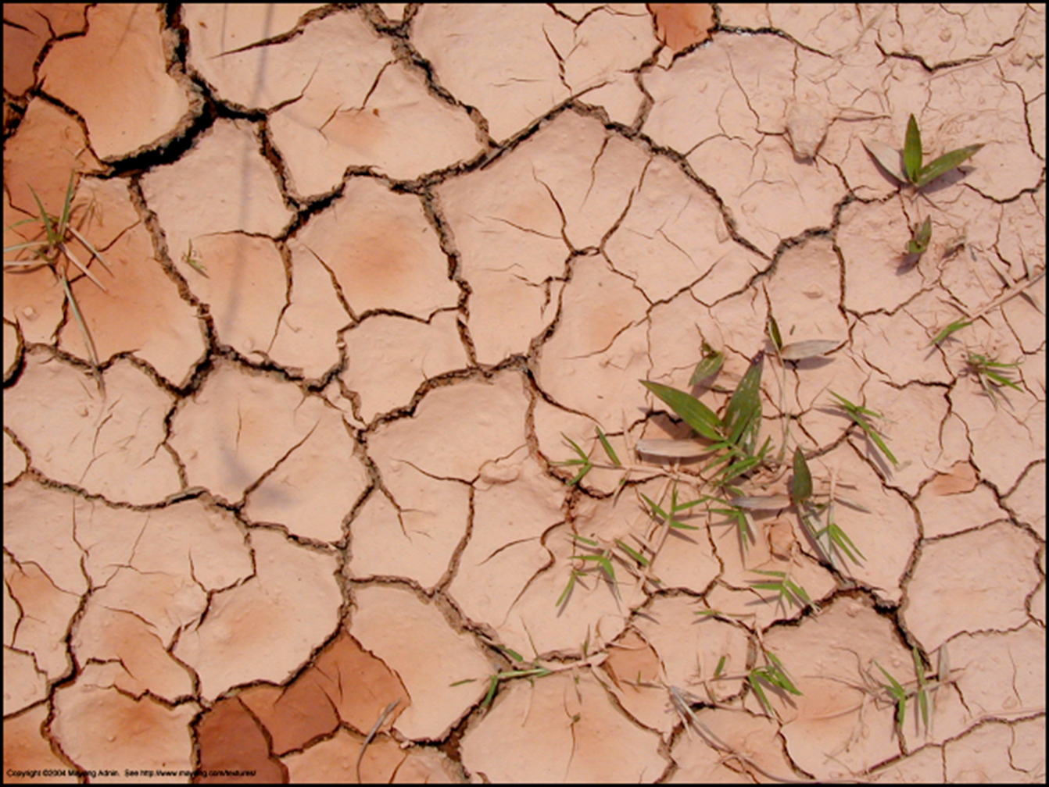
The effect of electric field on crack formation patterns in drying laponite
Sujata Tarafdar
Jadavpur University
Kolkata, INDIA

Slide 2
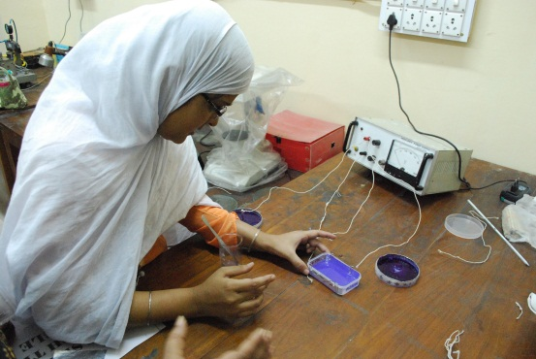
Collaborators:
Collaborators
Most of the recent work is done by
Tajkera Khatun (Sukhi)
Dibyendu Mal
Suparna Sinha
Tapati Dutta
Supti Sadhukhan
Soma Nag

Slide 3
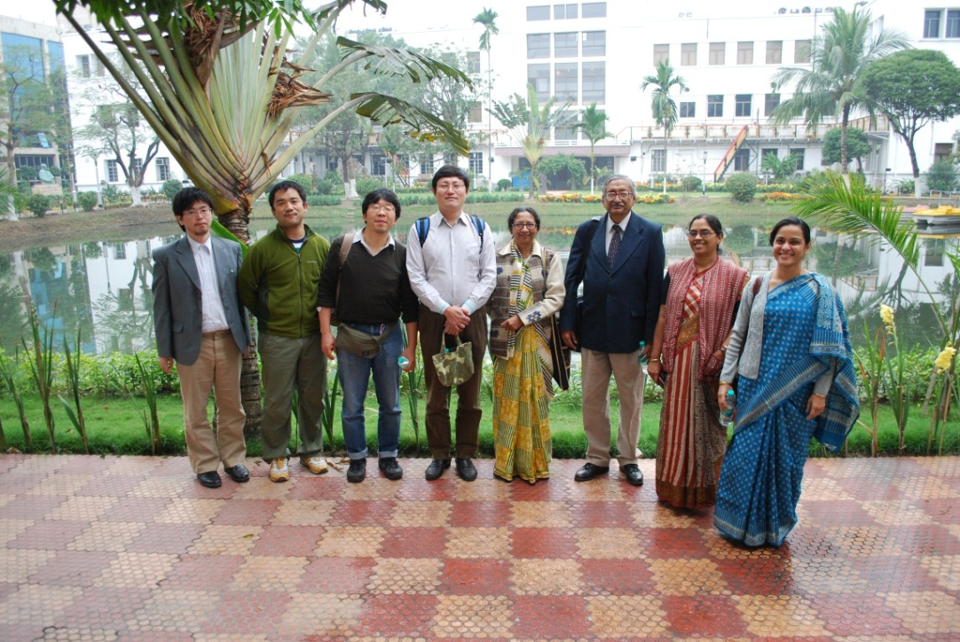
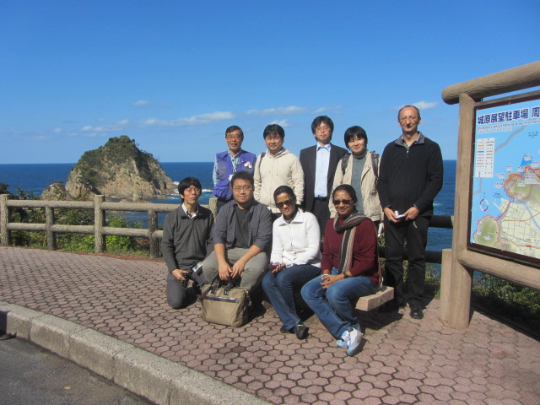
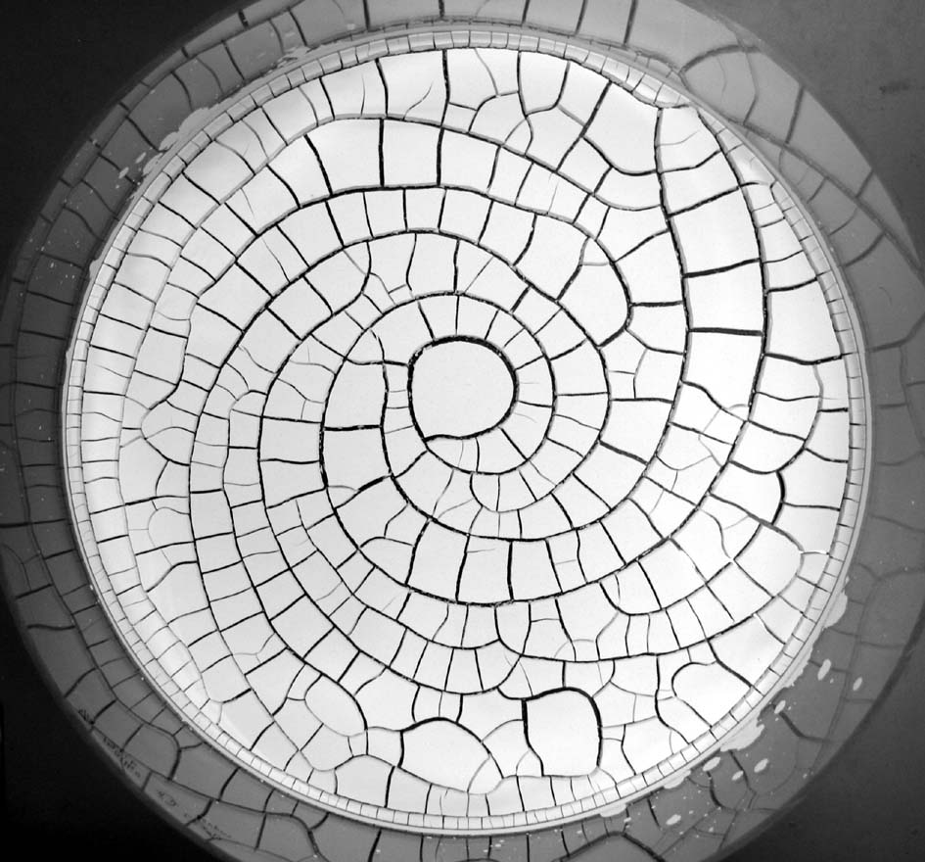
Thanks to DST-JSPS for
funding joint research
With Akio Nakahara,
So Kitsunezaki and their
Colleagues,
Indian collaborator:
Tapati Dutta
Spiral pattern
produced by
‘Memory Effect’
Matsuo and
Nakahara
J. Phys. Soc. Japan 81
(2012) 024801

Slide 4
We are all familiar with Desiccation cracks in clay
Natural clay is not homogeneous
For experiments we choose
LAPONITE
a synthetic clay
Inhomogeneity in the system arises from
An Electric field acting on the system

Slide 5
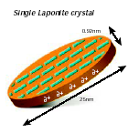
Some information about laponite.
Its particles are flat, disc-like and have a radius ~12 nm
And thickness ~ 1 nm.
Laponite structure and formula

Slide 6
In water LAPONITE particles acquire
a negative charge
and it forms a GEL

Slide 7
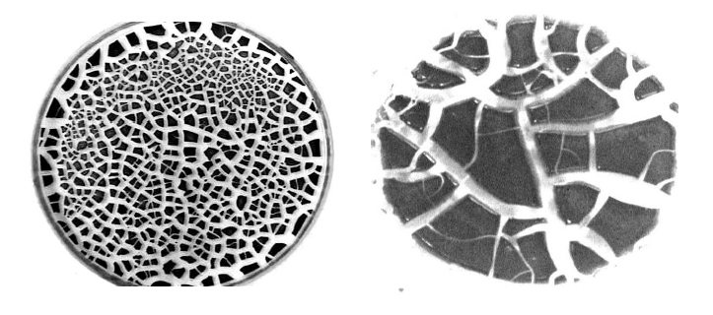
Laponite- methanol suspension – dried on-
Polypropylene
Glass

Slide 8
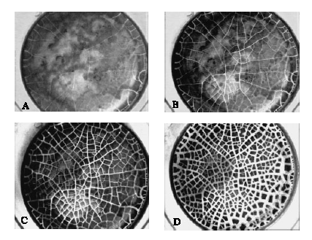
Time development of cracks

Slide 9
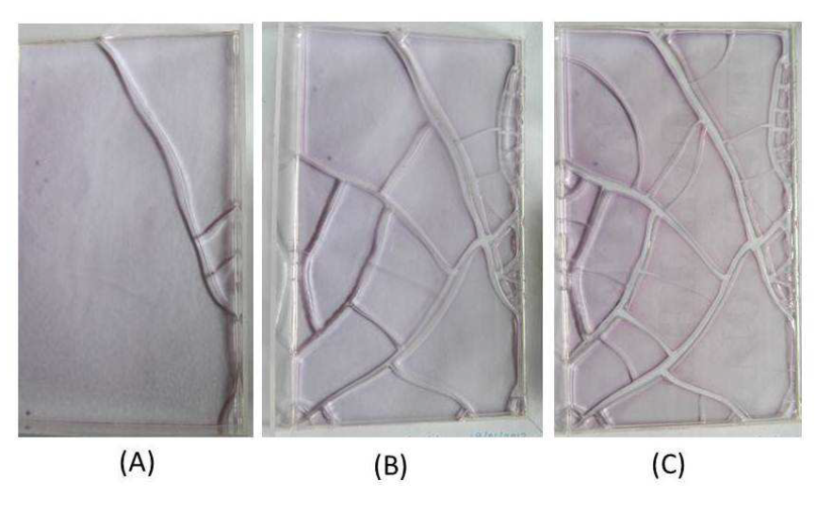
Rectangular sample of aqueous gel
(A) 47h:44m, (B) 71 h:47m and (C) 118h:53m

Slide 10
To study the effect of an
electric field on the crack pattern
We adopt a setup with
Circular geometry
Rectangular geometry
Experiment:
7.5 gm of laponite +120 ml of distilled water,
stirred and poured into acrylic petri-dish/box

Slide 11
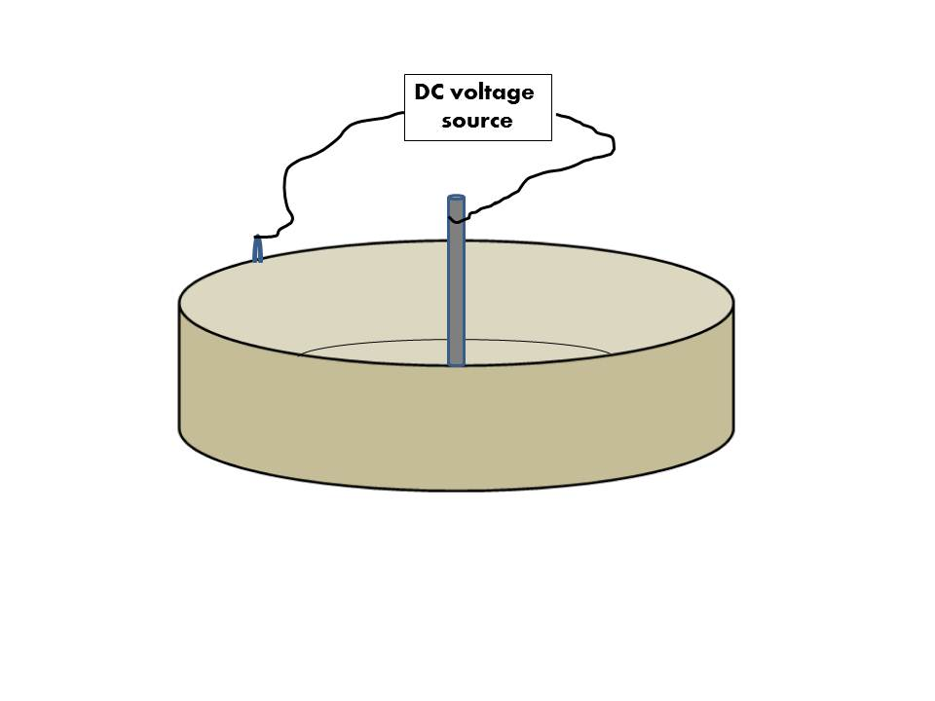
Metal foil
electrode
Circular geometry

Slide 12
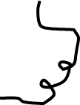
RECTANGULAR GEOMETRY
Length-wise field
Breadth-wise field
+ve
+ve
79 V
20 cm
11.7 cm
11.7 cm
135 V
Produce same
field strength
-ve
-ve

Slide 13
Results:
For CIRCULAR FIELD
Radial cracks appear
From center
Field is on for time τ

Slide 14
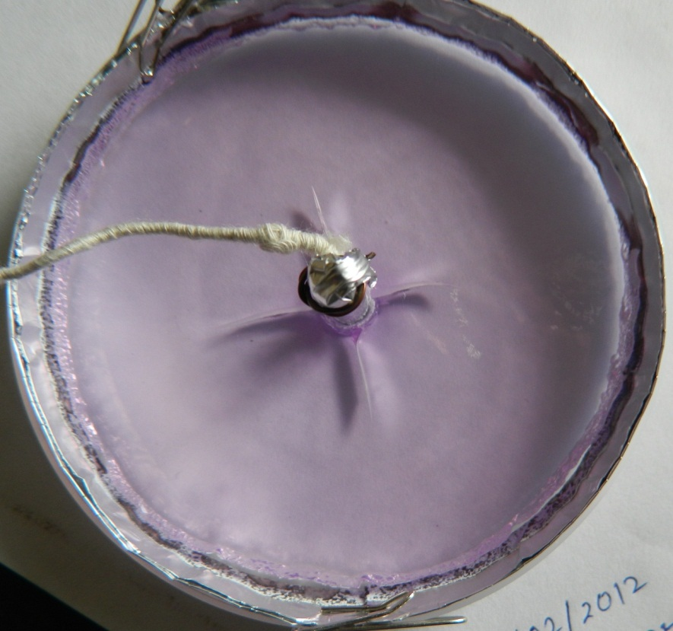
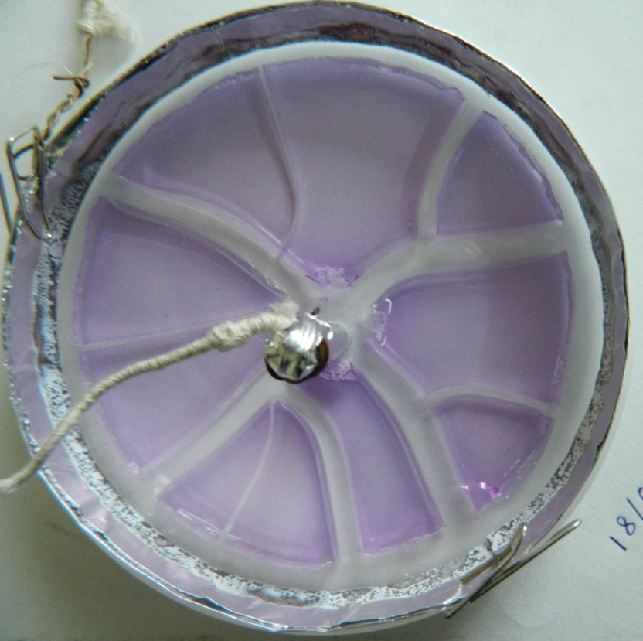
τ→∞
24 HRS
75 HRS
Center positive – 120 Volts, Al foil electrodes

Slide 15
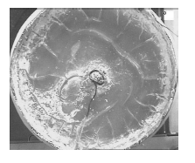
Center Negative
Radial cracks from boundary –
Cross Radial cracks near center

Slide 16
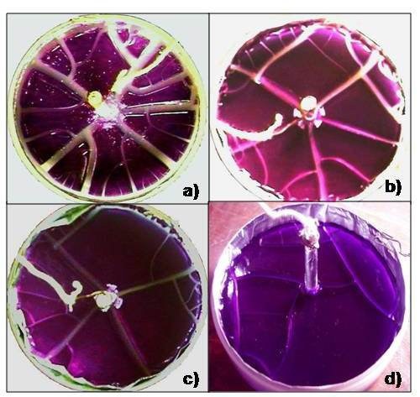
Effect of varying τ in Circular Geometry
Center Positive
a)Field on for 10 min
b) Field on for15 sec
c) Field on for 10 sec
d) Field on for 5 sec.
Field effect disappears

Slide 17
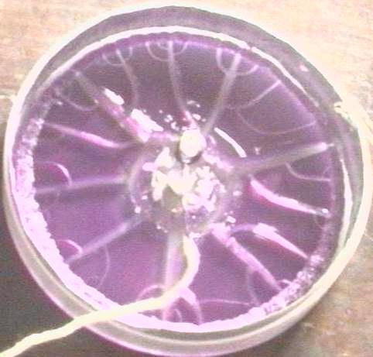
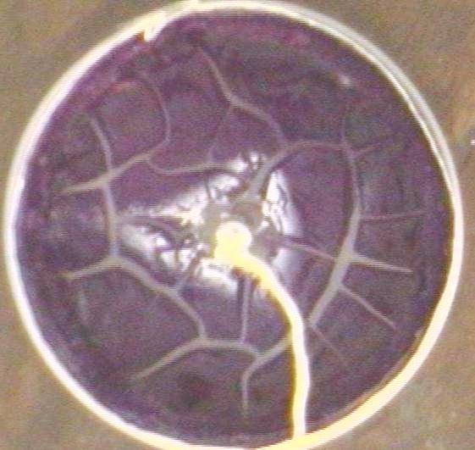
Center Negative
τ
∞
τ=10 m, t=72h
It takes much
Longer time of
Field exposure (τ)
To induce
Pattern similar to
τ ∞
τ=5 h
T= 70 h

Slide 18
Results for Rectangular field
Field is on for time τ

Slide 19
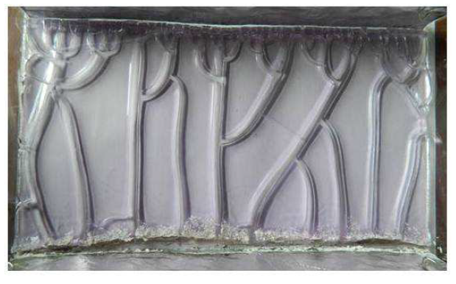
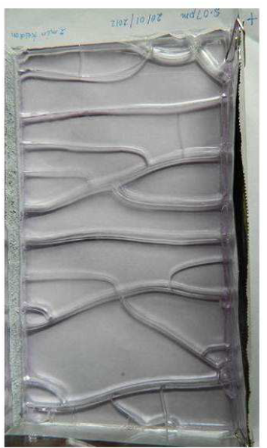
Breadth-wise field
After 84 h:12 m
+ ve
τ→∞
t = 18h:13min at +ve end
Field switched
Off after τ= 2 min

Slide 20
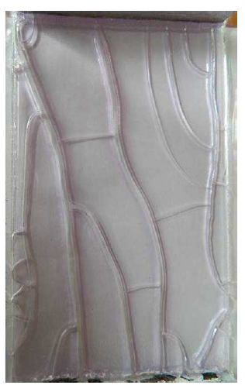
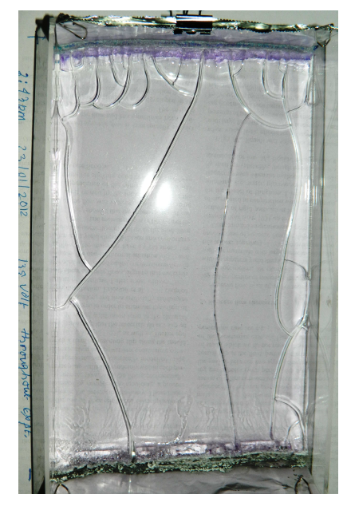
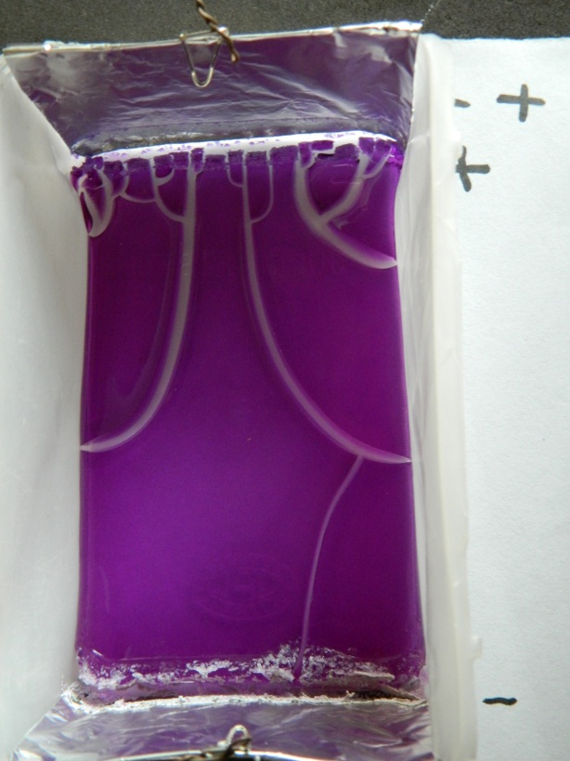
E
+ve
Length-wise Field
Experiment in
plastic
Pencil box
τ = 1h
Photo t = 69 h:36 m
= ∞
Photo t = 51 h:19 m

Slide 21
Observations:
Cracks run from +ve to –ve electrode
In rectangular system for τ→∞ tree-like motifs form
For finite τ
Cracks proceed
straighter

Slide 22
Attempts to understand
these observations
We adapt spring network model
introduced earlier
(S Sadhukhan, S Roy Majumder, D Mal, T Dutta and S Tarafdar
J. Phys. Cond. Mat.19, 2008, 356206)
to include effect of the electric field
(T Khatun et al, PHYS REV E 86, 016114 , 2012)

Slide 23
The 2-dimensional Spring network model
Each node on a square lattice represents a laponite particle
Springs with a certain spring constant (g) and Breaking threshold (s) connect nearest neighbors

Slide 24
Force experienced by a laponite particle
Red node moves under
force due to the 4
Springs connecting to
4 nearest neighbors
Spring connecting i and j
has stiffness g(i,j)
spring breaks
If strain threshold
S(i,j) is crossed

Slide 25
Desiccation Process
Desiccation is implemented by reducing the natural length of each spring in successive stages according to
d_{(n+1)} = d_{n}(1 – b/r^{n})
d_{n} is natural length of spring at n’th
Stage, b and r are constants. This can be written as

Slide 26
The net force gives the acceleration (a)
on the particle
It moves to new position at next time-step
x_{τ+1} = x_{τ} + a δt²
System relaxes for n steps before
next desiccation(here, n =1,
i.e quick drying compared
To relaxation assumed)

Slide 27
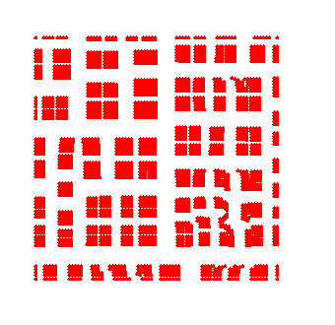
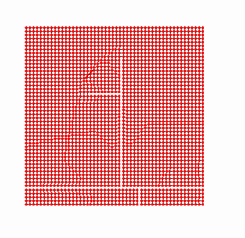
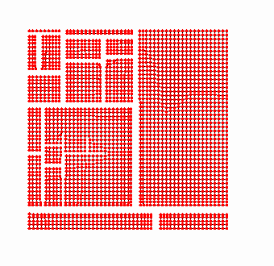
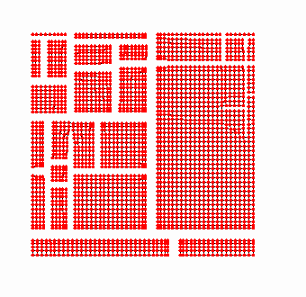
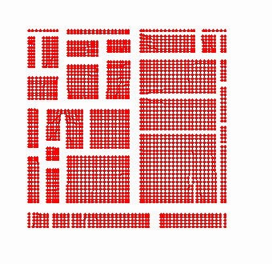
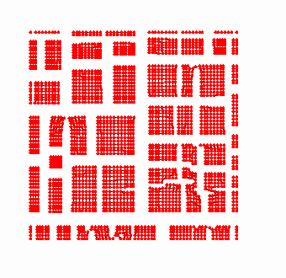
Top view of a desiccating layer

Slide 28
How to include force due to electric field ??
Case of circular geometry
Embed square lattice
In a circular boundary

Slide 29
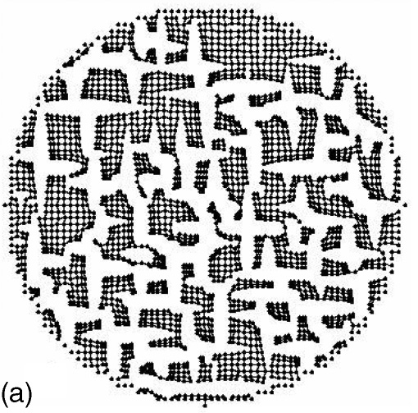
Simulated cracks in Circular Sample without electric field

Slide 30
From radial symmetry of the setup,
we expect a net force towards/away from
The center
Total Force on each node :
Desiccation Force + Electric Force
Calculation of force due to imposed
Electric field

Slide 31
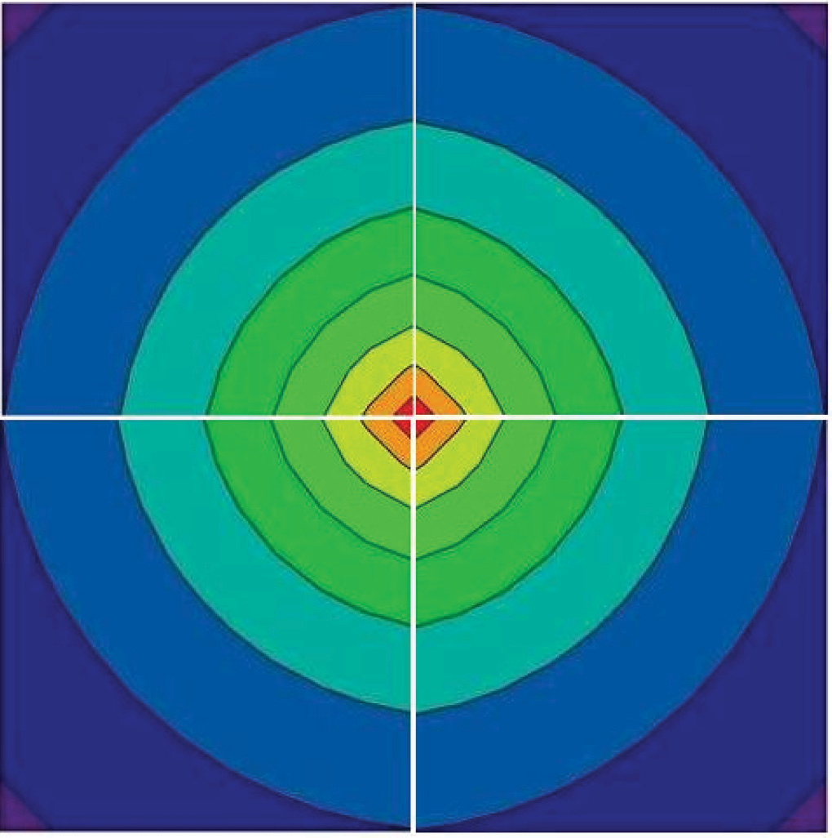
ELECTRIC FIELD
Assume:
Laplace’s equation valid in the Laponite gel away from electrodes
Boundary Conditions potential φ is +V (−V ) at the inner electrode periphery and −V (+V) at the outer periphery.
Potential map
φ has cylindrical symmetry

Slide 32
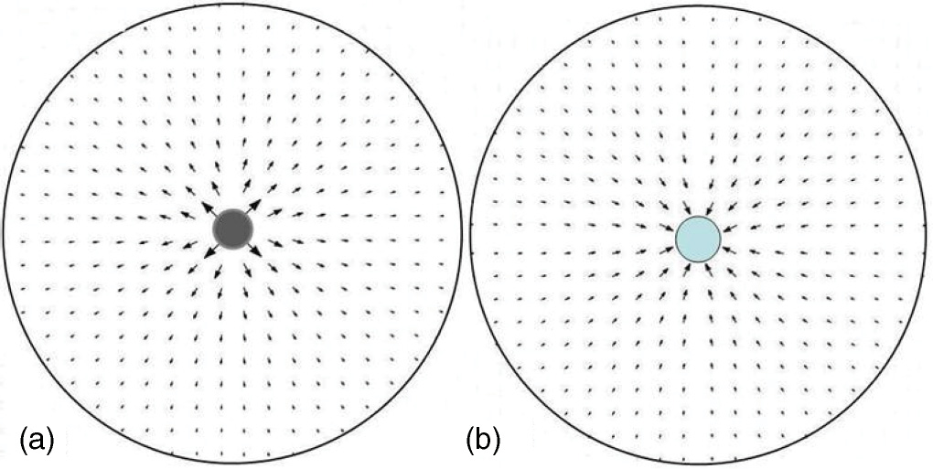
DIRECTION OF FORCE FIELD IN VECTOR MAP
+V
-V
+V
-V
Arrows show direction and magnitude of field

Slide 33
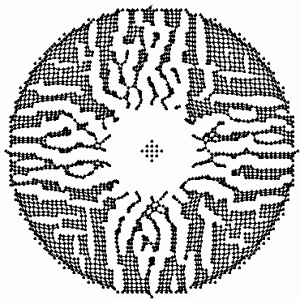
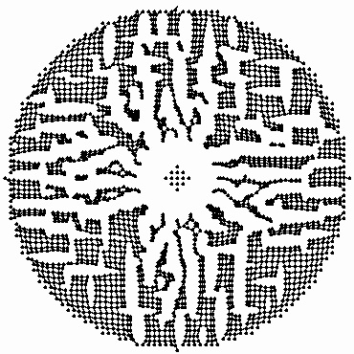
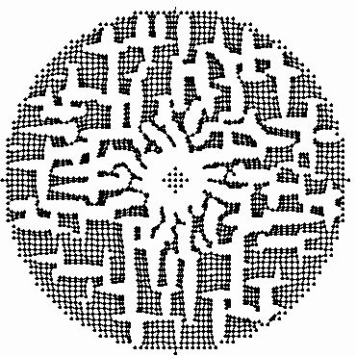
Crack formation with nodes driven radially
away from center with force ∝ electric field
V=20
V=10
V=20
V=10
V=5
V is proportional to field strength

Slide 34
Mechanism of formation of radial cracks
Small system (CP) with exaggerated distortion shows nodes pushed outward.
Cross-radially placed springs stretch and break, so radial cracks are formed.

Slide 35
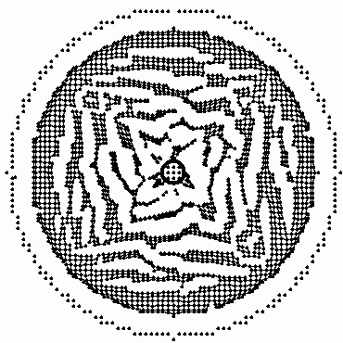
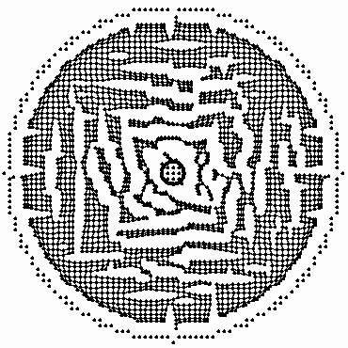
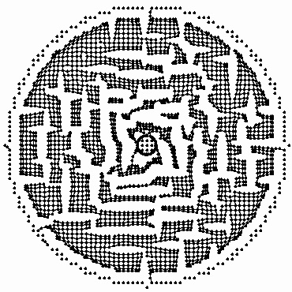
NODES ARE DRIVEN TOWARDS THE CENTRE
V=20
V=10
V=5

Slide 36
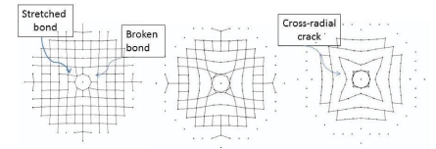
Mechanism of formation of cross-radial cracks
Small system (CN) with exaggerated distortion shows nodes pushed inward.
Radially placed springs stretch and break, so cross-radial cracks are formed.

Slide 37
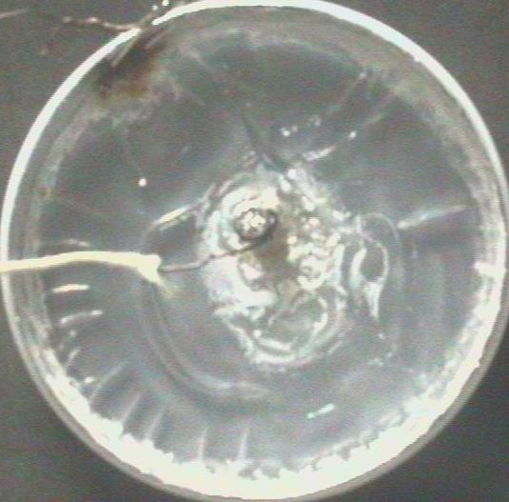
Notice a strong qualitative match in Patterns
Nodes forced
Away from
center
Centre
+ve
Are Laponite particles +ve charged ??
Nodes forced
towards
center
Centre
-ve

Slide 38
There is a contradiction here
Clay macro-ions in colloidal solution are
Known to be –ve charged
A possible explanation -
Overcharging of macro-ions
in colloids

Slide 39
Overcharging effect in colloids
Colloidal particles dissociate in water → macro-ions
with –ve surface charge +ve counterions.
Counterions form a double layer on the surface of the clay platelet, screening the bare charge.
Presence of multivalent cations can lead to a strong accumulation of opposite charge on the surface, which actually reverses the net charge on the macroion.
In our experiment Al³⁺ ions from anode may overcharge the laponite disks making them effectively +ve charged.
This counter-intuitive effect arises from strong
localization and interaction between Counter-ions

Slide 40
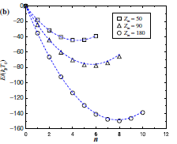
Simulations demonstrating overcharging Ref: R. Messina, J. Phys.: Condens. Matter 21, 113102 (2009).
Overcharged configuration has minimum energy –
More so for
larger macro-ions

Slide 41
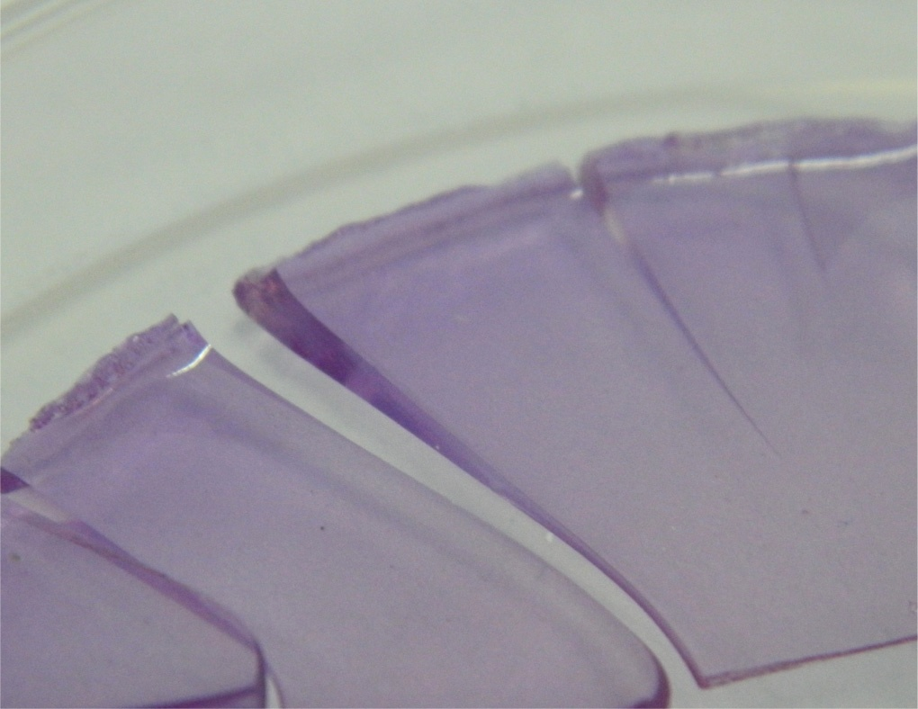
More indications of Overcharging
Thickening of the laponite film near the negative electrode.
In circular geometry
Negative side
Ref: T. Khatun , M. D. Choudhury T. Dutta and S. Tarafdar , Phys. Rev. E 86, 016114 (2012)

Slide 42
Also observed in rectangular geometry
Initial solidification and shrinking at the +ve electrode
τ→ ∞, photo t = 20hr:38min
+ve
-ve
Thickening at –ve electrode, Photo t = 95hr:54min

Slide 43
We try a similar analysis for the
Rectangular system
Problem:
Boundary conditions at the sides
(normal to electrodes)
Are not well-defined
+V
??
??
-V

Slide 44
A set-up with better
defined boundary conditions
+ve
+V
20 cm
11.7 cm
- V
-ve

Slide 45
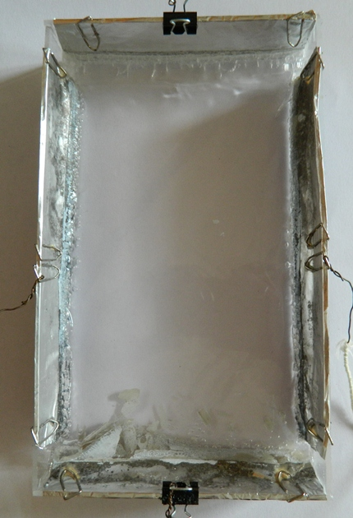
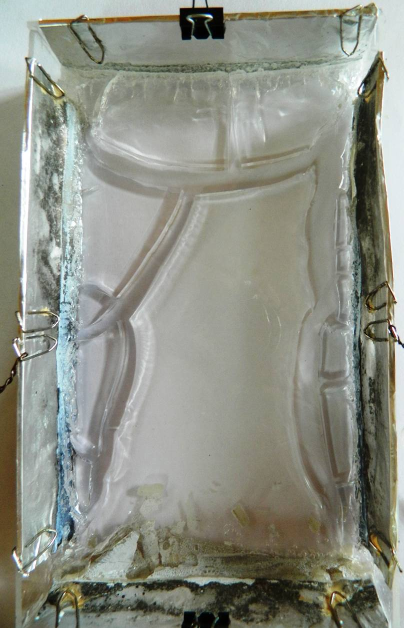
+ve
Aluminum Electrodes
+ve
Bubbles appear
–ve electrode strongly corroded

Slide 46
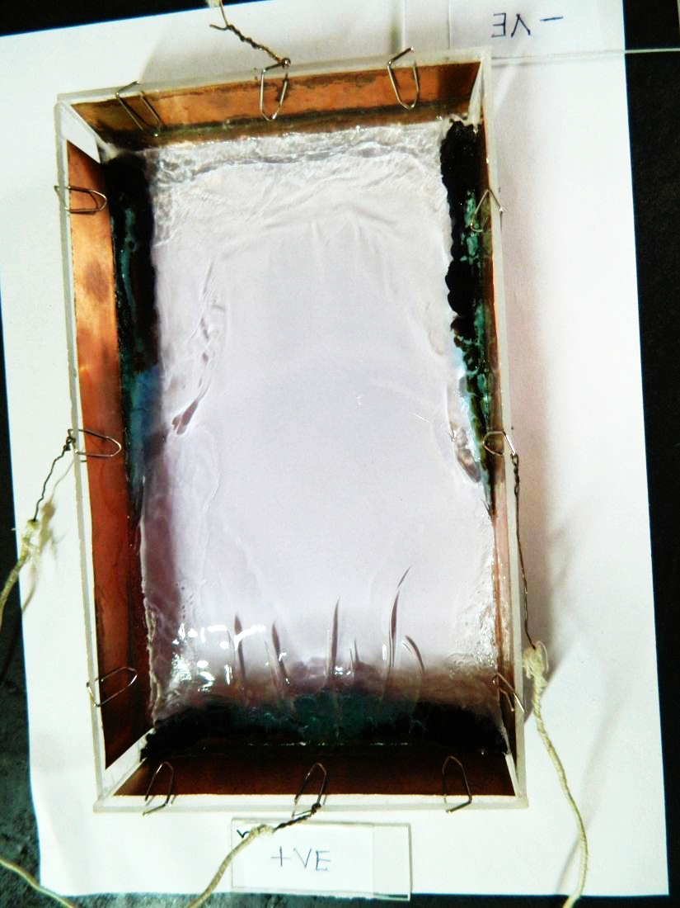
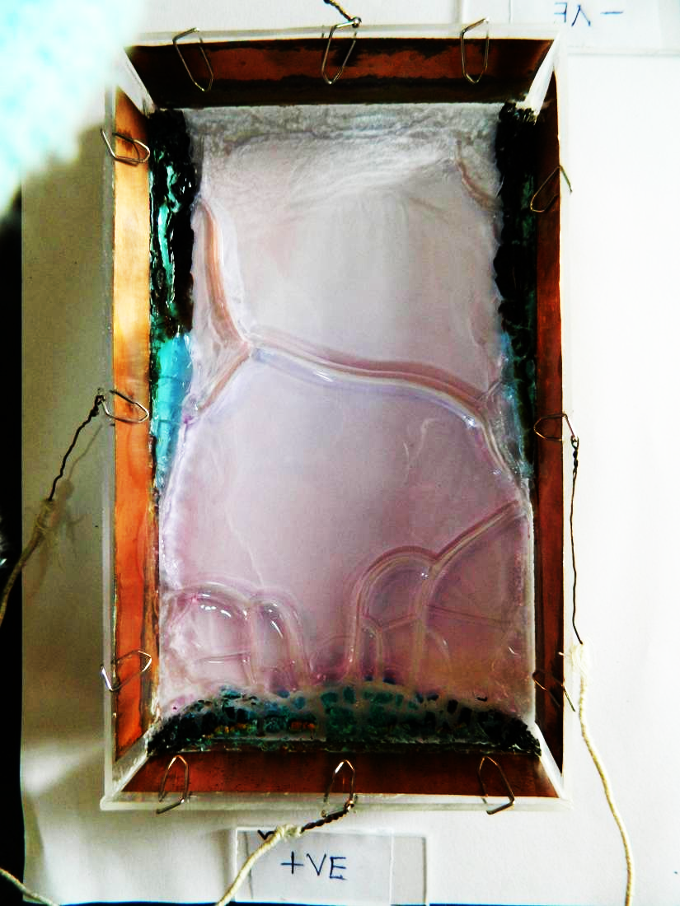
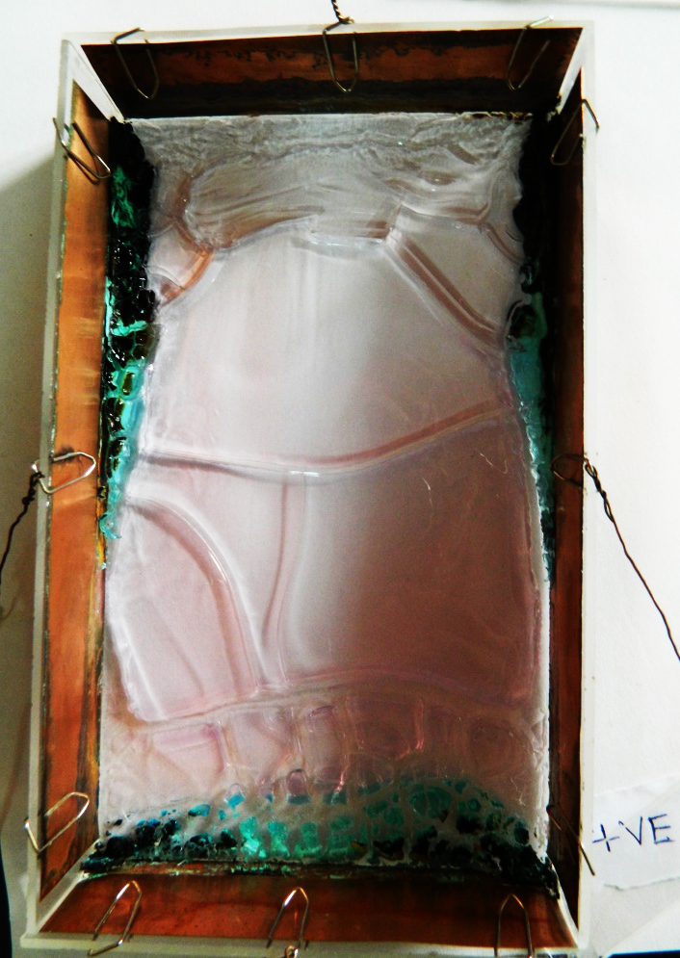
Copper Electrodes
Cracks normal
To field
Cracks parallel
To field
+ve electrode is strongly corroded

Slide 47
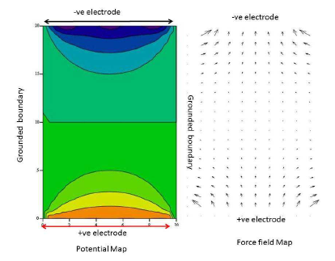

Slide 48
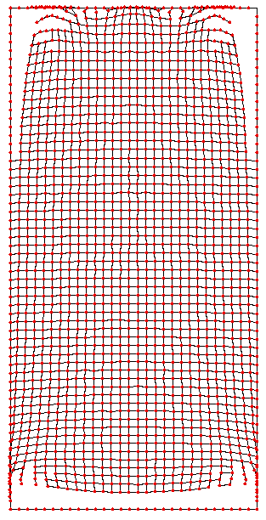
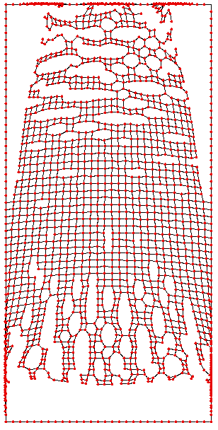
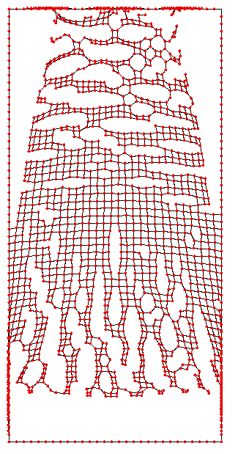
Crack growth in spring model assuming nodes are pushed along the field lines (i.e. the particles have effective positive charge).

Slide 49
Alternating Field
AC fields of different strengths gave some
Peculiar effects in a circular set-up
Voltage was varied from 20 to 70 V at
Frequency 50 Hz

Slide 50
20 Volts
After 17h:9min
After 23h:55min

Slide 51
25 Volts
23h:50min
Pattern starts to change
30 Volts
25h:4min

Slide 52
40 Volts
5h:52min
50 Volts
4h:29min

Slide 53
50 Volts
Close-up
4h:42min
50 Volts
24h:24min

Slide 54
70 volt field turned off after 4h:40min
Taken after 4h:40min
Then field switched off
After 22h:11min

Slide 55
For higher fields there
was sparking and we were
scared to go on

Slide 56
70 Volt AC in Rectangular sample

Slide 57
AC applied along width

Slide 58
Still a long way to go to understand
fully crack formation in electric fields ………
But lots of interesting results
to think about

Slide 59
References
[1] D Mal, S Sinha, S Mitra and S Tarafdar Physica A, 346, 110, (2005)
[2] D Mal, S Sinha, T Dutta, S Mitra, S Tarafdar, Fractals, 14, 283 (2006)
[3] D Mal, S Sinha, T Dutta S Mitra, S Tarafdar, J. Phys. Soc. Jpn.76, 014801 (2006)
[4] D Mal, S Sinha, T Middya, S Tarafdar, Physica A 384 (2007)182
[5] D Mal, S Sinha, T Middya, S Tarafdar, Appl. Clay Science 39 (2008) 106
[6] S Sadhukhan, S Roy Majumder, D Mal, T Dutta and S Tarafdar
J. Phys. Cond. Mat.19, 2008, 356206
[7] S Sadhukhan, J Prehl, P Blaudeck, K H Hoffmann, T Dutta, S Tarafdar, Eur. Phys. J. E, 27 (2008) 391
[8] S Tarafdar, S Sinha, Ind. Eng. Chem. Res., Vol. 47, (2008) 6459
[9] Nag, S., Sinha, S., Sadhukhan, S., Dutta, T., Tarafdar, S. 2010
J. Phys. Cond Mat 22 (1), art. no. 015402
[10] Tajkera Khatun, Moutushi Dutta Choudhury, Tapati Dutta, Sujata Tarafdar, Phys. Rev. E 86 (2012), 016114

Slide 60
Thank You

