Slide 1
FracMeet III, IMSc, Chennai, 21-24 January, 2013
Scaling forms for Relaxation Times
of the Fiber Bundle Model
S. S. Manna
In collaboration with
C. Roy,S. Kundu and S. Pradhan
Satyendra Nath Bose National Center for Basics Sciences, Kolkata
SINTEF Petroleum Research, Trondheim, Norway

Slide 2
FIBER BUNDLE MODEL
● What is a fiber bundle?
Fiber bundle models study breakdown properties of a bundle composed of a
large number of N parallel elastic fibers.
● Arrangement
All fibers of the bundle are rigidly clamped at one end and is externally loaded
at the other end. The load is equally distributed among all fibers.
● Disorder
Each fiber i has a breaking threshold b_{i} of its own. If the stress acting through
it exceeds b_{i} the fiber breaks. The bi values are drawn from a distribution p(b)
whose cumulative distribution is

Slide 3
STRESS RELAXATION
● Suppose σ is the external load per fiber applied on a complete bundle. Then the
fibers having breaking thresholds b_{i} < σ would break.
● They release the total amount of stress that were acting through them.
● The released stress gets distributed among some other fibers. In the Equal Load
Sharing (ELS) version the released stress is equally distributed among all
intact fibers.
● This is one time step.
● If the new stress per fiber is σ’ then there will be another set of fibers which will
break again and release stress.
● A cascade of such activities follows for T time steps which stops when the system
reaches a stable state.
● A stable state may have (i) all fibers broken – supercritical state,
(ii) n fibers broken when n < N – subcritical state.

Slide 4
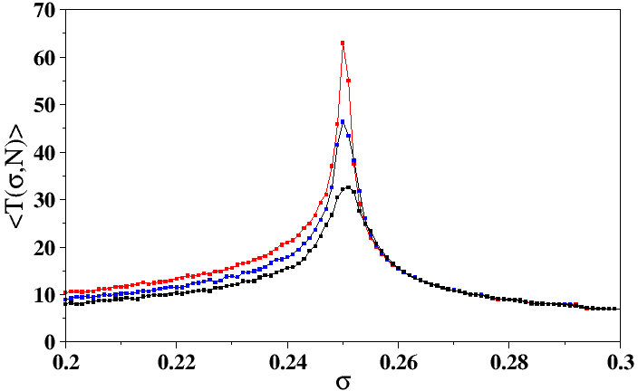
SYSTEM RELAXES LONGER, CLOSER TO A SPECIFIC σ_{c}
● An ensemble of many fiber bundles with same size N is considered, each has a different set of thresholds {b_{i}}.
● The external load σ per fiber is applied on each bundle.
● The bundle relaxes for time T(σ,N) and its average <T(σ,N)> is calculated, varying σ from 0 to 1/2, with Δσ = 0.001.
● For uniformly distributed {b_{i}}, curves for all three values of N show sharp peaks at or very close to σ_{c} ≈ 0.25.
N = 10000, 30000, 100000

Slide 5
CRITICAL LOAD σ_{c}
● Each fiber is assigned a random breaking threshold b_{i} that consists a set {b_{i}}.
These thresholds are drawn from a probability density p(b). Let p(b) be the
uniform distribution: p(b)=1.
● Initially let the applied load be F and σ = F/N be the stress per fiber.
● All fibers with b_{i} < σ break. Each broken fiber releases σ amount of stress.
● This stress is distributed equally to N[1 - P(σ)] intact fibers on the average.
● If x₁ be the stress per fiber after the first relaxation then F=Nx₁[1 - P(σ)].
● Therefore after successive relaxations we have
F = Nx₁[1 - P(σ)] = Nx₂[1 - P(x₁)] = Nx₃[1 - P(x₂)] = ……
● After T steps the process converges to a stable state when x_{T+1} – x_{T} < 1/N.
● The applied load F on the bundle can be written as function of the stress
x per fiber at the final state: F(x) = Nx[1 - P(x)]
● F(x) has a maximum at x_{c} where dF/dx=0
1 - P(x_{c}) - x_{c}p(x_{c}) = 0
● With uniform distribution of p(x) = 1, x_{c} = 1/2, F_{c} = N/4 and therefore:
σ_{c} = 1/4.

Slide 6
NUMERICAL ESTIMATION OF σ_{c} (N)
● An ensemble of fiber bundles, one member is α
Let a fiber bundle with a specific sequence of breaking thresholds {b_{i}} be
denoted by α.
● Critical load of the bundle α
Let σ^{α}_{c}(N) be the maximum value of the applied load σ per fiber in the
subcritical phase.
If σ is increased by a least possible amount to include only a single additional
fiber the system crosses over to the supercritical phase. On the average this
increment is 1/N.
● Bisection method
Breaking threshold for the fiber α.
Let σ_{sub} and σ_{sup} be the initial guesses for which the system is subcritical
and supercritical respectively.
For the same fiber α one tries σ = (σ_{sub} + σ_{sup} )/2; if the system is subcritical
one makes σ_{sub} = σ otherwise σ_{sup} = σ. This is continued iteratively
till σ_{sup} - σ_{sub} ≤ 1/N. At this stage: σ^{α}_{c}(N) = (σ_{sub} + σ_{sup})/2.
● Averaging over many different bundles α: σ_{c}(N) = <σ^{α}_{c}(N)>.

Slide 7
FINITE SIZE CORRECTION AND EXTRAPOLATION
● Assume that the average value of the critical
load σ_{c}(N) for bundle size N converges to the
asymptotic value σ_{c}(∞) as:
σ_{c}(N) - σ_{c}(∞) = A N^{-1/ν}
● Fig (a): Used σ_{c}(∞) = 1/4 and 1/ν = 0.6666
to plot the data and then least sq. fit a straight
line which is found to be:
σ_{c}(N) – 1/4 = 1.0091 x 10⁻⁵+0.30198N^{-1/ν} .
● Fig (b): Plot of:
[σ_{c}(N) – 1/4]N^{0.661} against ln(N).
We tried to make the middle portion horizontal,
by tuning the exponent ν and the best value of
1/ν = 0.661

Slide 8
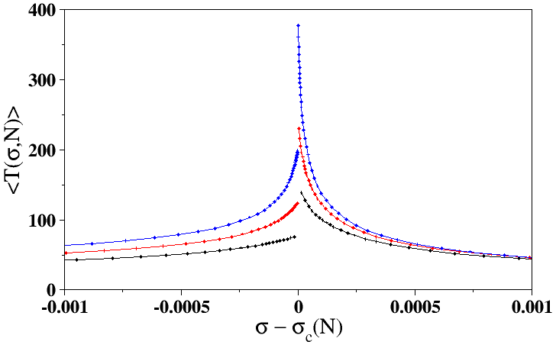
RELAXATION AWAY FROM THE CRITICAL POINT
● For every bundle α we first calculate the critical
load σ^{α}_{c} and then for the same bundle calculate
T(σ,N) for different values of |Δσ| = | σ^{α}_{c} – σ |
● The limiting values of the relaxation times from
both sides as |Δσ| → 0 are distinctly different.
● The ratio of <T_{sub}(σ_{c}(N),N)> and <T_{sup}(σ_{c}(N),N)>
approaches 2 as N →∞

Slide 9
RELAXATION TIME AT THE CRITICAL APPLIED LOAD
● For each bundle two different times T.
● T^{sub} and T^{sup} are the maximal relaxation times
for the subcritical and supercritical phases.
● Plot <T^{sup}(σ_{c}(N),N)> and <T^{sub}(σ_{c}(N),N)> and with N for 2⁸, 2¹⁰, …. , 2²⁴.
Assume: <T(σ_{c}(N),N)> ~ N^{η}
● Small curvature in the small N regime.
● Estimated slopes between successive pts.
● Plotted
η(sub,N)-1/3 ~ N^{-0.3279}
and η(sup,N)-1/3 ~ N^{-0.2619}.
The intercepts are 0.00061 and 0.00085
respectively.
Conclusion: η ≈ 1/3

Slide 10
ANALYTICAL RESULTS FOR RELAXATION TIMES
S. Pradhan and P. C. Hemmer, Phys. Rev. E, 75, 056112 (2007).
● For supercritical phase σ > σ_{c}
T(σ, N) ≈ (π/2)(σ – σ_{c})^{-1/2}
● For subcritical phase σ < σ_{c}
T(σ, N) ≈ (ln(N)/4)(σ_{c} – σ)^{-1/2}

Slide 11
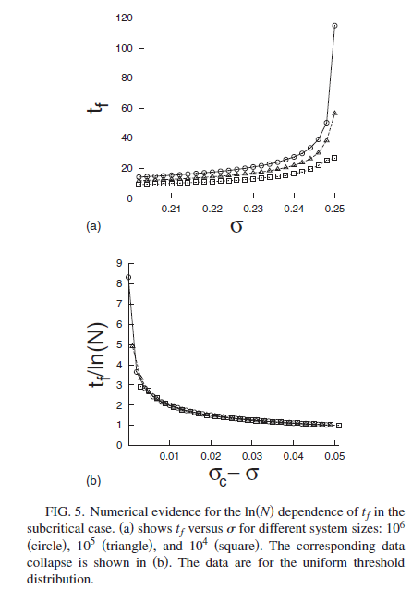
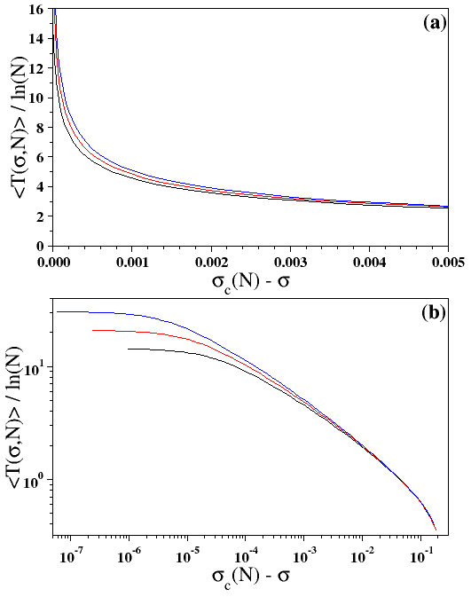
RELAXATION AWAY FROM THE CRITICAL LOAD: PREVIOUS RESULTS
N = 2²⁰, 2²², 2²⁴
S. Pradhan and P. C. Hemmer, Phys. Rev. E, 75, 056112 (2007).

Slide 12
RELAXATION AWAY FROM THE CRITICAL LOAD
● (a) [<T(σ,N)>/ln(N)] against [σ_{c}(N) – σ]
data collapse is not very well.
● (b) [<T(σ,N)>/N^{η}] against [σ_{c}(N) – σ]N^{ζ}
collapse is good for small values of
[σ_{c}(N) – σ]N^{ζ} with η = 0.336 and ζ = 0.666.
<T(σ,N)>/N^{η} ~ G[{σ_{c}(N) – σ}N^{ζ} ]
There are two regimes:
● A constant regime where
<T(σ,N)>/ N^{η} = C i.e., here <T(σ,N)> ~ N^{-η}
This regime is extended to: [σ_{c}(N) – σ]N^{ζ} ~ 1 i.e., [σ_{c}(N) – σ] ~ N^{-ζ}
ζ = 1/ν
● A power law regime which in N →∞ limit
is G(y) ~ y^{-τ} so that
-τζ + η = 0 i. e., τ = η / ζ
From the estimates of η and ζ
τ = 0.50(1)

Slide 13
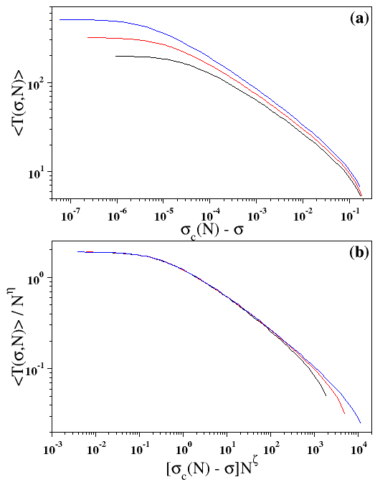
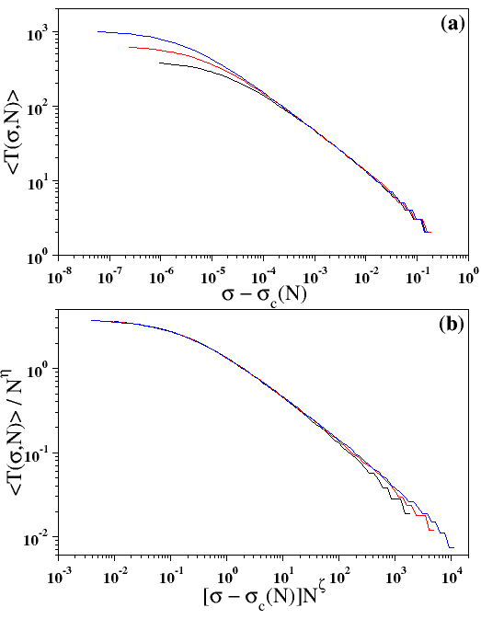
SUBCRITICAL STATE
SUPERCRITICAL STATE
[<T(σ,N)>/N^{η}] ~ G[{σ_{c}(N) – σ}N^{ζ} ] with η = 0.336 and ζ = 0.666.

Slide 14
DETERMINISTIC FIBER BUNDLE (DFBM) MODEL
● A deterministic version of FB where the breaking
thresholds are uniformly spaced: b_{i} = n/N
where n = 1, 2, 3, …., N.
● Plot of [σ_{c}(N) – 1/4] with 1/N gives a nice
straight line σ_{c}(N) – 1/4 = -1.3x10⁻¹⁵ + 0.5/N.
● Plot of [σ_{c}(N) – 1/4]N against log(N) gives a nice
st. line parallel to x-axis with the average value
at 0.5000(1).
We conjecture:
σ_{c}(N) = 1/4 +1/(2N)
i.e., the exponent ζ = 1.

Slide 15
DFBM: RELAXATION AT THE CRITICAL POINT
● Again two relaxation times are estimated.
● T^{sub}(σ_{c}(N),N) and T^{sup} (σ_{c}(N),N) are the relaxation times right before and
right after the critical point, plotted with N on a log-log scale.
● The little curvature for small values of N is absent -- only a single slope for the entire range.
T^{sub}(σ_{c}(N),N) ~ N^{ηsub}
and
T^{sup} (σ_{c}(N),N) ~ N^{ηsup}
with η_{sub} = 0.50209 and η_{sup} = 0.50075
Our conjecture: η_{sub} = η_{sup} = 1/2,
(ref. Pradhan and Hemmer)

Slide 16
DFBM: RELAXATION AWAY FROM CRITICALITY
● Relaxation times T(σ,N) are estimated for both subcritical
and supercritical regimes.
● N = 2¹⁸, 2²⁰, 2²², 2²⁴ and 2²⁶ .
● Data collapse is obtained for a finite size scaling of:
T(σ,N) / N^{1/2} ~ G[(1/4 - σ)N]
η = 1/2 and ζ = 1 implies τ = 1/2

Slide 17
CRITICAL POINTS AND CRITICAL EXPONENTS
P(b) | σ_{c} | ν | η | ζ | τ
Uniform P(b) = b | 0.250(1) 1/4 | 1.50(1) 3/2 | 0.336(5) 1/3 | 0.666(5) 2/3 | 0.50(1) 1/2
Weibull P(b) = 1-exp(-b⁵) | 0.593(1) (5e)^{-1/5} | 1.50(1) 3/2 | 0.335(5) 1/3 | 0.663(5) 2/3 | 0.50(1) 1/2
DFBM | 0.2500(1) 1/4 | 1.00(1) 1 | 0.50(1) 1/2 | 1.00(1) 1 | 0.50(1) 1/2
Numerical Estimates Exact Results Conjectures
Exact values are from:
S. Pradhan and P. C. Hemmer, Phys. Rev. E, 75, 056112 (2007).

Slide 18
SUMMARY
● An extensive numerical analysis has been performed for revisiting the behavior of relaxation
times of the ELS version of the Fiber Bundle model.
● It has been observed that the average critical load σ_{c}(N) depends on the bundle size N and
extrapolates to σ_{c} = σ_{c}(∞) = 1/4 as N^{-0.666} in the limit of N→∞.
● The average relaxation time at the critical load grows as <T(σ_{c}(N),N)> ~ N^{0.336}.
● Away from the critical point, the relaxation times obey the finite-size scaling form:
[<T(σ,N)>/N^{η}] ~ G[{σ_{c}(N) – σ}N^{ζ} ]
at both subcritical and supercritical states with with η = 0.336 and ζ = 0.666. This implies
that in the asymptotic limit of N →∞
T(σ,N) ~ |σ_{c} – σ|^{-1/2}.
● The deterministic fiber bundle model has different set of exponents.

