Slide 1


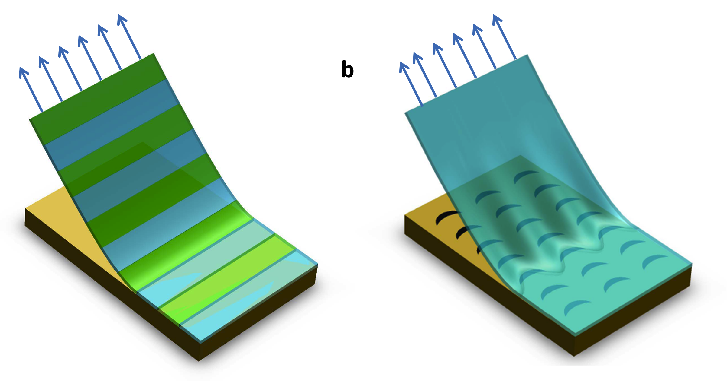
From microstructural to macroscopic properties in failure of brittle heterogeneous materials
Laurent Ponson
Institut Jean le Rond d’Alembert
CNRS – Université Pierre et Marie Curie, Paris
Notes:
Good morning
I would like to present you this recent work on the peeling properties of heterogeneous adhesives.
And show you through this example how we can bridge microscopic properties of brittle systems with their macroscopic effective failure properties.
I started this work as a post-doc at Caltech with my colleauges …. And I pursued it at Institut d’Alembert in Paris where I am currently working as a CNRS researcher.
Some background explanations: post-doc at Caltech where you did this work
Then, CNRS position when you pursued it.
You are interested by the failure properties of heterogeneous solids, and you develop new approaches in order to integrate the effect of material microstructure on their macroscopic failure properties

Slide 2
Predicting the effective toughness of heterogeneous systems:
A challenging multi-scale problem
σ₀
Young’s modulus:
E^{eff} ≅ average (E^{local})
X
Fracture energy:
G_{c}^{eff} ≅ average (G_{c}^{local})
σ₀
Notes:
pour vous présenter la position du problème, considérons un matériau fissuré sous contrainte extérieure.

Slide 3
Predicting the effective toughness of heterogeneous systems:
A challenging multi-scale problem
σ₀
Stress field diverges at the crack tip
σ (r)
r
σ₀

Slide 4
Predicting the effective toughness of heterogeneous systems:
A challenging multi-scale problem
σ₀
Stress field diverges at the crack tip
σ (r)
r
σ₀
Macroscopic failure properties strongly dependent on material heterogeneities

Slide 5
Predicting the effective toughness of heterogeneous systems:
A challenging multi-scale problem
σ₀
Stress field diverges at the crack tip
σ (r)
r
σ₀
Macroscopic failure properties strongly dependent on material heterogeneities
Opens the door to microstructure design in order to achieve improved failure properties

Slide 6
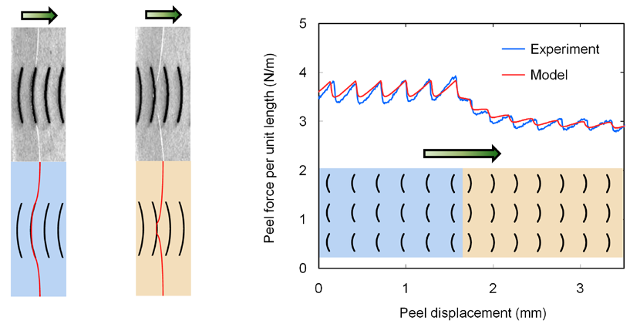
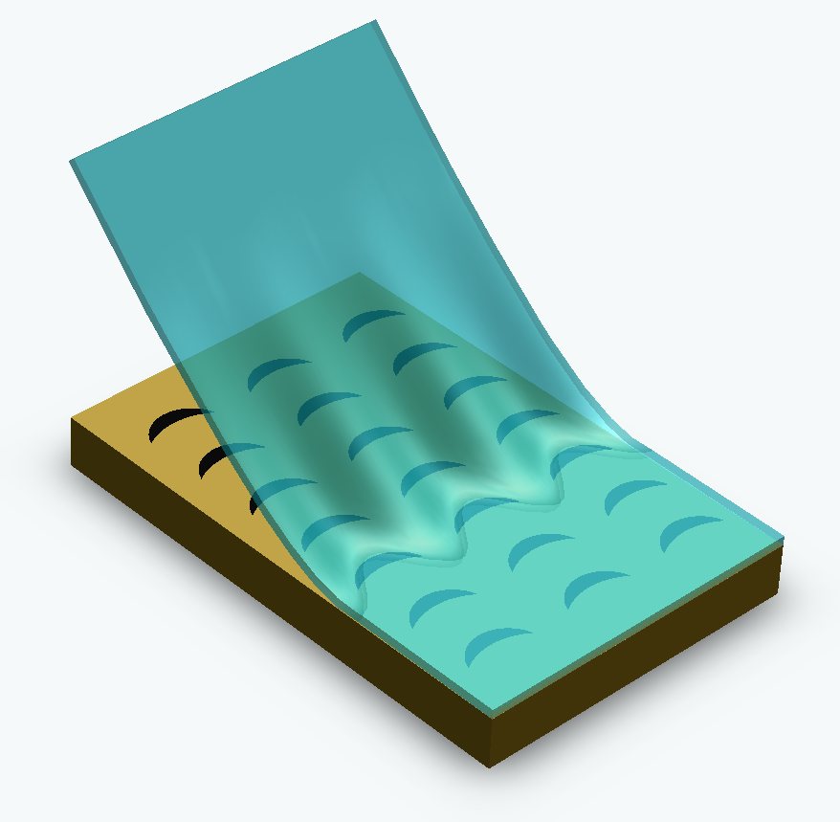
Application: Asymmetric adhesives
Easy direction
Hard direction
S. Xia, L. Ponson, G. Ravichandran and K. Bhattacharya, Phys. Rev. Lett. 2012 and International Patent 2011

Slide 7
Goal: Developing a theoretical framework that predicts the
effective resistance of heterogeneous brittle systems
Using it for designing systems with improved failure properties
Approach & outline:
1- Theoretical approach: Equation of motion for a crack in an heterogeneous material
Failure as a depinning transition
2- Confrontation with experiments in the case of materials with disordered microstructures
Effective fracture energy of disordered materials
3- Application to material design in the context of thin film adhesives
Enhancement and asymmetry of peeling strength

Slide 8
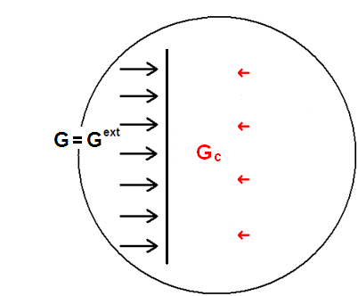
1. Theory: deriving the equation of motion of a crack
What are the effects of heterogeneities on the propagation of a crack?
G^{ext}
z
x
Notes:
coualitative

Slide 9
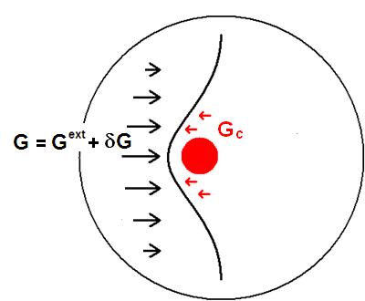
1. Theory: deriving the equation of motion of a crack
What are the effects of heterogeneities on the propagation of a crack?
Pinning of the crack front:
G^{ext}
z
x
Notes:
coualitative

Slide 10
1. Theory: deriving the equation of motion of a crack
G^{ext}
y
Real material =
Homogeneous
material
+
Fracture energy fluctuations
G_{C}(M) = <G_{C}> + δG_{c}(M)
z
x
Hypothesis:
-Brittle material
-Quasi-static crack
propagation

Slide 11
1. Theory: deriving the equation of motion of a crack
G^{ext}
y
Real material =
Homogeneous
material
+
Fracture energy fluctuations
G_{C}(M) = <G_{C}> + δG_{c}(M)
z
Random quenched noise with amplitude σ_{Gc}
x
For disordered materials
Hypothesis:
-Brittle material
-Quasi-static crack
propagation

Slide 12
1. Theory: deriving the equation of motion of a crack
G^{ext}
y
Real material =
Homogeneous
material
+
Fracture energy fluctuations
f(z,t)
G_{C}(M) = <G_{C}> + δG_{c}(M)
M
z
x
Elasticity of the material
Crack front as an elastic line:
J. Rice (1985)

Slide 13
1. Theory: deriving the equation of motion of a crack
G^{ext}
y
Real material =
Homogeneous
material
+
Fracture energy fluctuations
f(z,t)
G_{C}(M) = <G_{C}> + δG_{c}(M)
M
z
x
Elasticity of the material
Crack front as an elastic line:
J. Rice (1985)
Equation of motion for a crack
L. B. Freund (1990)

Slide 14
1. Theory: deriving the equation of motion of a crack
G^{ext}
y
Real material =
Homogeneous
material
+
Fracture energy fluctuations
f(z,t)
G_{C}(M) = <G_{C}> + δG_{c}(M)
M
z
x
Elasticity of the material
Crack front as an elastic line:
J. Rice (1985)
Equation of motion for a crack
J. Schmittbuhl et al. 1995, D. Bonamy et al. 2008, L. Ponson et al. 2010

Slide 15
1. Theory: deriving the equation of motion of a crack
G^{ext}
y
Real material =
Homogeneous
material
+
Fracture energy fluctuations
f(z,t)
G_{C}(M) = <G_{C}> + δG_{c}(M)
M
z
x
Elasticity of the material
Crack front as an elastic line:
J. Rice (1985)
Equation of motion for a crack
J. Schmittbuhl et al. 1995, D. Bonamy et al. 2008, L. Ponson et al. 2010
Crack propagation as an elastic interface driven in a heterogeneous plane

Slide 16
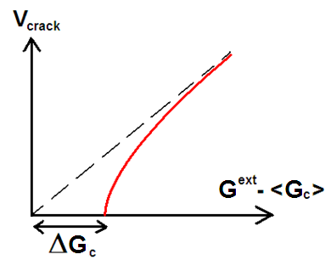
1. Theory: deriving the equation of motion of a crack
Predictions on the dynamics of cracks
G^{ext}
Variations of the average crack velocity with the external driving force
V_{crack}
G^{ext}
For disordered materials

Slide 17

1. Theory: deriving the equation of motion of a crack
Predictions on the dynamics of cracks
G^{ext}
Variations of the average crack velocity with the external driving force
V_{crack}
G^{ext}
Effective fracture energy:
Stable
Propagating
Toughening effect

Slide 18


1. Theory: deriving the equation of motion of a crack
Predictions on the dynamics of cracks
G^{ext}
Variations of the average crack velocity with the external driving force
V_{crack}
G^{ext}
Effective fracture energy:
Stable
Propagating
Toughening effect
Crack velocity:
Power law variation of the crack velocity

Slide 19
1. Theory: deriving the equation of motion of a crack
Predictions on the dynamics of cracks
G^{ext}
Variations of the average crack velocity with the external driving force
V_{crack}
G^{ext}
Effective fracture energy:
Stable
Propagating
Toughening effect
Crack velocity:
Power law variation of the crack velocity
Fluctuations of velocity
Intermittent dynamics of cracks
Power law distributed fluctuations of velocity

Slide 20
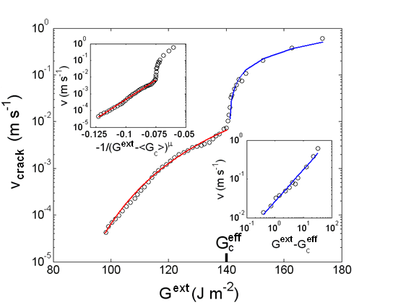
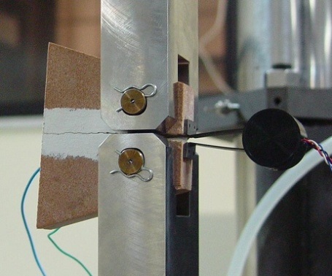
2. Confrontation with experiments on disordered materials
Confrontation with experimental observations
Variations of the average crack velocity with the external driving force
L. Ponson, Phys. Rev. Lett. 2009
Fracture test of a disordered brittle rock

Slide 21

2. Confrontation with experiments on disordered materials
Confrontation with experimental observations
Variations of the average crack velocity with the external driving force
L. Ponson, Phys. Rev. Lett. 2009
Fracture test of a disordered brittle rock
Critical regime

Slide 22


2. Confrontation with experiments on disordered materials
Confrontation with experimental observations
Variations of the average crack velocity with the external driving force
L. Ponson, Phys. Rev. Lett. 2009
Fracture test of a disordered brittle rock
Critical regime
Subcritical regime
(thermally activated)

Slide 23
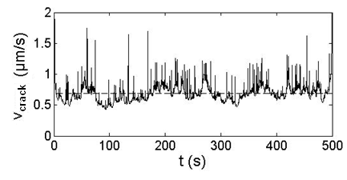
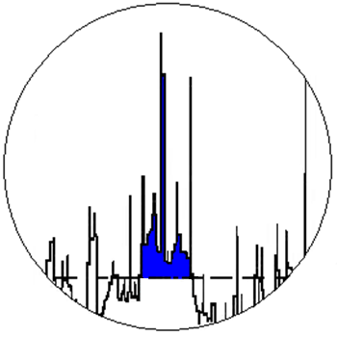
2. Confrontation with experiments on disordered materials
Confrontation with experimental observations
Variations of the average crack velocity with the external driving force
L. Ponson, Phys. Rev. Lett. 2009
Fracture test of a disordered brittle rock
Critical regime
Subcritical regime
(thermally activated)
Fluctuations of velocity
D. Bonamy, S. Santucci and L. Ponson, Phys. Rev. Lett. 2008
Variations of crack velocity as a function of time
Définition of the size S of a fluctuation

Slide 24
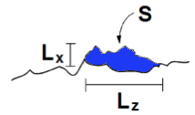
2. Confrontation with experiments on disordered materials
Confrontation with experimental observations
Variations of the average crack velocity with the external driving force
L. Ponson, Phys. Rev. Lett. 2009
Fracture test of a disordered brittle rock
Critical regime
Subcritical regime
(thermally activated)
Fluctuations of velocity
D. Bonamy, S. Santucci and L. Ponson, Phys. Rev. Lett. 2008
Variations of crack velocity as a function of time
Définition of the size S of a fluctuation

Slide 25
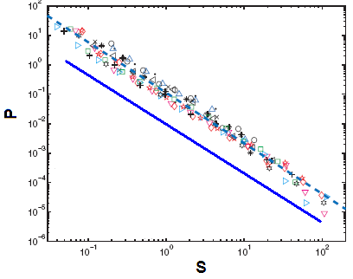
2. Confrontation with experiments on disordered materials
Confrontation with experimental observations
Variations of the average crack velocity with the external driving force
L. Ponson, Phys. Rev. Lett. 2009
Fracture test of a disordered brittle rock
Critical regime
Subcritical regime
(thermally activated)
Fluctuations of velocity
D. Bonamy, S. Santucci and L. Ponson, Phys. Rev. Lett. 2008
Variations of crack velocity as a function of time
Définition of the size S of a fluctuation
Distribution of fluctuation sizes
Experimental results, Maloy, Santucci et al.
P(S) ~ S^{-α}
with α ~ 1.65
Theoretical predictions

Slide 26
2. Confrontation with experiments on disordered materials
Confrontation with experimental observations
Variations of the average crack velocity with the external driving force
L. Ponson, Phys. Rev. Lett. 2009
Fracture test of a disordered brittle rock
Critical regime
Subcritical regime
(thermally activated)
Fluctuations of velocity
D. Bonamy, S. Santucci and L. Ponson, Phys. Rev. Lett. 2008
Variations of crack velocity as a function of time
Définition of the size S of a fluctuation
Distribution of fluctuation sizes
Experimental results, Maloy, Santucci et al.
P(S) ~ S^{-α}
with α ~ 1.65
Theoretical predictions
Failure of disordered brittle solids as a depinning transition

Slide 27
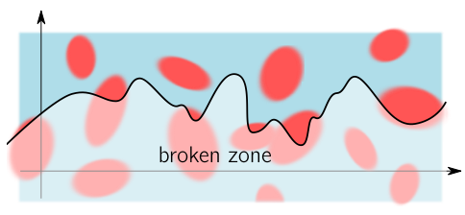
2. Effective fracture energy of disordered materials
Application: Effective fracture energy of disordered solids
Propagation direction
Equation of motion of the crack
Fracture energy randomly distributed with standard deviation σ_{Gc}

Slide 28
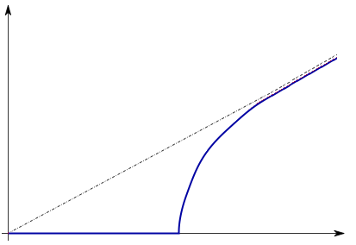
2. Effective fracture energy of disordered materials
Application: Effective fracture energy of disordered solids
Propagation direction
z
Equation of motion of the crack
Fracture energy randomly distributed with standard deviation σ_{Gc}
Effective fracture energy given by the depinning threshold
Effect of disorder strength σ_{Gc}? Of its distribution (Gaussian, bivalued…)?

Slide 29
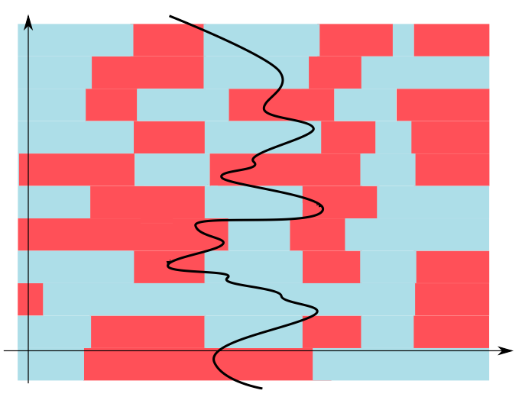
2. Effective fracture energy of disordered materials
Theory: A simplified linear model inspired by Larkin
A. Larkin and Y. Ovchinnikov (1979)
Propagation direction

Slide 30
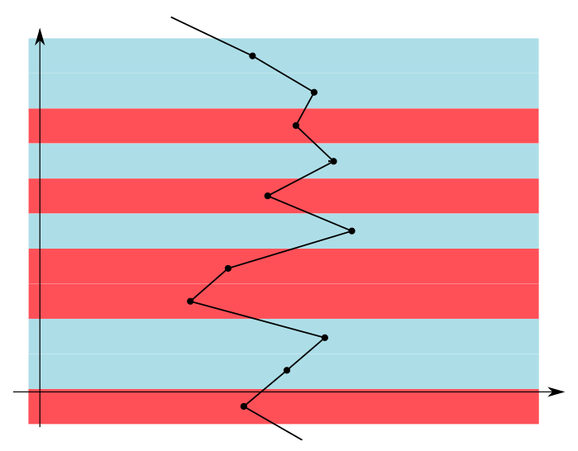
2. Effective fracture energy of disordered materials
Theory: A simplified linear model inspired by Larkin
A. Larkin and Y. Ovchinnikov (1979)
Propagation direction
Validity range: so that
z
z
Front geometry
Larkin length

Slide 31
2. Effective fracture energy of disordered materials
Theory: A simplified linear model inspired by Larkin
A. Larkin and Y. Ovchinnikov (1979)
Propagation direction
Validity range: so that
z
z
Front geometry
Larkin length
Typical resistance felt by a domain of size L
if L<ξ
if L<ξ

Slide 32
2. Effective fracture energy of disordered materials
Theory: A simplified linear model inspired by Larkin
A. Larkin and Y. Ovchinnikov (1979)
Propagation direction
Validity range: so that
z
z
Front geometry
Larkin length
Typical resistance felt by a domain of size L
Effective fracture energy
if
if L<ξ
if L<ξ
Larkin argument: critical depinning force set by the Larkin domains
Individual pinning
if
Collective pinning

Slide 33
2. Effective fracture energy of disordered materials
Simulations: collective vs individual pinning
V. Démery, A. Rosso and L. Ponson (2013)
Collective pinning
Follows theoretical predictions
Depends on σ_{Gc} only
Individual pinning
Depends on more parameters (strongest impurities)

Slide 34
2. Effective fracture energy of disordered materials
Simulations: collective vs individual pinning
V. Démery, A. Rosso and L. Ponson (2013)
Collective pinning
Follows theoretical predictions
Depends on σ_{Gc} only
Individual pinning
Depends on more parameters (strongest impurities)
Disordered induced toughening relevant for the design of stronger solids

Slide 35
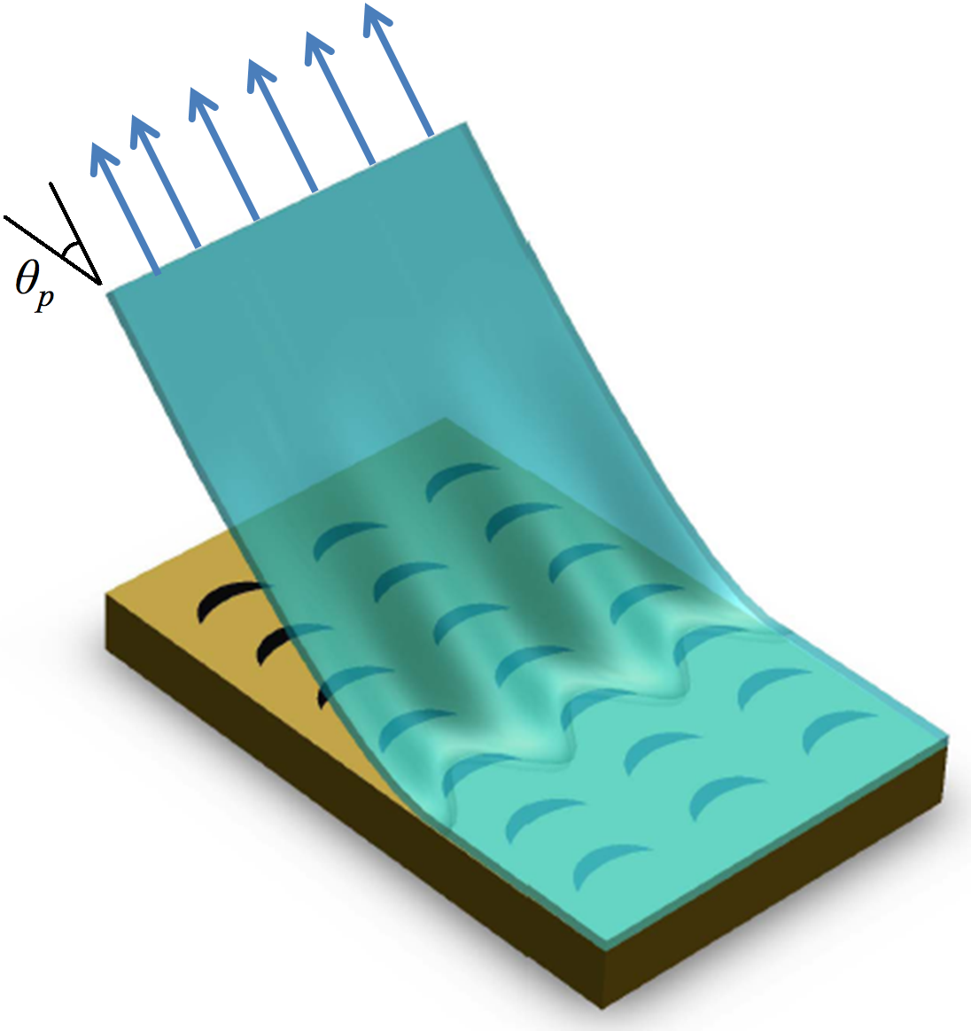
3. Toughening and asymmetry in peeling of heterogeneous adhesives
Peeling of heterogeneous adhesives
F_{p}
Equation of motion of the peeling front
Van Karman plate theory
L. Ponson et al. (2013)
z
f(z)
Local driving force:
M
x

Slide 36
3. Toughening and asymmetry in peeling of heterogeneous adhesives
Peeling of heterogeneous adhesives
F_{p}
Equation of motion of the peeling front
Van Karman plate theory
L. Ponson et al. (2013)
z
f(z)
Local driving force:
M
External driving force:
x
Displacement controlled
Hypothesis
Quasi-static propagation
Weakly heterogeneous
Brittle system

Slide 37
3. Toughening and asymmetry in peeling of heterogeneous adhesives
Peeling of heterogeneous adhesives
F_{p}
Equation of motion of the peeling front
Van Karman plate theory
L. Ponson et al. (2013)
z
f(z)
Local driving force:
M
External driving force:
x
Displacement controlled
Local field of resistance:
if M belongs to a pinning site
elsewhere

Slide 38
3. Toughening and asymmetry in peeling of heterogeneous adhesives
Peeling of heterogeneous adhesives
F_{p}
Equation of motion of the peeling front
Van Karman plate theory
L. Ponson et al. (2013)
z
f(z)
Local driving force:
M
External driving force:
x
Displacement controlled
Local field of resistance:
G^{ext}
if M belongs to a pinning site
elsewhere
Similar to crack fronts in 3D elastic solids
J. Rice (1985)

Slide 39
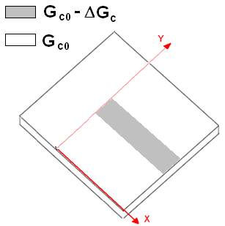
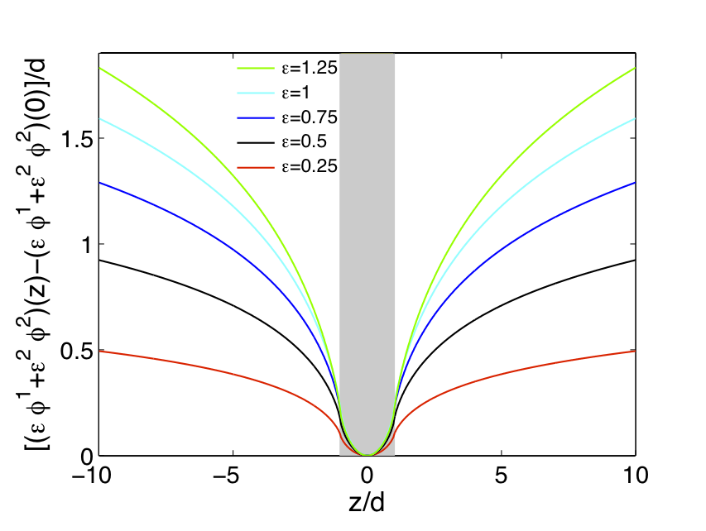
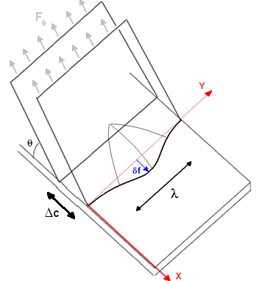
3. Toughening and asymmetry in peeling of heterogeneous adhesives
Experiments on single defects: test of the approach
Deformation of the front
z
Theoretical predictions
1.25
1.00
0.75
0.50
0.25
ContrastΔG_{c}/G_{c0}
z
x
δf/d
δf
x

Slide 40
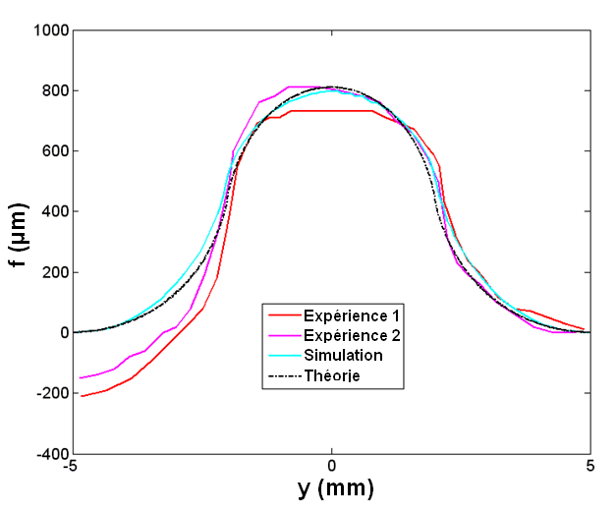



3. Toughening and asymmetry in peeling of heterogeneous adhesives
Experiments on single defects: test of the approach
z
Comparison with experiments
z
x
Δf/d
δf (μm)
δf
z (mm)
x

Slide 41
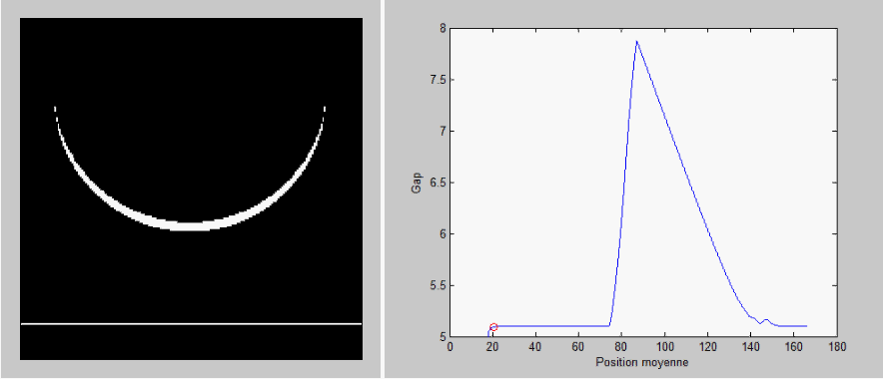
1. Theory: deriving an equation of motion for a peeling front
From the local field of fracture energy …

Slide 42
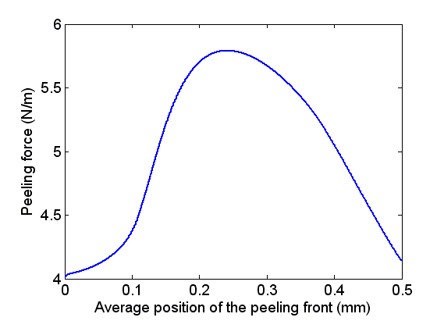
1. Theory: deriving an equation of motion for a peeling front
… to the effective adhesion properties
z
G_{max}
Peeling force G per unit length (N/m)
f(z)
Peeling force G per unit length (N/m)
M
x
Average position of the peeling front (mm)
Average position of the peeling front (mm)
Effective peeling strength

Slide 43
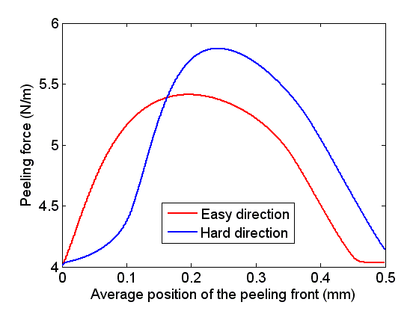
1. Theory: deriving an equation of motion for a peeling front
… to the effective adhesion properties
G_{max}^{hard}
z
G_{max}
z
G_{max}^{easy}
Easy
direction
Peeling force G per unit length (N/m)
Peeling force G per unit length (N/m)
f(z)
Peeling force G per unit length (N/m)
f(z)
M
M
Hard direction
x
x
Average position of the peeling front (mm)
Average position of the peeling front (mm)
Average position of the peeling front (mm)
Strength asymmetry

Slide 44
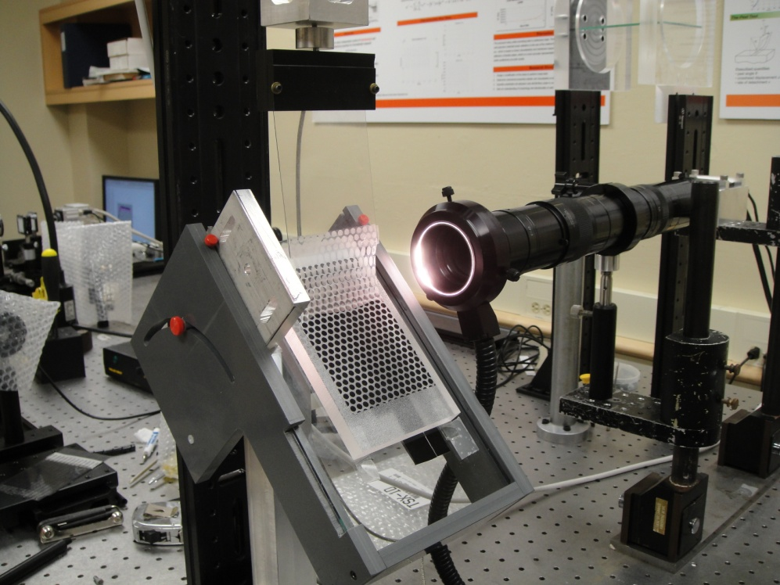
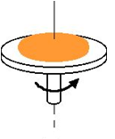
2. Confrontation with experiments on a model heterogeneous adhesive
A model system for heterogeneous adhesion
Adhesive:
PDMS thin film produced by spin coating
Substrate:
Transparent sheet printed with a standard printer
Thickness between
100µm and 3mm
Adhesion energy:
PDMS-ink
PDMS-transparent sheet
G_{c1} = 12 J.m⁻²
G_{c2} = 4 J.m⁻²
Contrast:
G_{c1}/G_{c0} ≈ 3
Local field G_{c}(M) of local adhesion energy perfectly controled and known

Slide 45
2. Confrontation with experiments on a model heterogeneous adhesive
S. Xia, L. Ponson, G. Ravichandran and K. Bhattacharya, Phys. Rev. Lett. 2012 and international patent 2011
Easy direction
Asymmetric adhesives
Hard direction

Slide 46
2. Confrontation with experiments on a model heterogeneous adhesive
S. Xia, L. Ponson, G. Ravichandran and K. Bhattacharya, Phys. Rev. Lett. 2012 and international patent 2011
Easy direction
Asymmetric adhesives
Hard direction
Optimization of the asymmetry by changing shape and contrast of pinning sites

Slide 47
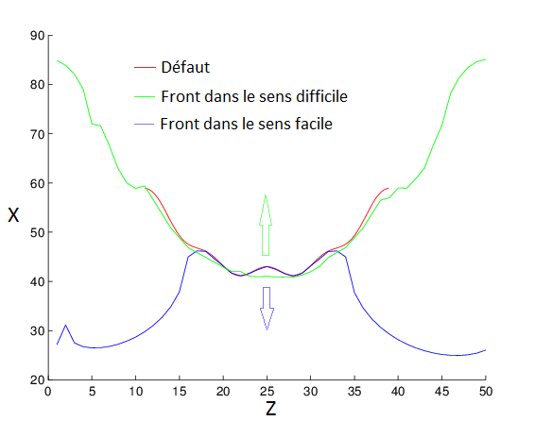
3. Optimization and design of adhesives
Optimization procedure
Algorithm predicting G_{max} from the local field G_{c}(x,z)
Genetic algorithm
A. Rosso and W. Krauth, PRE 2001
BIANCA algorithm, Vincenti et al., J. Glob. Opt. 2010
Defect
Front in the difficult direction
Front in the easy direction
Elementary cell L_{z} x L_{x}

Slide 48
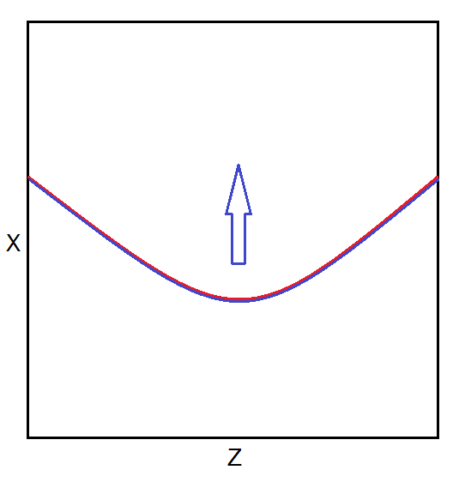
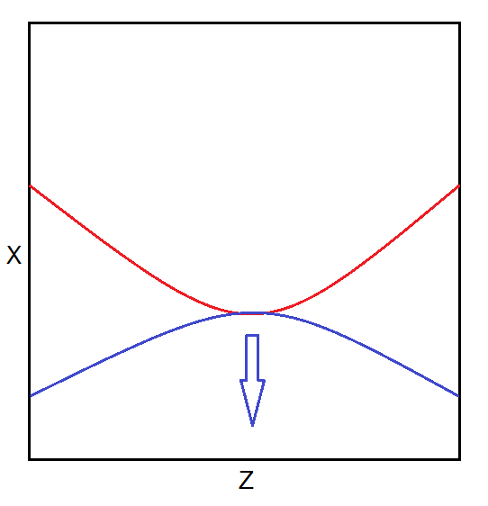
3. Optimization and design of adhesives
Optimization result
Thin defects with U shape
G_{c1} as upper bound of G^{hard}
G_{c0} as lower bound of G^{easy}
Asymmetry ≤ G_{c1}/G_{c0}

Slide 49
3. Optimization and design of adhesives
Parametric study
Defect shape
G_{c0}
G_{c1}
f/d
y/d
z/d
Equilibrium shape of a front crossing a stripe with larger adhesion energy
M. Vasoya, J.B. Leblond and L. Ponson IJSS 2012

Slide 50
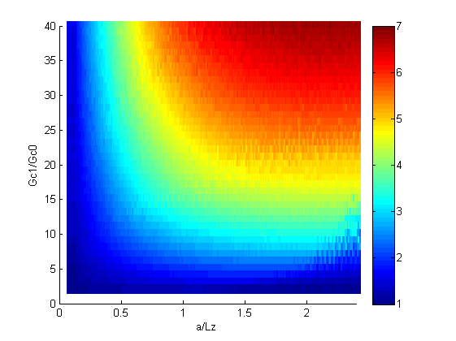
3. Optimization and design of adhesives
Parametric study
Asymmetry
Defect shape
G_{c0}
G_{c1}
Contrast C = G_{c1}/G_{c0}
f/d
y/d
Defect width d/L_{y} normalized by the cell width
Equilibrium shape of a front crossing a stripe with larger adhesion energy
M. Vasoya, J.B. Leblond and L. Ponson IJSS 2013

Slide 51
Beyond asymmetry:
how achieving enhanced peel strength

Slide 52
Beyond asymmetry:
how achieving enhanced peel strength
Heterogeneities of adhesion energy
Effective peeling strength bonded by the max of the local G_{c}
Heterogeneities of elastic stiffness

Slide 53
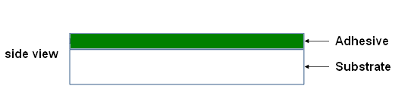
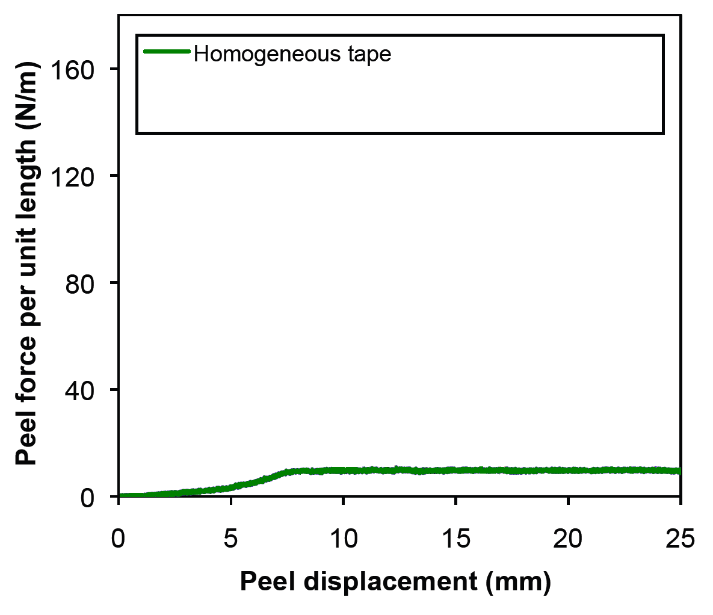

Adhesives with elastic heterogeneities: experimental study

Slide 54
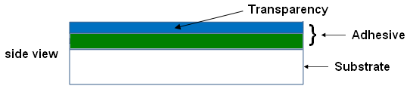
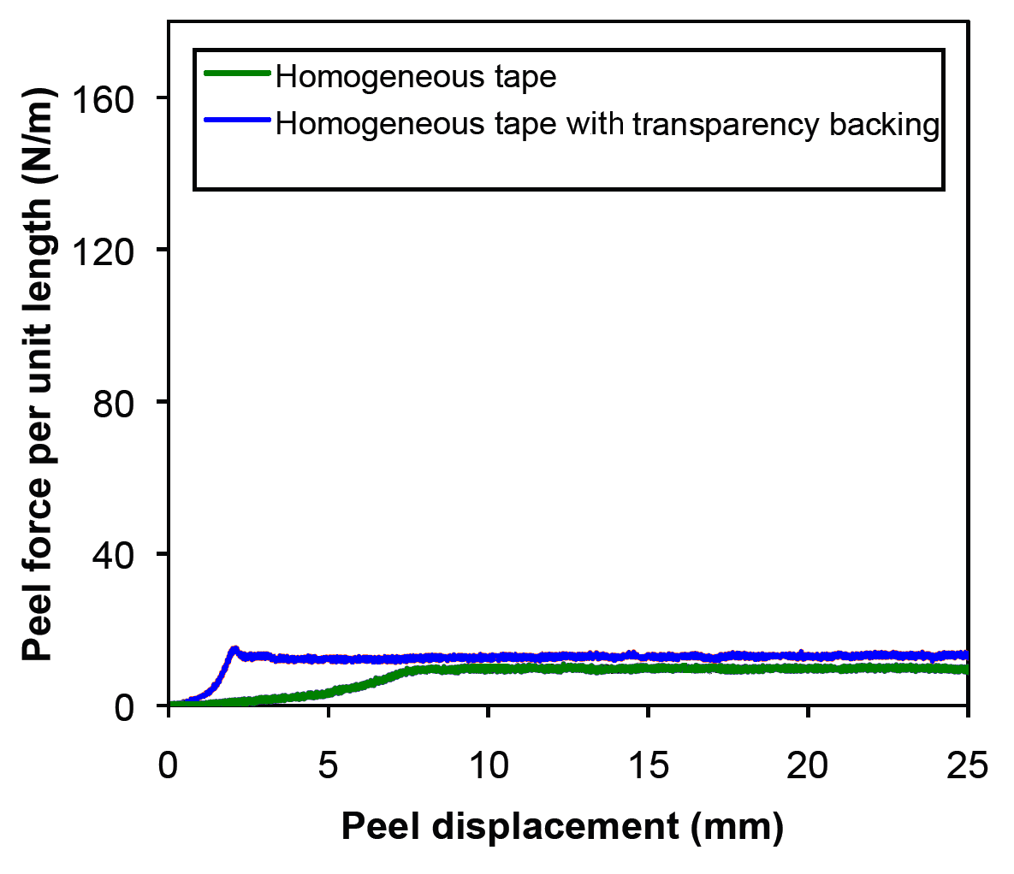
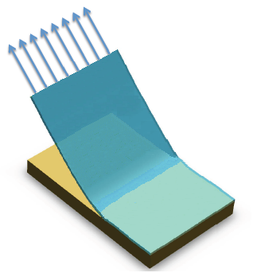
Adhesives with elastic heterogeneities: experimental study

Slide 55
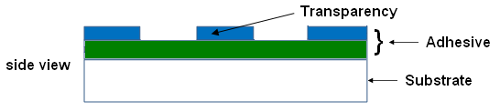
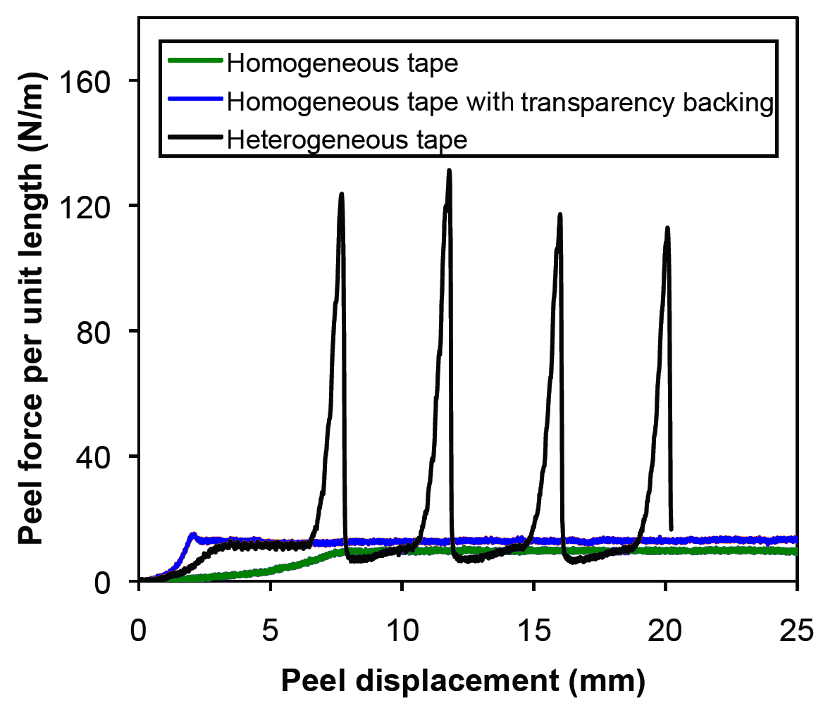

Adhesives with elastic heterogeneities: experimental study
Dramatic increase of the effective peeling force

Slide 56
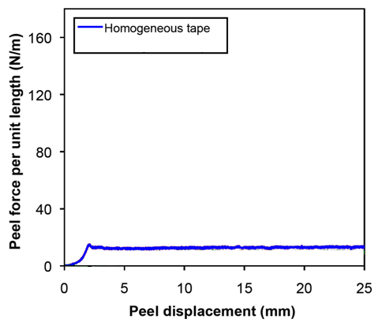
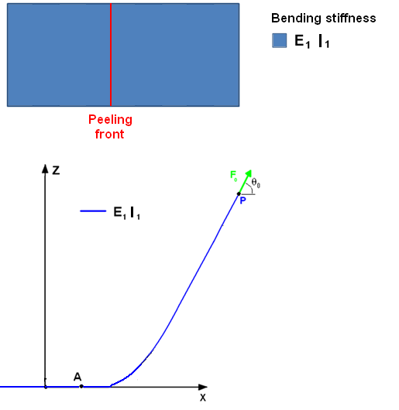
Peeling mechanism: homogeneous tape
Bending stiffness: D = EI
with moment of inertia: I = bh³/12
b

Slide 57
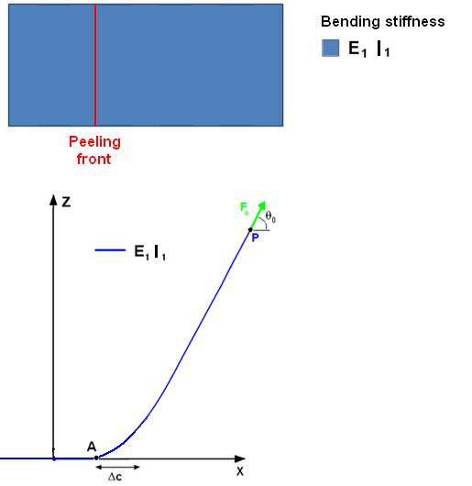
Peeling mechanism: homogeneous tape
Bending stiffness: D = EI
with moment of inertia: I = bh³/12
b

Slide 58
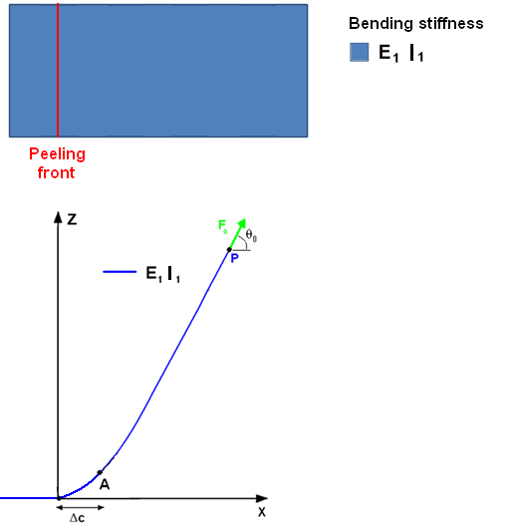
Peeling mechanism: homogeneous tape
Bending stiffness: D = EI
with moment of inertia: I = bh³/12
b

Slide 59
Peeling mechanism: homogeneous tape
Bending stiffness: D = EI
with moment of inertia: I = bh³/12
b
During the peeling process, for a propagation over Δc:
W_{F0} = ∆E_{s} + ∆E_{el}

Slide 60
Peeling mechanism: homogeneous tape
Bending stiffness: D = EI
with moment of inertia: I = bh³/12
b
During the peeling process, for a propagation over Δc:
X
W_{F0} = ∆E_{s} + ∆E_{el}
F₀ Δc (1-cosθ₀)
G_{c} bΔc

Slide 61
Peeling mechanism: homogeneous tape
Bending stiffness: D = EI
with moment of inertia: I = bh³/12
b
During the peeling process, for a propagation over Δc:
X
W_{F0} = ∆E_{s} + ∆E_{el}
F₀ Δc (1-cosθ₀)
G_{c} bΔc
Peeling force
F_{c} = bG_{c}/(1-cosθ₀)
R. S. Rivlin 1944

Slide 62
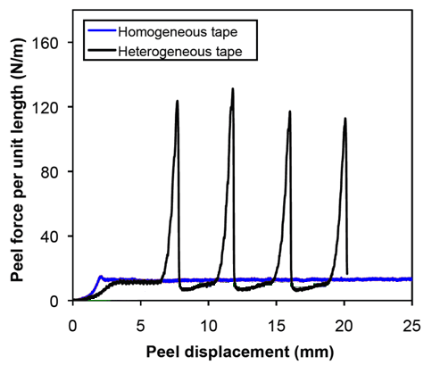
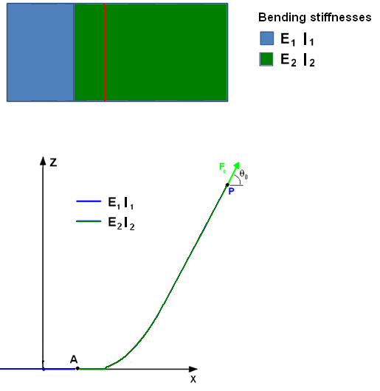
Toughening mechanism: heterogeneous tape
Simplest system that could give rise to toughening
One interface + inextensible tape

Slide 63
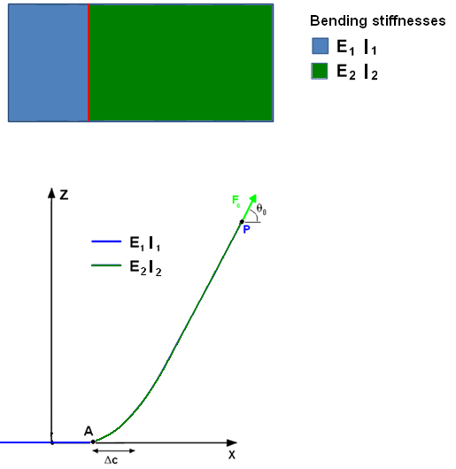
Toughening mechanism: heterogeneous tape
Simplest system that could give rise to toughening
One interface + inextensible tape

Slide 64
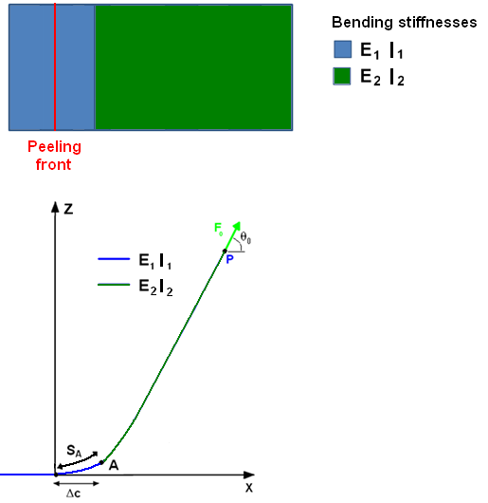
Toughening mechanism: heterogeneous tape
Simplest system that could give rise to toughening
One interface + inextensible tape

Slide 65
Toughening mechanism: heterogeneous tape
Simplest system that could give rise to toughening
One interface + inextensible tape
During the peeling process, for a propagation over Δc:
W_{F0} = ∆E_{s} + ∆E_{el}

Slide 66
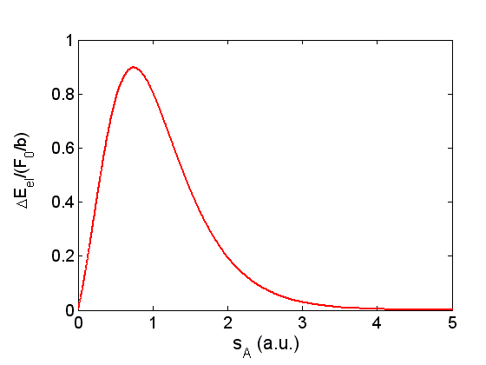
Toughening mechanism: heterogeneous tape
Simplest system that could give rise to toughening
One interface + inextensible tape
During the peeling process, for a propagation over Δc:
W_{F0} = ∆E_{s} + ∆E_{el}
Variation of the bending energy
Euler-Bernoulli beam theory

Slide 67
Toughening mechanism: heterogeneous tape
Simplest system that could give rise to toughening
One interface + inextensible tape
During the peeling process, for a propagation over Δc:
W_{F0} = ∆E_{s} + ∆E_{el}
Euler-Bernoulli beam theory

Slide 68
Toughening mechanism: heterogeneous tape
Simplest system that could give rise to toughening
One interface + inextensible tape
h₁/h₂ = 2
F^{het} /F^{hom} ≈ 8
During the peeling process, for a propagation over Δc:
W_{F0} = ∆E_{s} + ∆E_{el}
Euler-Bernoulli beam theory

Slide 69
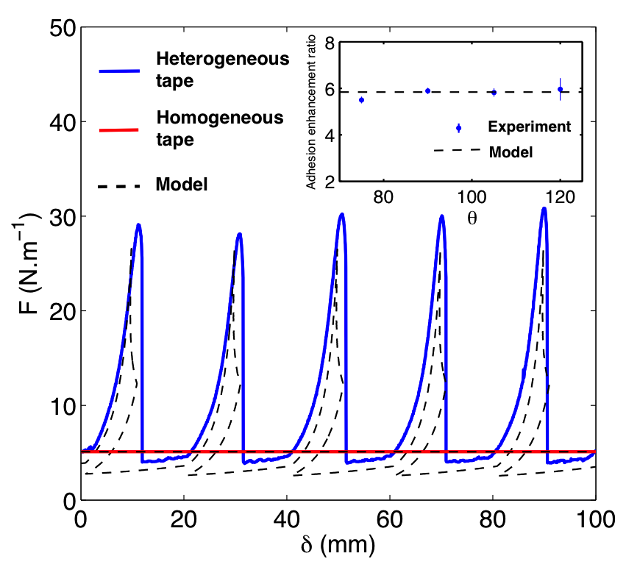
Adhesives with stripes of alternated stiffness
Adhesive described as a beam with alternating stiffness/bending rigidity
Work of the peel force used to bend the stiffer domains
d
Driven away from the peel front
For d>λ_{b}
S. Xia, L. Ponson, G. Ravichandran and K. Bhattacharya, J. Mech. Phys. Solids (2013)
Notes:
So now, I would like to go beyond pinning of crack fronts by adhesion energy heterogeneities, and tell you a word about the effect of elastic properties heterogeneities

Slide 70
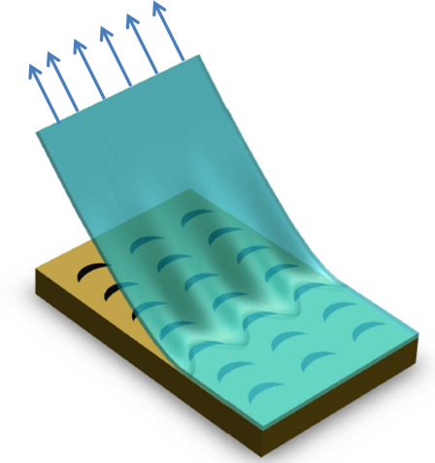
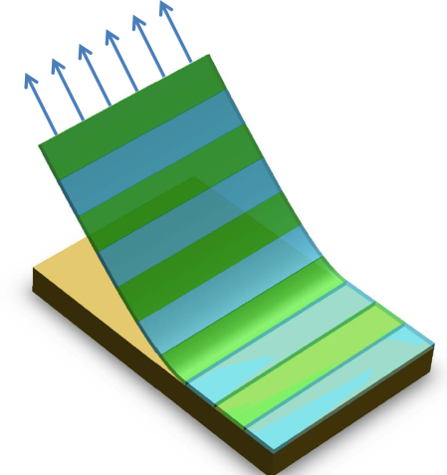
Conclusions
Spatial distribution of heterogeneities at the microscale
Effectives adhesion properties of thin films
Application: design of adhesives with new and improved properties

Slide 71
Acknowledgements
To my collaborators and student
Shuman Xia, Guruswami Ravichandran, Kaushik Bhattacharya (Caltech)
Alberto Rosso (ENS, Paris)
Vincent Demery (Post-doc)
To my sources of funding
Marie Curie fellowship (FP7 of European Union)
Integration grant (FP7 of European Union)

Slide 72
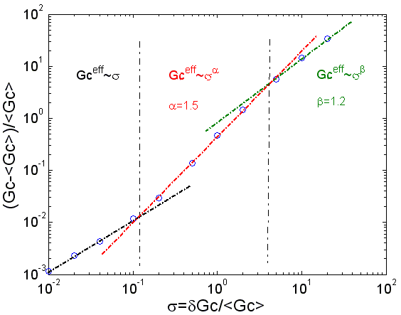

…and perspectives
Toughening in 3D brittle solids
Induced by collective pinning for materials with a disordered microstructure
Effective resistance as a function of δG_{c}
Induced by elastic heterogeneities, inspired by the adhesion enhancement mechanisms
Extension of this theoretical framework to quasi-brittle solids

Slide 73



Interaction between a crack front and material heterogeneties: dramatatic effects at all scales
Large scale roughness on fracture surfaces
Silica glass
(courtesy of M. Ciccotti et al.)
Sandstone
L. Ponson et al. PRE 07
Scale of heterogeneities in sandstone
.
Intermittent crack dynamics
K. Måløy et al. PRL 2006, D. Bonamy, S. Santucci and L. Ponson PRL 2008
Direction of
propagation
Notes:
Why is microstructure so important: because its effect is felt at all length scales
Here, two examples to illustrate this effect
(i) fracture surfaces:
Roughness with universal scaling properties observed at scales much larger than heterogeneity size in these materials
(ii) Crack dynamics:
Crack is observed to propagate through jumps with typical size much larger than heterogeneity size
Main question: how to bridge microscale properties of materials with their macroscopic failure properties

Slide 74
The crack tip as a magnifying glass of the material heterogeneities
σ₀
σ₀
Notes:
Difficulty:
Stress concentration at crack tip makes the system response very sensitive to the local properties of the material
As a result predicting macro scale properties of solids from their microscale characteristics is a very challenging task

Slide 75
The crack tip as a magnifying glass of the material heterogeneities
σ₀
Stress fied diverges at the crack tip
σ (r)
r
σ₀
Macroscopic response depends strongly on the material properties at the microstructure scale
Notes:
Difficulty:
Stress concentration at crack tip makes the system response very sensitive to the local properties of the material
As a result predicting macro scale properties of solids from their microscale characteristics is a very challenging task

Slide 76
The crack tip as a magnifying glass of the material heterogeneities
σ₀
Stress fied diverges at the crack tip
σ (r)
r
σ₀
Macroscopic response depends strongly on the material properties at the microstructure scale
Opens the door to microstructure design in order to achieve improved failure properties
Notes:
However, good news, this effect opens the door to the design of heterogeneous brittle solids with improved failure properties, by taking advantage of the interaction between the crack front and the material microstructure

Slide 77
1. Theory: deriving an equation of motion for a crack or a peeling front
What are the effects of heterogeneities on the propagation of a crack?
G^{ext}
z
x
Notes:
coualitative

Slide 78
1. Theory: deriving an equation of motion for a crack or a peeling front
What are the effects of heterogeneities on the propagation of a crack?
Pinning of the crack front:
G^{ext}
z
x
Notes:
coualitative

Slide 79
1. Theory: deriving an equation of motion for a crack or a peeling front
G^{ext}
y
Resistance of a real material
=
Average resistance
+
Fluctuating part
.
G_{C}(M) = <G_{C}> + δG_{c}(M)
M
with <δG_{c}>=0
z
x
Hypothesis
Brittle material
Quasi-static propagation
Weakly heterogeneous

Slide 80
1. Theory: deriving an equation of motion for a crack or a peeling front
G^{ext}
y
Resistance of a real material
=
Average resistance
+
Fluctuating part
.
f(z,t)
G_{C}(M) = <G_{C}> + δG_{c}(M)
M
with <δG_{c}>=0
z
x
Elasticity of the material
Crack front as an elastic line:
J. R. Rice (1985)

Slide 81
1. Theory: deriving an equation of motion for a crack or a peeling front
G^{ext}
y
Resistance of a real material
=
Average resistance
+
Fluctuating part
.
f(z,t)
G_{C}(M) = <G_{C}> + δG_{c}(M)
M
with <δG_{c}>=0
z
x
Elasticity of the material
Crack front as an elastic line:
J. R. Rice (1985)
Equation of motion for a crack
L. B. Freund (1990)

Slide 82
1. Theory: deriving an equation of motion for a crack or a peeling front
G^{ext}
y
Resistance of a real material
=
Average resistance
+
Fluctuating part
.
f(z,t)
G_{C}(M) = <G_{C}> + δG_{c}(M)
M
with <δG_{c}>=0
z
x
Elasticity of the material
Crack front as an elastic line:
J. R. Rice (1985)
Equation of motion for a crack
J. Schmittbuhl et al. PRL 1995, L. Ponson PRL 2009, L. Ponson et al., IJF 2010

Slide 83



2. Experiments: peeling of thin films with controlled heterogeneities
Experimental setup
Peeling of an PDMS thin film from a printed heterogeneous substrate
Perturbation of the front: comparison theory/experiment
h=1.2mm
G_{c}^{PDMS-ink} = 1.4 J.m⁻²
G_{c}^{PDMS-transparent} = 6 J.m⁻²

Slide 84
3. Application to the design of adhesives with improved properties
Experimental study of the effect of elastic heterogeneities
Notes:
So now, I would like to go beyond pinning of crack fronts by adhesion energy heterogeneities, and tell you a word about the effect of elastic properties heterogeneities

Slide 85
3. Application to the design of adhesives with improved properties
Experimental study of the effect of elastic heterogeneities
Notes:
So now, I would like to go beyond pinning of crack fronts by adhesion energy heterogeneities, and tell you a word about the effect of elastic properties heterogeneities

Slide 86
3. Application to the design of adhesives with improved properties
Experimental study of the effect of elastic heterogeneities
Dramatic increase of the effective peeling force
Notes:
So now, I would like to go beyond pinning of crack fronts by adhesion energy heterogeneities, and tell you a word about the effect of elastic properties heterogeneities

Slide 87
3. Application to the design of adhesives with improved properties
Peeling mechanisms: homogeneous tape
Bending stiffness: EI
Moment of inertia: I = bh³/12
b

Slide 88
3. Application to the design of adhesives with improved properties
Peeling mechanisms: homogeneous tape
Bending stiffness: EI
Moment of inertia: I = bh³/12

Slide 89
3. Application to the design of adhesives with improved properties
Peeling mechanisms: homogeneous tape
Bending stiffness: EI
Moment of inertia: I = bh³/12

Slide 90
3. Application to the design of adhesives with improved properties
Peeling mechanisms: homogeneous tape
Bending stiffness: EI
Moment of inertia: I = bh³/12
During the peeling process, for a propagation over Δc:
W_{F0} = ∆E_{s} + ∆E_{el}
R. S. Rivlin 1944

Slide 91
3. Application to the design of adhesives with improved properties
Peeling mechanisms: homogeneous tape
Bending stiffness: EI
Moment of inertia: I = bh³/12
During the peeling process, for a propagation over Δc:
X
W_{F0} = ∆E_{s} + ∆E_{el}
F₀ Δc (1-cosθ₀)
G_{c} bΔc

Slide 92
3. Application to the design of adhesives with improved properties
Peeling mechanisms: homogeneous tape
Bending stiffness: EI
Moment of inertia: I = bh³/12
During the peeling process, for a propagation over Δc:
X
W_{F0} = ∆E_{s} + ∆E_{el}
F₀ Δc (1-cosθ₀)
G_{c} bΔc
Peeling force
F_{c} = bG_{c}/(1-cosθ₀)
R. S. Rivlin 1944

Slide 93
3. Application to the design of adhesives with improved properties
Peeling mechanisms: heterogeneous tape
Simplest system susceptible to give rise to toughening
One interface + inextensible

Slide 94
3. Application to the design of adhesives with improved properties
Peeling mechanisms: heterogeneous tape
Simplest system susceptible to give rise to toughening
One interface + inextensible

Slide 95
3. Application to the design of adhesives with improved properties
Peeling mechanisms: heterogeneous tape
Simplest system susceptible to give rise to toughening
One interface + inextensible

Slide 96
3. Application to the design of adhesives with improved properties
Peeling mechanisms: heterogeneous tape
Simplest system susceptible to give rise to toughening
One interface + inextensible
During the peeling process, for a propagation over Δc:
W_{F0} = ∆E_{s} + ∆E_{el}

Slide 97
3. Application to the design of adhesives with improved properties
Peeling mechanisms: heterogeneous tape
Simplest system susceptible to give rise to toughening
One interface + inextensible
During the peeling process, for a propagation over Δc:
W_{F0} = ∆E_{s} + ∆E_{el}
Variation of the bending energy
Euler-Bernoulli beam theory

Slide 98
3. Application to the design of adhesives with improved properties
Peeling mechanisms: heterogeneous tape
Simplest system susceptible to give rise to toughening
One interface + inextensible
During the peeling process, for a propagation over Δc:
W_{F0} = ∆E_{s} + ∆E_{el}
Variation of the bending energy
Euler-Bernoulli beam theory

Slide 99
3. Application to the design of adhesives with improved properties
Peeling mechanisms: heterogeneous tape
Simplest system susceptible to give rise to toughening
One interface + inextensible
h₁/h₂ = 2
F^{het} /F^{hom} = 8
During the peeling process, for a propagation over Δc:
W_{F0} = ∆E_{s} + ∆E_{el}
Variation of the bending energy
S. Xia, L. Ponson, G. Ravichandran and K. Bhattacharya (Submitted)
Euler-Bernoulli beam theory

Slide 100
3. Application to the design of adhesives with improved properties
Toughening mechanism: numerical investigation
S. Xia, L. Ponson, G. Ravichandran and K. Bhattacharya
US and international patent application 61/290, 133 (2010)
Finite element simulations with cohesive zone model

Slide 101
2. Effective fracture energy of disordered materials
Application: Effective fracture energy of disordered solids
Propagation direction
z
Normalized equation of motion of the crack
Fracture energy fluctuations
distributed in P(g_{c})
Effective fracture energy given by the depinning threshold
Effect of disorder strength σ? Of its distribution P (Gaussian, bivalued…)?

Slide 102
2. Effective fracture energy of disordered materials
A simplified (linear) model
Propagation direction
Validity range: so that
Front geometry
Larkin length
Typical resistance felt by a domain of size L given by
Effective fracture energy
if L_{Larkin}<ξ
if L_{Larkin}<ξ
if L<ξ
if L<ξ
Larkin argument: critical depinning force set by the Larkin domains
Individual pinning
Collective pinning

