Slide 1
On obtaining a polynomial as a projection of another polynomial
Neeraj Kayal
Microsoft Research

Slide 2
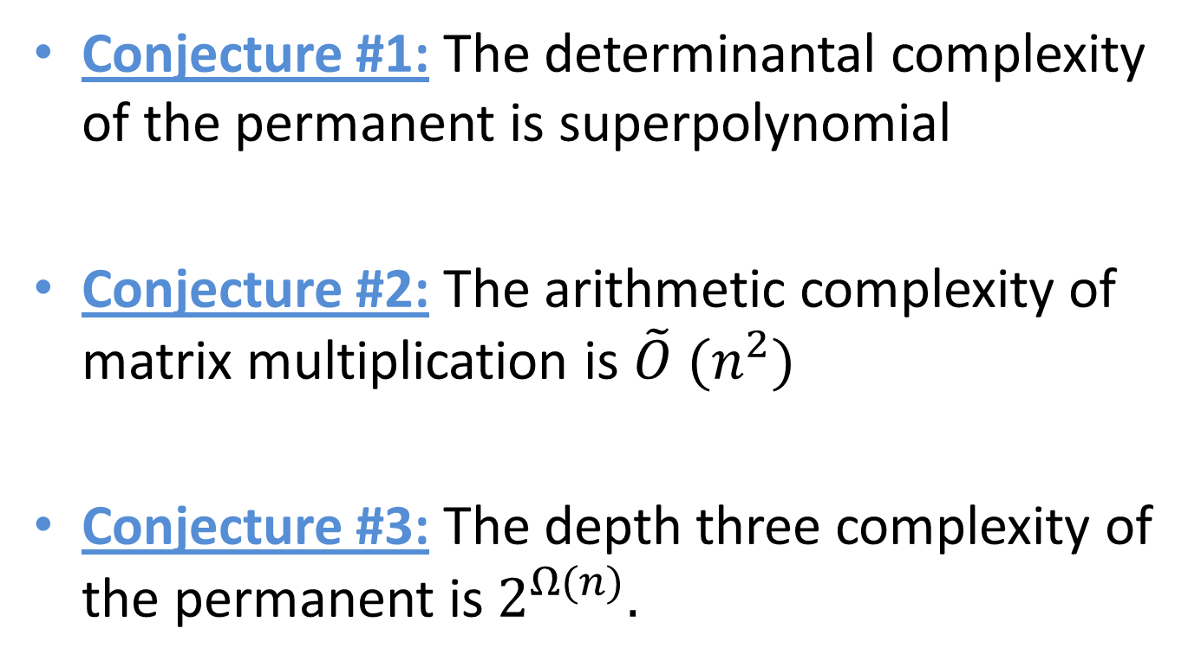
A dream
Conjecture #1: The determinantal complexity of the permanent is superpolynomial
Conjecture #2: The arithmetic complexity of matrix multiplication is $\tilde{O} (n^{2})$
Conjecture #3: The depth three complexity of the permanent is $2^{Ω(n)}.$

Slide 3
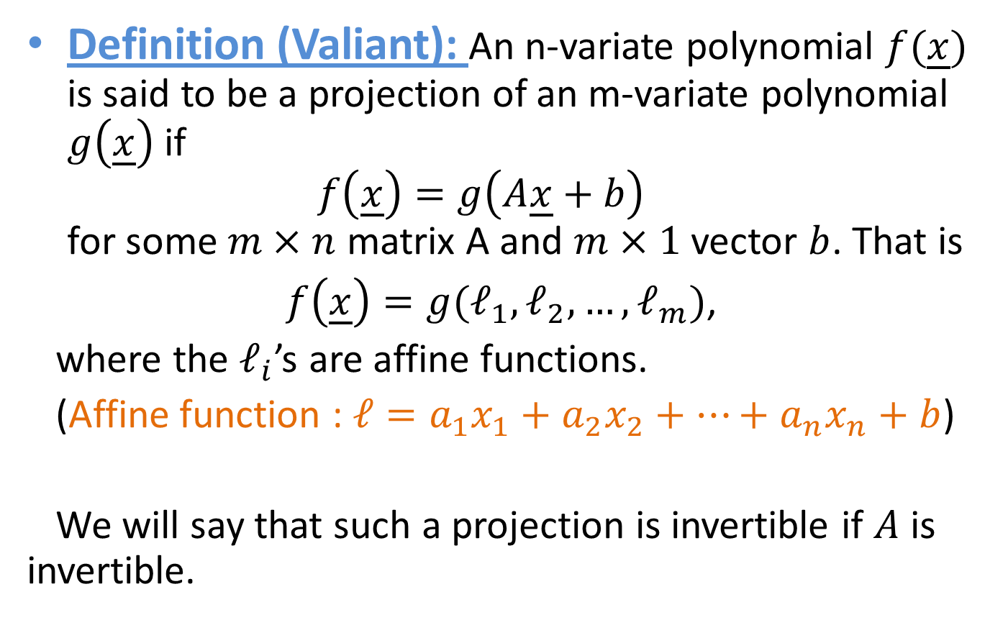
Projections of polynomials
Definition (Valiant): An n-variate polynomial $f(\underline{x})$ is said to be a projection of an m-variate polynomial $g\left(\underline{x}\right)$ if
$f\left(\underline{x}\right)=g\left(A\underline{x}+b\right)$
for some $m×n$ matrix A and $m×1$ vector $b$. That is
$f\left(\underline{x}\right)=g(ℓ_{1},ℓ_{2},…,ℓ_{m})$,
where the $ℓ_{i}$’s are affine functions.
(Affine function : $ℓ=a_{1}x_{1}+a_{2}x_{2}+…+a_{n}x_{n}+b$)
We will say that such a projection is invertible if $A$ is invertible.

Slide 4
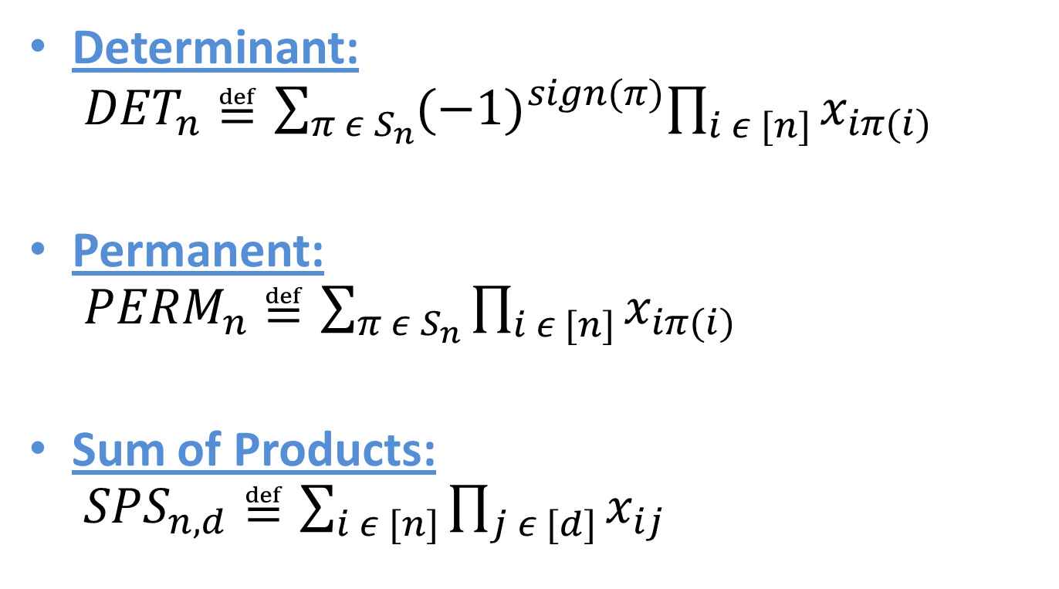
Some families of polynomials
Determinant:
${DET}_{n}≝\sum_{π ε S_{n}}{{(−1)}^{sign(π)}\prod_{i ε [n]}{x_{iπ(i)}}}$
Permanent:
${PERM}_{n}≝\sum_{π ε S_{n}}{\prod_{i ε [n]}{x_{iπ(i)}}}$
Sum of Products:
${SPS}_{n,d}≝\sum_{i ε [n]}{\prod_{j ε [d]}{x_{ij}}}$

Slide 5
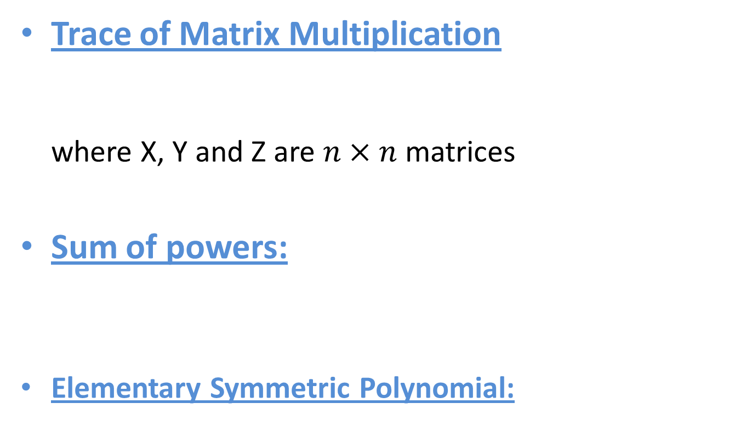
Some families of polynomials
Trace of Matrix Multiplication
where X, Y and Z are $n×n$ matrices
Sum of powers:
Elementary Symmetric Polynomial:

Slide 6
The dream
Conjecture #1: The determinantal complexity of the permanent is superpolynomial
Conjecture #2: The arithmetic complexity of matrix multiplication is $\tilde{O} (n^{2})$
Conjecture #3: The depth three complexity of the permanent is $2^{Ω(n)}.$

Slide 7
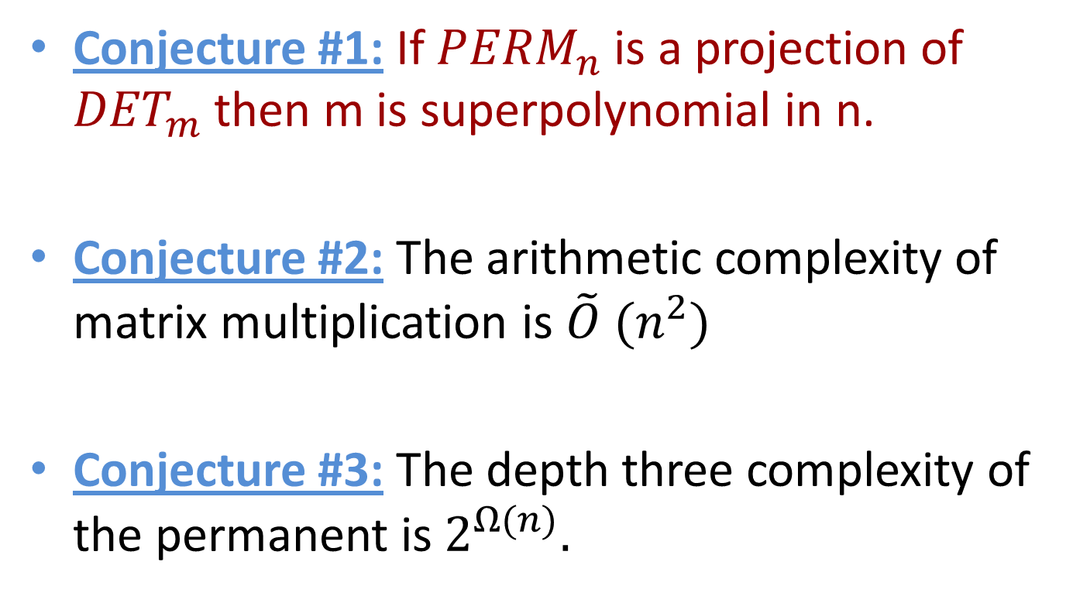
The dream
Conjecture #1: If ${PERM}_{n}$ is a projection of ${DET}_{m}$ then m is superpolynomial in n.
Conjecture #2: The arithmetic complexity of matrix multiplication is $\tilde{O} (n^{2})$
Conjecture #3: The depth three complexity of the permanent is $2^{Ω(n)}.$

Slide 8
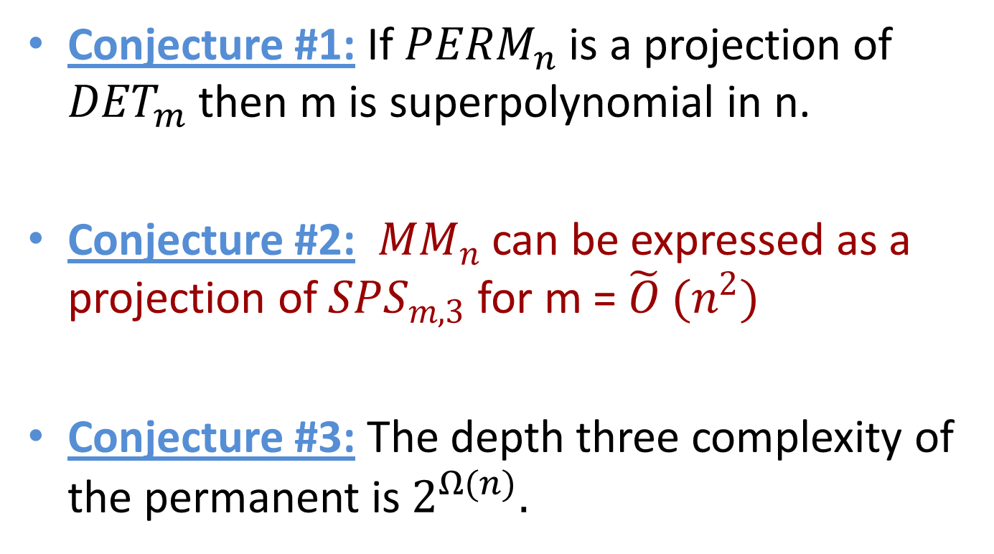
The dream
Conjecture #1: If ${PERM}_{n}$ is a projection of ${DET}_{m}$ then m is superpolynomial in n.
Conjecture #2: ${ MM}_{n}$ can be expressed as a projection of ${SPS}_{m,3}$ for m = $\tilde{O} (n^{2})$
Conjecture #3: The depth three complexity of the permanent is $2^{Ω(n)}.$

Slide 9
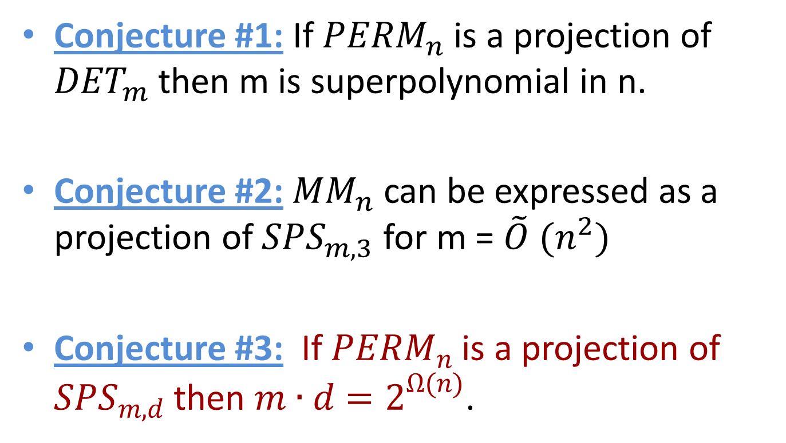
The dream
Conjecture #1: If ${PERM}_{n}$ is a projection of ${DET}_{m}$ then m is superpolynomial in n.
Conjecture #2:${ MM}_{n}$ can be expressed as a projection of ${SPS}_{m,3}$ for m = $\tilde{O} (n^{2})$
Conjecture #3: If ${PERM}_{n}$ is a projection of ${SPS}_{m,d}$ then $m∙d=2^{Ω(n)}$.

Slide 10
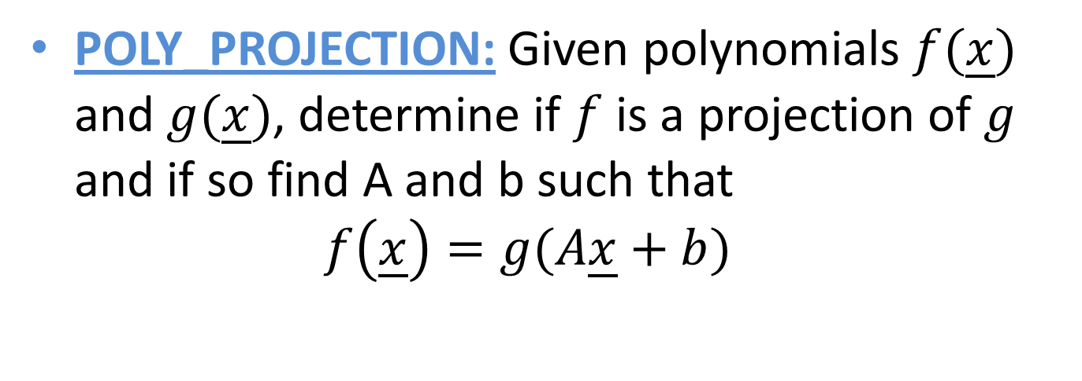
A computational problem
POLY_PROJECTION: Given polynomials $f(\underline{x})$ and $g(\underline{x})$, determine if $f$ is a projection of $g$ and if so find A and b such that
$f\left(\underline{x}\right)=g(A\underline{x}+b)$

Slide 11
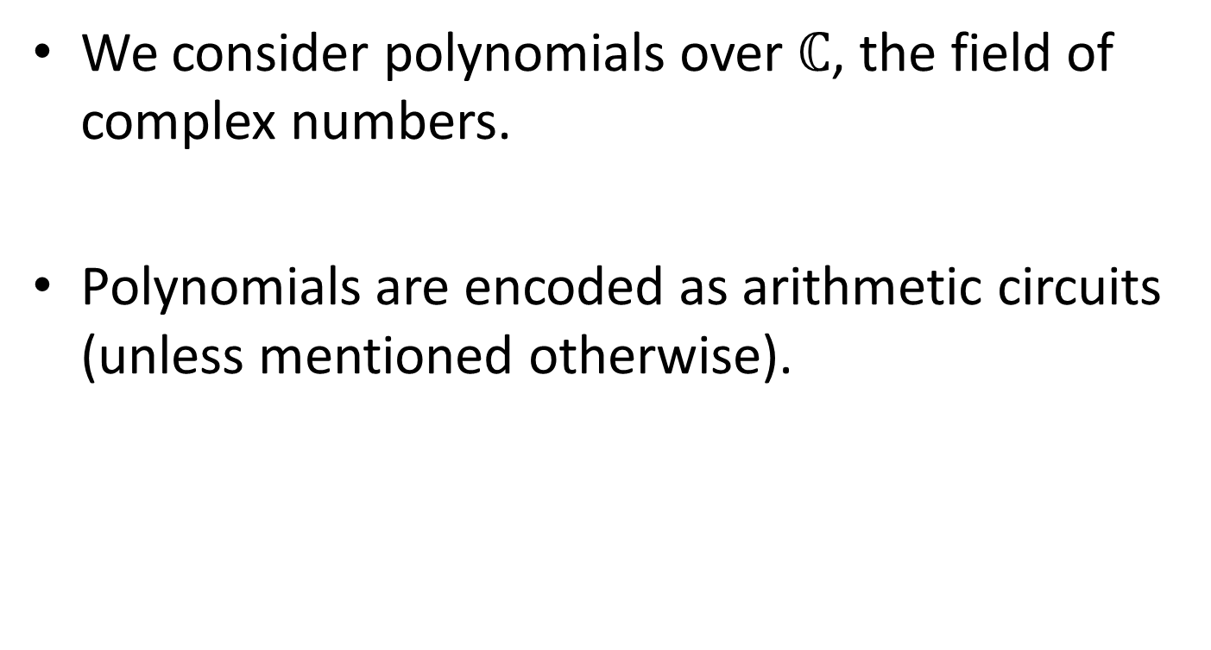
Some conventions
We consider polynomials over $ℂ$, the field of complex numbers.
Polynomials are encoded as arithmetic circuits (unless mentioned otherwise).

Slide 12
Unfortunately …
Theorem: POLY_PROJECTION is NP-complete.

Slide 13
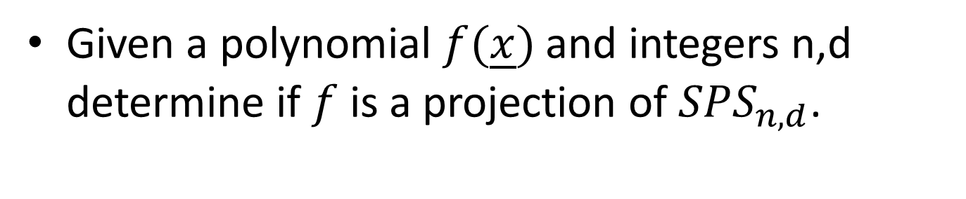
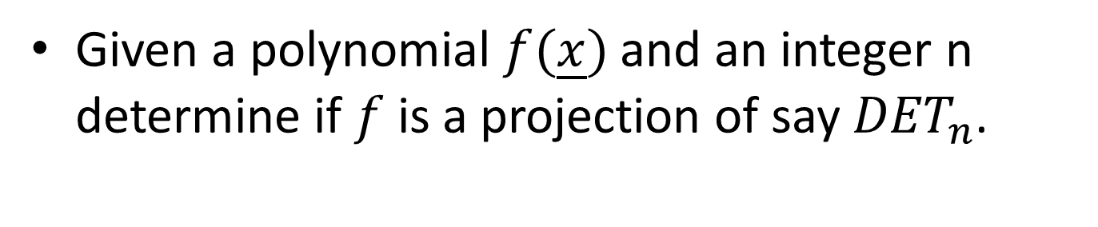
A more modest ambition
Given a polynomial $f(\underline{x})$ and an integer n determine if $f$ is a projection of say ${DET}_{n}$.
Given a polynomial $f(\underline{x})$ and integers n,d determine if $f$ is a projection of ${SPS}_{n,d}$.

Slide 14
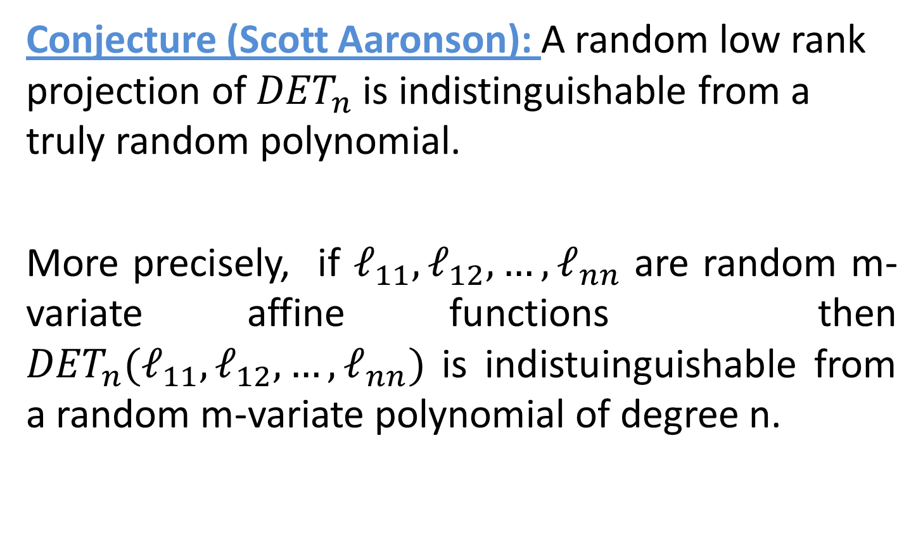
A conjecture
Conjecture (Scott Aaronson): A random low rank projection of ${DET}_{n}$ is indistinguishable from a truly random polynomial.
More precisely, if $ℓ_{11},ℓ_{12}, …, ℓ_{nn}$ are random m-variate affine functions then ${DET}_{n}(ℓ_{11},ℓ_{12}, …, ℓ_{nn})$ is indistuinguishable from a random m-variate polynomial of degree n.

Slide 15
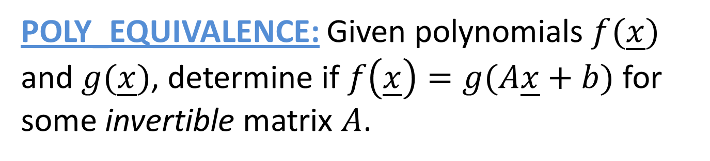
Polynomial Equivalence
POLY_EQUIVALENCE: Given polynomials $f(\underline{x})$ and $g(\underline{x})$, determine if $f\left(\underline{x}\right)=g(A\underline{x}+b)$ for some invertible matrix $A$.
Theorem (Agrawal-Saxena): POLY_EQUIVALENCE is at least as hard as graph isomorphism.
(Probably much harder than graph isomorphism.)

Slide 16
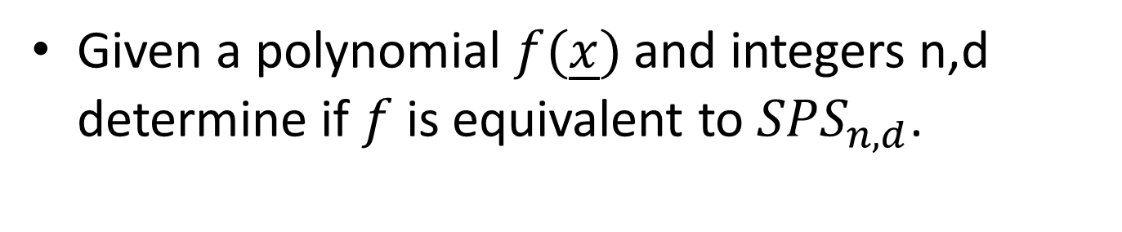
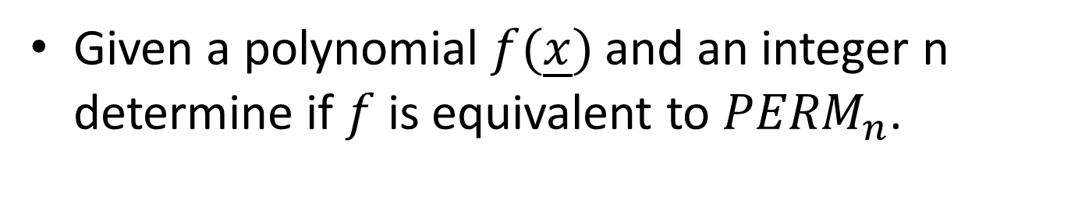
Lowering our sights further
Given a polynomial $f(\underline{x})$ and an integer n determine if $f$ is equivalent to ${PERM}_{n}$.
Given a polynomial $f(\underline{x})$ and integers n,d determine if $f$ is equivalent to ${SPS}_{n,d}$.

Slide 17
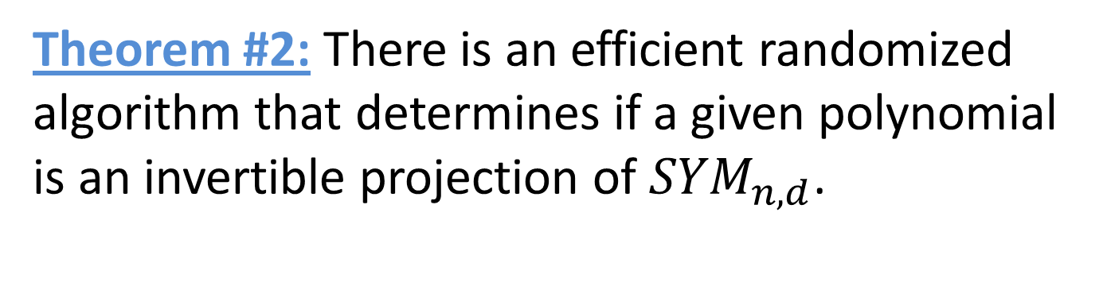

Polynomial Equivalence Results
Theorem #1: There is an efficient randomized algorithm that determines if a given polynomial is an invertible projection of ${POW}_{n, d}$.
Theorem #2: There is an efficient randomized algorithm that determines if a given polynomial is an invertible projection of ${SYM}_{n, d}$.

Slide 18


Invertible Projections
Theorem #3: There is an efficient randomized algorithm that determines if a given polynomial is an invertible projection of ${MM}_{n}$.
Theorem #4: There is an efficient randomized algorithm that determines if a given polynomial is an invertible projection of ${PERM}_{n}$.

Slide 19


Invertible Projections
Theorem #3: There is an efficient randomized algorithm that determines if a given polynomial is an invertible projection of ${MM}_{n}$.
Theorem #4: There is an efficient randomized algorithm that determines if a given polynomial is an invertible projection of ${PERM}_{n}$.
… and so on for the other families of polynomials

Slide 20
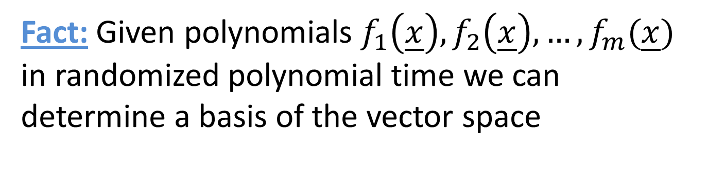
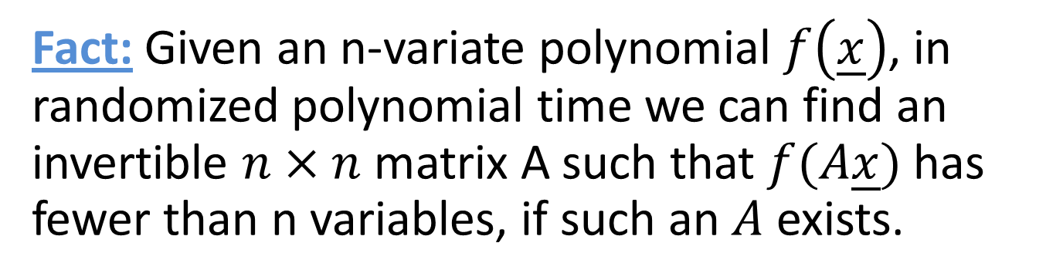
Preliminaries
Fact: Given polynomials $f_{1}\left(\underline{x}\right), f_{2}\left(\underline{x}\right), …,f_{m}(\underline{x})$ in randomized polynomial time we can determine a basis of the vector space
Fact: Given an n-variate polynomial $f\left(\underline{x}\right)$, in randomized polynomial time we can find an invertible $n×n$ matrix A such that $f(A\underline{x})$ has fewer than n variables, if such an $A$ exists.

Slide 21

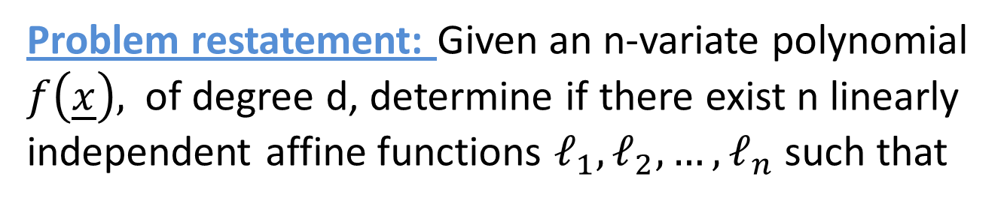
Equivalence to ${POW}_{n,d}$
Problem restatement: Given an n-variate polynomial $f\left(\underline{x}\right),$ of degree d, determine if there exist n linearly independent affine functions $ℓ_{1}, ℓ_{2}, …, ℓ_{n}$ such that

Slide 22
Introducing the Hessian
Definition: The hessian of an n-variate polynomial g is the following matrix:
(here $∂_{i}∂_{j}$g is a shorthand for the second order derivative $\frac{∂^{2}g}{∂_{i}∂_{j}}.$)
Property: If $f\left(\underline{x}\right)=g\left(Ax+b\right)$ then $H_{f}\left(\underline{x}\right)=A^{T}∙H_{g}\left(Ax+b\right)∙A$

Slide 23
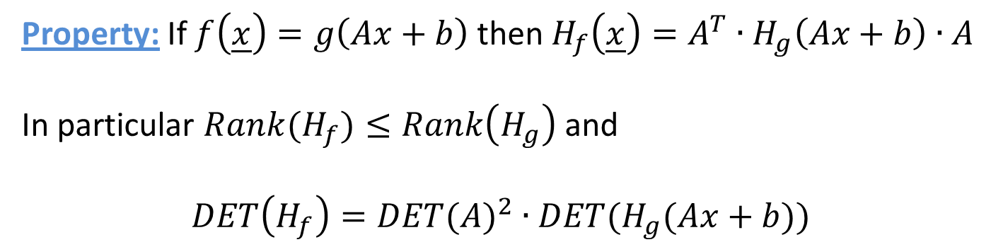
Using the Hessian
Property: If $f\left(\underline{x}\right)=g\left(Ax+b\right)$ then $H_{f}\left(\underline{x}\right)=A^{T}∙H_{g}\left(Ax+b\right)∙A$
In particular $Rank(H_{f})≤Rank\left(H_{g}\right)$ and
$$DET\left(H_{f}\right)={DET(A)}^{2}∙DET(H_{g}(Ax+b))$$
Fact:

Slide 24
Using the Hessian
In particular, if
In particular, then
This gives the algorithm for equivalence to ${POW}_{n,d}.$

Slide 25

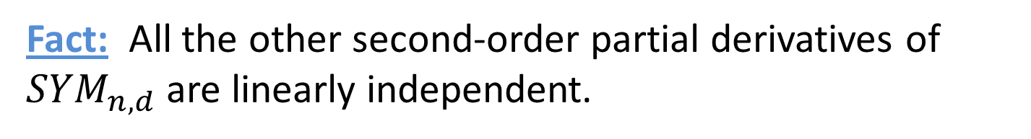
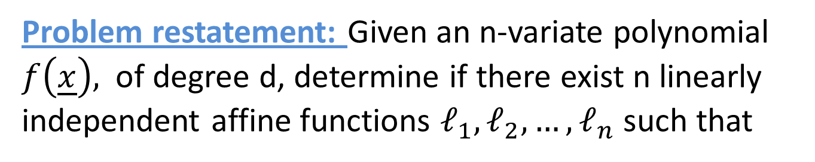
Equivalence to ${SYM}_{n,d}$
Problem restatement: Given an n-variate polynomial $f\left(\underline{x}\right),$ of degree d, determine if there exist n linearly independent affine functions $ℓ_{1}, ℓ_{2}, …, ℓ_{n}$ such that
Fact: ${SYM}_{n,d}$ is a multilinear polynomial, so
Fact: All the other second-order partial derivatives of ${SYM}_{n,d}$ are linearly independent.

Slide 26
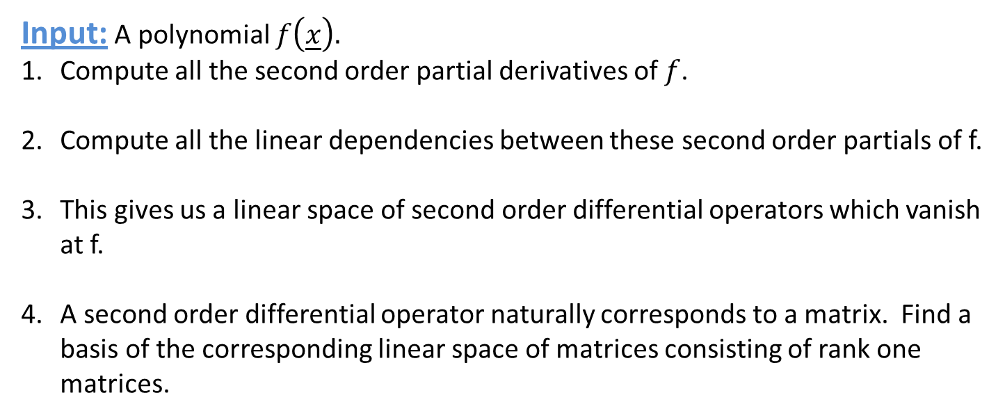
Outline of Algorithm
Input: A polynomial $f\left(\underline{x}\right).$
Compute all the second order partial derivatives of $f$.
Compute all the linear dependencies between these second order partials of f.
This gives us a linear space of second order differential operators which vanish at f.
A second order differential operator naturally corresponds to a matrix. Find a basis of the corresponding linear space of matrices consisting of rank one matrices.

Slide 27

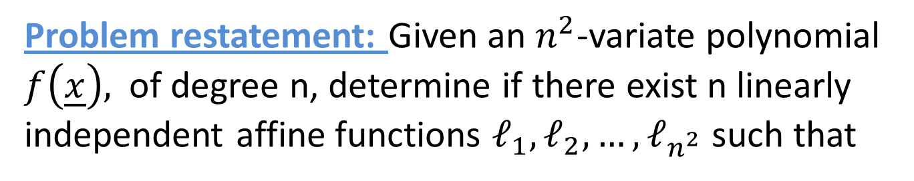
Equivalence to ${PERM}_{n}$
Problem restatement: Given an $n^{2}$-variate polynomial $f\left(\underline{x}\right),$ of degree n, determine if there exist n linearly independent affine functions $ℓ_{1}, ℓ_{2}, …, ℓ_{n^{2}}$ such that
The following approach was suggested by Mulmuley and Sohoni.
Fact: The group of symmetries of ${PERM}_{n}$ is continuous.

Slide 28

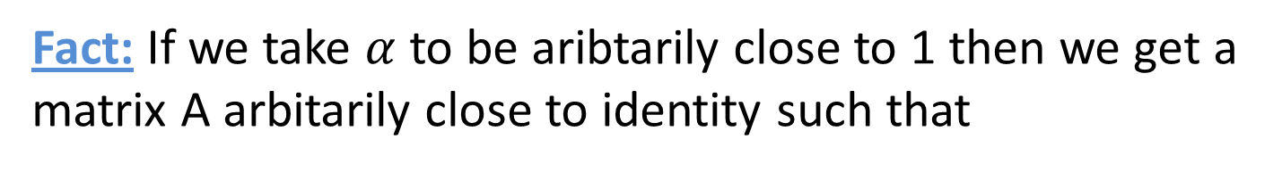
Symmetries of ${PERM}_{n}$
Fact: If we take $α$ to be aribtarily close to 1 then we get a matrix A arbitarily close to identity such that

Slide 29
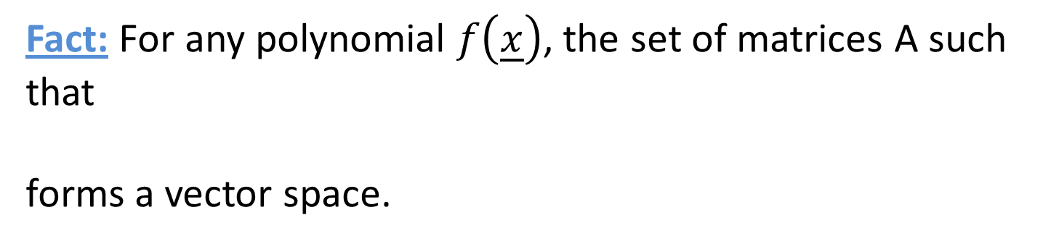
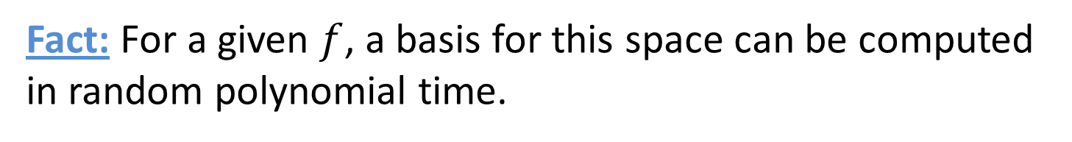

Symmetries of ${PERM}_{n}$
Let $δ$ be a formal variable with $δ^{2}=0$. Then there exist nontrivial matrices A such that
Fact: For any polynomial $f\left(\underline{x}\right)$, the set of matrices A such that
forms a vector space.
Fact: For a given $f$, a basis for this space can be computed
in random polynomial time.

Slide 30
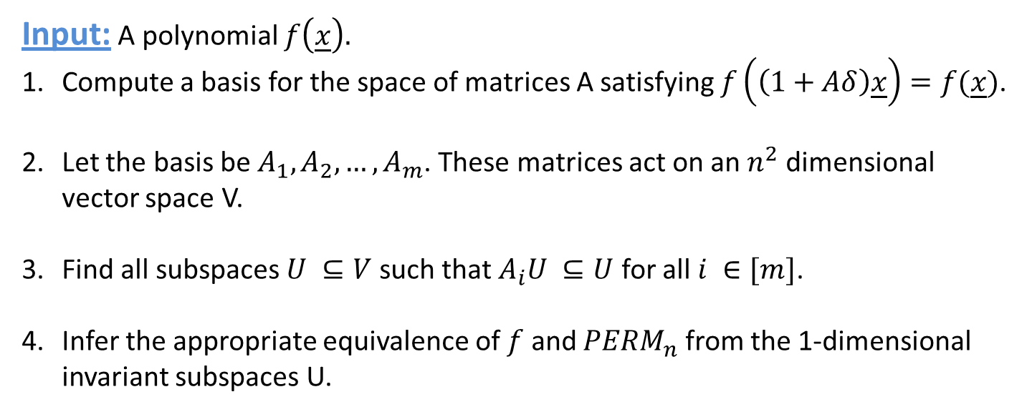
Outline of Algorithm
Input: A polynomial $f\left(\underline{x}\right).$
Compute a basis for the space of matrices A satisfying $f\left(\left(1+Aδ\right)\underline{x}\right)=f(\underline{x})$.
Let the basis be $A_{1}, A_{2}, …, A_{m}$. These matrices act on an $n^{2}$ dimensional vector space V.
Find all subspaces $U ⊆V$ such that $A_{i}U ⊆U$ for all $i ∈[m]$.
Infer the appropriate equivalence of $f$ and ${PERM}_{n}$ from the 1-dimensional invariant subspaces U.

Slide 31
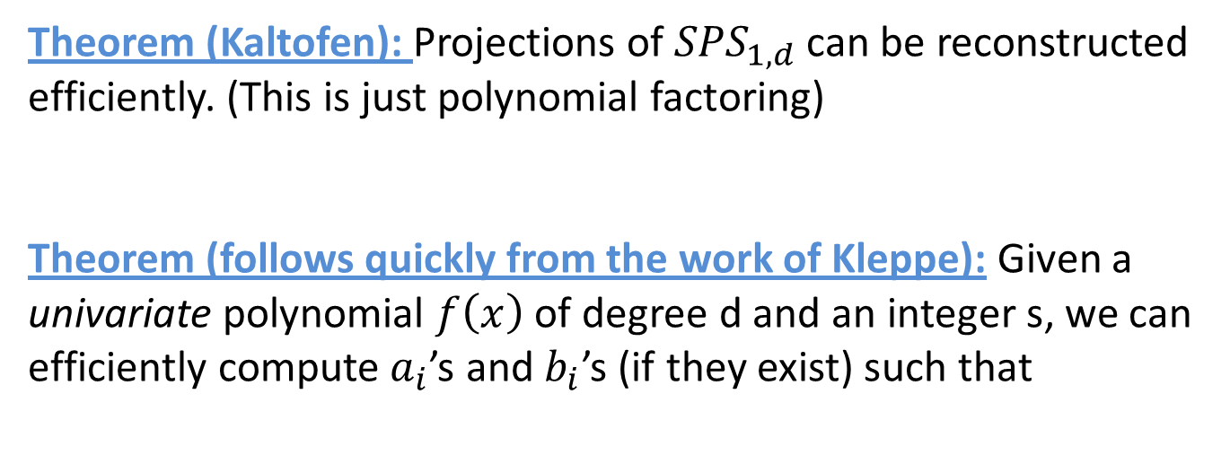
That’s all fine, but what about POLY_PROJECTION?
Theorem (Kaltofen): Projections of ${SPS}_{1,d}$ can be reconstructed efficiently. (This is just polynomial factoring)
Theorem (follows quickly from the work of Kleppe): Given a univariate polynomial $f\left(x\right)$ of degree d and an integer s, we can efficiently compute $a_{i}$’s and $b_{i}$’s (if they exist) such that

Slide 32
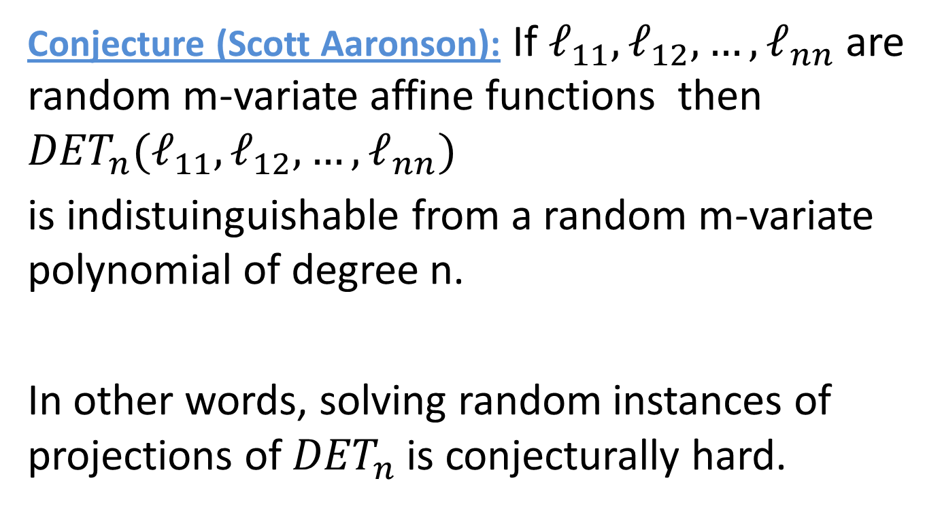
Scott’s conjecture
Conjecture (Scott Aaronson): If $ℓ_{11},ℓ_{12}, …, ℓ_{nn}$ are random m-variate affine functions then ${DET}_{n}(ℓ_{11},ℓ_{12}, …, ℓ_{nn})$
is indistuinguishable from a random m-variate polynomial of degree n.
In other words, solving random instances of projections of ${DET}_{n}$ is conjecturally hard.

Slide 33
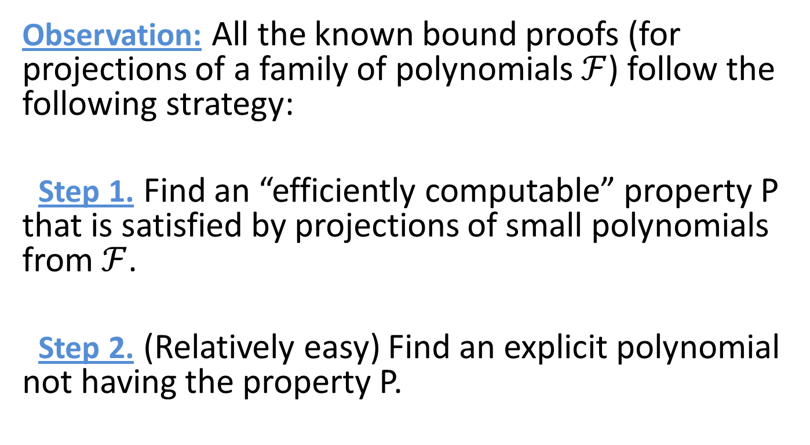
Digression: Background of Scott’s conjecture
Observation: All the known bound proofs (for projections of a family of polynomials $ℱ$) follow the following strategy:
Step 1. Find an “efficiently computable” property P that is satisfied by projections of small polynomials from $ℱ$.
Step 2. (Relatively easy) Find an explicit polynomial not having the property P.

Slide 34
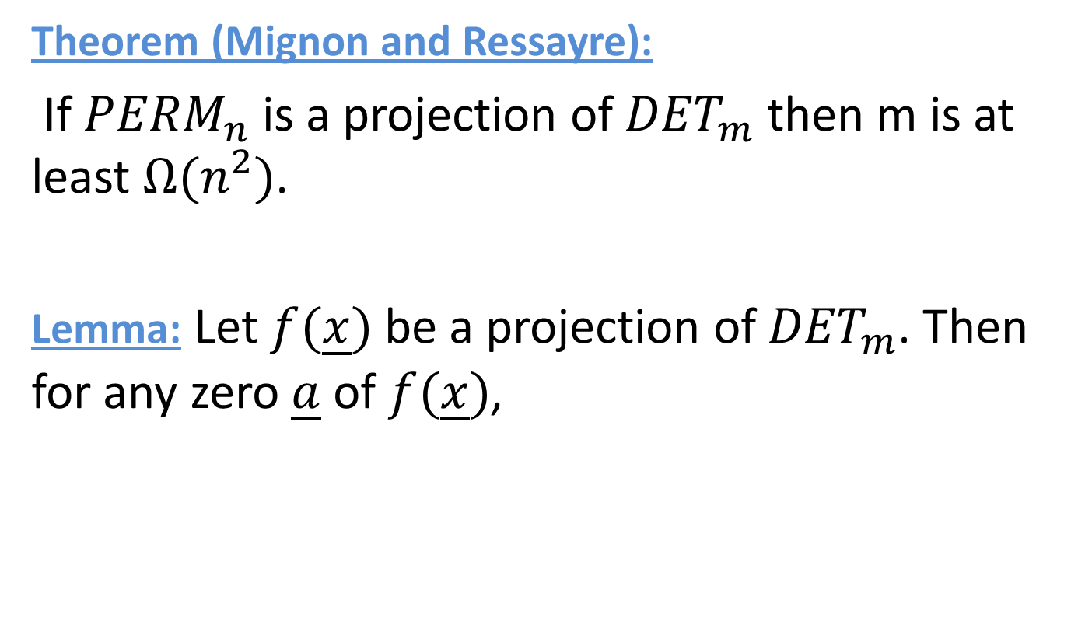
Example: Mignon and Ressayre
Theorem (Mignon and Ressayre):
If ${PERM}_{n}$ is a projection of ${DET}_{m}$ then m is at least $Ω(n^{2})$.
Lemma: Let $f(\underline{x})$ be a projection of ${DET}_{m}$. Then for any zero $\underline{a}$ of $f(\underline{x})$,

Slide 35
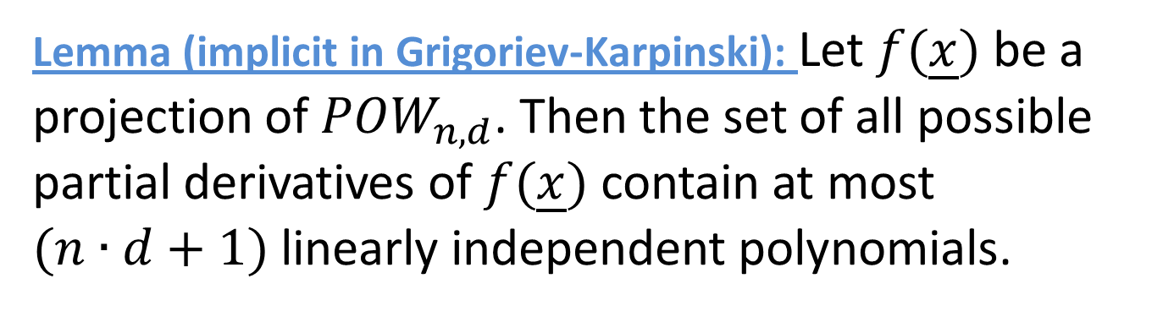
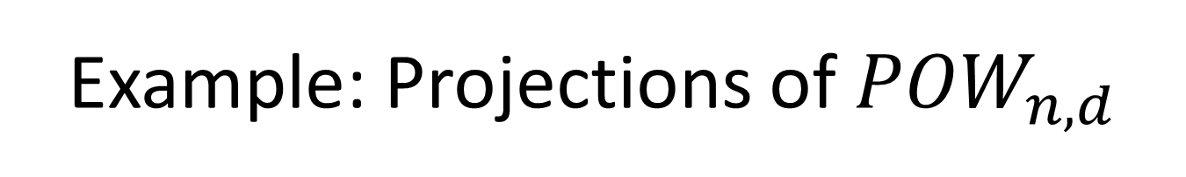
Example: Projections of ${POW}_{n,d}$
Lemma (implicit in Grigoriev-Karpinski): Let $f(\underline{x})$ be a projection of ${POW}_{n,d}$. Then the set of all possible partial derivatives of $f(\underline{x})$ contain at most $(n∙d+1)$ linearly independent polynomials.

Slide 36
Consequences of Scott’s conjecture
If the conjecture is true then no current proof technique will yield superpolynomial formula size lower bound.
If the conjecture is false then we would have obtained a good handle on the determinant versus permanent conjecture.

Slide 37
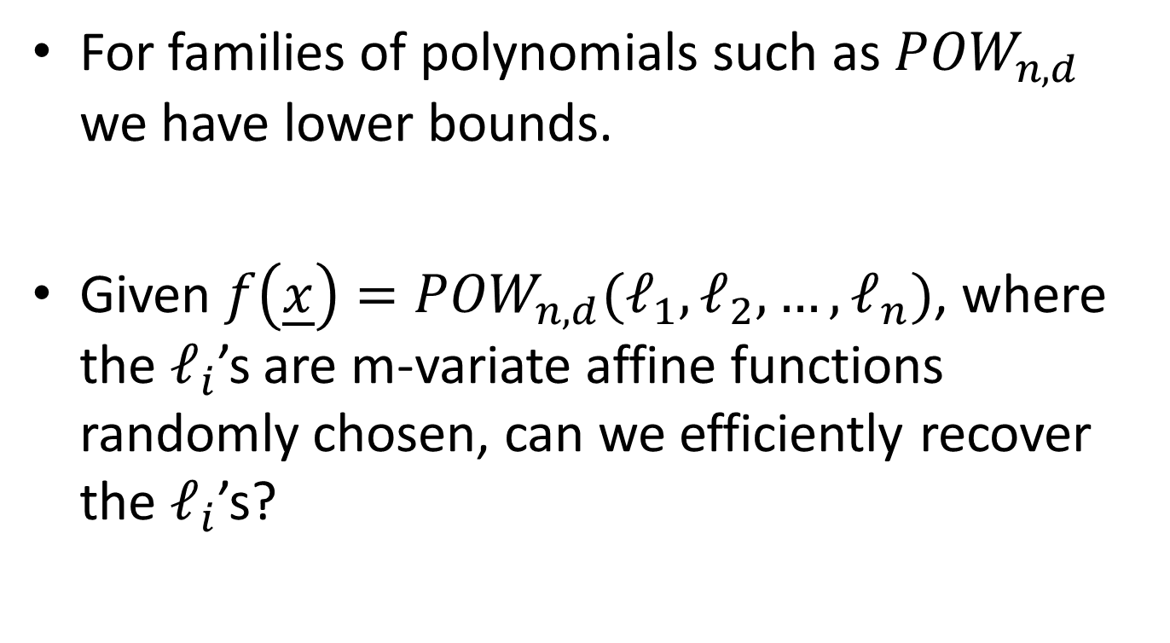
Probing a little deeper
For families of polynomials such as ${POW}_{n,d}$ we have lower bounds.
Given $f\left(\underline{x}\right)={POW}_{n,d}(ℓ_{1}, ℓ_{2}, …, ℓ_{n})$, where the $ℓ_{i}$’s are m-variate affine functions randomly chosen, can we efficiently recover the $ℓ_{i}$’s?

Slide 38
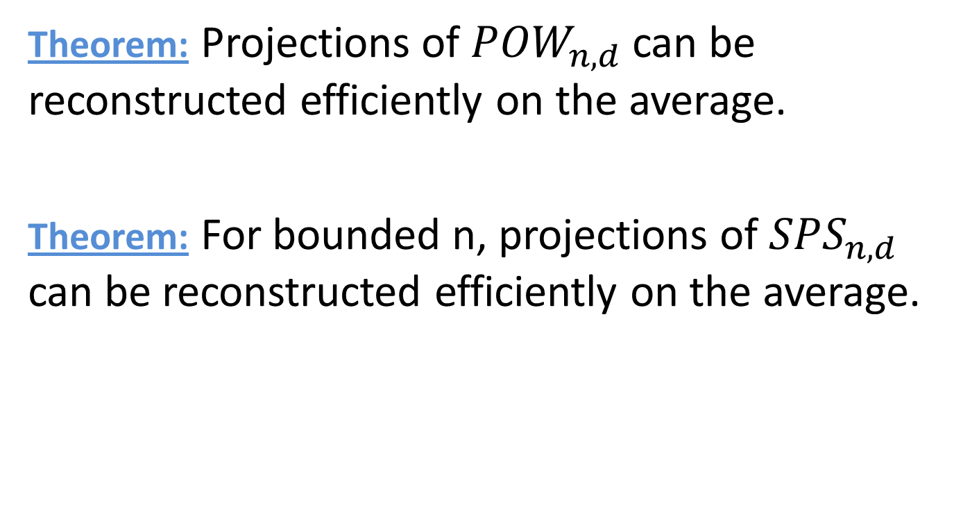
POLY_PROJECTION on the average
Theorem: Projections of ${POW}_{n, d}$ can be reconstructed efficiently on the average.
Theorem: For bounded n, projections of ${SPS}_{n,d}$ can be reconstructed efficiently on the average.

Slide 39
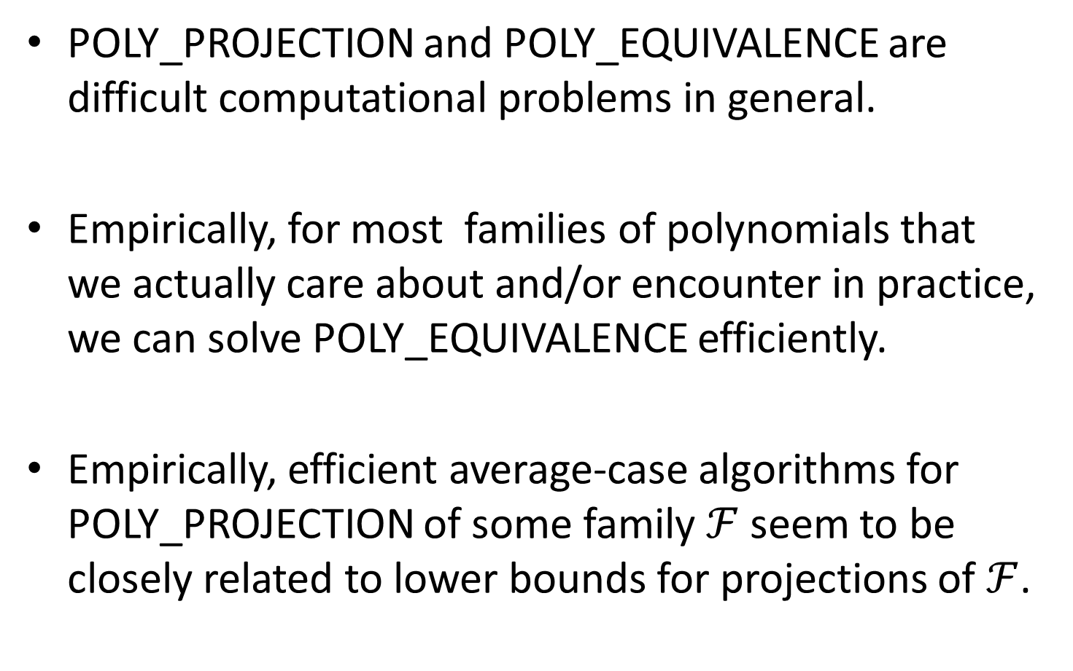
Summary
POLY_PROJECTION and POLY_EQUIVALENCE are difficult computational problems in general.
Empirically, for most families of polynomials that we actually care about and/or encounter in practice, we can solve POLY_EQUIVALENCE efficiently.
Empirically, efficient average-case algorithms for POLY_PROJECTION of some family $ℱ$ seem to be closely related to lower bounds for projections of $ℱ$.

Slide 40
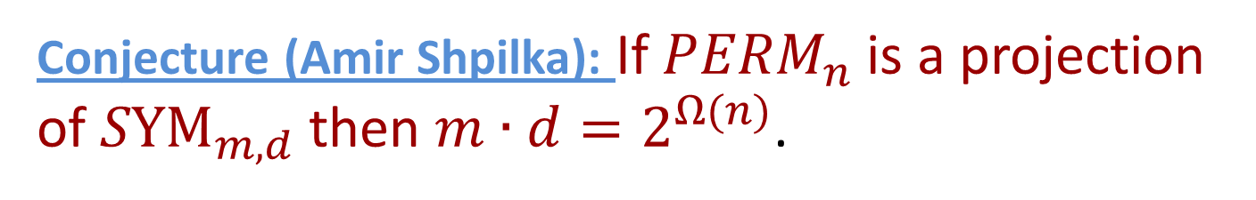
Conclusion: An easier(?) open problem
Conjecture (Amir Shpilka): If ${PERM}_{n}$ is a projection of ${SYM}_{m,d}$ then $m∙d=2^{Ω(n)}$.
THE END

