Slide 1
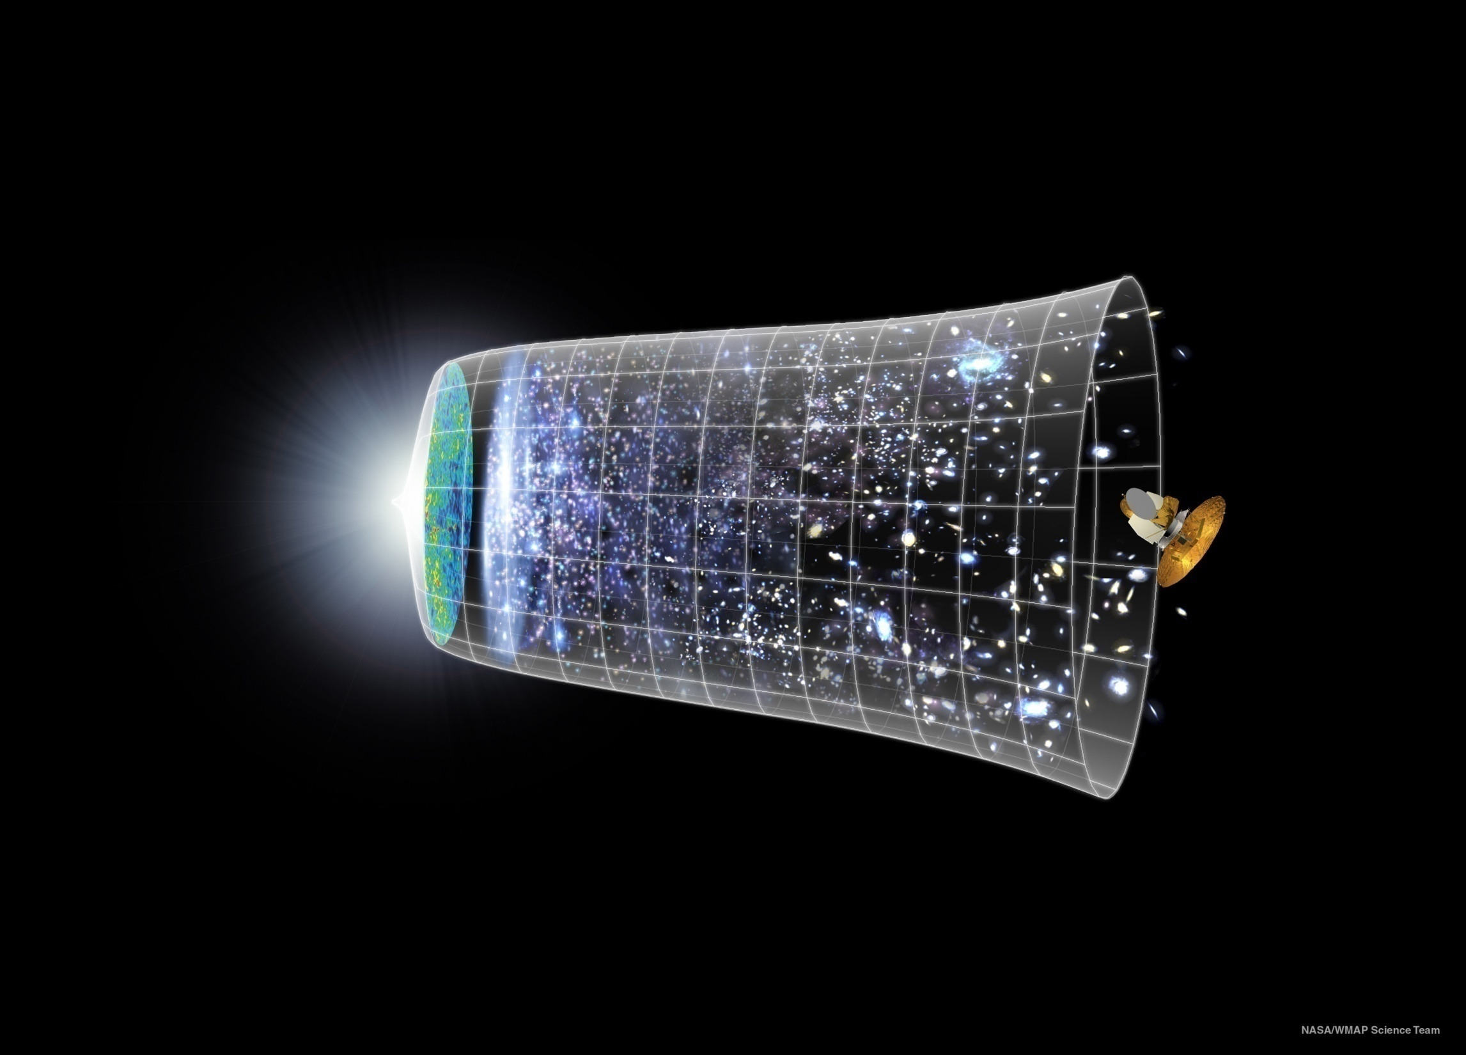

Holographic Systematics of D-Brane Inflation
Liam McAllister
Cornell
ISM08, Pondicherry December 9, 2008

Slide 2
Based on:
D. Baumann, A. Dymarsky, S. Kachru, I. Klebanov, & L.M., 0808.2811.
Building on:
S. Kachru, R. Kallosh, A. Linde, J. Maldacena, L.M., S. Trivedi, hep-th/0308055.
D. Baumann, A. Dymarsky, I. Klebanov, J. Maldacena, L.M., & A. Murugan,
hep-th/0607050.
D. Baumann, A. Dymarsky, I. Klebanov, L.M., & P. Steinhardt, 0705.3837.
D. Baumann, A. Dymarsky, I. Klebanov, & L.M., 0706.0360.
See also:
C. Burgess, J. Cline, K. Dasgupta, & H. Firouzjahi, hep-th/0610320.
O. DeWolfe, L.M., G.Shiu, & B. Underwood, hep-th/0703088.
A. Krause & E. Pajer, 0705.4682.
S. Panda, M. Sami, S. Tsujikawa, 0707.2848.
A. Ali, R. Chingangbam, S. Panda, M. Sami, 0809.4941.

Slide 3
Plan
Motivation and background
    Inflation
    Inflation in string theory
Case study: warped D-brane inflation
Direct approach: computation of nonperturbative superpotential
Systematic method: enumeration of contributing modes
Pre-Conclusions
Remarks on primordial tensor signature
Conclusions

Slide 4
Part I.
Inflation and
String Inflation

Slide 5
Inflation
A period of accelerated expansion
Solves horizon, flatness, and monopole problems.
i.e. explains why universe is so large, so flat, and so empty.
A.Guth,1981.

Slide 6
Inflation
A period of accelerated expansion
Solves horizon, flatness, and monopole problems.
i.e. explains why universe is so large, so flat, and so empty.
Predicts scalar fluctuations in CMB temperature:
  - approximately, but not exactly, scale-invariant
  - approximately Gaussian
Predicts primordial tensor fluctuations
A.Guth,1981.

Slide 7
Physics of inflation
Scalar field φ with a potential. V(φ) ~ 10¹⁶ GeV
Potential drives acceleration.
Acceleration is prolonged if V(φ) is flat in Planck units:
L
V(φ)
A.Linde,1982.
A. Albrecht and P.Steinhardt,1982.
φ

Slide 8
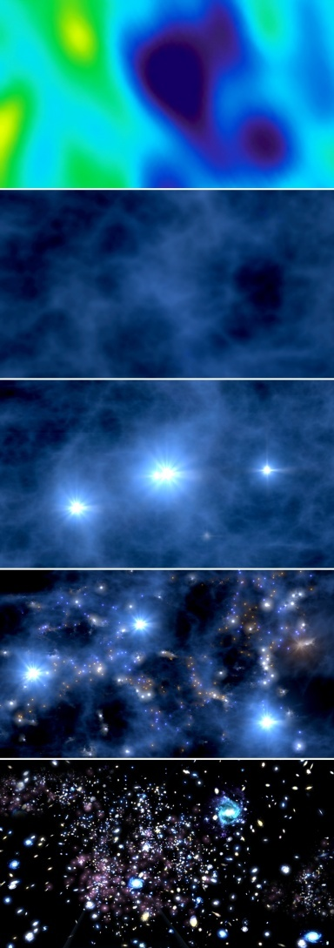
Quantum fluctuations seed structure formation
Perturbations are small enough to permit linear analysis, for a while.
This is a very clean and tractable system.
Prediction: these perturbations are approximately scale-invariant.
NASA/WMAP Science Team

Slide 9
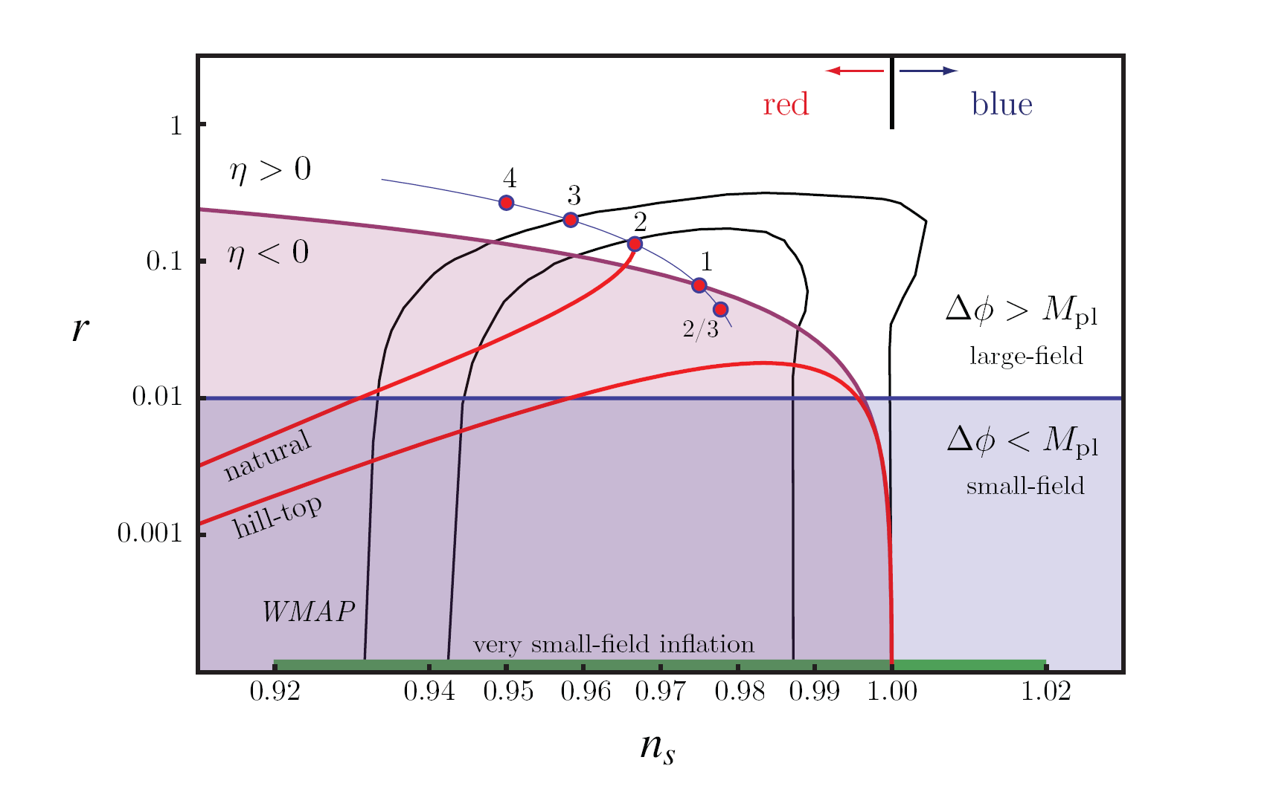
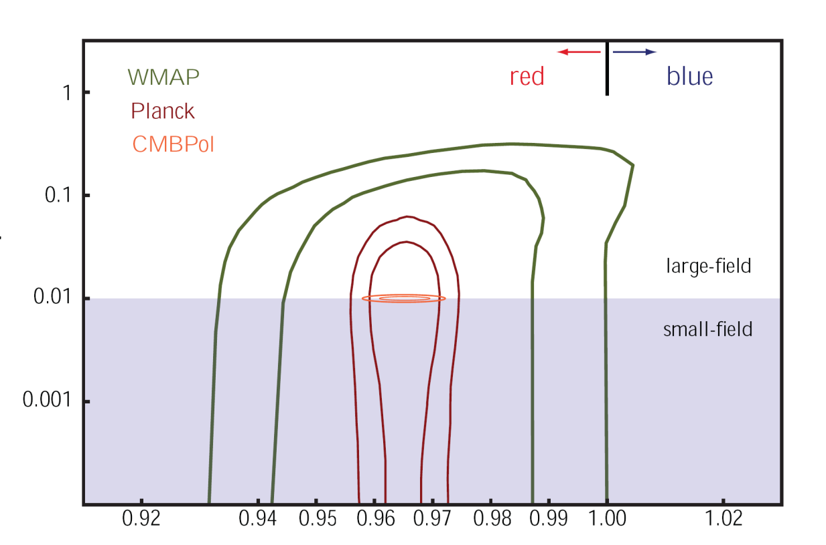
Current Constraints
Expect dramatic improvements in these limits in next 5-10 years: Planck, SPIDER, EBEX, Clover, QUIET, BICEP, PolarBEAR,...

Slide 10
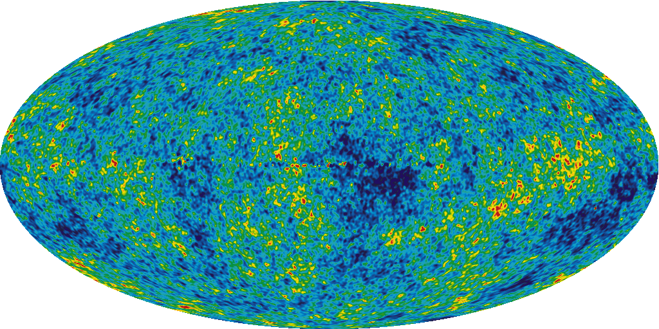
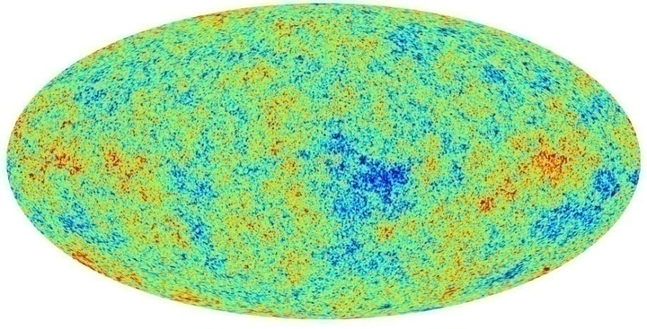
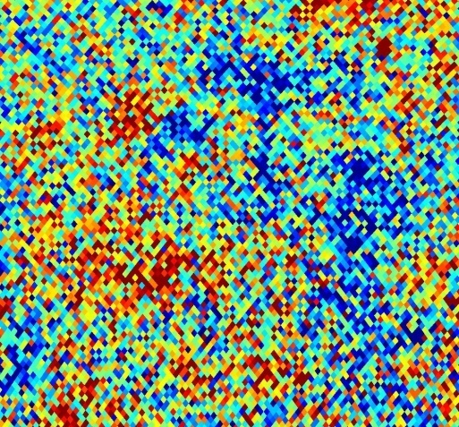
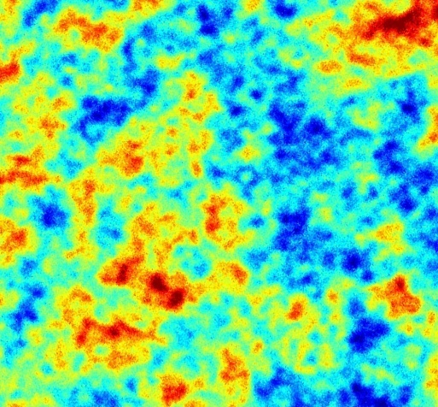
From WMAP to PLANCK (2010?)
WMAP; C. Cantalupo, J. Borrill, and R. Stompor

Slide 11
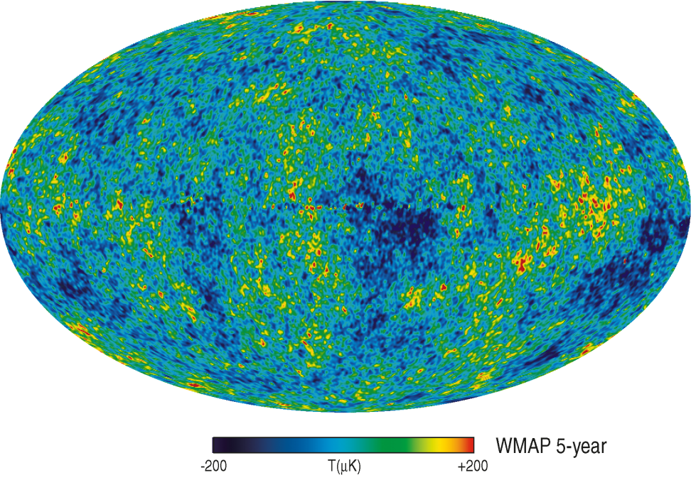
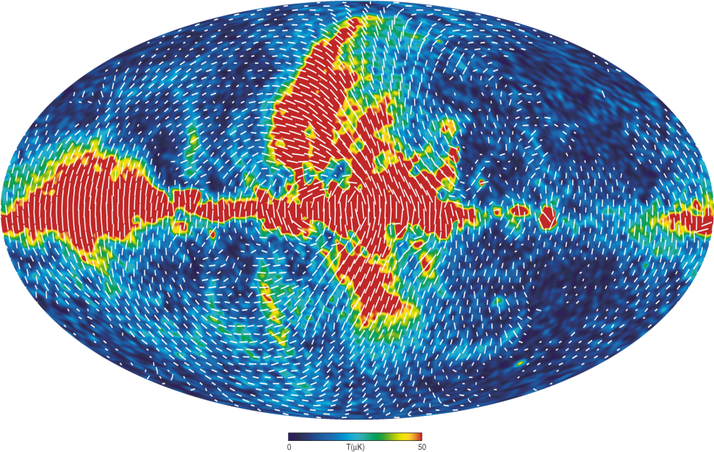

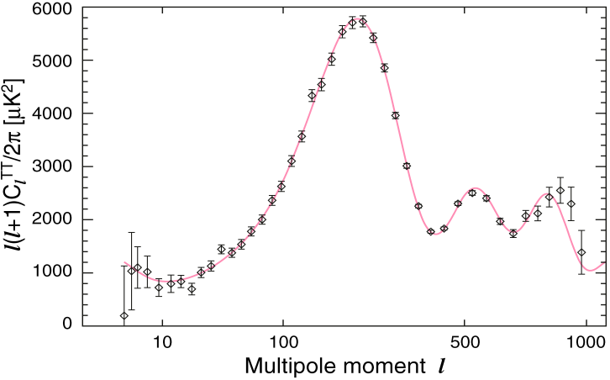
Goal: develop theoretical models of the early universe suitable for an era of precision cosmology.
NASA/WMAP Science Team

Slide 12
Since inflation occurred at sub-Planckian energies, why not just use effective QFT?
  Consistent if one is careful. However, inflation is UV-sensitive!
  So, would like toy models (at least) in which Planck-scale theory is specified.
  Moreover, rare opportunity to probe (some aspects of) Planck-scale physics.

Slide 13
Since inflation occurred at sub-Planckian energies, why not just use effective QFT?
  Consistent if one is careful. However, inflation is UV-sensitive!
  So, would like toy models (at least) in which Planck-scale theory is specified.
  Moreover, rare opportunity to probe (some aspects of) Planck-scale physics.
String theory provides:
  many fundamental scalar fields
  considerable UV control
Hope:
  use string theory to clarify UV issues in inflation
  use UV-sensitive aspects of inflation to constrain string theory – or at least, constrain string theory models of inflation
Warning: many aspects of inflation are not UV-sensitive.

Slide 14
Aim:
Use CMB and LSS to probe fundamental physics.
Propose and constrain mechanisms for inflation in string theory.
Focus on correlated signatures (tilt; tensors; non-Gaussianity; cosmic strings; isocurvature;...).
Derive inflaton action in consistent, computable string compactifications with stabilized moduli.
Method:
Task:

Slide 15
Status Report: Inflation in String Theory
We now have
  many scenarios that are partially constructed in string theory.
  a few scenarios that are complete or nearly so
Modern models are far more realistic than those of 5-10 years ago. Moduli problem explicitly solved in a few cases, implicitly in a few more.
Making correct predictions is still very difficult!
  A key lesson across scenarios has been that solving the moduli problem changes the scenario and can shift n_{s}, r dramatically. So one should be skeptical of predictions for these quantities in the absence of stabilization.
It is clear that many complete models will soon exist. At present only a few are worked out in enough detail to make correct predictions.
This talk: one of the best-understood scenarios.

Slide 16
The eta problem
Successful inflation requires controlling Planck-suppressed contributions to inflaton potential.
e.g.

Slide 17
The eta problem
Successful inflation requires controlling Planck-suppressed contributions to inflaton potential.
e.g.

Slide 18
The eta problem
Successful inflation requires controlling Planck-suppressed contributions to inflaton potential.
e.g.

Slide 19
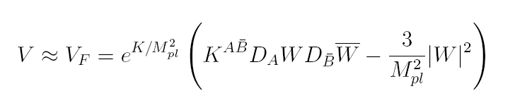
The eta problem
from an F-term potential

Slide 20

The eta problem
from an F-term potential

Slide 21

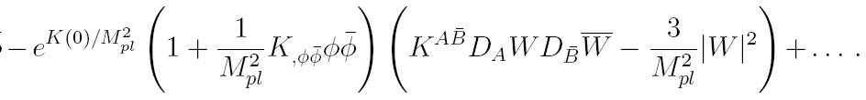

The eta problem
from an F-term potential

Slide 22
Moduli stabilization and the eta problem
Inflation requires controlling Planck-suppressed contributions to the inflaton potential up to dimension 6.
Moduli stabilization almost always introduces such terms.
Knowing (and controlling) the inflaton potential therefore requires detailed information about moduli stabilization.

Slide 23
Moduli stabilization and the eta problem
Inflation requires controlling Planck-suppressed contributions to the inflaton potential up to dimension 6.
Moduli stabilization almost always introduces such terms.
Knowing (and controlling) the inflaton potential therefore requires detailed information about moduli stabilization.
‘Detailed’ means one usually needs to know string + α′ corrections, backreaction effects, etc.
Common approximations (classical, noncompact/large-volume, probe...) are often insufficient.
String incarnation of (misnamed) supergravity eta problem (Copeland, Liddle, Lyth, Stewart, & Wands astro-ph/9401011).

Slide 24
Today’s talk
Focus on a specific, concrete model: warped D-brane inflation.
Determine form of inflaton potential, incorporating all relevant contributions.
  approached directly, this is highly nontrivial.
  We have explicitly computed a wide class of contributions.
  to finish the job, we will take a different tack, inspired by AdS/CFT, that gives the complete answer and reduces to our earlier result in the appropriate limit.
This gives very substantial progress towards an existence proof.
It also provides a truly general characterization of possible phenomenological models in this scenario.

Slide 25
Part II.
D-brane Inflation
initiated in:
Dvali&Tye 1998
Dvali,Shafi,Solganik 2001
Burgess,Majumdar,Nolte,Quevedo,Rajesh,Zhang 2001

Slide 26
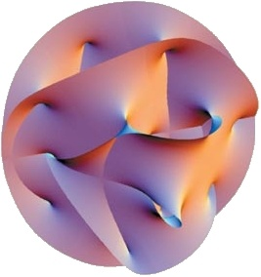
Warped D-brane inflation
warped throat
(e.g. Klebanov-Strassler)
CY orientifold, with fluxes and nonperturbative W
(GKP 2001, KKLT 2003)
warped throat gives:
weak Coulomb potential
control of energy scales
explicit local geometry
dual CFT
(3+1)d
anti-D3-brane
Kachru, Kallosh, Linde, Maldacena, L.M., Trivedi, 2003

Slide 27
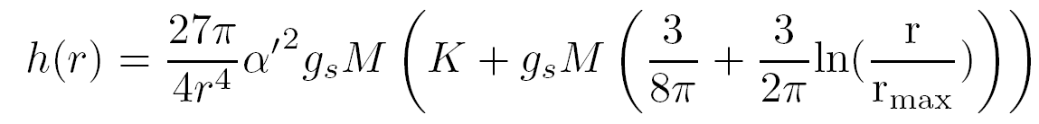
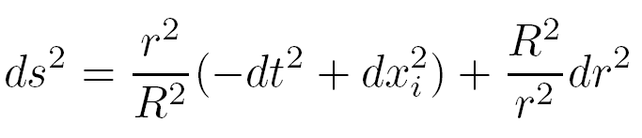
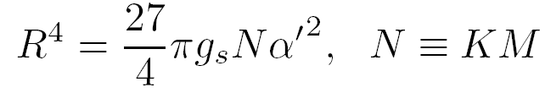
Throat Geometry
Finite-length KS throat, which we approximate by
the Klebanov-Tseytlin solution:
Can ignore logs and approximate as AdS₅ x T^{1,1} :
+ angles

Slide 28
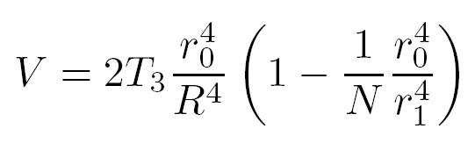
Coulomb Potential
Looks extremely flat, because interaction term is warped.
If this were the whole story, the model would be perfect
  dimensional transmutation explains smallness of slow-roll parameters
  inflation has a natural end, with the possibility of interesting topological defects from tachyon condensation: cosmic superstrings.

Slide 29
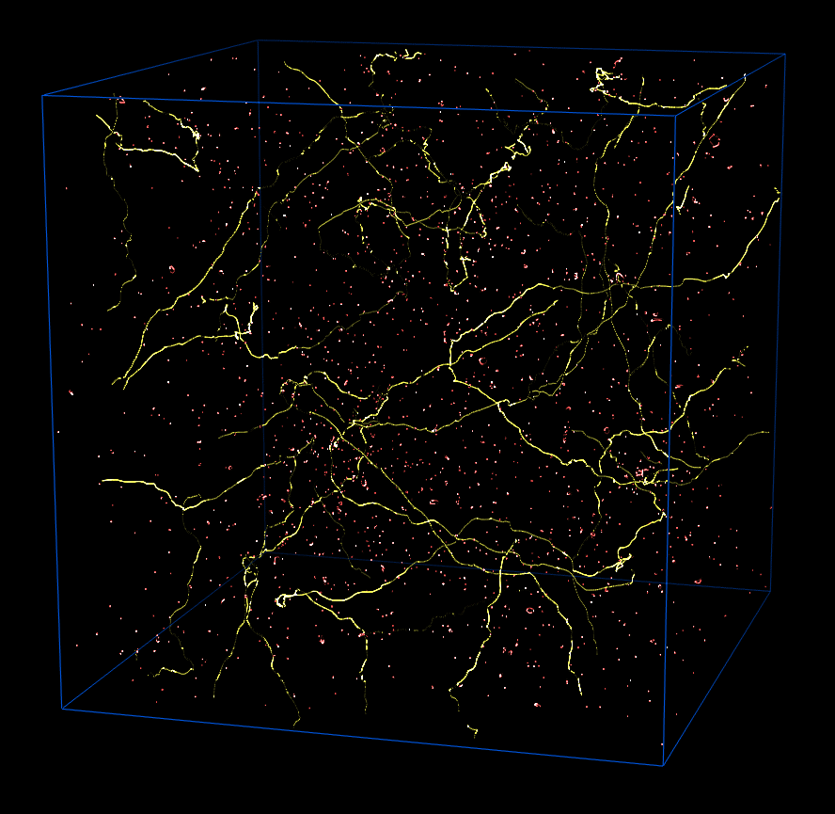
Cosmic superstrings
B. Allen and E.P. Shellard

Slide 30
Coulomb Potential
Looks extremely flat, because interaction term is warped.
If this were the whole story, the model would be perfect
  dimensional transmutation explains smallness of slow-roll parameters
  inflation has a natural end, with the possibility of interesting topological defects from tachyon condensation: cosmic superstrings.
In reality, many more important contributions to the potential!
Origin: moduli stabilization and other `compactification effects’
We need to understand and incorporate these effects.

Slide 31
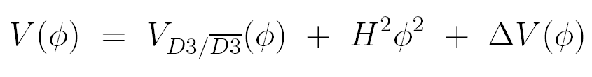
Does it work?
?
known in initial proposal
introduced by moduli stabilization

Slide 32
Does it work?
?
known in initial proposal
introduced by moduli stabilization
One contribution to ∆V determined in 2006-2007:
D. Baumann, A. Dymarsky, I. Klebanov, J. Maldacena, L.M., & A. Murugan,
hep-th/0607050.
C. Burgess, J. Cline, K. Dasgupta, & H. Firouzjahi, hep-th/0610320.
D. Baumann, A. Dymarsky, I. Klebanov, L.M., & P. Steinhardt, 0705.3837.
A. Krause & E. Pajer, 0705.4682.
D. Baumann, A. Dymarsky, I. Klebanov, & L.M., 0706.0360.

Slide 33
Does it work?
?
known in initial proposal
introduced by moduli stabilization
One contribution to ∆V determined in 2006-2007:
D. Baumann, A. Dymarsky, I. Klebanov, J. Maldacena, L.M., & A. Murugan,
hep-th/0607050.
C. Burgess, J. Cline, K. Dasgupta, & H. Firouzjahi, hep-th/0610320.
D. Baumann, A. Dymarsky, I. Klebanov, L.M., & P. Steinhardt, 0705.3837.
A. Krause & E. Pajer, 0705.4682.
D. Baumann, A. Dymarsky, I. Klebanov, & L.M., 0706.0360.
Complete parameterization:
D. Baumann, A. Dymarsky, S. Kachru, I. Klebanov, & L.M., 0808.2811.

Slide 34
Part III.
The D3-Brane Potential

Slide 35

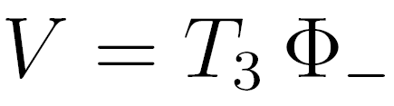

D3-branes in flux compactifications
GKP solutions:

Slide 36
D3-branes in flux compactifications
GKP solutions:
D3-branes feel no potential in GKP solutions (‘no-scale’),
but
nonperturbative stabilization of Kahler moduli will spoil this.

Slide 37
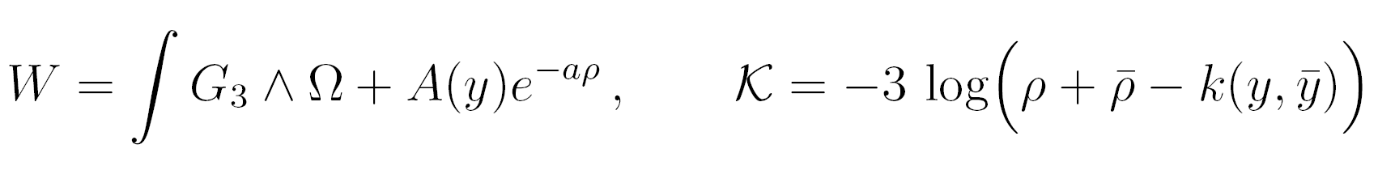
D3-brane vacua in KKLT compactifications
ED3/D7-branes responsible for Kahler moduli stabilization
I will assume that
# fermion zero modes = 2.
cf. A. Uranga’s talk

Slide 38
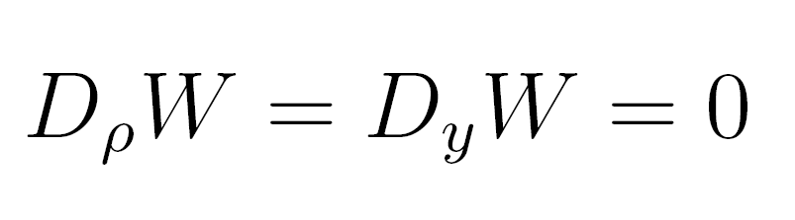
D3-brane vacua in KKLT compactifications
For generic A(y), solutions to
i.e., supersymmetric D3-brane vacua, are isolated. But where are they, and what is the potential in between?
ED3/D7-branes responsible for Kahler moduli stabilization
DeWolfe, L.M., Shiu, & Underwood, hep-th/0703088.

Slide 39
D3-brane vacua in KKLT compactifications
For generic A(y), solutions to
i.e., supersymmetric D3-brane vacua, are isolated. But where are they, and what is the potential in between?
We need to know A(y).
ED3/D7-branes responsible for Kahler moduli stabilization
DeWolfe, L.M., Shiu, & Underwood, hep-th/0703088.

Slide 40
Q. Can one compute A(y) in a special case?

Slide 41
Q. Can one compute A(y) in a special case?
A. Yes: Berg, Haack, & Körs were able to compute it in toroidal orientifolds. hep-th/0404087

Slide 42
Q. Can one compute A(y) in a special case?
A. Yes: Berg, Haack, & Körs were able to compute it in toroidal orientifolds. hep-th/0404087
In case of gaugino condensation, they compute dependence on D3 position y as threshold correction due to 3-7 strings.
D3 scalar
D3-D7
string
gluon

Slide 43
Q. Can one compute A(y) in a special case?
A. Yes: Berg, Haack, & Körs were able to compute it in toroidal orientifolds. hep-th/0404087
Q. What about a case directly applicable to a D3-brane in a warped throat?

Slide 44
Nonperturbative Effects
Gaugino condensation on N D7-branes wrapping a four-cycle Σ₄
Euclidean D3-branes wrapping a four-cycle Σ₄
Either case: can write

Slide 45
Corrected Warped Volumes
(probe approximation)
Including D3-brane backreaction:
D3-brane position
h = h(Y,X)

Slide 46
D3-brane Backreaction
Solve for δh
Integrate over Σ₄ to get δV(X)
Read off δW(X)
Baumann, Dymarsky, Klebanov, Maldacena, L.M., & Murugan,
hep-th/0607050.

Slide 47
Comparison
Open String
BHK
Closed String
Giddings-Maharana; Us
One-loop open string
Threshold correction
Gaugino only
Hard
Toroidal cases only
Unwarped only
Tree-level SUGRA
Backreaction on warping
Gaugino or ED3
Comparatively easy
More general geometries
Warping ok
Perfect agreement where comparison is possible.

Slide 48
A tractable background for computing A(y): a four-cycle embedded in the throat
Ideally, embedding should be SUSY in KS throat.

Slide 49
Result for a general warped throat
Ganor, hep-th/9612007
Baumann, Dymarsky, Klebanov, Maldacena, L.M., & Murugan,
hep-th/0607050.
If N wrapped branes are embedded along
then the superpotential correction is
so the superpotential is

Slide 50
Potential from the Kuperstein embedding
S. Kuperstein,
hep-th/0411097

Slide 51
Holomorphy + throat geometry constrain corrections to potential

Slide 52
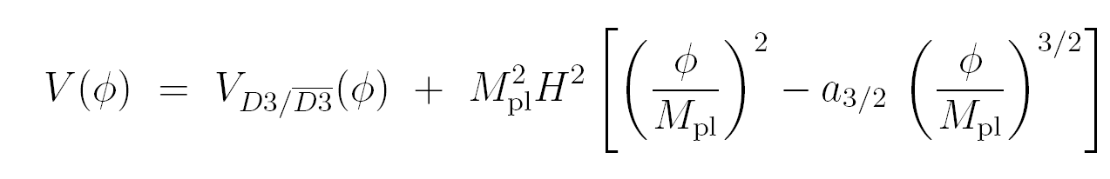
Holomorphy + throat geometry constrain corrections to potential
new term in ∆V
No quadratic correction from this embedding!
i.e. still cannot fine-tune inflaton mass per se

Slide 53
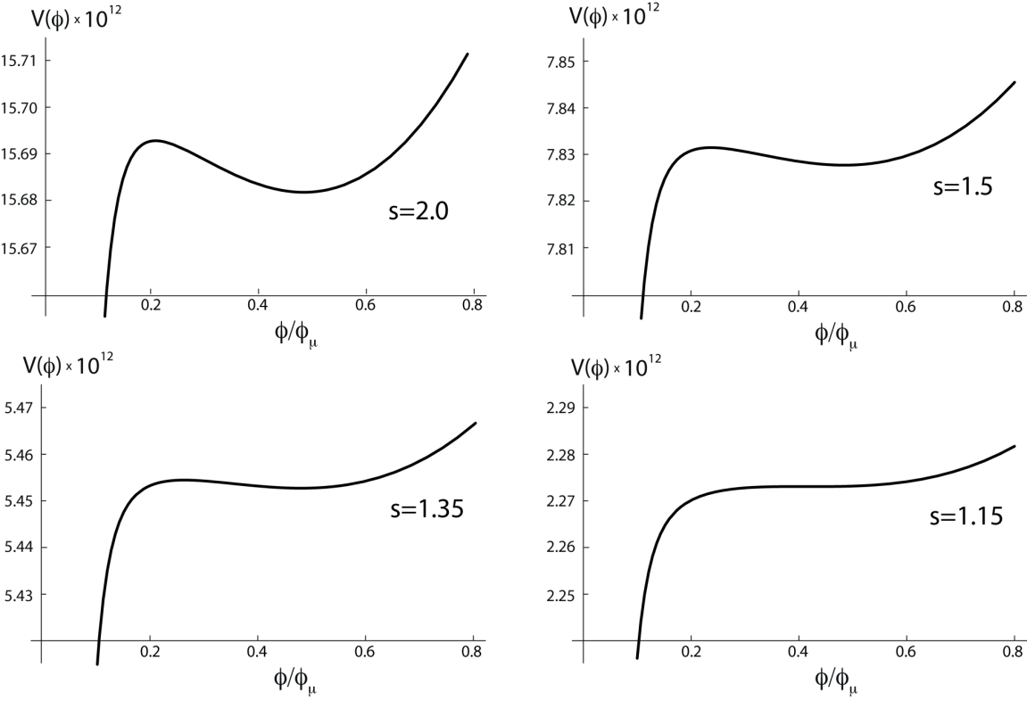
A Nearly Explicit Model of D-brane inflation
Baumann, Dymarsky, Klebanov, L.M., & Steinhardt, 0705.3837;
Baumann, Dymarsky, Klebanov, & L.M., 0706.0360.
Krause & Pajer, 0705.4682.
Dynamics:
Panda, Sami, Tsujikawa, 0707.2848.
∆V does not include a quadratic term.
Can fine-tune only locally.
D7-brane embedding:
For fine-tuned parameters, an inflection point appears.
Inflation can occur near this inflection point.

Slide 54
Part IV.
Holographic Systematics

Slide 55
How can we be more complete and systematic?
We had to assume that the divisor bearing nonperturbative effects sags into the throat.
  This is likely not generic, and it imposes strong constraints on the parameters that only reflect our wish to compute, not the underlying physics.
We have assumed that all other effects are negligible!
  We have thereby neglected more distant divisors, bulk fluxes, distant antibranes, etc.
Our result may be sensitive to the gluing of the throat into the compact space.
Purely practically, while it is easy to compute the superpotential for a general embedding in a general throat, it is slightly subtle and rather involved to read off the complete potential that results.

Slide 56
A Simple Idea
The D3-brane potential comes from Φ₋ alone. So we are interested in the profile of Φ₋.

Slide 57
A Simple Idea
The D3-brane potential comes from Φ₋ alone. So we are interested in the profile of Φ₋.
Arbitrary compactification effects can be represented by specifying boundary conditions for Φ₋ in the UV of the throat, i.e. by allowing arbitrary non-normalizable Φ₋ profiles.

Slide 58
A Simple Idea
The D3-brane potential comes from Φ₋ alone. So we are interested in the profile of Φ₋.
Arbitrary compactification effects can be represented by specifying boundary conditions for Φ₋ in the UV of the throat, i.e. by allowing arbitrary non-normalizable Φ₋ profiles.
The warped geometry filters these effects; the leading contributions are those that diminish least rapidly towards the IR (~ lowest few multipoles).
Normalizable Φ₋ profiles arise from supersymmetry-breaking at the tip and are already incorporated.
cf. DeWolfe, Kachru, & Mulligan 0801.1520

Slide 59
Gauge Theory version
Arbitrary compactification effects can be represented by allowing arbitrary deformations of the Lagrangian of the dual (approximate) CFT.
Supersymmetric deformations:
Aharony, Antebi, & Berkooz, hep-th/0508080

Slide 60
Gauge Theory version
Arbitrary compactification effects can be represented by allowing arbitrary deformations of the Lagrangian of the dual (approximate) CFT.
These deformations incorporate couplings to bulk moduli X that get F-term vevs.

Slide 61
Gauge Theory version
Arbitrary compactification effects can be represented by allowing arbitrary deformations of the Lagrangian of the dual (approximate) CFT.
These deformations incorporate couplings to bulk moduli X that get F-term vevs.
The RG flow filters these effects; the leading contributions are those that diminish least rapidly towards the IR, i.e. the most relevant contributions.
Deformations of the CFT state arise from supersymmetry-breaking at the tip and are already incorporated.

Slide 62
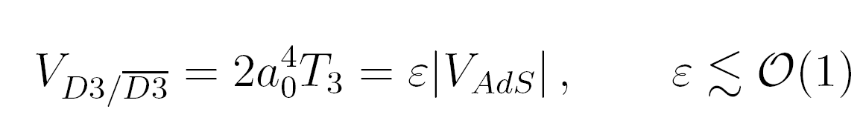
Scale of the moduli F-terms

Slide 63
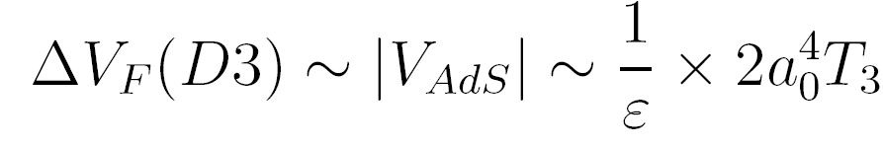
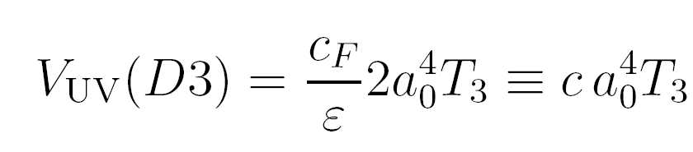
Scale of the moduli F-terms

Slide 64
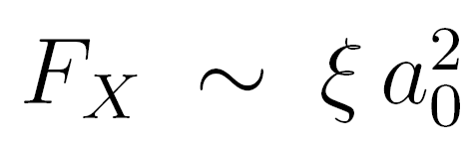
Scale of the moduli F-terms

Slide 65
Method
Consider linearized Φ₋ perturbations around a finite-length KS throat, which we approximate by AdS₅ x T^{1,1}.
In general, many other modes are turned on, but at the linear level they do not couple to D3-branes!
CFT version: interested only in operators that generate a potential on the Coulomb branch.

Slide 66
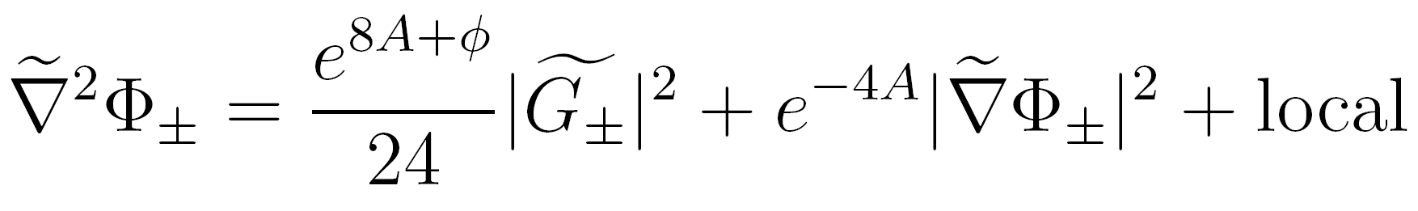
Linearization around ISD compactifications

Slide 67
Linearization around ISD compactifications
So, solve the Laplace equation in AdS₅ x T^{1,1}.

Slide 68
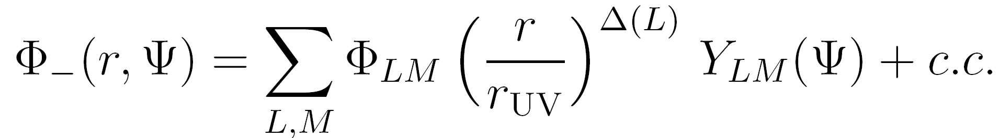


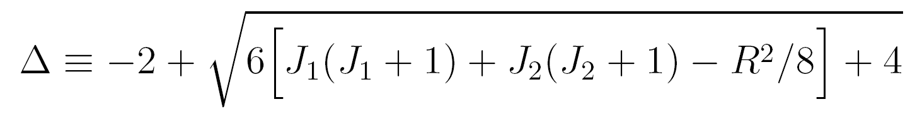
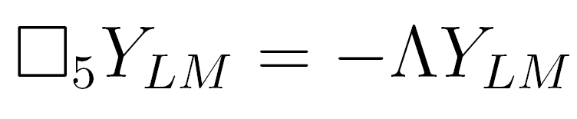
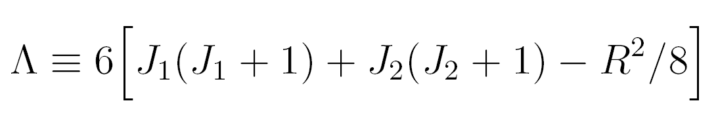
Solution:
Kim, Romans, & van Nieuwenhuizen, 1985.
Gubser, 1998.
Ceresole, Dall’Agata, D’Auria, Ferrara, 1999.

Slide 69
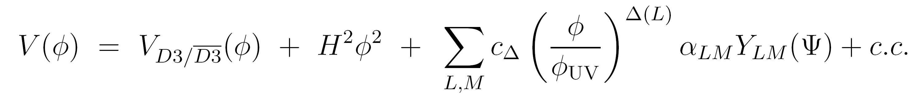
Solution:
Kim, Romans, & van Nieuwenhuizen, 1985.
Gubser, 1998.
Ceresole, Dall’Agata, D’Auria, Ferrara, 1999.

Slide 70
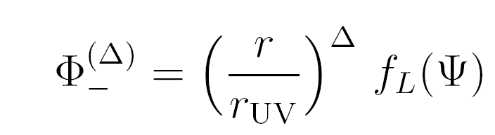
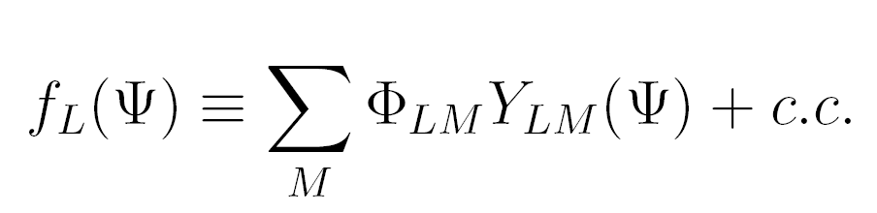
Simple case: one mode

Slide 71
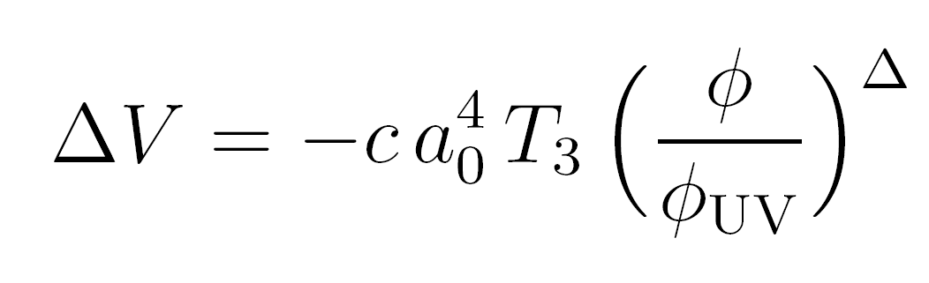
Simple case: one mode

Slide 72
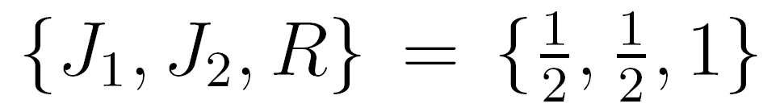
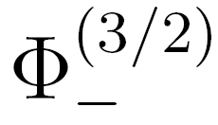
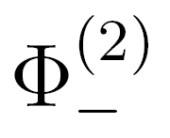
What are the lowest modes?
∆=3/2 chiral mode
∆=2 nonchiral mode

Slide 73
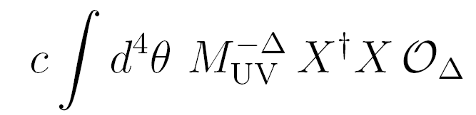
Gauge Theory Description
Klebanov-Witten CFT:
SU(N) x SU(N) gauge group
SU(2) x SU(2) x U(1)_{R} global symmetry
bifundamentals A_{i}, B_{i}
Klebanov & Witten, hep-th/9807080
ultraviolet deformation:

Slide 74
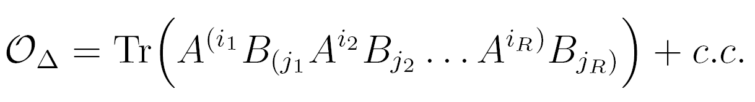
Gauge Theory Description
Klebanov-Witten CFT:
SU(N) x SU(N) gauge group
SU(2) x SU(2) x U(1)_{R} global symmetry
bifundamentals A_{i}, B_{i}
Klebanov & Witten, hep-th/9807080
ultraviolet deformation:
contributing
chiral operators:

Slide 75
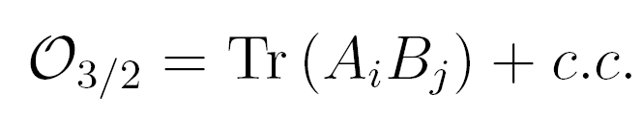
Gauge Theory Description
Klebanov-Witten CFT:
SU(N) x SU(N) gauge group
SU(2) x SU(2) x U(1)_{R} global symmetry
bifundamentals A_{i}, B_{i}
Klebanov & Witten, hep-th/9807080
ultraviolet deformation:
contributing
chiral operators:
most relevant
chiral operators:

Slide 76
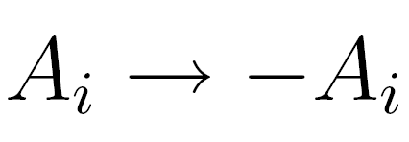
Discrete symmetries can forbid chiral perturbations
e.g., forbids
Moreover, the following nonchiral operators are in the supermultiplets of global symmetry currents, and have protected dimension, ∆=2:
If the compactification preserves a discrete symmetry that forbids the leading chiral perturbation O_{3/2}, the dominant compactification effect comes from O₂.

Slide 77
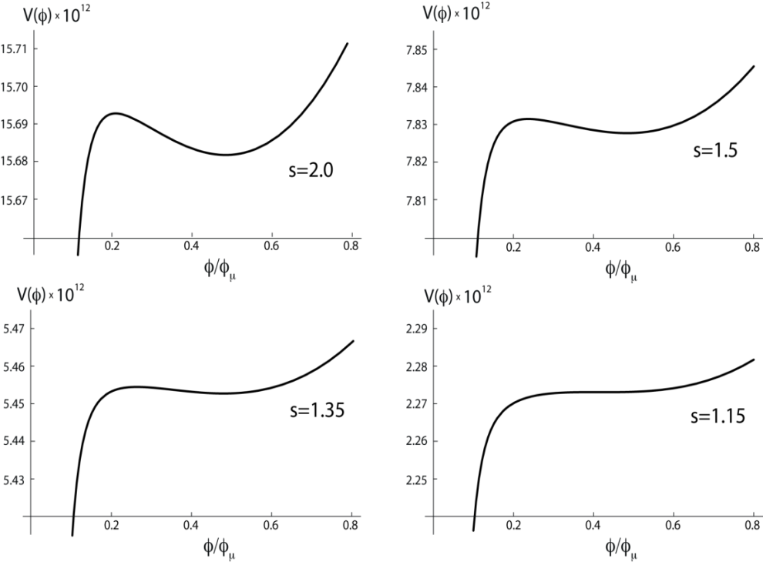
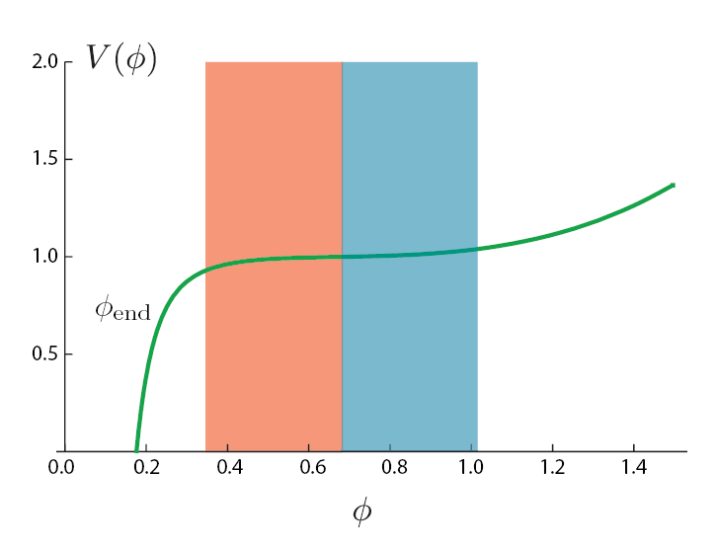
Scenario I:
Inflection point inflation again!

Slide 78
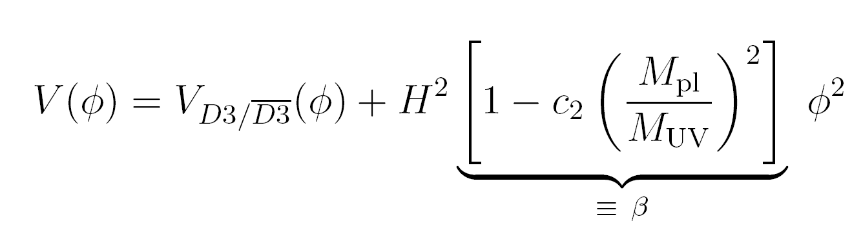
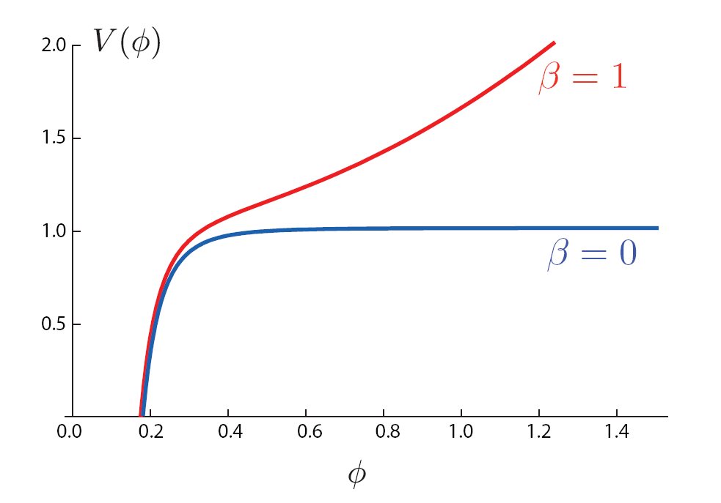
Scenario II: wherein the inflaton mass admits fine-tuning
(This is the leading term if discrete symmetries forbid the chiral perturbation.)
Phenomenology:
Firouzjahi & Tye, hep-th/0501009

Slide 79
Part IV.
Pre-Conclusions

Slide 80
Conclusions, Part I: Method
We have an easy and completely systematic approach to computing the inflaton potential in warped brane inflation.
Method: consider generic perturbation of ultraviolet region, sourced by supersymmetry-breaking compactification effects, and focus on most relevant terms.
Equivalently, perturb dual CFT Lagrangian by most relevant operators.
Our approach reproduces, extends, and simplifies the results of direct computation of W from wrapped D7-branes.
We reliably capture totally general effects of compactification, provided that the D3-brane is far from the top and far from the tip.

Slide 81
Conclusions, Part II: Implications
Two scenarios:
  inflection point inflation is most generic possibility.
  discrete symmetry leads instead to terms that allow direct fine-tuning of the inflaton mass.
Study of multifield effects is now straightforward.
Moreover, since we know the structure of the most general potential for this system, one could try to understand generic predictions.

Slide 82
Part V.
Primordial Gravitational Waves from
String Inflation

Slide 83
Vacuum Fluctuations: Tensors
tensor-to-scalar ratio,
a measure of the
primordial tensor signal
May be visible through induced curl of CMB photons’ polarization (B-mode): SPIDER, Clover, QUIET, BICEP, EBEX, PolarBEAR,...

Slide 84
Polarization seen by WMAP
NASA/WMAP Science Team

Slide 85
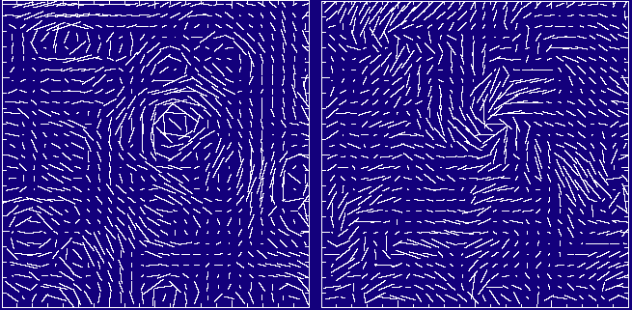
E-mode vs. B-mode
(curl-free) (curl)
Primordial tensors induce curl of CMB photons’ polarization (B-mode).
Image: Seljak and Zaldarriaga

Slide 86
Lyth Bound
D.H. Lyth, 1996
Threshold for detection:
next decade
ultimate
Observable tensors
require
trans-Planckian field variation
WHICH requires
Ultraviolet input.

Slide 87
Planckian distances
Tensors in CMB
String theory
Lyth bound
geometry of compact space
constraints/predictions

Slide 88
The challenge:
Small-field inflation requires controlling Planck-suppressed corrections up to dimension 6
Large-field inflation requires control of Planck-suppressed contributions of arbitrary dimension!
Detectable tensors require super-Planckian displacements, so observations will distinguish these cases.
Reasonable to enumerate and fine-tune
these terms.
Symmetry clearly essential.
Lyth 1996

Slide 89
Computing the Field Range
warped cone over X₅
r_{max}
Gubser

Slide 90
Compactification Volume determines the 4d Planck Mass

Slide 91
Compactification Constraint on the Field Variation
4d Planck Mass
+
Canonical Inflaton Field

Slide 92
Resulting field range, for any scenario involving a D3-brane in a throat:
N = the number of colors in the dual gauge theory
D. Baumann and L.M., hep-th/0610285.

Slide 93
Resulting field range, for any scenario involving a D3-brane in a throat:
N = the number of colors in the dual gauge theory
D. Baumann and L.M., hep-th/0610285.

Slide 94
However, large field ranges, and hence tensor signals, are possible in string inflation – just not in warped D3-brane inflation.
Mechanism:
Linear Inflation from Axion Monodromy
L.M., Silverstein,& Westphal, 0808.0706
see also:
Silverstein & Westphal, 0803.3085.

Slide 95
Natural Inflation in string theory?
Freese, Frieman, & Olinto, 1990:
f > M_{P}
Axion shift symmetry protects inflaton potential.
Banks, Dine, Fox, & Gorbatov, hep-th/0303252:
f > M_{P} not attainable in string theory?
(cf. also Svrcek & Witten, hep-th/0605206)
Dimopoulos, Kachru, McGreevy, & Wacker, hep-th/0507205
“N-flation”: use N ~10³ axions at once,
as a collective excitation.
Our idea: recycle a single axion N times.

Slide 96
Axion Inflation from Wrapped Fivebranes
warped throat
CY orientifold, with fluxes and nonperturbative W
(GKP 2001, KKLT 2003)
Σ
D5-brane/NS5-brane
warped throat gives:
control of energy scales
(3+1)d

Slide 97

Axion monodromy from wrapped fivebranes
Fivebrane contribution not periodic: as axion shifts by a period, potential undergoes a monodromy
This unwraps the axion circle and provides a linear potential over an a priori unlimited field range.
In practice, controllable over large
(>> M_{P}) but finite range.
cf. inflation from D-brane monodromy Silverstein&Westphal, 0803.3085.

Slide 98
It Works
Backreaction on local geometry can be made small.
Checked consistency with moduli stabilization (KKLT scenario).
Renormalization of Planck mass from many light species is small.
For very reasonable parameter choices, the instanton contributions to the effective action can be neglected, and the additional problems above are addressed.
Assumptions Summarized:
  NS5-brane wrapping a curve Σ that is in a warped region and stabilized at finite volume.
  Remaining moduli stabilized as in KKLT, by fluxes and strong gauge dynamics (ED3 stabilization may be manageable as well).
  Tadpole canceled by e.g. anti-NS5-brane on distant cycle homologous to Σ
Reasonable to expect more efficient/minimal realizations.
Core idea is very simple: the axionic shift symmetry protects the inflaton potential, just as in Natural Inflation.

Slide 99


Slide 100
Conclusions
We can construct string inflation models that are realistic, reasonably explicit, and falsifiable.
Well-understood class of small-field hybrid models: warped D3-brane inflation.
  Computable local model with systematic incorporation of compactification effects from moduli stabilization.
  Signatures include cosmic strings but not tensors.
New class of large-field models: axion monodromy.
  Axion shift symmetry naturally controls contributions to the inflaton action.
  Robust tensor prediction r=.07 can be falsified in 5-10 years.

